Slide 1
Business Strategy and Policy
Lecture 23

Slide 2
Recap
INTENSIVE STRATEGIES
  Market Penetration
    A market-penetration strategy seeks to increase market share for present products or services in present markets through greater marketing efforts
  Market Development
    Developing a new market for the existing company product is called market development strategy. This is the process of finding new market for the new customer to increase company performance by increasing sales and profits
  Product Development
    Product development is a strategy that seeks increased sales by improving or modifying present products or services.

Slide 3
Today’s Lecture
DIVERSIFICATION STRATEGIES
  Related Diversification
  Unrelated Diversification

Slide 4
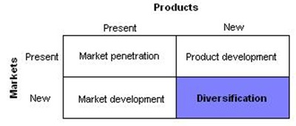
Diversification Strategy
Diversification Strategy is the development of new products in the new market.
  Diversification strategy is adopted by the company if the current market is saturated due to which revenues and profits are lower.
  At the corporate level, it is generally and its also very interesting entering a promising business outside of the scope of the existing business unit

Slide 5
Diversification Strategy
The two general types of diversification strategies are related and unrelated.
A process that takes place when a business expands its activities into product lines that are similar to those it currently offers.
A term which refers to the manufacture of diverse products which have no relation to each other. An example of unrelated diversification in a business could be a toy manufacturer that is also manufacturing industrial wiring for the construction industry.

Slide 6
Related Diversification
Related Diversification occurs when the company adds to or expands its existing line of production or markets. In these cases, the company starts manufacturing a new product or penetrates a new market related to its business activity.
Under related diversification the company makes easier the consumption of its products by producing complementing goods or offering complementing services.
For example, a shoe producer starts a line of purses and other leather accessories; an electronics repair shop adds to its portfolio of services the renting of appliances to the customers for temporary use until their own are repaired.

Slide 7
Advantages of Related Diversification
Spreading the risk by way of producing similar and/or related goods, offering similar or complementing services, or penetrating similar markets;
In the majority of cases the companies use existing, available resources and experience;
If the company starts producing part of the raw materials (components) for its main production line, it guarantees better quality, lower prices and regular supplies;
Strategic goals can be combined and, as a result, opportunities arising throughout the "production chain" can be shared and fully utilized;

Slide 8
Advantages of Related Diversification
Better usage of opportunities to share technologies, skills and expertise, common distribution channels, similar management techniques and adapting resources;
Economies of scale can be achieved through the elimination or significant reduction of certain expenses when more than one business activity is developed in a common company and also because of the opportunities to use any internal connections arising along the business chain;
Synergy effect - when two activities are integrated, the result is greater than the sum of the results of two individual activities.

Slide 9
Guidelines for Related Diversification
Six guidelines for when related diversification may be effective are identified below:
When an organization competes in a no growth or slow growth industry
When adding new, but related products would enhance sales of current products.
When new, but related products could be offered at competitive prices
When new, but related products have seasonal sales levels that counterbalance existing peaks and valleys.
When an organization's products are in the decline stage of the life cycle.
When an organization has a strong management team.

Slide 10
Unrelated Diversification
Unrelated Diversification is a form of diversification when the business adds new or unrelated product lines and penetrates new markets.
  For example, if the shoe producer enters the business of clothing manufacturing. In this case there is no direct connection with the company´s existing business - this diversification is classified as unrelated.

Slide 11
Unrelated Diversification
Using the existing basic competences of the company and expanding from existing markets into new ones and starting new lines of production.
Penetrating completely new markets. Usually such opportunity can be identified as a result of the main company business.
  For example a car dealer may start offering financial services by developing a car leasing scheme and selling cars through leasing.
Developing new competences to use new market opportunities.

Slide 12
Disadvantages of Unrelated Diversification
Achieving successful unrelated diversification requires good management skills, closely following each of the business activities and timely identifying and solving even the smallest problems. The greater the number of business activities, the more difficult is the total management task.
In many instances the overall performance of the unrelated business activities does not exceed the individual ones. Sometimes it is even worse, unless the managers are exceptionally talented and focused.
As a rule, the implementation of unrelated diversification strategy requires allocation of significant financial and human resources and there is always the risk of harming the main company business.

Slide 13
Disadvantages of Unrelated Diversification
The unrelated diversification which is carefully developed and undertaken only after thorough analysis of the environment and the company´s own resources usually brings very good financial results. However, in all cases it should be a low risk investment with a potential for high returns.
In some cases of company acquisition, this diversification can secure funds on hand during a seasonal slowdown, adding to the cash flow for the main business activity.
Spreading the risk through different sectors of the economy. It is very important to identify industries in which the business activity slowdown does not coincide with the slowdowns in the main business of the company.

Slide 14
Guidelines for Unrelated Diversification
When revenues derived from an organization's current products or services would increase significantly by adding the new, unrelated products.
When an organization competes in a highly competitive and/or no-growth industry.
When an organization's present channels of distribution can be used to market the new products to current customers.
When the new products have countercyclical sales patterns compared to an organization's present products.
When an organization's basic industry is experiencing declining annual sales and profits.

Slide 15
Guidelines for Unrelated Diversification
When an organization has the capital and managerial talent needed to compete.
When an organization has the opportunity to purchase an unrelated business that is an attractive investment.
When financial synergy exists between the acquired and acquiring firms.
When existing markets for an organization's present products are saturated.
When antitrust action could be charged against an organization that historically has concentrated on a single industry.

Slide 16
The Risk of Diversification
Diversification is the riskiest of the four strategies. Because enter in the unknown market with unfamiliar product, and lack of experience in the new skills and techniques required
The greatest risk of being in a single industry is having all of the firm’s eggs in one basket. However, diversification must do more than simply spread business risk across different industries. It makes sense only when it adds to shareholder value.

Slide 17
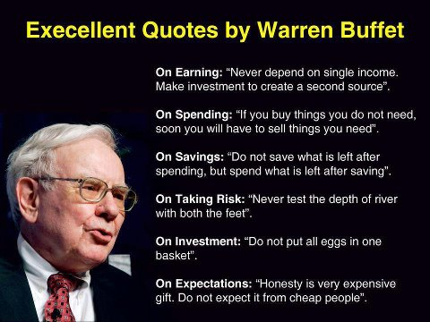
Warren Buffet

Slide 18
The Risk of Diversification
Diversification, being a strategic approach, is the subject of extensive research aiming to examine its relation to the financial results of the companies. In the majority of studies a comparison is done between results of related and unrelated diversification, although the distinctive line between them is still not clear.

Slide 19
Where should Diversification be undertaken?
Diversification can be considered a useful business development tool for companies in any sector and location of the economy.
However, you have to keep in mind that there is no recipe for successful diversification.
  It depends on multiple internal and external factors for each company, which should be carefully studied and taken into consideration when developing a diversification strategy.
  It is also very important to implement and update this strategy according to the dynamically changing conditions and strong competition under which business usually operates.

Slide 20
Summary
Diversification Strategy is the development of new products in the new market.
  Diversification strategy is adopted by the company if the current market is saturated due to which revenues and profits are lower.
  At the corporate level, it is generally and its also very interesting entering a promising business outside of the scope of the existing business unit

Slide 21
Next Lecture
DEFENSIVE STRATEGIES
Retrenchment
Defensive
Strategies
Divestiture
Liquidation

