Slide 1
Business Strategy and Policy
Lecture 22

Slide 2
Recap
  Forward Integration
Forward integration involves gaining ownership or increased control over distributors or retailers.
Franchising is an effective means of implementing forward integration.
Forward integration is a type of vertical merger (vertical integration) in which a supplier acquires a manufacturer or a manufacturer acquires a distributor.
Businesses engage in forward integration either to generate a higher margin from a key input which it owns or produces or to better market its products and increase its profitability.

Slide 3
Recap
  Backward Integration
    Backward integration is a strategy of seeking ownership or increased control of a firm's suppliers. This strategy can be especially appropriate when a firm's current suppliers are unreliable, too costly, or cannot meet the firm's needs.
  Horizontal Integration
    Horizontal integration refers to a strategy of seeking ownership of or increased control over a firm's competitors. One of the most significant trends in strategic management today is the increased use of horizontal integration as a growth strategy.

Slide 4
Today’s Lecture
INTENSIVE STRATEGIES
  Market Penetration
  Market Development
  Product Development

Slide 5
Intensive Strategies
Those three strategies are sometimes referred to as intensive strategies because they require intensive efforts if a firm’s competitive position with existing products is to improve.
The aim of intensive strategies is to broaden the market share and to increase the profit by making the existing products more effective and by introducing new and various sets of products in order to increase the market share too.
Market Penetration strategy | Market Development strategy | Product Development strategy

Slide 6
INTENSIVE STRATEGIES
Market Penetration
1. A market-penetration strategy seeks to increase market share for present products or services in present markets through greater marketing efforts.
2. Market penetration includes increasing the number of salespersons, advertising expenditures, and publicity efforts or offering extensive sales promotion items.
3. Market penetration for a good or service indicates potential for increased sales. In other words, the smaller a product's market penetration, the more a company should invest in its strategy for marketing that item. For this reason, high market penetration indicates that a product has become established and the company is a market leader.

Slide 7
Market Penetration Strategies
Price Adjustments
  One common market penetration strategy is to make price adjustments. By lowering prices, the business hopes to generate more sales volume by increasing the number of units purchased and to make prices more appealing to consumers when compared to the competition.
  Companies may also pursue a strategy of higher prices in the hope that higher revenues per unit sold translate into higher sales volume and a resulting increase in market penetration. With this strategy, a concern is that higher prices could deter customers from making a purchase.

Slide 8
Market Penetration Strategies
Increased Promotion
Companies may choose to increase market penetration through greater promotional efforts. They may launch an advertising campaign to generate greater brand awareness or implement a short-term promotion with a finite ending date. A promotion is often linked with pricing, such as advertising a special sale price for a limited period. A competitor may counter a successful promotion with one of its own in an attempt to regain lost market share.

Slide 9
Market Penetration Strategies
More Distribution Channels
A company can attempt to increase market penetration by increasing the methods it uses to get products into the hands of consumers, making them more readily available. For instance, a company that traditionally sells its products through retail outlets may add distribution channels such as sending direct mail offerings or instituting a telemarketing operation. It may also attempt to gain additional selling space in current distribution channels, such as when purchasing additional display space in retail stores.

Slide 10
Market Penetration Strategies
Product Improvements
Making product improvements can be used to create new interest in a stagnating product or to offer an extra benefit when using it. Consumer products manufacturers have often used the "new and improved" claim to entice customers to give a product another chance or to improve the perception of quality. Companies can also change the product's packaging to give it a more modern design that might appeal to a younger customer base.

Slide 11
Guidelines for Market Penetration
a. When current markets are not saturated.
b. When usage rate of current customers could be increased.
c. When market shares of major competitors have been declining while total industry sales have been increasing.
d. When the correlation between dollar sales and dollar marketing expenditures historically has been high.
e. When increased economies of scale provide major advantages.

Slide 12
  Market Development
1. Market development involves introducing present products or services into new geographic areas.
2. The climate for international market development is becoming more favorable. In many industries, such as airlines, it is going to be hard to maintain a competitive edge by staying close to home.

Slide 13
Market Development
Developing a new market for the existing company product is called market development strategy. This is the process of finding new market for the new customer to increase company performance by increasing sales and profits. Companies can develop market on geographical such as city, country, region, state etc and demographical such as age, gender, class etc.
Example:
Pakistan State Oil(PSO) developing new market by exporting oil to Afghanistan.
Chinese products developed new market for their product worldwide.

Slide 14
Guidelines for Market Development
When new channels of distribution are available that are reliable, inexpensive, and of good quality.
When an organization is very successful at what it does.
When new untapped or unsaturated markets exist.
When an organization has the needed capital and human resources to manage expanded operations.
When an organization has excess production capacity.
When an organization's basic industry rapidly is becoming global in scope.

Slide 15
Product development
Product development is a strategy that seeks increased sales by improving or modifying present products or services. Product development usually entails large research and development expenditures.
Product development usually entails large research and development expenditures
The best thing about this strategy is you’ve already established yourself in your current markets and you know what your customers want. You have the distribution channels, and you know how to reach them.

Slide 16



Guidelines for Product Development
When an organization has successful products that are in the maturity stage of the product life cycle

Slide 17


b.
When an organization competes in an industry that is characterized by rapid technological developments.

Slide 18




c.
When major competitors offer better-quality products at comparable prices.

Slide 19




d.When an organization competes in a high-growth industry.
e. When an organization has especially strong research and development capabilities.

Slide 20
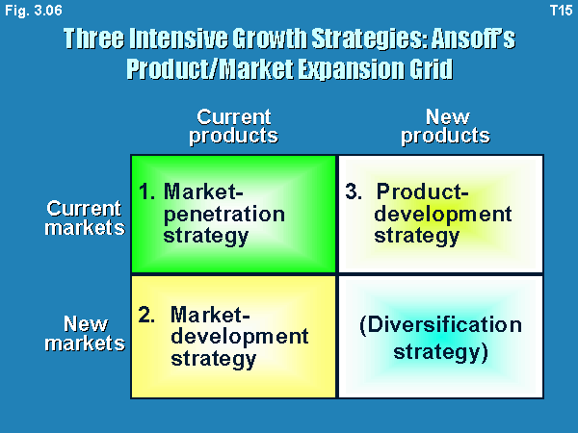
Summary

Slide 21
Next Lecture
Diversification Strategy is the development of new products in the new market.
  Diversification strategy is adopted by the company if the current market is saturated due to which revenues and profits are lower.
  At the corporate level, it is generally and its also very interesting entering a promising business outside of the scope of the existing business unit

