Slide 1
Business Strategy and Policy
Lecture 20

Slide 2
Recap
THE INTERNAL FACTOR EVALUATION (IFE) MATRIX
The Nature of Long-Term Objectives
Financial versus Strategic Objectives
Not Managing by Objectives

Slide 3
Today’s Lecture
The Balanced Scorecard
Levels of Strategies

Slide 4
The Balanced Scorecard
It was originated by Drs. Robert Kaplan (Harvard Business School) and David Norton as a performance measurement framework that added strategic non-financial performance measures to traditional financial metrics to give managers and executives a more 'balanced' view of organizational performance.
The balanced scorecard is a strategic planning and management system that is used extensively in
  business and industry, government, and nonprofit organizations worldwide
  to align business activities to the vision and strategy of the organization
  improve internal and external communications, and
  monitor organization performance against strategic goals.

Slide 5
The Balanced Scorecard
The balanced scorecard is a management system (not only a measurement system) that enables
  organizations to clarify their vision and strategy and translate them into action.
  It provides feedback around both the internal business processes and external outcomes in order to continuously improve strategic performance and results.
  When fully deployed, the balanced scorecard transforms strategic planning from an academic exercise into the nerve center of an enterprise.

Slide 6
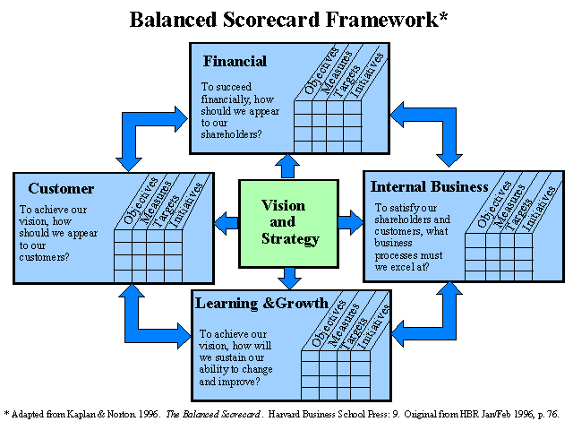
The Balanced Scorecard

Slide 7
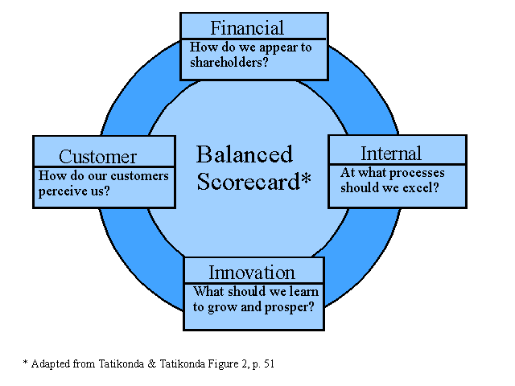
The Balanced Scorecard

Slide 8
The Balanced Scorecard
Perspective | Generic Measurements
Financial | Return of Capital Employed, Economic value added, Sales growth, Cash flow
Customer | Customer satisfaction, retention, acquisition, profitability, market share
Internal business process | Includes measurements for: Innovation - measures of how well the company identifies the customers’ future needs. Operations - measures of quality, cycle time, and costs. Post sales service - measures for warranty, repair and treatment of defects and returns.
Learning and growth | Includes measurements for: People - employee retention, training, skills, morale. Systems - measure of availability of critical real time information needed for front line employees.

Slide 9
Strategy Map
A strategy map is "a logical comprehensive architecture for describing strategy. It provides the foundation for designing a Balanced Scorecard that is the cornerstone of a strategic management system". Strategy Maps reveal the cause-and-effect linkages needed to transform intangible assets into tangible financial outcomes. Strategy Maps, if designed correctly, may provide the solution to the problems

Slide 10
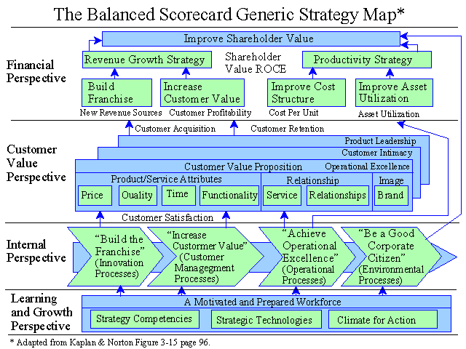
Strategy Map

Slide 11
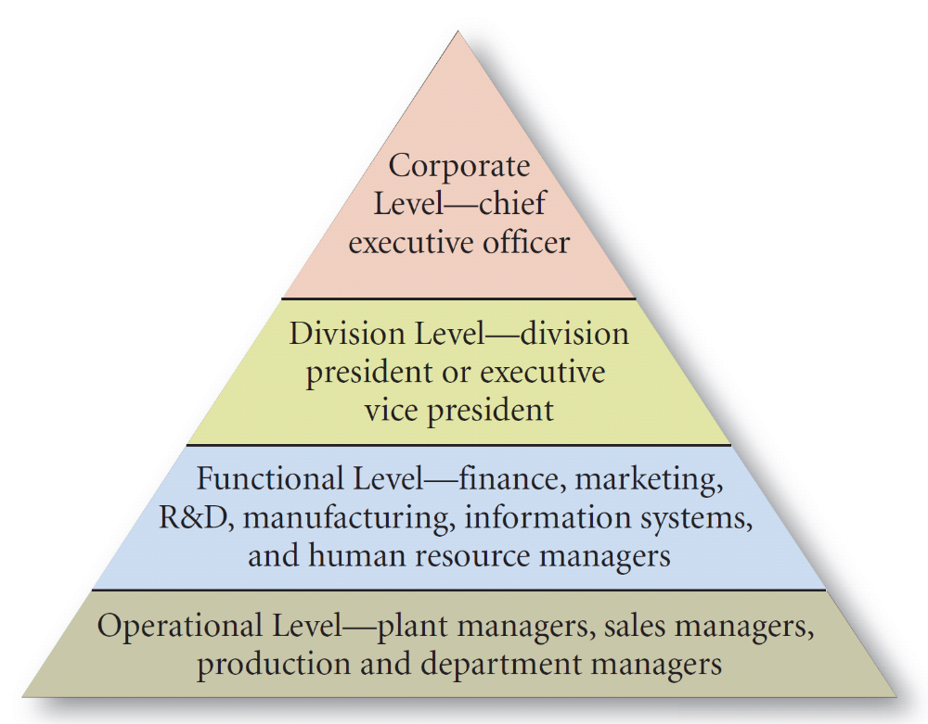
Levels of Strategies – Large Company

Slide 12
Levels of Strategies – Large Company
Corporate strategy—this strategy seeks to determine what businesses a company should be in or wants to be in. Corporate strategy determines the direction that the organization is going and the roles that each business unit in the organization will plan in pursuing that direction.
Four areas of focus
  Diversification management (acquisitions and divestitures)
  Synergy between units
  Investment priorities
  Business level strategy approval

Slide 13
The BCG “Portfolio” Matrix
Market Share
High
Low
Stars
Question Marks
?
?
?
High
?
Anticipated
Growth
Rate
Cash Cows
Dogs
Low

Slide 14
Business Level Strategy
How do we support the corporate strategy?
How do we compete in a specific business arena?
Three types of business level strategies:
  Low cost producer
  Differentiator
  Focus
Four areas of focus
  Generate sustainable competitive advantages
  Develop and nurture (potentially) valuable capabilities
  Respond to environmental changes
  Approval of functional level strategies

Slide 15
A Simple Organization Chart
(Single Product Business)
Business
Level
Strategy
Business
Research and
Development
Human
Resources
Manufacturing
Marketing
Finance
Functional
Level
Strategy

Slide 16
Functional / Operational Level Strategy
Functional: How do we support the business level strategy?
Operational: How do we support the functional level strategy?

Slide 17
A Simple Organization Chart
(Dominant or Related Product Business)
Corporate
Level
Multibusiness
Corporation
Business
Level
Business 1
(Related)
Business 2
(Related)
Business 3
(Related)
Functional
Level
Research and
Development
Human
Resources
Manufacturing
Marketing
Finance

Slide 18
An example of an Unrelated Product Business
(Note: By itself, an SBU can be considered a related product business)
SBU: a single business or collection of related businesses that is independent and formulates its own strategy
A
(Multi-business) Corporation
Ex.: G.E. (General
Electric Corp.)
Strategic Business Unit 1
S.B.U.
2
Company 1
Co. 2
Co. 3
Division 1
Div. 2
Div. 3

Slide 19
Summary
The Balanced Scorecard
Levels of Strategies

Slide 20
Next Lecture
Types of Strategies
  Forward Integration
  Backward Integration
  Horizontal Integration

