Slide 1
Business Policy and Strategy
Lecture-02

Slide 2
Recap
Course Objectives and Outcome
Course Outline
Grading Scheme
What is Business Strategy
Phases of Strategy Management

Slide 3
Today’s Lecture
Nature of Business Strategy
Importance of Strategic policy making
Key terms in Business Strategy and Policy
  Adopting change
  Strategies
  Mission & Vision statement
  SWOT

Slide 4
Nature of Business Strategy
The process of business strategy does not end when the firm decides what strategy or strategies to pursue
  Translation of strategic thought into strategic action
    Management understand the business
    feel a part of the company
    Through involvement in strategy-formulation activities

Slide 5
Nature of Business Strategy
Strategy Implementation
  Without understanding and commitment, strategy-implementation efforts face major problems
  Implementing strategy affects an organization from top to bottom
  it impacts all the functional and divisional areas of a business

Slide 6
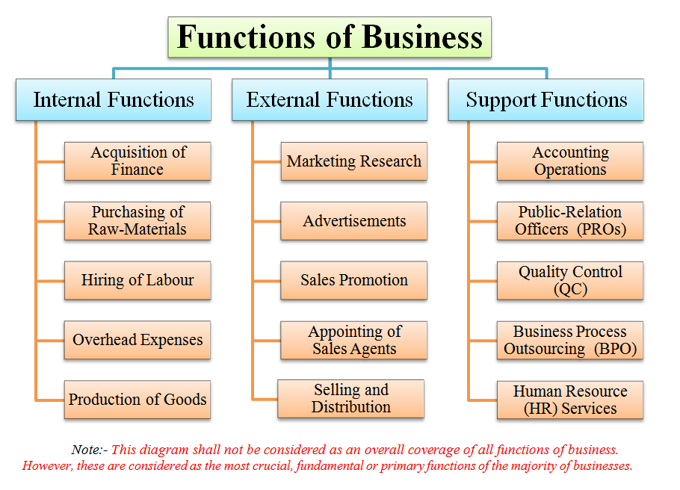

Slide 7
Business process outsourcing (BPO)
BPO is a subset of outsourcing that involves the contracting of the operations and responsibilities of specific business functions (or processes) to a third-party service provider. Originally, this was associated with manufacturing firms, such as Coca Cola that outsourced large segments of its supply chain.
  Back office outsourcing- HR functions
  Front Office outsourcing- Customer related services
  Offshore outsourcing- Outside a company's country

Slide 8
Nature of business strategy
Even the most technically perfect strategic plan will serve little purpose if it is not implemented.
Change comes through implementation and evaluation, not through the plan.
A technically imperfect plan that is implemented well will achieve more than the perfect plan

Slide 9
Importance of strategic planning-
Strategic Tools
Globalization
  Survival for business
  Managers gain better understanding of
    Competitors
    Markets
    Prices
    Suppliers
    Distributors
    Governments
    Shareholders
    Customers worldwide

Slide 10
Globalization-Benefits
Resources of different countries are used for producing goods and services they are able to do most efficiently
Consumers to get much wider variety of products to choose from.
Consumers get the product they want at more competitive prices.

Slide 11
Globalization-Benefits
Companies are able to procure input goods and services required at most competitive prices.
Companies get access to much wider markets
It promotes understanding and goodwill among different countries.
Businesses and investors get much wider opportunities for investment.

Slide 12
E-Commerce
Companies are gaining competitive advantage by using technology i.e. Internet
  Direct selling
    Telemarketing, Direct Mail, Direct response (Business reply card)
  Direct communication with
    Suppliers
    customers,
    partners,
    Shareholders
    Client
    and competitors who may be dispersed globally

Slide 13
Ecommerce-Benefits
Example: Physical store
Overcome Geographical Limitations
Gain New Customers With Search Engine Visibility
Lower Costs
  Advertising and Marketing
  Personnel
Locate the Product Quicker
Eliminate Travel Time and Cost
Provide Comparison Shopping
Provide Abundant Information
Create Targeted Communication- Amazon
Remain Open All the Time- 24/7/365

Slide 14
Lecture Summary
Nature of Business Strategy
Importance of strategic planning-
Strategic Tools
  Globalization
  Ecommerce

Slide 15
Next Lecture
Important terminologies in Business strategy and policy
Intuition and analysis
  Pillars of intuition
  Benefits of intuition in decision making

