Slide 1
Business Strategy and Policy
Lecture-19

Slide 2
Recap
Production/Operations Functions
    Production/Operations Audit Checklist
Research & Development
    R&D Audit Checklist of Questions
Management Information Systems
    Information Systems Audit Checklist
Value Chain Analysis

Slide 3
Today’s Lecture
THE INTERNAL FACTOR EVALUATION (IFE) MATRIX
The Nature of Long-Term Objectives
Financial versus Strategic Objectives
Not Managing by Objectives

Slide 4
INTERNAL FACTOR EVALUATION (IFE) MATRIX
This strategy-formulation tool summarizes and evaluates the major strengths and weaknesses in the functional areas of a business, and it also provides a basis for identifying and evaluating relationships among these areas.
Intuitive judgments are required in developing an IFE Matrix, so a thorough understanding of the factors included is more important than the actual numbers.

Slide 5
Steps in IFE MATRIX
1. List key internal factors as identified in the internal‑audit process. Use a total of from ten to twenty internal factors, including both strengths and weaknesses. List strengths first and then weaknesses. Be as specific as possible, using percentages, ratios, and comparative numbers.
2. Assign a weight that ranges from 0.0 (not important) to 1.0 (all‑important) to each factor. The weight assigned to a given factor indicates the relative importance of the factor to being successful in the firm's industry. Regardless of whether a key factor is an internal strength or weakness, factors considered to have the greatest effect on organizational performance should be assigned the highest weights. The sum of all weights must equal 1.0.

Slide 6
Steps in IFE MATRIX
3. Assign a I‑to‑4 rating to each factor to indicate whether that factor represents a major weakness (rating = 1), a minor weakness (rating = 2), a minor strength (rating = 3), or a major strength (rating = 4). Note that strengths must receive a 4 or 3 rating and weaknesses must receive a 1 or 2 rating. Ratings are thus company‑based, whereas the weights in Step 2 are industry‑based.
4. Multiply each factor's weight by its rating to determine a weighted score for each variable.
5. Sum the weighted scores for each variable to determine the total weighted score for the organization.

Slide 7
IFE MATRIX
Regardless of how many factors are included in an IFE Matrix, the total weighted score can range from a low of 1.0 to a high of 4.0, with the average score being 2.5. Total weighted scores well below 2.5 characterize organizations that are weak internally, whereas scores significantly above 2.5 indicate a strong internal position. Like the EFE Matrix, an IFE Matrix should include from 10 to 20 key factors. The number of factors has no effect upon the range of total weighted scores because the weights always sum to 1.0.

Slide 8
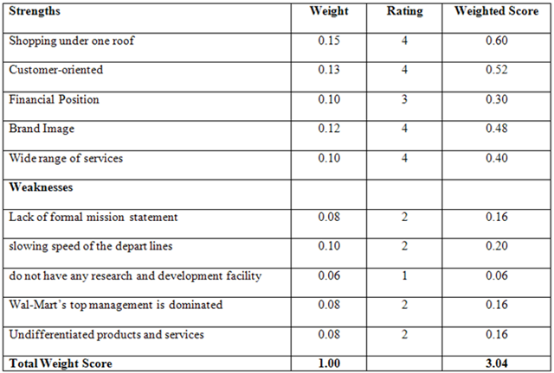
IFE MATRIX EXAMPLE

Slide 9
Long Term Objectives
Quantitative
Measurable
Realistic
Understandable
Challenging
Hierarchical
Obtainable
Congruent

Slide 10
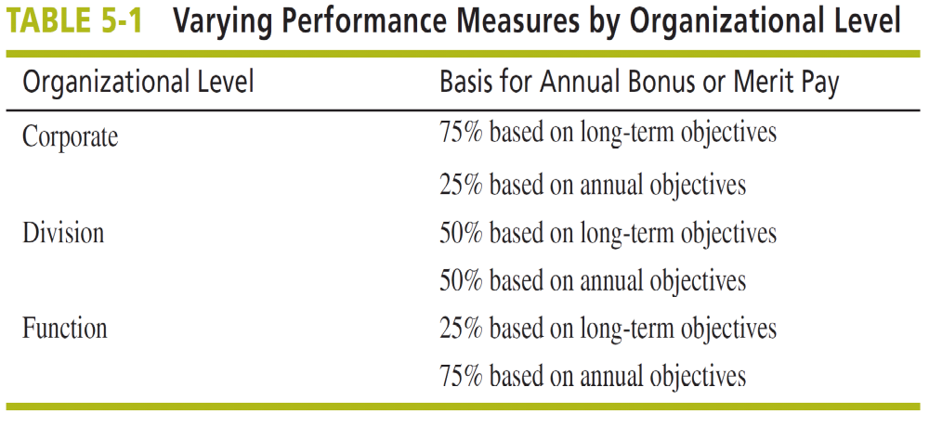

Slide 11
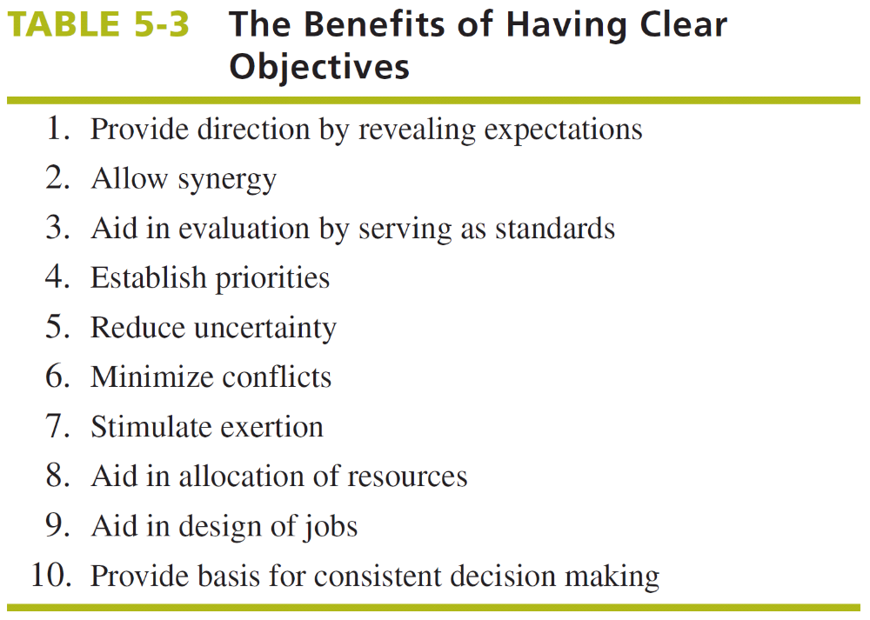

Slide 12
Financial vs. Strategic Objectives
Strategic Objectives
Larger market share
Quicker on-time delivery than rivals
Shorter design-to-market times than rivals
Lower costs than rivals
Higher product quality than rivals
Wider geographic coverage than rivals
Achieving technological leadership
Consistently getting new or improved products to market ahead of rivals

Slide 13
Financial vs. Strategic Objectives
Financial Objectives
Growth in revenues
Growth in earnings
Higher dividends
Larger profit margins
Greater ROI
Higher earnings per share
Rising stock price
Improved cash flow

Slide 14
Not Managing by Objectives
Managing by Extrapolation – “If it ain’t broke, don’t fix it”
Managing by Crisis – The true measure of a good strategist is the ability to fix problems
Managing by Subjectives – “Do your own thing, the best way you know how”
Managing by Hope – The future is full of uncertainty and if at first you don’t succeed, then you may on the second or third try

Slide 15
Summary
THE INTERNAL FACTOR EVALUATION (IFE) MATRIX
The Nature of Long-Term Objectives
Financial versus Strategic Objectives
Not Managing by Objectives

Slide 16
Next Lecture
The Balanced Scorecard
Levels of Strategies

