Slide 1
Business Strategy and Policy
Lecture-16

Slide 2
Recap
The External Assessment
  Competitive Analysis:
    Porter’s Five-Forces Model
  Sources of External Information
  Forecasting Tools and Techniques
  Industry Analysis:
    The External Factor Evaluation Matrix
  The Competitive Profile Matrix

Slide 3
Today’s Lecture
The Internal Assessment
  Nature of an Internal Audit
  Resource Based View (RBV)
  Integrating Strategy & Culture
  Functions of Management

Slide 4
Nature of an Internal Audit
Basis for Objectives & Strategies
Internal strengths/weaknesses
All organizations have strengths and weaknesses in the functional areas of business.
No enterprise is equally strong weak in all areas.
Internal strengths/weaknesses, coupled with external opportunities / threats
  A clear statement of mission, provide the basis for establishing objectives and strategies.

Slide 5
Nature of an Internal Audit
Parallels process of external audit
Information from:
  Management
  Marketing
  Finance/accounting
  Production/operations
  Research & Development
  Management Information Systems

Slide 6
Key Internal Forces
1. A firm’s strengths that cannot be easily matched or imitated by competitors are called distinctive competencies.
  Building competitive advantages involves taking advantage of distinctive competencies.
  A distinctive competency is a competency unique to a business organization, a competency superior in some aspect than the competencies of other organizations, which enables the production of a unique value proposition in the function of the business.
  2. Strategies are designed in part to improve on a firm’s weaknesses, turning them into strengths, and maybe even into distinctive competencies

Slide 7
Resource Based View (RBV)
Internal Factors versus External Factors
1. The RBV takes the opposing view to that of the I/O theorists. The RBV approach to competitive advantage contends that
- internal resource are more important than external factors for firm in achieving and sustaining competitive advantage.
2. Internal resources come from three categories.
a. Physical resources: plant, equipment, location, technology, raw materials, machines, etc.
b. Human resources: employees, training, experience, intelligence, knowledge, skills, abilities, etc.
c. Organizational resources: firm structure, planning processes, information systems, patents, trademarks, copyrights, databases, etc.

Slide 8
Resource Based View (RBV)
Valuable Resources:
Resources are only valuable if they have one or more of the following characteristics:
Rare
Hard to imitate
Not easily substitutable

Slide 9
Integrating Strategy & Culture
Organizational Culture
Pattern of behavior developed by an organization as it learns to cope with its problem of external adaptation and internal integration…is considered valid and taught to new members

Slide 10
Integrating Strategy & Culture
Organizational Culture
Relationships among a firm’s functional business activities perhaps can be exemplified by focusing on organizational culture, an internal phenomenon that infuse through all departments and divisions of an organization.
Organizational culture significantly affects business decisions and thus, must be evaluated during an internal strategic management audit.

Slide 11
United States versus Foreign Cultures
To successfully compete in world markets, U.S. managers must obtain a better knowledge of historical, cultural, and religious forces that motivates and drive people in other countries.
a. In Japan, for example, business relations operate within the context of wa, which stresses group harmony and social cohesion.
In China, business behavior revolves around guianxi, or personal relations.
In Korea, activities involve concern for inhwa, or harmony based on respect of hierarchical relationships, including obedience to authority.

Slide 12
United States versus Foreign Cultures
b. U.S. managers have a low tolerance for silence, whereas Asian managers view extended periods of silence as important for organizing and evaluating one’s thoughts. The book lists other important differences between U.S. and foreign managers.
c. Probably the biggest obstacle to the effectiveness of U.S. managers, or managers from any country working in another, is the fact that it is almost impossible to change the attitude of a foreign workplace.
The system drives you; you cannot fight the system or culture,´ says Bill Parker, president of Phillips Petroleum in Norway.

Slide 13
Integrating Strategy & Culture
Values
Legends
Beliefs
Heroes
Rites
Cultural
Products
Symbols
Rituals
Myths

Slide 14
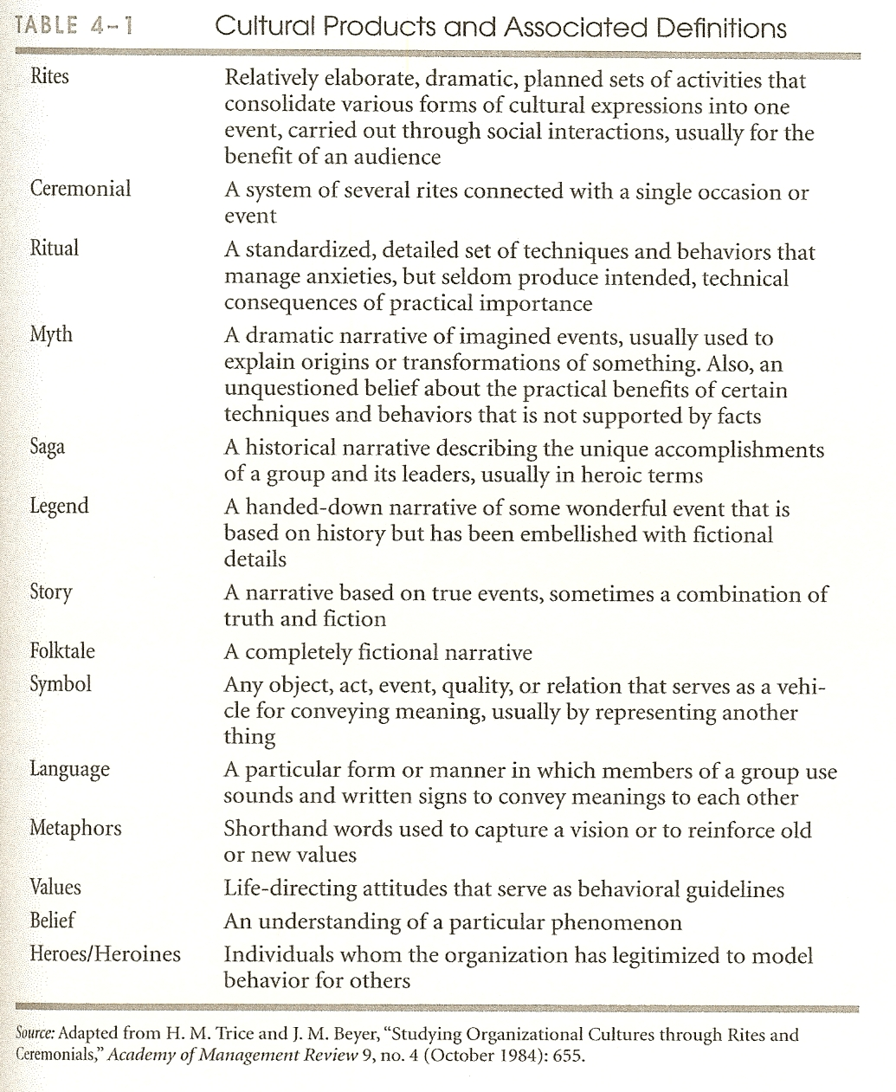

Slide 15
Management
Stage When Most Important
Function
Planning
Strategy Formulation
Organizing
Strategy Implementation
Motivating
Strategy Implementation
Staffing
Strategy Implementation
Controlling
Strategy Evaluation

Slide 16
Management
The functions of management consist of five basic activities: planning, organizing, motivating, staffing, and controlling.
a. Planning:
Planning consists of all those managerial activities related to preparing for the future. Specific tasks including forecasting, establishing objectives, devising strategies, developing policies, and setting goals. Planning is most important in the strategy-formulation stage of the strategic-management process.
b. Organizing:
Organizing includes all those managerial activities that result in a structure of task and authority relationships. Specific areas includes Specific areas include organizational design; job specialization, descriptions, specifications, design, and analysis; span of the control; unity of command; and coordination. Organizing is most important in the strategy implementation stage of the strategic-management process.

Slide 17
Management
c. Motivating:
Motivating involves efforts directed toward shaping human behavior. Specific topics include leadership, communication, work groups, behavior modification, delegation of authority, job enrichment, and so on. Motivating is most important in the strategy-implementation stage of the strategic-management process.
d. Staffing:
Staffing activities are centered on personnel or human resource management. Included are wage and salary administration, employee benefits, interviewing hiring, firing, training, employee safety, and so on. Staffing is the most important in the strategy-implementation stage of the strategic-management process.
e. Controlling:
Controlling refers to all those managerial activities directed toward ensuring that actual results are consistent with planned results. Key areas of concern include quality, financial, sales, inventory, and expenses control; analysis of variance, rewards and sanctions. Controlling is most important in the strategy-evaluation stage of the strategic-management process. It consists of four basic steps: 1) establishing performance standards, 2) measuring individual and organizational performance, 3) comparing actual performance to planned performance standards, and 4) taking corrective actions.

Slide 18
Summary
The Internal Assessment
  Nature of an Internal Audit
  Resource Based View (RBV)
  Integrating Strategy & Culture
  Functions of Management

Slide 19
Next Lecture
Management Audit Checklist of Questions
Marketing
  Marketing Check List
FINANCE/ACCOUNTING
  FINANCE/ACCOUNTING Check List

