Slide 1
Business Policy and Strategy
MGT599
Lecture 01

Slide 2
Introduction
Dr. Muhammad Shakil Ahmad
Assistant Professor
  PhD Business Management
    Universiti Teknologi Malaysia, Malaysia
  MS (Management)
    COMSATS Institute of Information Technology

Slide 3
Core Course Objective
The core objective of the course is tell students how to gain competitive advantages in a competitive situation, where fundamental choices in critical business areas like products, markets and consumers need to be made on, on going basis.

Slide 4
Learning Objectives
This course is designed to provide analytical tolls and general management approaches for understanding competitive forces and setting strategy.
Industry analysis, trend analysis, ratio analysis and resource evaluation are needed just for strategy formulation and a knowledge of organizational structure, information systems, planning systems, control systems, motivational systems together with an understanding of leadership styles and communication methods are required for strategy implementation.

Slide 5
Outcome
Students will learn how to analyze industries and position the firm for superior performance.

Slide 6
Course Outline
Defining Business Strategy and its Nature
Key terms in Business Strategy and Policy
Internal Factors and Long Term Goals
Characteristics of Mission and Vision Statements
External Assessment (Key External Factors)
Industry Analysis
  External Factor Evaluation Martix
  Porter Five Force Model
Internal Factor Evaluation Matrix
  Internal Assessment (Finance and Accounting)

Slide 7
Course Outline
Functions of Management
Types of Strategies
Strategy Formulation Framework
  BOSTON CONSULTING GROUP (BCG) MATRIX
  GRAND STRATEGY MATRIX
STRATEGY IMPLEMENTATION
RESOURCE ALLOCATION
Organizational Structure
Strategy Evaluation

Slide 8
Grading
Marks Distribution
Assignments (04) 15
Quiz (04) 10
Sessional Exam 1 10
Sessional Exam 2 15
Internal Total Marks 50
5. Final Examination 50
Total 100
Passing Marks: 50

Slide 9
Text & Reference Books
Text:
Strategic Management: Concepts and Cases, 12th Edition by Fred R. David, Pearson Prentice Hall
Reference Text:
Exploring Corporate Strategy, Gerry Johnson et al., 5th Edition, Pearson Prentice Hall

Slide 10
What is Business Strategy
A plan of action or policy designed to achieve a major or overall aim
The on-going process of formulating, implementing and controlling broad plans guide the organizational in achieving the strategic goods given its internal and external environment

Slide 11
Interpretation of Definition
1. On-going process:
Business Strategy is an on-going process, which is in existence through out the life of organization.
2. Shaping broad plans:
First, it is an on-going process in which broad plans are firstly formulated than implementing and finally controlled.

Slide 12
Interpretation of Definition
3. Strategic goals:
Strategic goals are those which are set by top management. The broad plans are made in achieving the goals.
4. Internal and external environment:
Internal and external environment generally set the goals. Simply external environment forced internal environment to set the goals and guide them that how to achieve the goals?

Slide 13
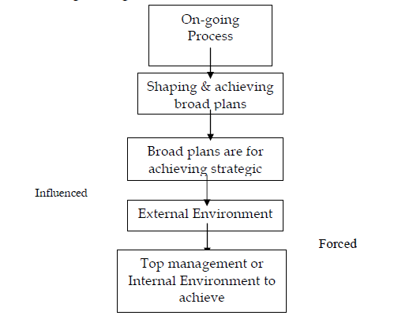

Slide 14
Environment Scanning
Strategy Fermentation
Strategy Implication
Evaluation
Control

Slide 15
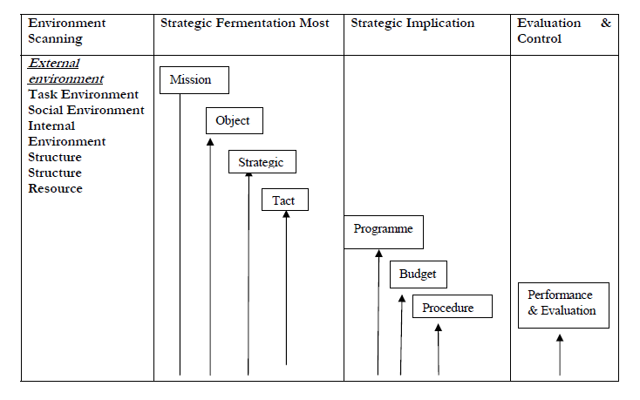
Phases of Strategy Management

Slide 16
Strategy Formulation
Vision and Mission
Strength and Weaknesses
Opportunities and Opportunities
long term goals and objectives

Slide 17
Strategy Implementation
Establish annual objectives
Devise policies
Motivating employees
Resources allocation to execute formulated strategies

Slide 18
Strategy Evaluation
Strategy evaluation is the final stage
Management evaluate when particular strategies are not working well
As internal as well as external environment never remain constant, therefore, mostly organizations have to modify their strategies from time to time

Slide 19
Strategy Implementation
Strategy Formulation
HR Practices
Recruiting
Training
Performance Management
Job Analysis
Job Design
Selection
Development
Pay Structure
Incentives
Benefits
Labor Relations
Employee Relations
Mission
SWOT
Goals
Strategic Choice
Firm Performance
Productivity
Quality
Productivity
Human Resource Capability
Skills
Abilities
Knowledge
Human Resource Actions
Behaviors
Results (Productivity, Absenteeism, Turnover)
Human Resource Needs
Skills
Behaviors
Culture
Strategy Evaluation
Emergent Strategies

Slide 20
Next Lecture
Nature of Business Strategy
Importance of Strategic policy making
Key terms in Business Strategy and Policy
  Adopting change
  Strategies
  Mission & Vision statement
  SWOT

