Slide 1
Strategic Human Resource Management
Imran Ghaznavi
Twitter: @ighaznavi
Course Code: MGT557
COMSATS

Slide 2
Lecture 9

Slide 3
Lecture outline
Overview of 8th Lecture
Case study

Slide 4
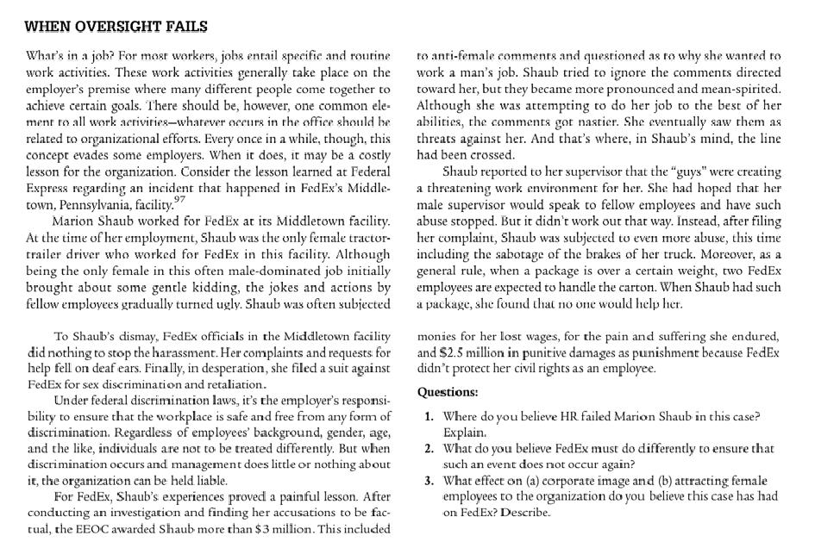
Material for next lecture
  Case Study

Slide 5
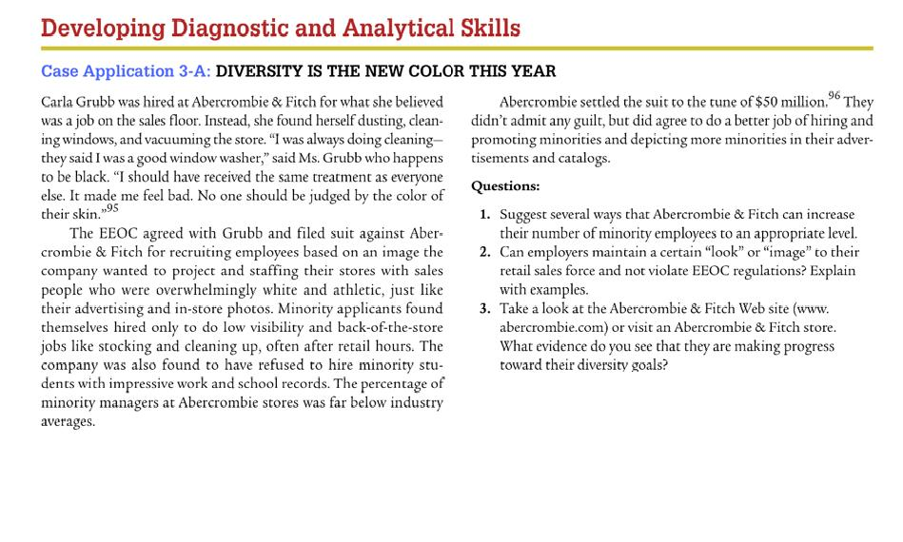

Slide 6
New case studies &HRM Guidelines

Slide 7
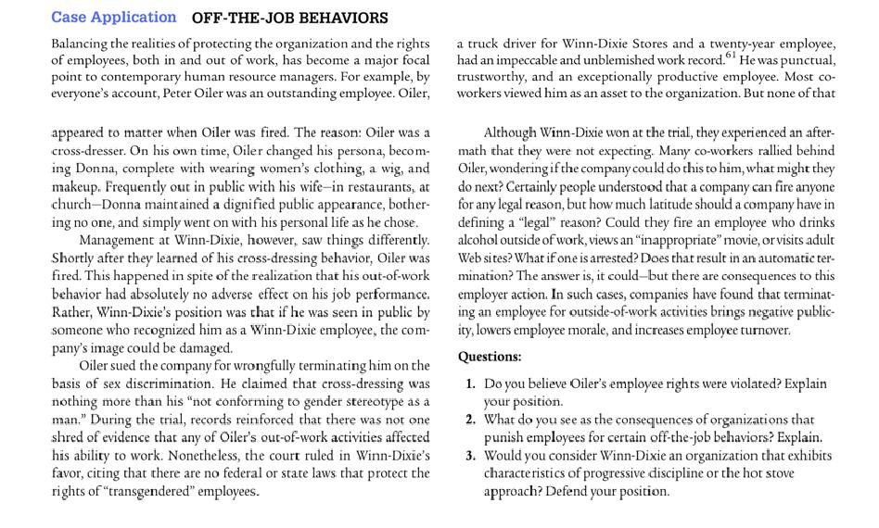

Slide 8
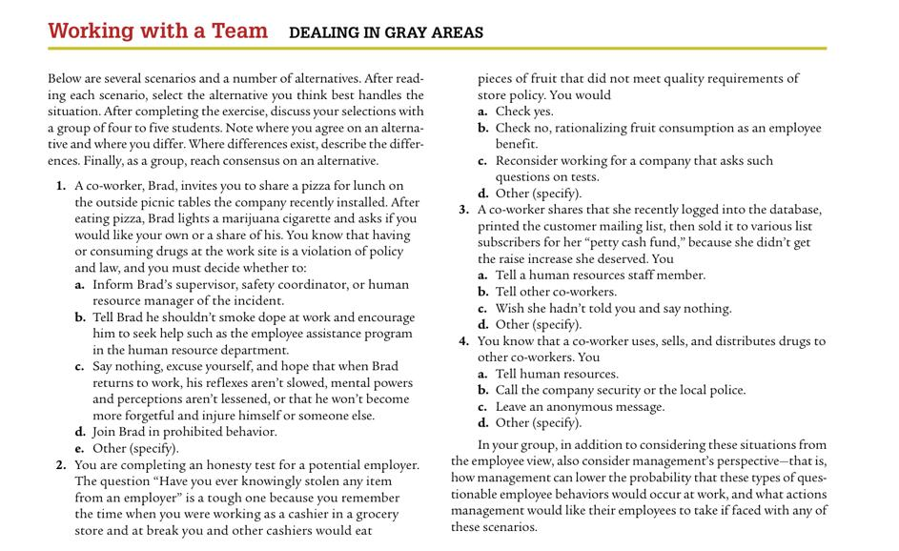

Slide 9
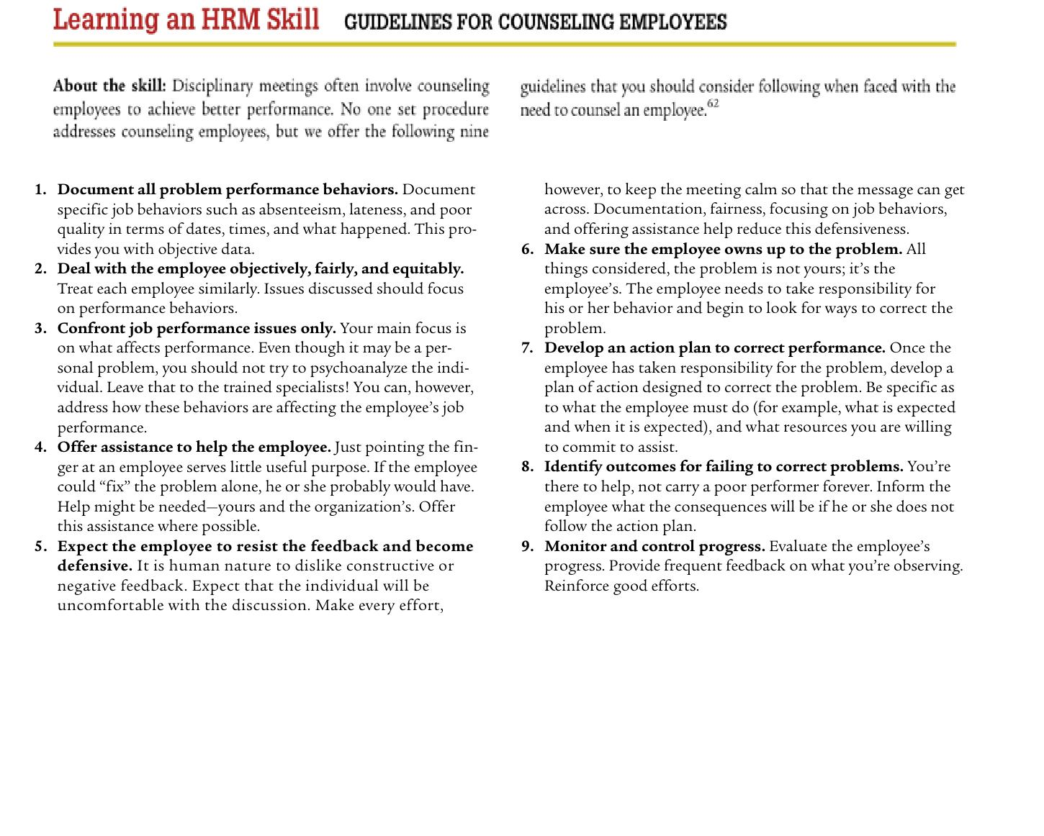

Slide 10
Thank you
For any question or query contact through
twitter: @ighaznavi

