Slide 1
Strategic Human Resource Management
Imran Ghaznavi
Twitter: @ighaznavi
Course Code: MGT557
COMSATS

Slide 2
Lecture 8

Slide 3
Lecture outline
Overview of 7th Lecture
Case study

Slide 4
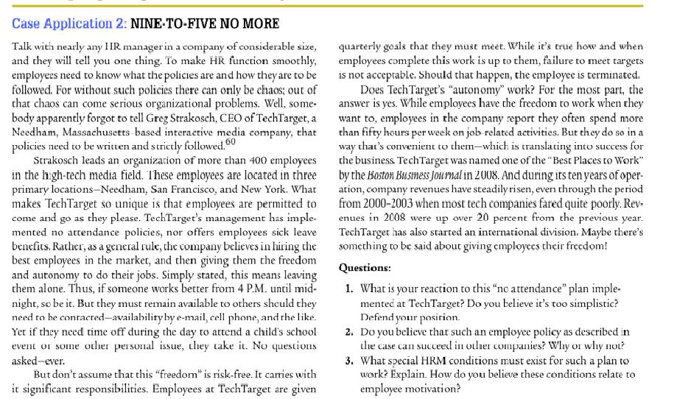

Slide 5
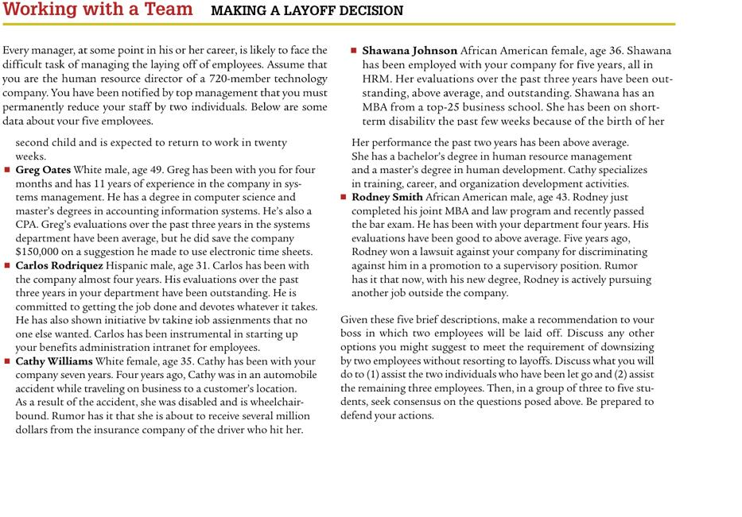

Slide 6
New Case studies

Slide 7
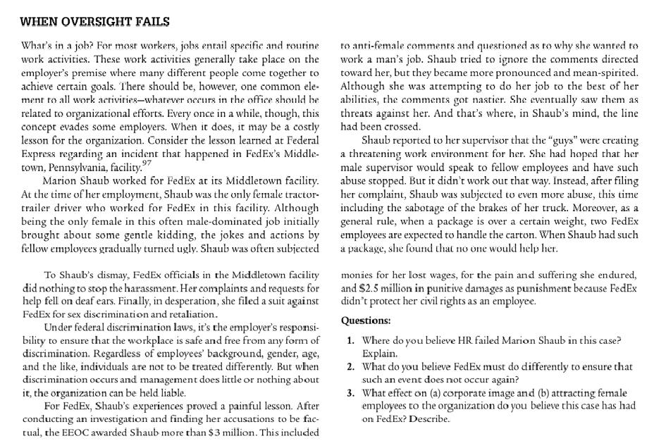
Material for next lecture
  Case Study

Slide 8
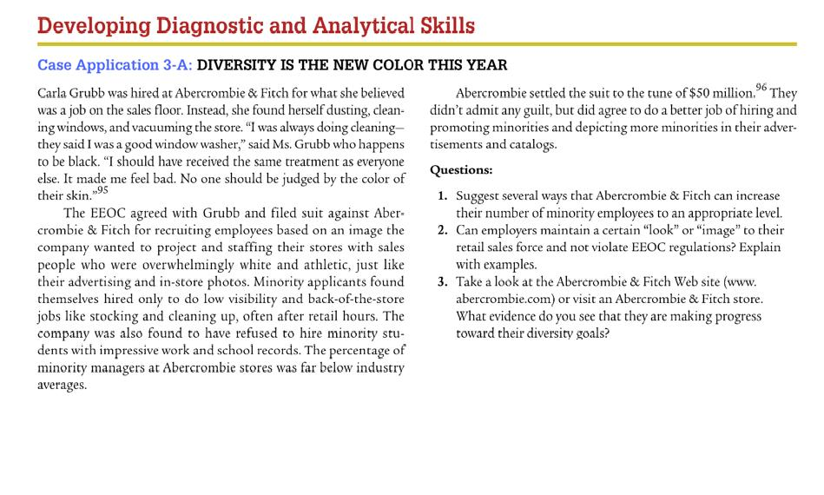

Slide 9
Material for next lecture
  Case Study
  HRM Skill

Slide 10
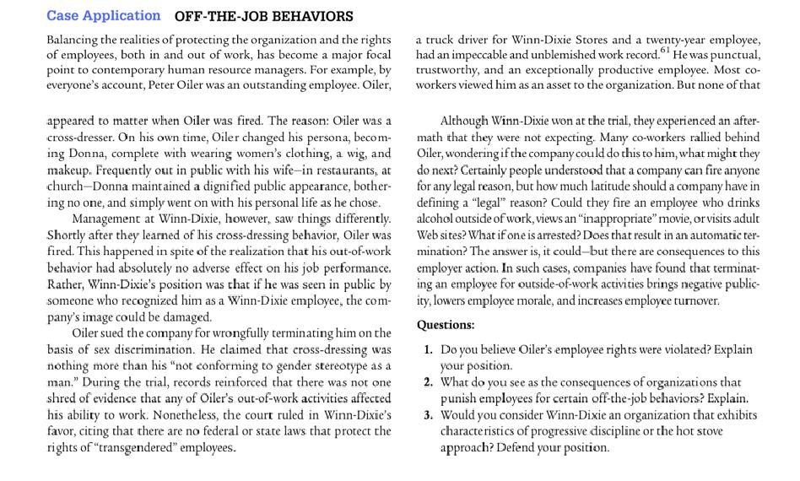

Slide 11
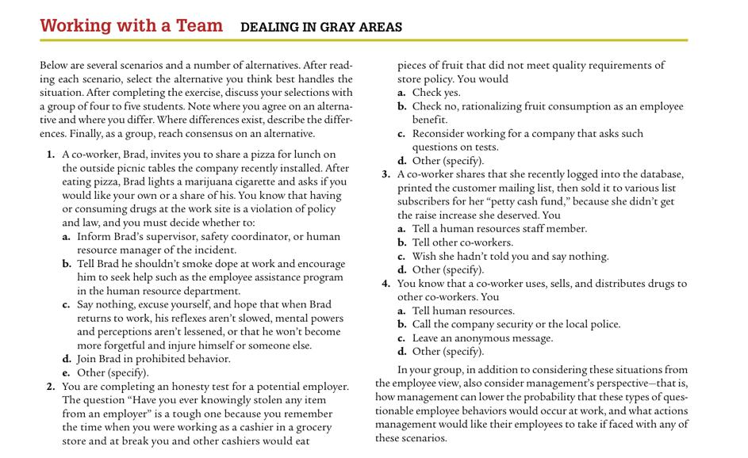

Slide 12
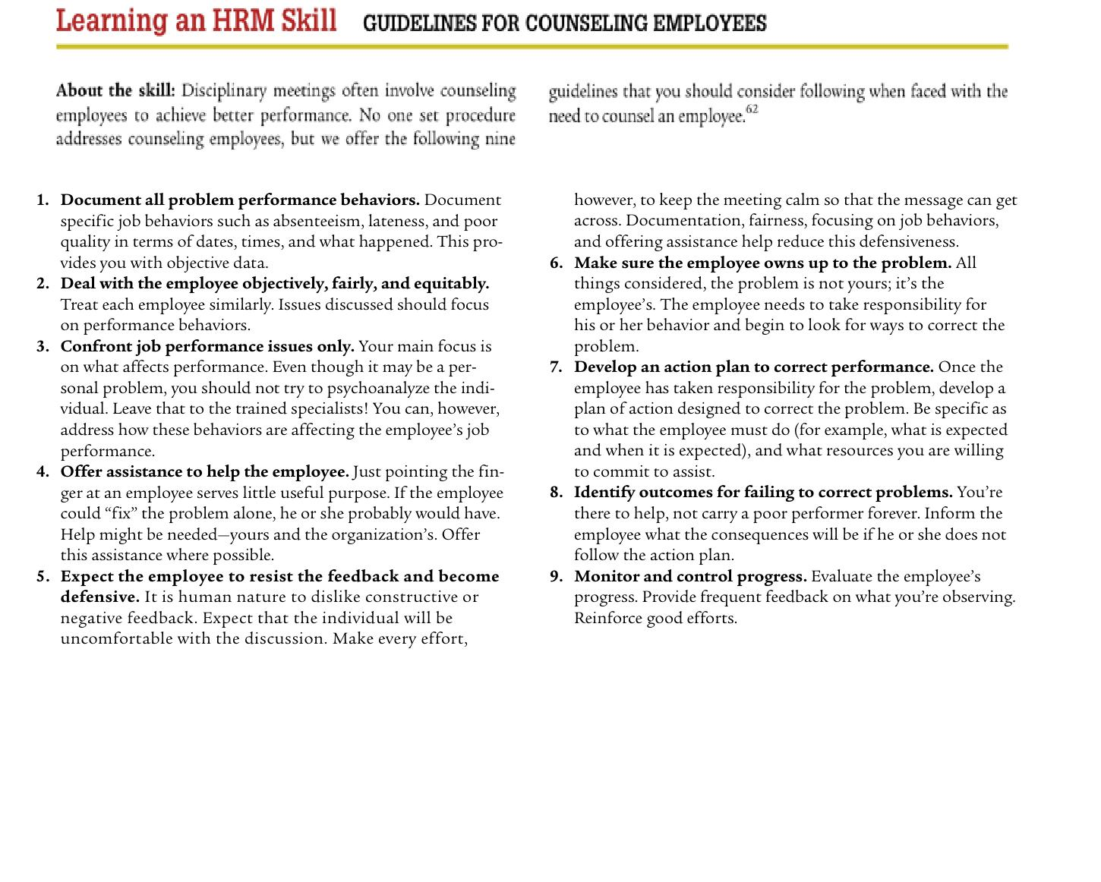

Slide 13
Thank you
For any question or query contact through
twitter: @ighaznavi

