Slide 1
Strategic Human Resource Management
Imran Ghaznavi
Twitter: @ighaznavi
Course Code: MGT557
COMSATS

Slide 2
Lecture Seven

Slide 3
Lecture outline
Overview of 6th Lecture

Slide 4
Aim of HRM
HRM is concerned with achieving objectives in the areas;
  Organizational effectiveness
  Human capital management
  Knowledge management
  Reward management
  Employee relations
  Meeting diverse needs
  Bridging the gap between rhetoric and reality

Slide 5
CHARACTERISTICS OF HRM
The characteristics of the HRM concept are that :
  diverse;
  strategic, with an emphasis on integration;
  commitment-orientated;
  based on the belief that people should be treated as assets (human capital);
  unitarist rather than pluralist, individualistic rather than collective, in its approach to employee relations;

Slide 6
CHARACTERISTICS OF HRM
a management-driven activity – the delivery of HRM is a line management responsibility;
focused on business values, although this emphasis is being modified in some quarters and more recognition is being given to the importance of moral and social values.

Slide 7
People as ‘human capital’
The notion that people should be regarded as assets rather than variable costs, in other words treated as human capital, was originally advanced by Beer et al (1984).
‘People and their collective skills, abilities and experience, coupled with their ability to deploy these in the interests of the employing organization, are now recognized as making a significant contribution to organizational success and as constituting a significant source of competitive advantage.’
Armstrong and Baron (2002)

Slide 8
HRM as a management-driven activity
It is a central, senior management-driven strategic activity that is developed, owned and delivered by management as a whole to promote the interests of their organization.

Slide 9
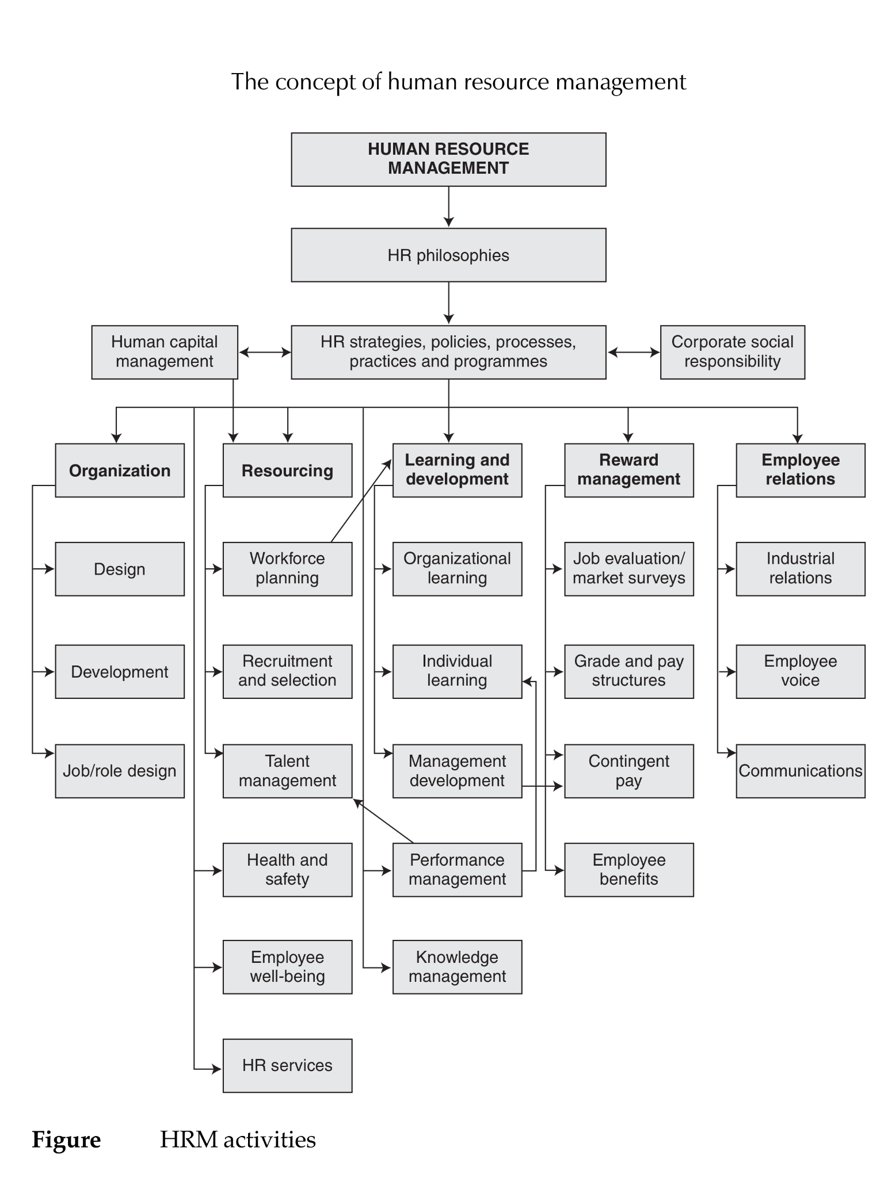

Slide 10
Case study

Slide 11
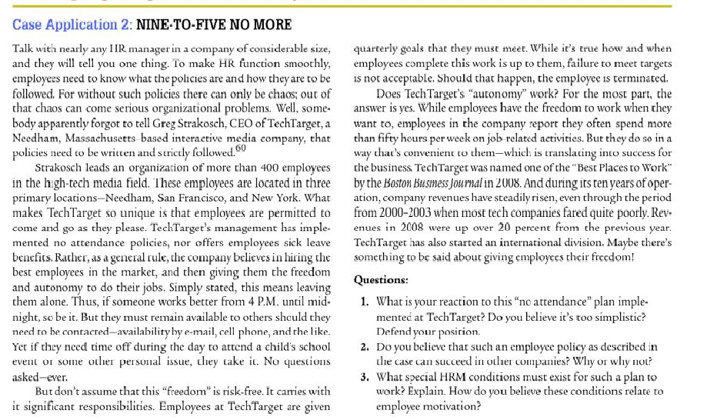

Slide 12
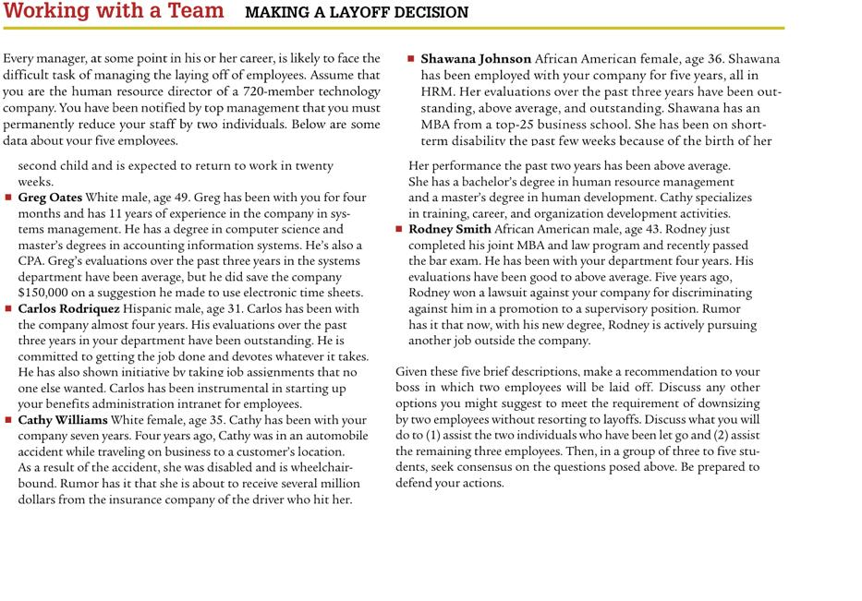

Slide 13
Material for next lecture
  Case Study

Slide 14
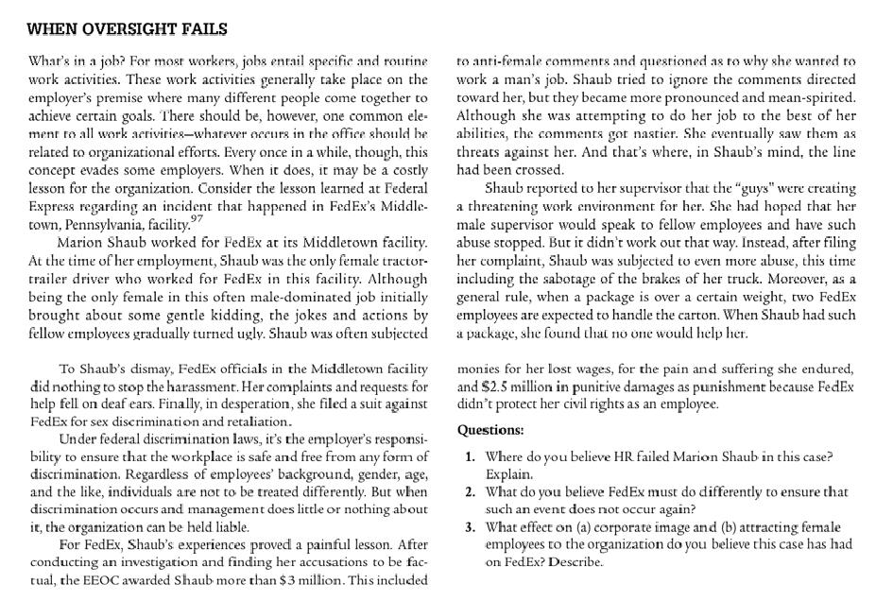
Material for next lecture
  Case Study

Slide 15
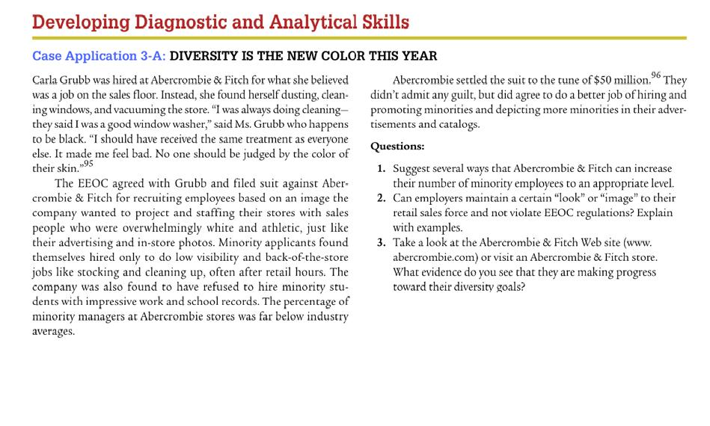

Slide 16
Thank you
For any question or query contact through
twitter: @ighaznavi

