Slide 1
Strategic Human Resource Management
Imran Ghaznavi
Twitter: @ighaznavi
Course Code: MGT557
COMSATS

Slide 2
Lecture Six

Slide 3
Lecture outline
Overview of 5th Lecture
Characteristics of HRM

Slide 4
Overview of last lecture
Human Resource System (5P’s & S)
  HR philosophies
  HR strategies
  HR policies
  HR processes
  HR practices
  HR programs

Slide 5
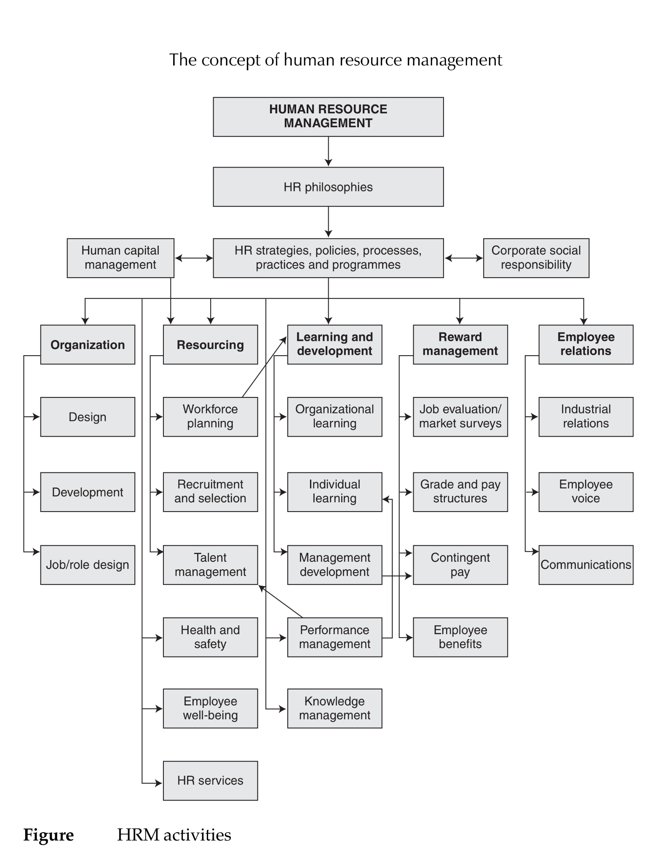

Slide 6
AIMS OF HRM
Twelve policy goals for HRM have been identified by Caldwell (2004):
  1. managing people as assets that are fundamental to the competitive advantage of the organization;
  2. aligning HRM policies with business policies and corporate strategy;
  3. developing a close fit of HR policies, procedures and systems with one another;
  4. creating a flatter and more flexible organization capable of responding more quickly to change;

Slide 7
Policy goals for HRM
  5. encouraging team working and cooperation across internal organizational boundaries;
  6. creating a strong customer-first philosophy throughout the organization;
  7. empowering employees to manage their own self development and learning;
  8. developing reward strategies designed to support a performance-driven culture;

Slide 8
Policy goals for HRM
  9. improving employee involvement through better internal communication;
  10. building greater employee commitment to the organization;
  11. increasing line management responsibility for HR policies;
  12. developing the facilitating role of managers as enablers.

Slide 9
AIM of HRM
Dyer and Holder (1988) emphasize:
  ‘HRM goals vary according to competitive choices, technologies or service tangibles, characteristics of their employees (e.g could be different for managers), the state of the labour market and the societal regulations and national culture.
Boxall, Purcell and Wright (2007) note that
  ‘The general motives of HRM are multiple.’

Slide 10
Aim of HRM
HRM is concerned with achieving objectives in the areas;
  Organizational effectiveness
  Human capital management
  Knowledge management
  Reward management
  Employee relations
  Meeting diverse needs
  Bridging the gap between rhetoric and reality

Slide 11
Organizational effectiveness
Distinctive human resource practices shape the core competencies that determine how firms compete’
    (Cappelli and Crocker-Hefter, 1996).
Extensive research has shown that such practices can make a significant impact on firm performance.
Notes:
HRM strategies aim to support programmes for improving organizational effectiveness by developing policies in such areas as knowledge management, talent management and generally creating ‘a great place to work’.

Slide 12
Human capital management
Human capital represents the human factor in the organization; the combined intelligence, skills and expertise that gives the organization its distinctive character.
The human elements of the organization are those that are capable of learning, changing, innovating and providing the creative thrust which if properly motivated can ensure the long-term survival of the organization.
Bontis et al (1999)
Notes:
The human capital of an organization consists of the people who work there and on whom the success of the business depends.
2. Human capital can be regarded as the prime asset of an organization, and businesses need to invest in that asset to ensure their survival and growth.

Slide 13
Knowledge management
‘Any process or practice of creating, acquiring, capturing, sharing and using knowledge, wherever it resides, to enhance learning and performance in organizations’
(Scarborough et al, 1999).
Notes:
HRM aims to support the development of firm-specific knowledge and skills that are the result of organizational learning processes.

Slide 14
Reward management
HRM aims to enhance motivation, job engagement and commitment by introducing policies and processes that ensure that people are valued and rewarded for what they do and achieve and for the levels of skill and competence they reach.

Slide 15
Employee relations
The aim is to create a climate in which productive and harmonious relationships can be maintained through partnerships between management and employees and their trade unions.

Slide 16
Meeting diverse needs
HRM aims to develop and implement policies that balance and adapt to the needs of its stakeholders and provide for the management of a diverse workforce, taking into account individual and group differences in employment, personal needs, work style and aspirations and the provision of equal opportunities for all.

Slide 17
Bridging the gap between rhetoric and reality
The research conducted by Gratton et al (1999) found that there was generally a wide gap between the sort of rhetoric expressed earlier and reality.
Management with all of its good intentions may implement all or some of the areas discussed here but the realization of them is often very difficult.
This arises because of contextual and process problems:
  Other business priorities, short-termism, limited support from line managers, an inadequate infrastructure of supporting processes, lack of resources, resistance to change and lack of trust.
Notes:
An overarching aim of HRM is to bridge this gap by making every attempt to ensure that aspirations are translated into sustained and effective action

Slide 18
CHARACTERISTICS OF HRM
The characteristics of the HRM concept are that :
  diverse;
  strategic, with an emphasis on integration;
  commitment-orientated;
  based on the belief that people should be treated as assets (human capital);
  unitarist rather than pluralist, individualistic rather than collective, in its approach to employee relations;

Slide 19
CHARACTERISTICS OF HRM
a management-driven activity – the delivery of HRM is a line management responsibility;
focused on business values, although this emphasis is being modified in some quarters and more recognition is being given to the importance of moral and social values.

Slide 20
The strategic nature of HRM
The most significant feature of HRM is the importance attached to strategic integration, which flows from top management’s vision and leadership, and which requires the full commitment of people to it.
The key policy goal for HRM, is the ability of the organization to integrate HRM issues into its strategic plans, to ensure that the various aspects of HRM cohere, and to encourage line managers to incorporate an HRM perspective into their decision making.
David Guest (1987, 1989a, 1989b, 1991)

Slide 21
The commitment-orientated nature of HRM
The importance of commitment and mutuality was emphasized by Walton (1985) as follows:
  “ The new HRM model is composed of policies that promote mutuality – mutual goals, mutual influence, mutual respect, mutual rewards, mutual responsibility. The theory is that policies of mutuality will elicit commitment which in turn will yield both better economic performance and greater human development.”

Slide 22
People as ‘human capital’
The notion that people should be regarded as assets rather than variable costs, in other words treated as human capital, was originally advanced by Beer et al (1984).
‘People and their collective skills, abilities and experience, coupled with their ability to deploy these in the interests of the employing organization, are now recognized as making a significant contribution to organizational success and as constituting a significant source of competitive advantage.’
Armstrong and Baron (2002)

Slide 23
HRM as a management-driven activity
It is a central, senior management-driven strategic activity that is developed, owned and delivered by management as a whole to promote the interests of their organization.

Slide 24
Focus on business values
The concept of HRM has been largely based on a management- and business orientated philosophy
It is concerned with the total interests of the organization
The interests of the members of the organization are recognized but subordinated to those of the enterprise
“HRM policies are adapted to drive business values and are modified in the light of changing business objectives and conditions. “
Karen Legge 1995

Slide 25
Material for next lecture
  Case Study

Slide 26
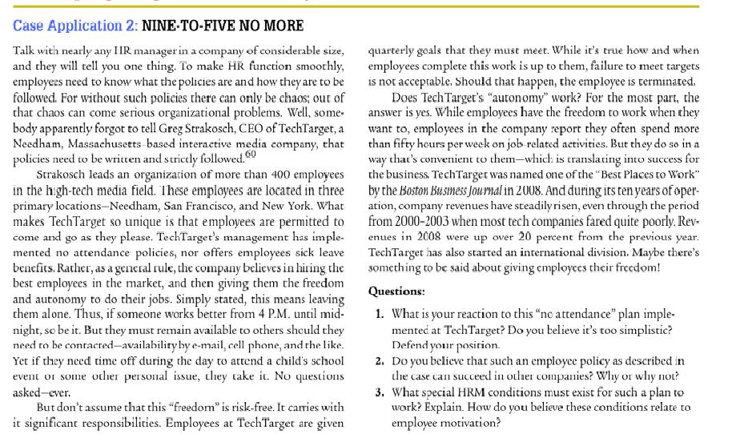

Slide 27
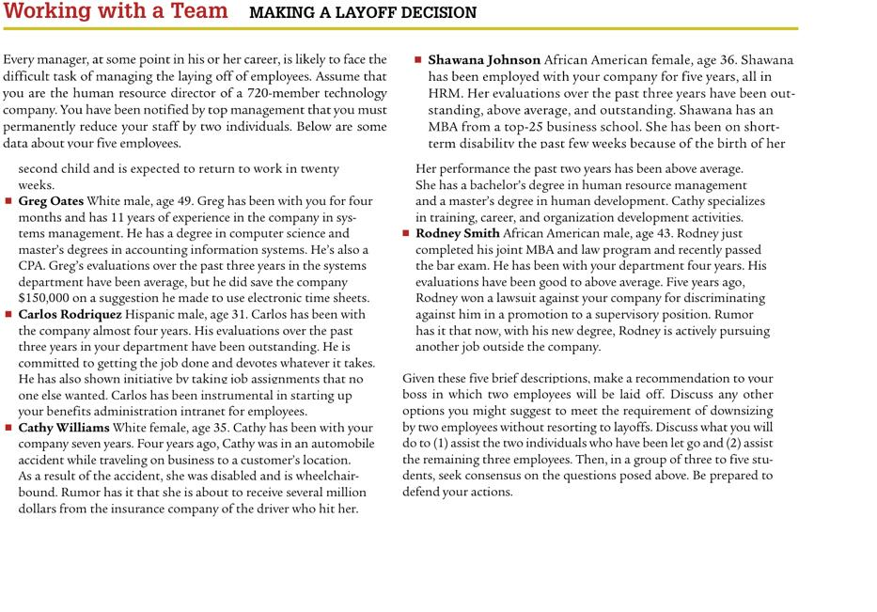

Slide 28
Thank you
For any question or query contact through
twitter: @ighaznavi

