Slide 1
Strategic Human Resource Management
Imran Ghaznavi
Twitter: @ighaznavi
Course Code: MGT557
COMSATS

Slide 2
Lecture Five

Slide 3
Lecture outline
Overview of 4th Lecture
Human Resource System
Aims of HRM
Characteristics of HRM

Slide 4
Overview of last lecture
Case study

Slide 5


Slide 6
HUMAN RESOURCE SYSTEMS
Human resource management operates through human resource systems as illustrated in Figure 1.3. These bring together in a coherent way:
HR philosophies, describing the overarching values and guiding principles adopted in managing people;
HR strategies, defining the direction in which HRM intends to go;
HR policies, which are the guidelines defining how these values, principles and strategies should be applied and implemented in specific areas of HRM;

Slide 7
HUMAN RESOURCE SYSTEMS
HR processes, consisting of the formal procedures and methods used to put HR strategic plans and policies into effect;
HR practices, consisting of the informal approaches used in managing people;
HR programs, which enable HR strategies, policies and practices to be implemented according to plan.

Slide 8
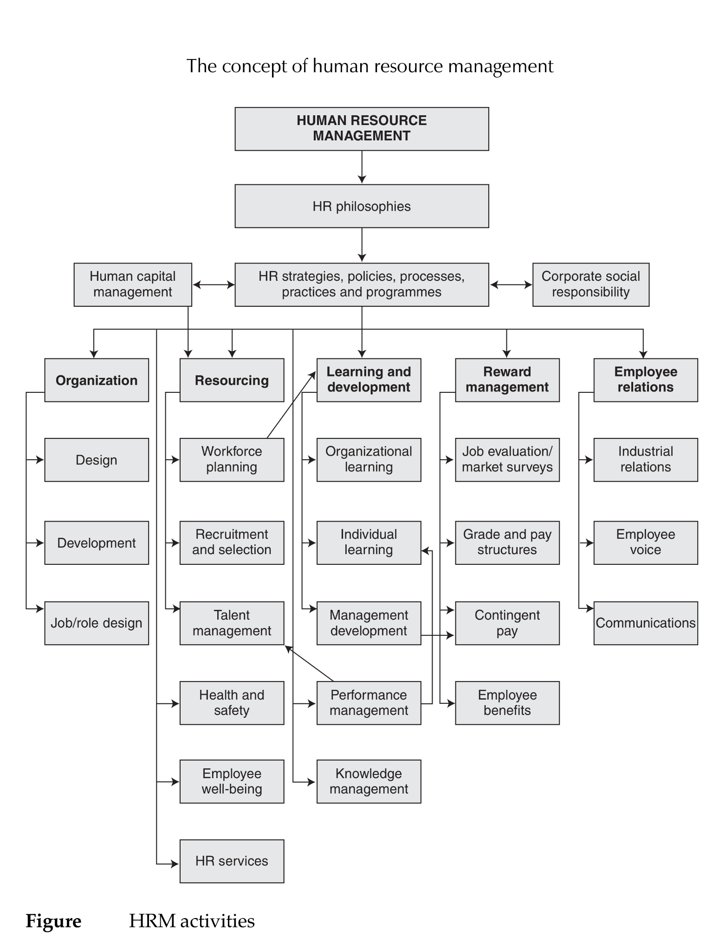

Slide 9
Thank you
For any question or query contact through
twitter: @ighaznavi

