Slide 1
Strategic Human Resource Management
Imran Ghaznavi
Twitter: @ighaznavi
Course Code: MGT557
COMSATS

Slide 2
Lecture 32

Slide 3
Lecture outline
Review
HRM
Strategy
Strategic HRM

Slide 4
Current Issues in HRM
Managing Downsizing
  The planned elimination of jobs in an organization
    Provide open and honest communication.
    Provide assistance to employees being downsized.
    Reassure and counseling to surviving employees.
Managing Work Force Diversity
  Widen the recruitment net for diversity
  Ensure selection without discrimination
  Provide orientation and training that is effective

Slide 5
Current Issues in HRM
Sexual Harassment
  An unwanted activity of a sexual nature that affects an individual’s employment.
    Unwanted sexual advances, requests for sexual favors, and other verbal or physical conduct of a sexual nature when submission or rejection of this conduct explicitly or implicitly affects an individual’s employment.
  An offensive or hostile environment
    An environment in which a person is affected by elements of a sexual nature.
Workplace Romances
  Potential liability for harassment

Slide 6
Current Issues in HRM
Work-Life Balance
  Employees have personal lives that they don’t leave behind when they come to work.
  Organizations have become more attuned to their employees by offering family-friendly benefits:
    On-site child care
    Summer day camps
    Flextime
    Job sharing
    Leave for personal matters
    Flexible job hours

Slide 7
Current Issues in HRM
Controlling HR Costs
  Employee health-care
    Encouraging healthy lifestyles
      Financial incentives
      Wellness programs
      Charging employees with poor health habits more for benefits
  Employee pension plans
    Reducing pension benefits
    No longer providing pension plans

Slide 8
The concept of strategy
Strategy was originally a military term,
  defined in the Oxford English Dictionary as:
  ‘The art of a commander-in-chief; the art of projecting and directing the larger military movements and operations of a campaign.’

Slide 9
Strategy
Commanders-in-chief and military campaigns do not exist in business, the public sector or voluntary organizations, but at least this definition conveys the messages that strategy is the ultimate responsibility of the head of the organization
Notes:
This lecture starts with definitions of strategy and goes on to describe the fundamentals of strategy in more detail. It concludes with a review of the process of strategy formulation

Slide 10
Strategy defined
Strategy has two fundamental meanings.
  First, it is forward looking.
  It is about deciding where you want to go and how you mean to get there.
  It is concerned with both ends and means.
  In this sense a strategy is a declaration of intent:
  ‘This is what we want to do and this is how we intend to do it.’
Strategies define longer-term goals, but they also cover how those goals will be attained. They guide purposeful action to deliver the required result. A good strategy is one that works

Slide 11
Strategy Defined
The second meaning of strategy is conveyed by the concept of strategic fit.
The focus is upon the organization and the world around it. To maximize competitive advantage a firm must match its capabilities and resources to the opportunities available in the external environment.

Slide 12
Strategy Defined
Strategy is the determination of the basic long-term goals and objectives of an enterprise, and the adoption of courses of action and the allocation of resources necessary for carrying out these goals.
(Chandler, 1962)
Strategy is a set of fundamental or critical choices about the ends and means of a business.
(Child, 1972)
[Strategy involves] the constant search for ways in which the firm’s unique resources can be redeployed in changing circumstances.
(Rumelt, 1984)

Slide 13
Strategy Defined
Strategy should be understood as a framework of critical ends and means.
(Boxall, 1996)
Business strategy is concerned with the match between the internal capabilities of the company and its external environment.
(Kay, 1999)

Slide 14
Strategy Defined
The emphasis (in strategy) is on focused actions that differentiate the firm from its competitors.
(Purcell, 1999)
Strategy, then, is a set of strategic choices, some of which may be formally planned. It is inevitable that much, if not most, of a firm’s strategy emerges in a stream of action over time.
(Boxall and Purcell, 2003)

Slide 15
The Concept of Strategy
It is based on a number of associated concepts:
competitive advantage, resource-based strategy, distinctive capabilities, strategic intent, strategic capability, strategic management, strategic goals and strategic plans.
Notes:
Porter emphasized the importance of differentiation, which consists of offering a product or service ‘that is perceived industry-wise as being
unique’,

Slide 16
Concept of Strategy
Competitive advantage
The concept of competitive advantage was formulated by Michael Porter (1985).
“Competitive advantage, arises out of a firm creating value for its customers. To achieve it, firms select markets in which they can excel and present a moving target to their competitors by continually improving their position.

Slide 17
Distinctive capabilities
‘The opportunity for companies to sustain competitive advantage is determined by their capabilities.’
Kay (1999)
Distinctive capabilities are those characteristics that cannot be replicated by competitors or can only be imitated with great difficulty.
Distinctive capabilities or core competences describe what the organization is specially or uniquely capable of doing

Slide 18
Strategic intent
In its simplest form, strategy could be described as an expression of the intentions of the organization
– what it means to do and how,
Wickens (1987) suggests that the business means to ‘get from here to there’.

Slide 19
Strategic intent
The strategic intent sequence has been defined by Miller and Dess (1996) as:
1. a broad vision of what the organization should be;
2. the organization’s mission;
3. specific goals, which are operationalized as:
4. strategic objectives.

Slide 20
Strategic capability
Strategic capability is a concept that refers to the ability of an organization to develop and implement strategies that will achieve sustained competitive advantage
It is therefore about the capacity to select the most appropriate vision, to define realistic intentions, to match resources to opportunities and to prepare and implement strategic plans.
Notes:
The strategic capability of an organization depends on the strategic capabilities of its managers. People who display high levels of strategic capability know where they are going and know how they are going to get there. They recognize that, although they must be successful now to succeed in the future, it is always necessary to create and sustain a sense of purpose and direction.

Slide 21
The resource-based view
The resource-based view of strategy is that the strategic capability of a firm depends on its resource capability
As Boxall (1996)belives, ‘Competitive success does not come simply from making choices in the present; it stems from building up distinctive capabilities over significant periods of time.’

Slide 22
Strategic management
‘Strategic management is the set of decisions and actions resulting in the formulation and implementation of strategies designed to achieve the objectives of an organization.’
Pearce and Robinson (1988)

Slide 23
Strategic Management
Strategic management has been described by Burns (1992) as being primarily concerned with:
  the full scope of an organization’s activities, including corporate objectives and organizational boundaries;
  matching the activities of an organization to the environment in which it operates;
  ensuring that the internal structures, practices and procedures enable the organization to achieve its objectives;

Slide 24
Strategic Management
matching the activities of an organization to its resource capability, assessing the extent to which sufficient resources can be provided to take advantage of opportunities or to avoid threats in the organization’s environment;
acquiring, divesting and reallocating resources;
translating the complex and dynamic set of external and internal variables that an organization faces into a structured set of clear future objectives that can then be implemented on a day-to-day basis.
Notes:
The focus is on identifying the organization’s mission and strategies, but attention is also given to the resource base required to make it succeed.
Managers who think strategically will have a broad and long-term view of where they are going

Slide 25
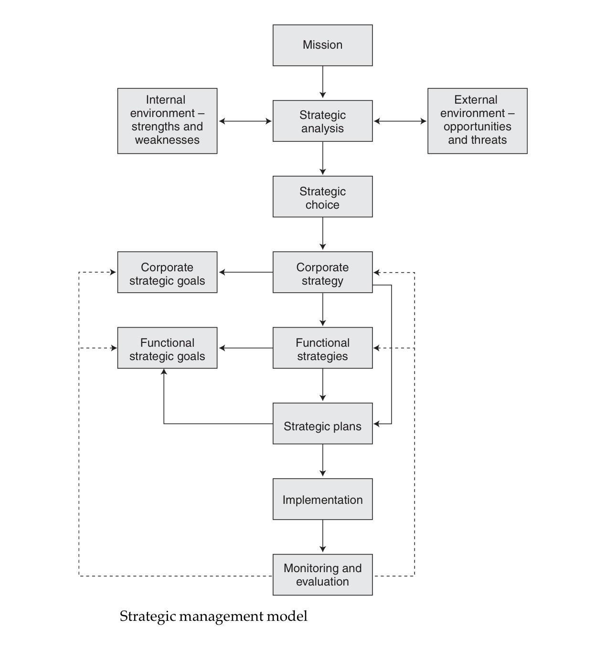
The process of strategic management

Slide 26
The process of strategic management
It involves defining the organization’s mission, analyzing the internal and external environment, exercising strategic choice (there is always choice), formulating corporate and functional strategies and goals, implementing strategies and monitoring and evaluating progress in achieving goals.

Slide 27
Strategic goals
Strategic goals define where the organization wants to be. They may be specified in terms of actions, quantified in terms of growth, or expressed in general terms as aspirations rather than specifics.

Slide 28
Strategic plans
Strategic plans are formal expressions of how an organization intends to attain its strategic goals.

Slide 29
The process of strategic management

Slide 30
The Formulation of Strategy
It is best described as a process for developing a sense of direction and ensuring strategic fit.
It has often been described as a logical, step-by-step affair, the outcome of which is a formal written statement that provides a definitive guide to the organization’s intentions.

Slide 31
Approaches to strategy formulation
Whittington (1993) has identified four approaches to the formulation of strategy:
Classical
Evolutionary
Processual
Systemic

Slide 32
Approaches to strategy formulation:
Classical
Classical – strategy formulation as a rational process of deliberate calculation. The process of strategy formulation is seen as being separate from the process of implementation

Slide 33
Approaches to strategy formulation:
Evolutionary
Evolutionary – strategy formulation as an evolutionary process that is a product of market forces in which the most efficient and productive organizations win through

Slide 34
Approaches to strategy formulation:
Processual
Processual – strategy formulation as an incremental process that evolves through discussion and disagreement. It may be impossible to specify what the strategy is until after the event.

Slide 35
Approaches to strategy formulation:
Systemic
Systemic – strategy is shaped by the social system in which it is embedded. Choices are constrained by the cultural and institutional interests of a broader society rather than the limitations of those attempting to formulate corporate strategy.

Slide 36
The classical approach to formulating strategy
Conceptually, the classical approach as described by Whittington involves the following steps (implementation and monitoring steps have been added to the Whittington model):
1. Define the mission.
2. Set objectives.
3. Conduct internal and external environmental scans to assess internal strengths and weaknesses and external opportunities and threats (a SWOT analysis).

Slide 37
The classical approach to formulating strategy
Analyze existing strategies to determine their relevance in the light of the internal and external appraisal. This may include gap analysis, which will establish the extent to which environmental factors might lead to gaps between what could be achieved if no changes were made and what needs to be achieved
Define in the light of this analysis the distinctive capabilities of the organization
Define the key strategic issues emerging from the previous analysis. These will be concerned with such matters as product-market scope, enhancing shareholder value and resource capability.

Slide 38
The classical approach to formulating strategy
Determine corporate and functional strategies for achieving goals and competitive advantage, taking into account the key strategic issues.
  These may include business strategies for growth or diversification, or broad generic strategies for innovation, quality or cost leadership; or they could take the form of specific corporate/functional strategies concerned with product-market scope, technological development or human resource development.

Slide 39
The classical approach to formulating strategy
Prepare integrated strategic plans for implementing strategies
Implement the strategies.
Monitor implementation and revise existing strategies or develop new strategies as necessary.

Slide 40
The concept of strategic human resource management

Slide 41
The concept of SHRM
‘Business objectives are accomplished when human resource practices, procedures and systems are developed and implemented based on organizational needs, that is, when a strategic perspective to human resource management is adopted.’
Baird and Meshoulam (1988)

Slide 42
SHRM Defined
Strategic HRM is an approach that defines how the organization’s goals will be achieved through people by means of HR strategies and integrated HR policies and practices.
Strategic HRM is concerned with ‘seeing the people of the organization as a strategic resource for the achievement of competitive advantage’
(Hendry and Pettigrew, 1986)

Slide 43
SHRM Defined
‘The pattern of planned human resource deployments and activities intended to enable an organization to achieve its goals’
(Wright and McMahan, 1992).
‘The central premise of strategic human resource management theory is that successful organizational performance depends on a close fit or alignment between business and human resource strategy’
(Batt, 2007).

Slide 44
Basis of SHRM
Strategic HRM is based on three propositions:
  1. The human resources or human capital of an organization play a strategic role in its success and are a major source of competitive advantage.
  2. HR strategies should be integrated with business plans (vertical integration). . The major focus of strategic HRM should be aligning HR with firm strategies.
  3. Individual HR strategies should cohere by being linked to each other to provide mutual support (horizontal integration).

Slide 45
Principles of SHRM
Strategic HRM supplies a perspective on the way in which critical issues or success factors related to people can be addressed, and strategic decisions are made that have a major and long-term impact on the behavior and success of the organization.

Slide 46
Principles of SHRM
As a means of developing integrated HR strategies, strategic HRM is facilitated to the extent to which the following seven principles set out by Ondrack and Nininger (1984) are followed:
  1. There is an overall purpose and the human resource dimensions of that purpose are evident.
  2. A process of developing strategy within the organization exists and is understood, and there is explicit consideration of human resource dimensions.
  3. Effective linkages exist on a continuing basis to ensure the integration of human resource considerations with the organizational decision-making process.

Slide 47
Principles of SHRM
  4.The office of the chief executive provides the challenge for integrating human resource considerations to meet the needs of the business.
  5. The organization of all levels establishes responsibility and accountability for human resource management.

Slide 48
Principles of SHRM
  6.Initiatives in the management of human resources are relevant to the needs of the business.
  7. It includes the responsibility to identify and interact in the social, political, technological and economic environments in which the organization is and will be doing business.

Slide 49
AIM of SHRM
The fundamental aim of strategic HRM is to generate strategic capability by ensuring that the organization has the skilled, engaged and well-motivated employees it needs to achieve sustained competitive advantage.

Slide 50
AIM of SHRM
Strategic human resource management is largely about integration and adaptation.
Its concern is to ensure that:
(1) human resources (HR) management is fully integrated with the strategy and strategic needs of the firm;
(2) HR policies cohere both across policy areas and across hierarchies; and
(3) HR practices are adjusted, accepted and used by line and employees as part of their every day work.

Slide 51
Concepts of Strategic HRM
Strategic HRM is underpinned by three concepts, namely
  resource-based view,
  strategic fit and
  strategic flexibility.

Slide 52
Concepts of Strategic HRM
The resource-based view
  To a large extent, the philosophy of strategic HRM is based on the resource based view.
  This states that it is the range of resources in an organization, including its human resources, that produces its unique character and creates competitive advantage
(Hamel and Prahalad, 1989).

Slide 53
The resource-based view
For a firm resource to have the potential for creating sustained competitive advantage it should have four attributes:
  it must be 1) valuable, 2) rare, 3) imperfectly imitable and 4) non-substitutable.
  To discover these resources and capabilities, managers must look inside their firm for valuable, rare and costly-to imitate resources, and then exploit these resources through their organization.

Slide 54
The resource-based view
Resource-based strategic HRM can produce what Boxall and Purcell (2003) refer to as human resource advantage.
The aim is to develop strategic capability.

Slide 55
The resource-based view
The strategic fit between resources and opportunities, obtaining added value from the effective deployment of resources, and developing people who can think and plan strategically in the sense that they understand the key strategic issues and ensure that what they do support the achievement of the business’s strategic goals.

Slide 56
Concepts of Strategic HRM
Strategic fit
  As explained by Wright and McMahan (1992) strategic fit refers to the two dimensions that distinguish strategic HRM:
  ‘First, vertically, it entails the linking of human resource management practices with the strategic management processes of the organization.
  Second, horizontally, it emphasizes the coordination or congruence among the various human resource management practices.’

Slide 57
Concepts of Strategic HRM
Strategic flexibility
Strategic flexibility is defined as the ability of the firm to respond and adapt to changes in its competitive environment.

Slide 58
Strategic flexibility
Environmental differences will affect a flexibility strategy.
Wright and Snell (1998) indicated that ,
  In a stable, predictable environment the strategy could be to develop people with a narrow range of skills (or not to develop multi-skilled people) and to elicit a narrow range of behavior (eg tight job descriptions).
  In a dynamic, unpredictable environment, however, organizations might develop organic HR systems that produce a human capital pool with people possessing a wide range of skills who can engage in a wide variety of behaviors.
The need is to achieve resource flexibility by developing a variety of ‘behavioral scripts’ and encourage employees to apply them in different situations.

Slide 59
Perspectives on SHRM
Taking into account the concepts of the resource-based view and strategic fit, Delery and Doty (1996) identified three HRM perspectives:
The universalistic perspective
The contingency perspective
The configurational perspective

Slide 60
Perspectives on SHRM
The universalistic perspective – some HR practices are better than others and all organizations should adopt these best practices. There is a universal relationship between individual ‘best’ practices and firm performance.

Slide 61
Perspectives on SHRM
The contingency perspective – in order to be effective, an organization’s HR policies must be consistent with other aspects of the organization. The primary contingency factor is the organization’s strategy. This can be described as ‘vertical fit’.

Slide 62
Perspectives on SHRM
The configurational perspective – this is a holistic approach that emphasizes the importance of the pattern of HR practices and is concerned with how this pattern of independent variables is related to the dependent variable of organizational performance

Slide 63
Best Practice Approach
A number of lists of ‘best practices’ have been produced, the best known of which was produced by Pfeffer (1994), namely
  1. employment security;
  2. selective hiring;
  3. self-managed teams;
  4. high compensation contingent on performance;
  5. training to provide a skilled and motivated workforce;
  6. reduction of status differentials;
  7. sharing information.

Slide 64
Best Practice Approach
List drawn up by Guest (1999):
1. selection and the careful use of selection tests to identify those with potential to make a contribution;
2. training, and in particular a recognition that training is an ongoing activity;
3. job design to ensure flexibility, commitment and motivation, including steps to ensure that employees have the responsibility and autonomy fully to use their knowledge and skills;
4. communication to ensure that a two-way process keeps everyone fully informed;
5. employee share ownership programms to increase employees’ awareness of the implications of their actions on the financial performance of the firm.

Slide 65
The Best-Fit Approach
The best-fit approach emphasizes that HR strategies should be contingent on the context, circumstances of the organization and its type.
‘Best fit’ can be perceived in terms of vertical integration or alignment between the organization’s business and HR strategies.
There is a choice of models, namely life cycle, competitive strategy, and strategic configuration.
Notes:
Dependent

Slide 66
The Best-Fit Approach
The life cycle model
  The life cycle model is based on the theory that the development of a firm takes place in four stages: start-up, growth, maturity and decline. This is in line with product life cycle theory.

Slide 67
Best fit approach : Life cycle model
Human resource management’s effectiveness depends on its fit with the organization’s stage of development.
As the organization grows and develops, human resource management programs, practices and procedures must change to meet its needs.
Consistent with growth and development models it can be suggested that human resource management develops through a series of stages as the organization becomes more complex.
Baird and Meshoulam (1988)

Slide 68
Best fit :Competitive strategies
Three strategies aimed at achieving competitive advantage have been identified by Porter (1985):
  1. innovation – being the unique producer;
  2. quality – delivering high-quality goods and services to customers;
  3. cost leadership – the planned result of policies aimed at ‘managing away’ expense.
‘Effectiveness can be increased by systematically melding human resource practices with the selected competitive strategy’.
Schuler and Jackson (1987)
They described the HR characteristics of firms pursuing one or other of the three strategies (Table ).

Slide 69
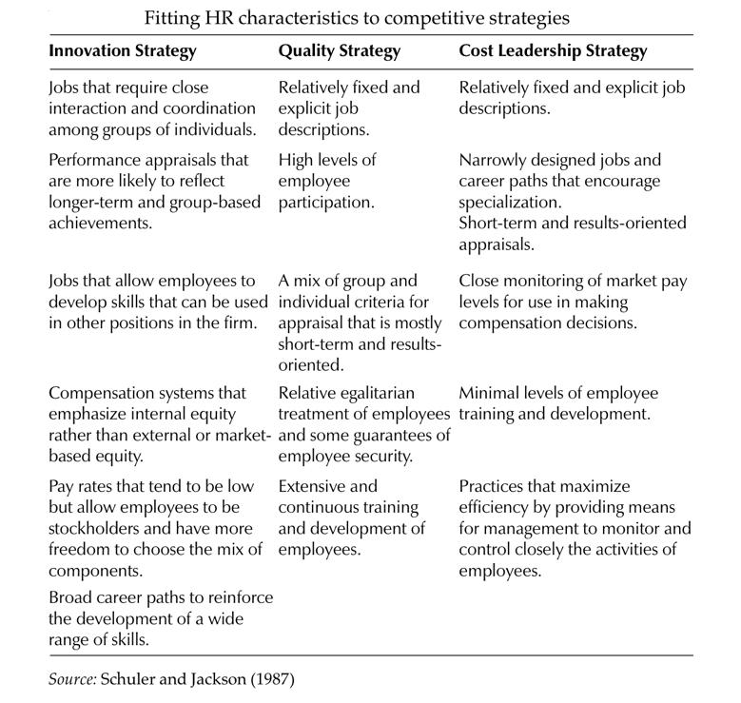

Slide 70
Strategic Configuration
Another approach to best fit is the proposition that organizations will be more effective if they adopt a policy of strategic configuration by matching their strategy to one of the ideal types defined by theories such as those produced by Mintzberg (1979) and Miles and Snow (1978).

Slide 71
Strategic configuration
Mintzberg (1979) classified them into five ideal types: simple structure, machine bureaucracy, professional bureaucracy, divisionalized form and adhocracy.
Miles and Snow (1978) identified four types of organizations, classifying the first three types as ‘ideal’ organizations:

Slide 72
Strategic Configuration
1. Prospectors, which operate in an environment characterized by rapid and unpredictable changes. They react to this environment by focusing on the development of new products, markets and technologies.
  Prospectors have low levels of formalization and specialization and high levels of decentralization. They have relatively few hierarchical levels

Slide 73
Strategic Configuration
2. Defenders, which operate in a more stable and predictable environment than prospectors and engage in more long-term planning.
  They have more mechanistic or bureaucratic structures than prospectors and obtain coordination through formalization, centralization, specialization and vertical differentiation

Slide 74
Strategic Configuration
3. Analyzers, which are a combination of the prospector and defender types. They operate in stable environments like defenders and also in markets where new products are constantly required like prospectors.
They are usually not the initiators of change like prospectors but they follow the changes more rapidly than defenders.
Analyzers seek effectiveness through both efficiency and new products or markets.
They may also exhibit higher levels of interdependence than either prospectors or defenders.

Slide 75
Strategic Configuration
4. Reactors, which are unstable organizations existing in what they believe to be an unpredictable environment. They lack consistent, well-articulated strategies and do not undertake long-range planning.

Slide 76
Strategic Configuration
Delery and Doty (1996) suggest that organizations should align their HR systems with the strategy linked to their configuration and identified two systems :
market-type system where hiring is mainly from outside the organization, little use is made of internal career ladders, there is no formal training, performance appraisal is results-orientated, there is not much security, and jobs are not clearly defined.
internal system where hiring is mainly from within the organization, extensive use is made of career ladders, a lot of formal training is provided, performance is appraised by behavior orientated measures, there is considerable security, and jobs are tightly defined

Slide 77
Strategic Configuration
The prospector strategy requires a market system, while the internal system is appropriate for the defender strategy
The best-fit model seems to be more realistic than the best-practice model
Notes:
As Dyer and Holder (1988) point out, ‘The inescapable conclusion is that what is best depends.’ It can therefore be claimed that best fit is more important than best practice.

Slide 78
Bundling
‘A strategy’s success turns on combining “vertical” or external fit and “horizontal” or internal fit.’
  Richardson and Thompson (1999) conclude that a firm with bundles of associated HR practices should have a higher level of performance, providing it also achieves high levels of fit with its competitive strategy
‘Bundling’ is the development and implementation of several HR practices together so that they are interrelated and therefore complement and reinforce each other.

Slide 79
The practice of strategic HRM

Slide 80
HR strategies
As we have discussed that strategic HRM is a mindset, which leads to strategic actions and reactions, in the form of either overall or specific HR strategies or strategic behavior on the part of HR professionals

Slide 81
HR Strategies
Lets focuses on HR strategies under the following headings:
  What are HR strategies?
  What is the purpose of HR strategies?
  What are the main types of overall HR strategies?
  What are the main areas in which specific HR strategies are developed?
  What are the criteria for an effective HR strategy?
  How should HR strategies be developed?
  How should HR strategies be implemented?

Slide 82
WHAT ARE HR STRATEGIES?
HR strategies set out what the organization intends to do about its human resource management policies and practices and how they should be integrated with the business strategy and each other.
They are described by Dyer and Reeves (1995) as ‘internally consistent bundles of human resource practices’, and
In the words of Peter Boxall (1996) they provide ‘a framework of critical ends and means’

Slide 83
WHAT ARE HR STRATEGIES?
As we know all organizations are different, all HR strategies are different.
There is no such thing as a standard strategy, and research into HR strategy conducted by Armstrong and Long (1994) and Armstrong and Baron (2002) revealed many variations.
Some strategies are simply very general declarations of intent. Others go into much more detail.
But two basic types of HR strategies can be identified. These are: 1) overall strategies such as high performance working; and
2) specific strategies relating to the different aspects of human resource management such as learning and development and reward.

Slide 84
WHAT IS THE PURPOSE OF HR STRATEGIES?
The purpose of HR strategies is to articulate what an organization intends to do about its human resource management policies and practices now and in the longer term,
Bearing in mind the saying of Fombrun et al (1984) that business and managers should perform well in the present to succeed in the future.

Slide 85
WHAT IS THE PURPOSE OF HR STRATEGIES?
HR strategies may set out intentions and provide a sense of purpose and direction, but they are not just long-term plans.
As Lynda Gratton (2000) commented, ‘There is no great strategy, only great execution.’

Slide 86
OVERALL HR STRATEGIES
Overall strategies describe the general intentions of the organization about how people should be managed and developed and what steps should be taken to ensure that the organization can attract and retain the people it needs and ensure so far as possible that employees are committed, motivated and engaged.
There are four categories of overall strategy

Slide 87
OVERALL HR STRATEGIES
1. An emergent, evolutionary and possibly unarticulated understanding of the required approach to human resource management. This will be influenced by the business strategy as it develops, the position of the organization in its life cycle, and the organizational configuration (prospector, defender or analyser). It will also be affected by the views, experience and management style of the chief executive, senior managers and the head of HR, whose influence will depend on position and credibility.

Slide 88
OVERALL HR STRATEGIES
2. Broad-brush statements of aims and purpose that set the scene for more specific strategies. They will be concerned with overall organizational effectiveness – achieving human resource advantage by employing ‘better people in organizations with better process’ and generally creating ‘a great place to work’.
3. Specific and articulated plans to create ‘bundles’ of HR practices and develop a coherent HR system.

Slide 89
OVERALL HR STRATEGIES
4. The conscious introduction of overall approaches to human resource management such as high-performance management, high-involvement management and high-commitment management

Slide 90
High-performance management
High-performance management aims to make an impact on the performance of the organization through its people in such areas as productivity, quality, levels of customer service, growth, profits and, ultimately, the delivery of increased shareholder value.
As a bundle, these practices are often called high-performance work systems (HPWS)
Notes:
High-performance management practices include rigorous recruitment and selection procedures, extensive and relevant training and management development activities, incentive pay systems and performance management processes

Slide 91
High-involvement management
The term ‘high involvement’ was used by Lawler (1986) to describe management systems based on commitment and involvement, as opposed to the old bureaucratic model based on control.
Employees will increase their involvement with the company if they are given the opportunity to control and understand their work
This approach involves treating employees as partners in the enterprise whose interests are respected and who have a voice on matters that concern them.

Slide 92
High-commitment management
One of the defining characteristics of HRM is its emphasis on the importance of enhancing mutual commitment.
‘A form of management which is aimed at eliciting a commitment so that behaviour is primarily self regulated rather than controlled by sanctions and pressures external to the individual, and relations within the organization are based on high levels of trust.’
High-commitment management has been described by Wood (1996)

Slide 93
High-commitment management
The approaches to achieving high commitment as described by Beer et al (1984) and Walton (1985) are:
the development of career ladders and emphasis on trainability and commitment as highly valued characteristics of employees at all levels in the organization;
a high level of functional flexibility, with the abandonment of potentially rigid job descriptions;
the reduction of hierarchies and the ending of status differentials;
a heavy reliance on team structure for disseminating information (team briefing), structuring work (team working) and problem solving (quality circles).

Slide 94
SPECIFIC HR STRATEGIES

Slide 95
SPECIFIC HR STRATEGIES
Specific HR strategies set out what the organization intends to do in areas such as:
human capital management – obtaining, analyzing and reporting on data, which inform the direction of value-adding people management, strategic, investment and operational decisions;
high-performance management – developing and implementing high-performance work systems;
corporate social responsibility – a commitment to managing the business ethically in order to make a positive impact on society and the environment;

Slide 96
SPECIFIC HR STRATEGIES
organization development – the planning and implementation of programs designed to enhance the effectiveness with which an organization functions and responds to change;
engagement – the development and implementation of policies designed to increase the level of employees’ engagement with their work and the organization;
knowledge management – creating, acquiring, capturing, sharing and using knowledge to enhance learning and performance;

Slide 97
SPECIFIC HR STRATEGIES
resourcing – attracting and retaining high-quality people;
talent management – how the organization ensures that it has the talented people it needs to achieve success;
learning and development – providing an environment in which employees are encouraged to learn and develop;
reward – defining what the organization wants to do in the longer term to develop and implement reward policies, practices and processes that will further the achievement of its business goals and meet the needs of its stakeholders;

Slide 98
SPECIFIC HR STRATEGIES
employee relations – defining the intentions of the organization about what needs to be done and what needs to be changed in the ways in which the organization manages its relationships with employees and their trade unions.

Slide 99
SPECIFIC HR STRATEGIES
Some examples of specific HR strategies:
The Children’s Society:
  Implement the rewards strategy of the Society to support the corporate plan and secure the recruitment, retention and motivation of staff to deliver its business objectives.
  Manage the development of the human resources information system to secure productivity improvements in administrative processes.
  Introduce improved performance management processes for managers and staff of the Society.
  Implement training and development which supports the business objectives of the Society and improves the quality of work with children and young people.

Slide 100
SPECIFIC HR STRATEGIES
A government agency:
The key components of the HR strategy are:
  Investing in people – improving the level of intellectual capital.
  Performance management – integrating the values contained in the HR strategy into performance management processes and ensuring that reviews concentrate on how well people are performing those values.
  Job design – a key component concerned with how jobs are designed and how they relate to the whole business.
  The reward system – in developing rewards strategies, taking into account that this is a very hard-driven business.

Slide 101
CRITERIA FOR AN EFFECTIVE HR STRATEGY
An effective HR strategy is one that works in the sense that it achieves what it sets out to achieve. In particular, it:
  will satisfy business needs;
  will be founded on detailed analysis and study, not just wishful thinking;
  can be turned into actionable programmes that anticipate implementation requirements and problems;

Slide 102
CRITERIA FOR AN EFFECTIVE HR STRATEGY
  is coherent and integrated, being composed of components that fit with and support each other;
  takes account of the needs of line managers and employees generally as well as those of the organization and its other stakeholders.
  As Boxall and Purcell (2003) emphasize, ‘HR planning should aim to meet the needs of the key stakeholder groups involved in people management in the firm.’

Slide 103
DEVELOPING HR STRATEGIES
Five fundamental questions that need to be asked in formulating HR strategies have been posed by Becker and Huselid (1998):
  1. What are the firm’s strategic objectives?
  2. How are these translated into unit objectives?
  3. What do unit managers consider are the ‘performance drivers’ of those objectives?
  4. How do the skills, motivation and structure of the firm’s workforce influence these performance drivers?
  5. How does the HR system influence the skills, motivation and structure of the workforce?

Slide 104
DEVELOPING HR STRATEGIES
The following six-step approach is proposed by Gratton (2000):
  1. Build the guiding coalition – involve people from all parts of the business.
  2. Image the future – create a shared vision of areas of strategic importance.
  3. Understand current capabilities and identify the gap – establish ‘where the organization is now and the gap between aspirations for the future and the reality of the present’.
  4. Create a map of the system – ‘ensure that the parts can be built into a meaningful whole’.
  5. Model the dynamics of the system – ensure that the dynamic nature of the future is taken into account.
  6. Bridge into action – agree the broad themes for action and the specific issues related to those themes, develop guiding principles, involve line managers and create cross-functional teams to identify goals and performance indicators.

Slide 105
A methodology for formulating HR strategies
A methodology for formulating HR strategies was developed by Dyer and Holder (1988) as follows:
1. Assess feasibility. From an HR point of view, feasibility depends on whether the numbers and types of key people required to make the proposal succeed can be obtained on a timely basis and at a reasonable cost, and whether the behavioural expectations assumed by the strategy are realistic (eg retention rates and productivity levels).
2. Determine desirability. Examine the implications of strategy in terms of sacrosanct HR policies (eg a strategy of rapid retrenchment would have to be called into question by a company with a full employment policy).

Slide 106
A methodology for formulating HR strategies
3. Determine goals. These indicate the main issues to be worked on and they derive primarily from the content of the business strategy. For example, a strategy to become a lower-cost producer would require the reduction of labour costs. This in turn translates into two types of HR goals: higher performance standards (contribution) and reduced headcounts (composition).
4. Decide means of achieving goals. The general rule is that the closer the external and internal fit, the better the strategy, consistent with the need to adapt flexibly to change. External fit refers to the degree of consistency between HR goals on the one hand and the exigencies of the underlying business strategy and relevant environmental conditions on the other. Internal fit measures the extent to which HR means follow from the HR goals and other relevant environmental conditions, as well as the degree of coherency or synergy among the various HR means.

Slide 107
Setting out the strategy
There is no standard model of how an HR strategy should be set out. It all depends on the circumstances of the organization. But the following are the typical areas that may be covered in a written strategy:
1. Basis:
  business needs in terms of the key elements of the business strategy;
  environmental factors and analysis (SWOT/PESTLE);
  –cultural factors: possible helps or hindrances to implementation.
2. Content: details of the proposed HR strategy.
3. Rationale: the business case for the strategy against the background of business needs and environmental/cultural factors.

Slide 108
Setting out the strategy
4. Implementation plan:
  action programme;
  responsibility for each stage;
  resources required;
  proposed arrangements for communication, consultation, involvement and training;
  project management arrangements.

Slide 109
Setting out the strategy
5. Costs and benefits analysis: an assessment of the resource implications of the plan (costs, people and facilities) and the benefits that will accrue, for the organization as a whole, for line managers and for individual employees (so far as possible these benefits should be quantified in terms of return on investment or value added).

Slide 110
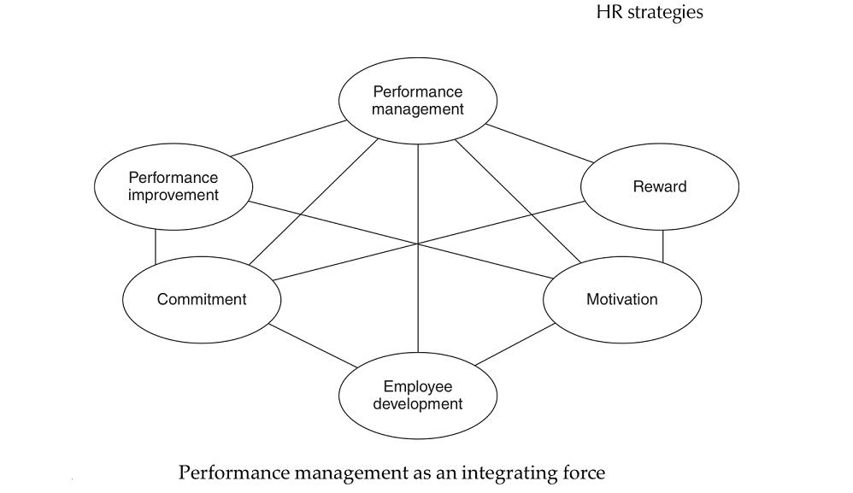

Slide 111
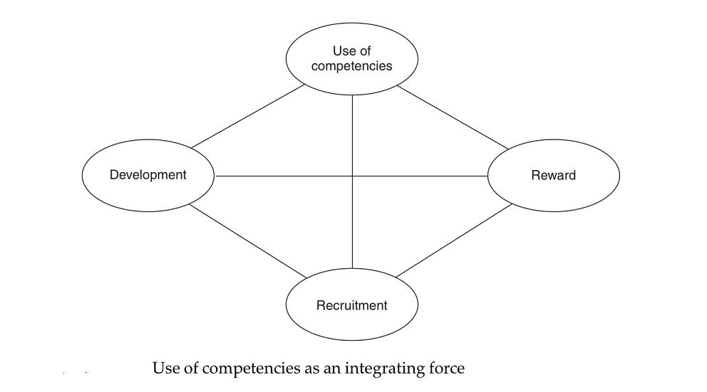

Slide 112
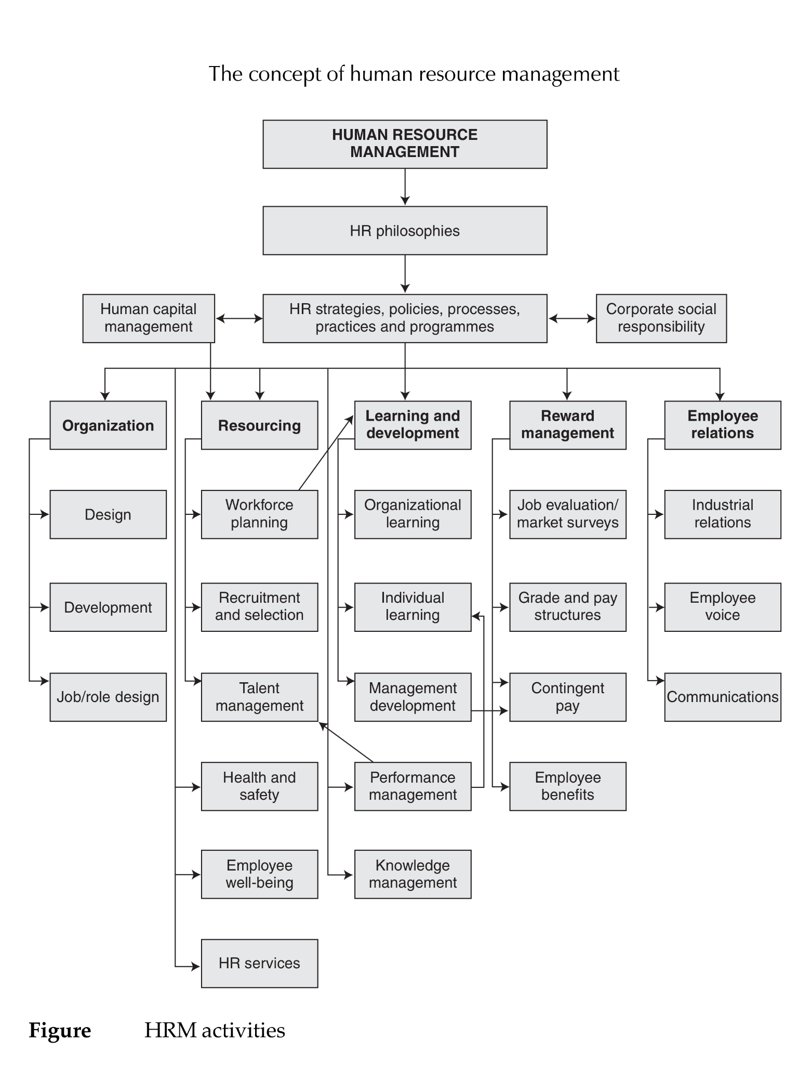

Slide 113
Thank you
For any question or query contact through
twitter: @ighaznavi

