Slide 1
Strategic Human Resource Management
Imran Ghaznavi
Twitter: @ighaznavi
Course Code: MGT557
COMSATS

Slide 2
Lecture 31

Slide 3
Lecture outline
Review
HRM
Strategy
Strategic HRM

Slide 4
HR Strategies

Slide 5
HR Strategies
Human capital management strategy
High-performance strategy
Corporate social responsibility strategy
Organization development strategy
Employee engagement strategy
Knowledge management strategy
Employee resourcing strategy

Slide 6
HR Strategies
Talent management strategy
Learning and development strategy
Reward strategy
Employee relations strategy

Slide 7
Employee relations strategy

Slide 8
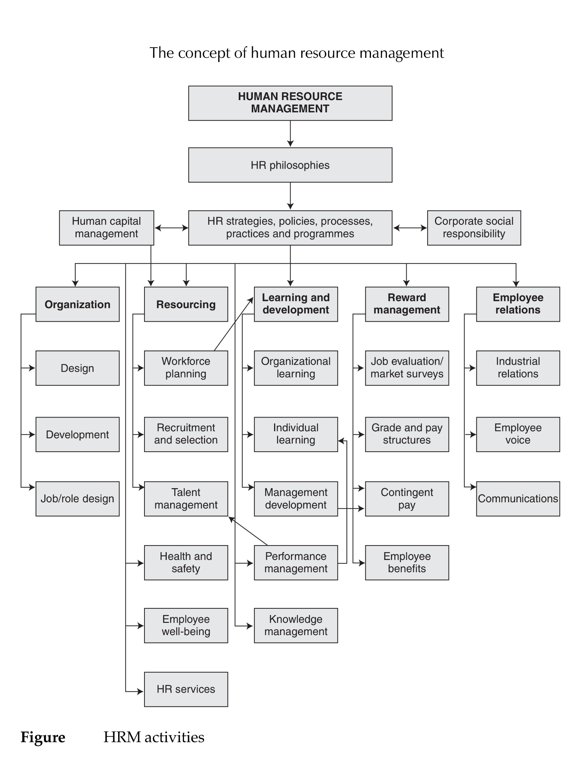

Slide 9
Employee relations strategy
Employee relations strategies define the intentions of the organization about what needs to be done and what needs to be changed in the ways in which the organization manages its relationships with employees and their trade unions.
Like all other aspects of HR strategy, employee relations strategies will flow from the business strategy but will also aim to support it.

Slide 10
CONCERNS OF EMPLOYEE RELATIONS STRATEGY
Employee relations strategy will be concerned with how to:
build stable and cooperative relationships with employees that minimize conflict;
achieve commitment through employee involvement and communications processes;
develop mutuality – a common interest in achieving the organization’s goals through the development of organizational cultures based on shared values between management and employees.

Slide 11
THE BACKGROUND TO EMPLOYEE RELATIONS STRATEGIES
Four approaches to employee relations have been identified by Industrial Relations Services (1993):
  1. Adversarial – the organization decides what it wants to do, and employees are expected to fit in. Employees only exercise power by refusing to cooperate.
  2. Traditional – a good day-to-day working relationship but management proposes and the workforce reacts through its elected representatives.
  3. Partnership – the organization involves employees in the drawing up and execution of organization policies, but retains the right to manage.
  4. Power sharing – employees are involved in both day-to-day and strategic decision making.

Slide 12
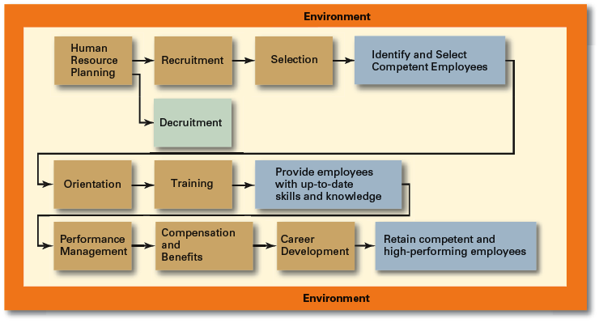
Human Resource Management Process

Slide 13
Environmental Factors Affecting HRM
Employee Labor Unions
  Organizations that represent workers and seek to protect their interests through collective bargaining.
    Collective bargaining agreement
      A contractual agreement between a firm and a union elected to represent a bargaining unit of employees of the firm in bargaining for wage, hours, and working conditions.
Governmental Laws and Regulations
  Limit managerial discretion in hiring, promoting, and discharging employees.
    Affirmative Action: the requirement that organizations take proactive steps to ensure the full participation of protected groups in its workforce.

Slide 14
Managing Human Resources
Human Resource (HR) Planning
  The process by which managers ensure that they have the right number and kinds of people in the right places, and at the right times, who are capable of effectively and efficiently performing their tasks.
  Helps avoid sudden talent shortages and surpluses.
  Steps in HR planning:
    Assessing current human resources
    Assessing future needs for human resources
    Developing a program to meet those future needs

Slide 15
Current Assessment
Human Resource Inventory
  A review of the current make-up of the organization’s current resource status
  Job Analysis
    An assessment that defines a job and the behaviors necessary to perform the job
      Knowledge, skills, and abilities (KSAs)
    Requires conducting interviews, engaging in direct observation, and collecting the self-reports of employees and their managers.

Slide 16
Current Assessment (cont’d)
Job Description
  A written statement of what the job holder does, how it is done, and why it is done.
Job Specification
  A written statement of the minimum qualifications that a person must possess to perform a given job successfully.

Slide 17
Meeting Future Human Resource Needs
Supply of Employees
Demand for Employees
Factors Affecting Staffing
Strategic Goals
Forecast demand for products and services
Availability of knowledge, skills, and abilities

Slide 18
Recruitment and Decruitment
Recruitment
  The process of locating, identifying, and attracting capable applicants to an organization
Decruitment
  The process of reducing a surplus of employees in the workforce of an organization
E-recruiting
  Recruitment of employees through the Internet
    Organizational web sites
    Online recruiters

Slide 19
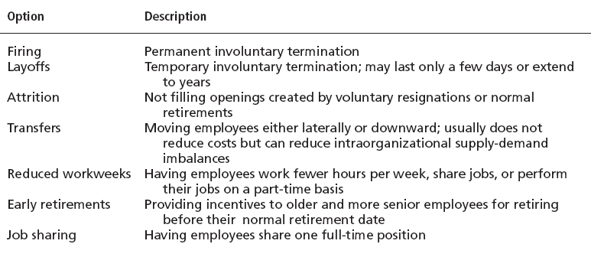
Decruitment Options

Slide 20
Selection
Selection Process
  The process of screening job applicants to ensure that the most appropriate candidates are hired
What is Selection?
  An exercise in predicting which applicants, if hired, will be (or will not be) successful in performing well on the criteria the organization uses to evaluate performance.
  Selection errors:
    Reject errors for potentially successful applicants
    Accept errors for ultimately poor performers

Slide 21
Selection Tools
Application Forms
Written Tests
Performance Simulations
Interviews
Background Investigations
Physical examinations

Slide 22
Written Tests
Types of Tests
  Intelligence: how smart are you?
  Aptitude: can you learn to do it?
  Attitude: how do you feel about it?
  Ability: can you do it now?
  Interest: do you want to do it?
Legal Challenges to Tests
  Lack of job-relatedness of test items or interview questions to job requirements
  Discrimination in equal employment opportunity against members of protected classes

Slide 23
Performance Simulation Tests
Testing an applicant’s ability to perform actual job behaviors, use required skills, and demonstrate specific knowledge of the job.
  Work sampling
    Requiring applicants to actually perform a task or set of tasks that are central to successful job performance.
  Assessment centers
    Dedicated facilities in which job candidates undergo a series of performance simulation tests to evaluate their managerial potential.

Slide 24
Other Selection Approaches
Interviews
  Although used almost universally, managers need to approach interviews carefully.
Background Investigations
  Verification of application data
  Reference checks:
    Lack validity because self-selection of references ensures only positive outcomes.
Physical Examinations
  Useful for physical requirements and for insurance purposes related to pre-existing conditions.

Slide 25
Other Selection Approaches (cont’d)
Realistic Job Preview (RJP)
  The process of relating to an applicant both the positive and the negative aspects of the job.
    Encourages mismatched applicants to withdraw.
    Aligns successful applicants’ expectations with actual job conditions; reducing turnover.

Slide 26
Orientation
Transitioning a new employee into the organization.
  Work-unit orientation
    Familiarizes new employee with work-unit goals
    Clarifies how his or her job contributes to unit goals
    Introduces he or she to his or her coworkers
  Organization orientation
    Informs new employee about the organization’s objectives, history, philosophy, procedures, and rules.
    Includes a tour of the entire facility

Slide 27
Types of Training
General
  Communication skills, computer systems application and programming, customer service, executive development, management skills and development, personal growth, sales, supervisory skills, and technological skills and knowledge
Specific
  Basic life/work skills, creativity, customer education, diversity/cultural awareness, remedial writing, managing change, leadership, product knowledge, public speaking/presentation skills, safety, ethics, sexual harassment, team building, wellness, and others

Slide 28
Employee Training Methods
Traditional
Training Methods
Technology-Based Training Methods
  On-the-job
  Job rotation
  Mentoring and coaching
  Experiential exercises
  Workbooks/manuals
  Classroom lectures
  CD-ROM/DVD/videotapes/ audiotapes
  Videoconferencing/ teleconferencing/
  satellite TV
  E-learning

Slide 29
Employee Performance Management
Performance Management System
  A process of establishing performance standards and appraising employee performance in order to arrive at objective HR decisions and to provide documentation in support of those decisions

Slide 30
Compensation and Benefits
Benefits of a Fair, Effective, and Appropriate Compensation System
  Helps attract and retain high-performance employees
  Impacts on the strategic performance of the firm
Types of Compensation
  Base wage or salary
  Wage and salary add-ons
  Incentive payments
  Skill-based pay
  Variable pay

Slide 31
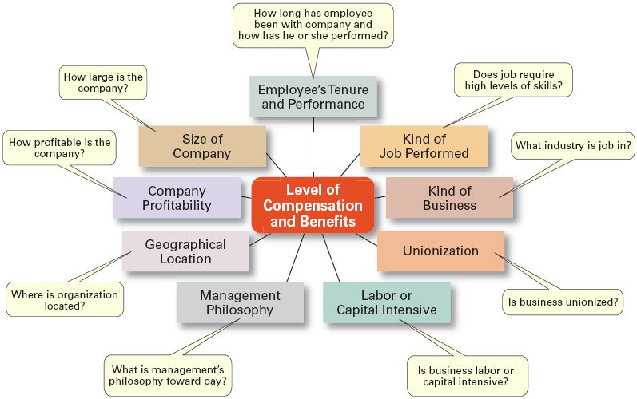
Factors That Influence Compensation and Benefits
Sources: Based on R.I. Henderson, Compensation Management, 6th ed. (Upper Saddle River, NJ: Prentice Hall, 1994), pp. 3–24; and A. Murray, “Mom, Apple Pie, and Small Business,” Wall Street Journal, August 15, 1994, p. A1

Slide 32
Career Development
Career Defined
  The sequence of positions held by a person during his or her lifetime.
  The Way It Was
    Career Development
      Provided for information, assessment, and training
      Helped attract and retain highly talented people
    Now
      Individuals—not the organization—are responsible for designing, guiding, and developing their own careers.
  Boundary less Career
    A career in which individuals, not organizations, define career progression and organizational loyalty

Slide 33
Current Issues in HRM
Managing Downsizing
  The planned elimination of jobs in an organization
    Provide open and honest communication.
    Provide assistance to employees being downsized.
    Reassure and counseling to surviving employees.
Managing Work Force Diversity
  Widen the recruitment net for diversity
  Ensure selection without discrimination
  Provide orientation and training that is effective

Slide 34
Current Issues in HRM
Sexual Harassment
  An unwanted activity of a sexual nature that affects an individual’s employment.
    Unwanted sexual advances, requests for sexual favors, and other verbal or physical conduct of a sexual nature when submission or rejection of this conduct explicitly or implicitly affects an individual’s employment.
  An offensive or hostile environment
    An environment in which a person is affected by elements of a sexual nature.
Workplace Romances
  Potential liability for harassment

Slide 35
Current Issues in HRM
Work-Life Balance
  Employees have personal lives that they don’t leave behind when they come to work.
  Organizations have become more attuned to their employees by offering family-friendly benefits:
    On-site child care
    Summer day camps
    Flextime
    Job sharing
    Leave for personal matters
    Flexible job hours

Slide 36
Current Issues in HRM
Controlling HR Costs
  Employee health-care
    Encouraging healthy lifestyles
      Financial incentives
      Wellness programs
      Charging employees with poor health habits more for benefits
  Employee pension plans
    Reducing pension benefits
    No longer providing pension plans

Slide 37
HUMAN RESOURCE SYSTEMS
Human resource management operates through human resource systems as illustrated in Figure 1.3. These bring together in a coherent way:
HR philosophies, describing the overarching values and guiding principles adopted in managing people;
HR strategies, defining the direction in which HRM intends to go;
HR policies, which are the guidelines defining how these values, principles and strategies should be applied and implemented in specific areas of HRM;

Slide 38
HUMAN RESOURCE SYSTEMS
HR processes, consisting of the formal procedures and methods used to put HR strategic plans and policies into effect;
HR practices, consisting of the informal approaches used in managing people;
HR programs, which enable HR strategies, policies and practices to be implemented according to plan.

Slide 40
AIMS OF HRM
Twelve policy goals for HRM have been identified by Caldwell (2004):
  1. managing people as assets that are fundamental to the competitive advantage of the organization;
  2. aligning HRM policies with business policies and corporate strategy;
  3. developing a close fit of HR policies, procedures and systems with one another;
  4. creating a flatter and more flexible organization capable of responding more quickly to change;

Slide 41
Policy goals for HRM
  5. encouraging team working and cooperation across internal organizational boundaries;
  6. creating a strong customer-first philosophy throughout the organization;
  7. empowering employees to manage their own self development and learning;
  8. developing reward strategies designed to support a performance-driven culture;

Slide 42
Policy goals for HRM
  9. improving employee involvement through better internal communication;
  10. building greater employee commitment to the organization;
  11. increasing line management responsibility for HR policies;
  12. developing the facilitating role of managers as enablers.

Slide 43
AIM of HRM
Dyer and Holder (1988) emphasize:
  ‘HRM goals vary according to competitive choices, technologies or service tangibles, characteristics of their employees (e.g could be different for managers), the state of the labour market and the societal regulations and national culture.
Boxall, Purcell and Wright (2007) note that
  ‘The general motives of HRM are multiple.’

Slide 44
Aim of HRM
HRM is concerned with achieving objectives in the areas;
  Organizational effectiveness
  Human capital management
  Knowledge management
  Reward management
  Employee relations
  Meeting diverse needs
  Bridging the gap between rhetoric and reality

Slide 45
Organizational effectiveness
Distinctive human resource practices shape the core competencies that determine how firms compete’
    (Cappelli and Crocker-Hefter, 1996).
Extensive research has shown that such practices can make a significant impact on firm performance.
Notes:
HRM strategies aim to support programmes for improving organizational effectiveness by developing policies in such areas as knowledge management, talent management and generally creating ‘a great place to work’.

Slide 46
Human capital management
Human capital represents the human factor in the organization; the combined intelligence, skills and expertise that gives the organization its distinctive character.
The human elements of the organization are those that are capable of learning, changing, innovating and providing the creative thrust which if properly motivated can ensure the long-term survival of the organization.
Bontis et al (1999)
Notes:
The human capital of an organization consists of the people who work there and on whom the success of the business depends.
2. Human capital can be regarded as the prime asset of an organization, and businesses need to invest in that asset to ensure their survival and growth.

Slide 47
Knowledge management
‘Any process or practice of creating, acquiring, capturing, sharing and using knowledge, wherever it resides, to enhance learning and performance in organizations’
(Scarborough et al, 1999).
Notes:
HRM aims to support the development of firm-specific knowledge and skills that are the result of organizational learning processes.

Slide 48
Reward management
HRM aims to enhance motivation, job engagement and commitment by introducing policies and processes that ensure that people are valued and rewarded for what they do and achieve and for the levels of skill and competence they reach.

Slide 49
Employee relations
The aim is to create a climate in which productive and harmonious relationships can be maintained through partnerships between management and employees and their trade unions.

Slide 50
Meeting diverse needs
HRM aims to develop and implement policies that balance and adapt to the needs of its stakeholders and provide for the management of a diverse workforce, taking into account individual and group differences in employment, personal needs, work style and aspirations and the provision of equal opportunities for all.

Slide 51
Bridging the gap between rhetoric and reality
The research conducted by Gratton et al (1999) found that there was generally a wide gap between the sort of rhetoric expressed earlier and reality.
Management with all of its good intentions may implement all or some of the areas discussed here but the realization of them is often very difficult.
This arises because of contextual and process problems:
  Other business priorities, short-termism, limited support from line managers, an inadequate infrastructure of supporting processes, lack of resources, resistance to change and lack of trust.
Notes:
An overarching aim of HRM is to bridge this gap by making every attempt to ensure that aspirations are translated into sustained and effective action

Slide 52
CHARACTERISTICS OF HRM
The characteristics of the HRM concept are that :
  diverse;
  strategic, with an emphasis on integration;
  commitment-orientated;
  based on the belief that people should be treated as assets (human capital);
  unitarist rather than pluralist, individualistic rather than collective, in its approach to employee relations;

Slide 53
CHARACTERISTICS OF HRM
a management-driven activity – the delivery of HRM is a line management responsibility;
focused on business values, although this emphasis is being modified in some quarters and more recognition is being given to the importance of moral and social values.

Slide 54
The strategic nature of HRM
The most significant feature of HRM is the importance attached to strategic integration, which flows from top management’s vision and leadership, and which requires the full commitment of people to it.
The key policy goal for HRM, is the ability of the organization to integrate HRM issues into its strategic plans, to ensure that the various aspects of HRM cohere, and to encourage line managers to incorporate an HRM perspective into their decision making.
David Guest (1987, 1989a, 1989b, 1991)

Slide 55
The commitment-orientated nature of HRM
The importance of commitment and mutuality was emphasized by Walton (1985) as follows:
  “ The new HRM model is composed of policies that promote mutuality – mutual goals, mutual influence, mutual respect, mutual rewards, mutual responsibility. The theory is that policies of mutuality will elicit commitment which in turn will yield both better economic performance and greater human development.”

Slide 56
People as ‘human capital’
The notion that people should be regarded as assets rather than variable costs, in other words treated as human capital, was originally advanced by Beer et al (1984).
‘People and their collective skills, abilities and experience, coupled with their ability to deploy these in the interests of the employing organization, are now recognized as making a significant contribution to organizational success and as constituting a significant source of competitive advantage.’
Armstrong and Baron (2002)

Slide 57
HRM as a management-driven activity
It is a central, senior management-driven strategic activity that is developed, owned and delivered by management as a whole to promote the interests of their organization.

Slide 58
Focus on business values
The concept of HRM has been largely based on a management- and business orientated philosophy
It is concerned with the total interests of the organization
The interests of the members of the organization are recognized but subordinated to those of the enterprise
“HRM policies are adapted to drive business values and are modified in the light of changing business objectives and conditions. “
Karen Legge 1995

Slide 59
Thank you
For any question or query contact through
twitter: @ighaznavi

