Slide 1
Strategic Human Resource Management
Imran Ghaznavi
Twitter: @ighaznavi
Course Code: MGT557
COMSATS

Slide 2
Lecture 30

Slide 3
Lecture outline
Overview of 29th Lecture
HR Strategies

Slide 4
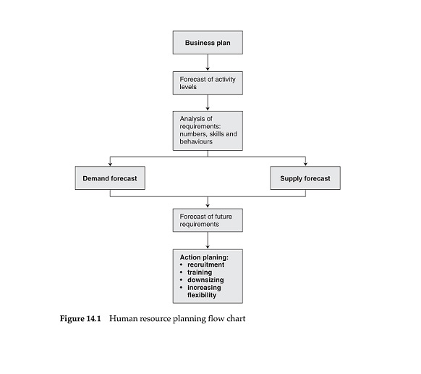
Human resource planning flow chart

Slide 5
HR Strategies

Slide 6
HR Strategies
Human capital management strategy
High-performance strategy
Corporate social responsibility strategy
Organization development strategy
Employee engagement strategy
Knowledge management strategy
Employee resourcing strategy

Slide 7
HR Strategies
Talent management strategy
Learning and development strategy
Reward strategy
Employee relations strategy

Slide 8
Talent management strategy

Slide 9
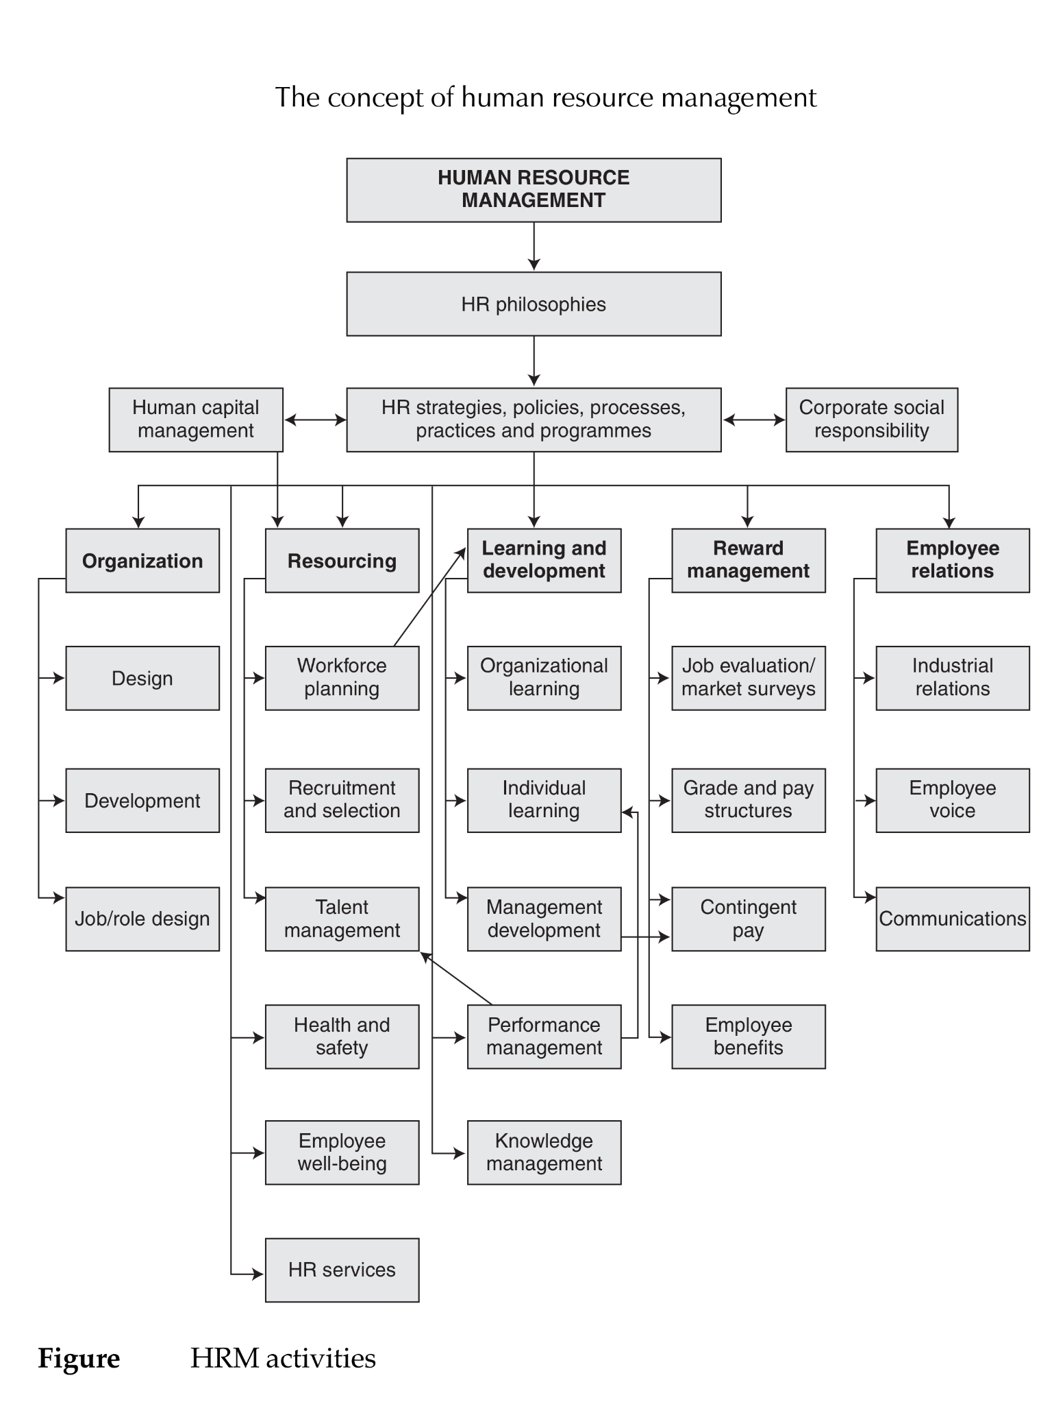

Slide 10
Talent management strategy
Talent management is basically about the identification and development of potential.
The process of identifying, developing, recruiting, retaining and deploying talented people.
It aims to secure the flow of talent in an organization, bearing in mind that talent is a major corporate resource.

Slide 11
What is talent?
‘Talent consists of those individuals who can make a difference to organizational performance, either through their immediate contribution or in the longer term by demonstrating the highest levels of potential.’

Slide 12
THE PROCESS OF TALENT MANAGEMENT
Talent management starts with the business strategy and what it signifies in terms of the talented people required by the organization.
Ultimately, its aim is to develop and maintain a pool of talented people.
Talent management takes the form of a ‘bundle’ of interrelated processes as shown in Figure.

Slide 13
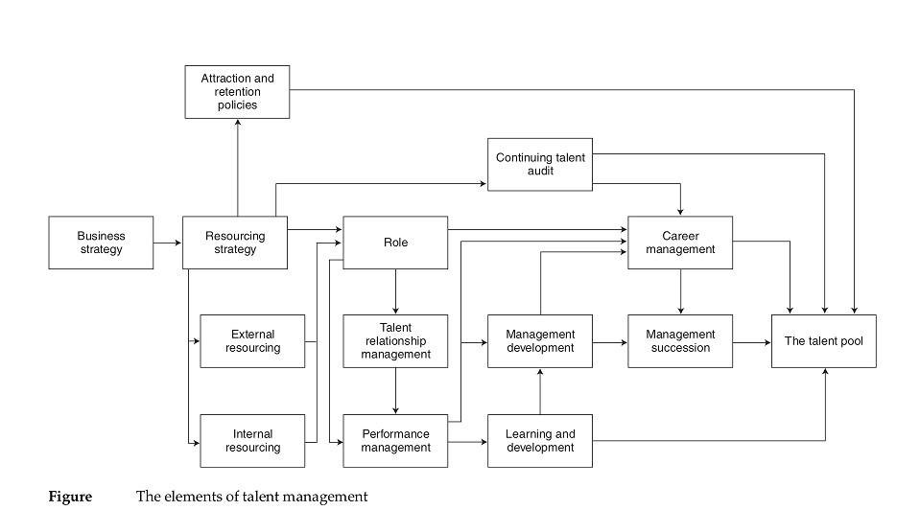
figure

Slide 14
THE PROCESS OF TALENT MANAGEMENT
The resourcing strategy
  The business plan provides the basis for human resource planning, which defines human capital requirements and leads to attraction and retention policies and programmes
Attraction and retention policies and programmes
  These policies and programmes describe the approach to ensuring that the organization both gets and keeps the talent it needs.
Talent audit
  A talent audit identifies those with potential and provides the basis for career planning and development

Slide 15
THE PROCESS OF TALENT MANAGEMENT
Role
  Talent management is concerned with the roles people carry out. This involves role design – ensuring that roles provide the responsibility, challenge and autonomy required to create role engagement and motivation
Talent relationship management
  Talent relationship management is the process of building effective relationships with people in their roles
Performance management
  Performance management processes provide a means of building relationships with people, identifying talent and potential, planning learning and development activities and making the most of the talent possessed by the organization.

Slide 16
THE PROCESS OF TALENT MANAGEMENT
Learning and development
  Learning and development policies and programmes are essential components in the process of talent management – ensuring that people acquire and enhance the skills and competencies they need
Career management
  Career management consists of the processes of career planning and management succession

Slide 17
DEVELOPING A TALENT MANAGEMENT STRATEGY
A talent management strategy consists of a view on how the processes described in previous slides should mesh together with an overall objective.
Talent management is the notion of ‘bundling’ in action.

Slide 18
Components of a talent management strategy
A talent management strategy involves:
  defining who the talent management programme should cover;
  defining what is meant by talent in terms of competencies and potential;
  defining the future talent requirements of the organization;
  developing the organization as an ‘employer of choice’ – a ‘great place to work’;
  using selection and recruitment procedures that ensure that good-quality people are recruited who are likely to thrive in the organization and stay with it for a reasonable length of time (but not necessarily for life);
  designing jobs and developing roles that give people opportunities to apply and grow their skills and provide them with autonomy, interest and challenge;
  providing talented staff with opportunities for career development and growth;

Slide 19
Components of a talent management strategy
creating a working environment in which work processes and facilities enable rewarding (in the broadest sense) jobs and roles to be designed and developed;
providing scope for achieving a reasonable balance between working in the organization and life outside work;
developing a positive psychological contract;
developing the leadership qualities of line managers;
recognizing those with talent by rewarding excellence, enterprise and achievement;
conducting talent audits that identify those with potential and those who might leave the organization;
introducing management succession planning procedures that identify the talent available to meet future requirements and indicate what management development activities are required.

Slide 20
Implementation of TMS
The development and implementation of a talent management strategy requires high-quality management and leadership from the top and from senior managers and the HR function

Slide 21
HR Strategies

Slide 22
HR Strategies
Human capital management strategy
High-performance strategy
Corporate social responsibility strategy
Organization development strategy
Employee engagement strategy
Knowledge management strategy
Employee resourcing strategy

Slide 23
HR Strategies
Talent management strategy
Learning and development strategy
Reward strategy
Employee relations strategy

Slide 24
Learning and development strategy

Slide 26
Learning and development strategy
Learning and development strategies enable activities to be planned and implemented,ensure that the organization has the talented and skilled people it needs and individuals are given the opportunity to enhance their knowledge, skills and levels of competency

Slide 27
STRATEGIC HUMAN RESOURCE DEVELOPMENT (SHRD)
‘Strategic human resource development involves introducing, eliminating, modifying, directing, and guiding processes in such a way that all individuals and teams are equipped with the skills, knowledge and competences they require to undertake current and future tasks required by the organization.’ - Walton (1999)

Slide 28
Elements of human resource development
The key elements of human resource development are:
  Learning – defined by Bass and Vaughan (1966) as ‘a relatively permanent change in behaviour that occurs as a result of practice or experience
  Training – the planned and systematic modification of behaviour through learning events, programmes and instruction that enable individuals to achieve the levels of knowledge, skill and competence needed to carry out their work effectively.
  Development – the growth or realization of a person’s ability and potential through the provision of learning and educational experiences.
  Education – the development of the knowledge, values and understanding required in all aspects of life rather than the knowledge and skills relating to particular areas of activity.

Slide 29
ORGANIZATIONAL LEARNING STRATEGIES
Organizations can be described as continuous learning systems,
Organizational learning strategy aims to develop a firm’s resource-based capability.
This is in accordance with one of the basic principles of human resource management

Slide 30
HR Strategies

Slide 31
HR Strategies
Human capital management strategy
High-performance strategy
Corporate social responsibility strategy
Organization development strategy
Employee engagement strategy
Knowledge management strategy
Employee resourcing strategy

Slide 32
HR Strategies
Talent management strategy
Learning and development strategy
Reward strategy
Employee relations strategy

Slide 33
Reward strategy

Slide 35
Reward strategy
Reward strategy is a declaration of intent that defines what the organization wants to do in the longer term to develop and implement reward policies, practices and processes that will further the achievement of its business goals and meet the needs of its stakeholders.
Reward strategy is underpinned by a reward philosophy, which expresses what the organization believes should be the basis upon which people are valued and rewarded

Slide 36
CHARACTERISTICS OF REWARD STRATEGIES
Reward strategists may have a clear idea of what needs to be done but they have to take account of the views of top management and be prepared to persuade them with convincing arguments that action needs to be taken.

Slide 37
DEVELOPING REWARD STRATEGY
The formulation of corporate strategy can be described as a process for developing and defining a sense of direction. There are four key development phases:
  1. the diagnosis phase, when reward goals are agreed, current policies and practices assessed against them, options for improvement considered and any changes agreed;
  2. the detailed design phase, when improvements and changes are detailed and any changes tested (pilot testing is important);
  3. the final testing and preparation phase;
  4. the implementation phase, followed by ongoing review and modification.

Slide 38
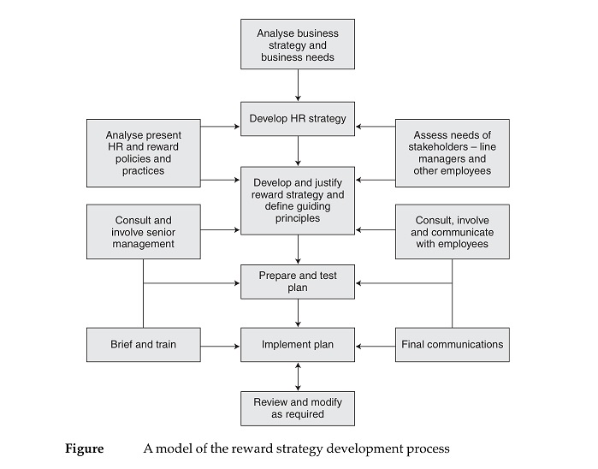
fig
Reward strategy process

Slide 39
EFFECTIVE REWARD STRATEGIES
Duncan Brown (2001) has suggested that effective reward strategies have three components:
  1. They have to have clearly defined goals and a well-defined link to business objectives.
  2. There have to be well-designed pay and reward programmes, tailored to the needs of the organization and its people, and consistent and integrated with one another.
  3. Perhaps most important and most neglected, there need to be effective and supportive HR and reward processes in place.

Slide 40
REWARD STRATEGY AND LINE MANAGEMENT
HR can initiate new reward policies and practices, but it is the line that has the main responsibility for implementing them. The trend is, rightly, to devolve more responsibility for managing reward to line managers

Slide 41
Thank you

