Slide 1
Strategic Human Resource Management
Imran Ghaznavi
Twitter: @ighaznavi
Course Code: MGT557
COMSATS

Slide 2
Lecture Three

Slide 3
Lecture outline
Overview of 2st Lecture
HRM Process
Human Resource System
Aims of HRM
Characteristics of HRM

Slide 4
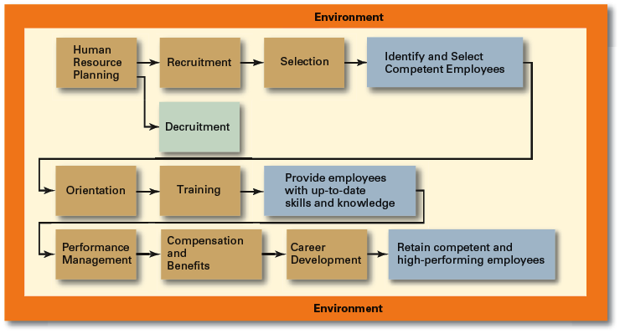
Human Resource Management Process

Slide 5
Career Development
Career Defined
  The sequence of positions held by a person during his or her lifetime.
  The Way It Was
    Career Development
      Provided for information, assessment, and training
      Helped attract and retain highly talented people
    Now
      Individuals—not the organization—are responsible for designing, guiding, and developing their own careers.
  Boundary less Career
    A career in which individuals, not organizations, define career progression and organizational loyalty

Slide 6
Current Issues in HRM
Managing Downsizing
  The planned elimination of jobs in an organization
    Provide open and honest communication.
    Provide assistance to employees being downsized.
    Reassure and counseling to surviving employees.
Managing Work Force Diversity
  Widen the recruitment net for diversity
  Ensure selection without discrimination
  Provide orientation and training that is effective

Slide 7
Current Issues in HRM
Sexual Harassment
  An unwanted activity of a that affects an individual’s employment.
    Unwanted advances, requests for illicit favors, and other verbal or physical conduct of a sexual nature when submission or rejection of this conduct explicitly or implicitly affects an individual’s employment.
  An offensive or hostile environment
    An environment in which a person is affected by elements of a sexual nature.
Workplace Romances
  Potential liability for harassment

Slide 8
Current Issues in HRM
Work-Life Balance
  Employees have personal lives that they don’t leave behind when they come to work.
  Organizations have become more attuned to their employees by offering family-friendly benefits:
    On-site child care
    Summer day camps
    Flextime
    Job sharing
    Leave for personal matters
    Flexible job hours

Slide 9
Current Issues in HRM
Controlling HR Costs
  Employee health-care
    Encouraging healthy lifestyles
      Financial incentives
      Wellness programs
      Charging employees with poor health habits more for benefits
  Employee pension plans
    Reducing pension benefits
    No longer providing pension plans

Slide 10
HUMAN RESOURCE SYSTEMS
Human resource management operates through human resource systems as illustrated in Figure 1.3. These bring together in a coherent way:
HR philosophies, describing the overarching values and guiding principles adopted in managing people;
HR strategies, defining the direction in which HRM intends to go;
HR policies, which are the guidelines defining how these values, principles and strategies should be applied and implemented in specific areas of HRM;

Slide 11
HUMAN RESOURCE SYSTEMS
HR processes, consisting of the formal procedures and methods used to put HR strategic plans and policies into effect;
HR practices, consisting of the informal approaches used in managing people;
HR programs, which enable HR strategies, policies and practices to be implemented according to plan.

Slide 12
Thank you
For any question or query contact through
twitter: @ighaznavi

