Slide 1
Strategic Human Resource Management
Imran Ghaznavi
Twitter: @ighaznavi
Course Code: MGT557
COMSATS

Slide 2
Lecture 29

Slide 3
Lecture outline
Overview of 28th Lecture
HR Strategies

Slide 4
HR Strategies

Slide 5
HR Strategies
Human capital management strategy
High-performance strategy
Corporate social responsibility strategy
Organization development strategy
Employee engagement strategy
Knowledge management strategy
Employee resourcing strategy

Slide 6
HR Strategies
Talent management strategy
Learning and development strategy
Reward strategy
Employee relations strategy

Slide 7
Employee engagement strategy

Slide 8
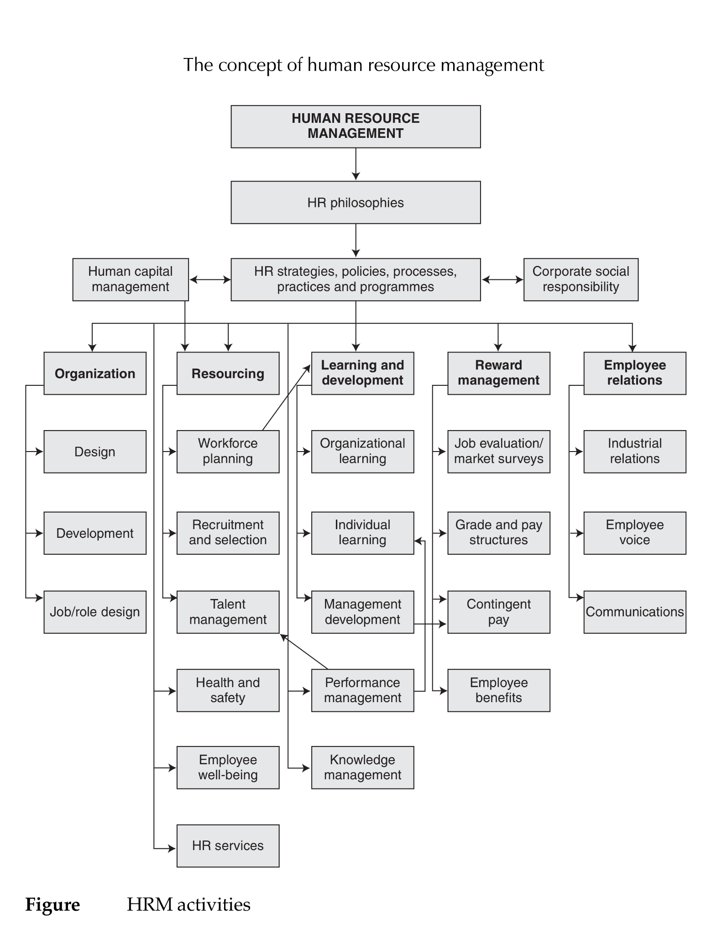

Slide 9
Employee engagement strategy
Engaged people at work are positive, interested in and even excited about their jobs and prepared to go the extra mile to get them done to the best of their ability
As defined by Towers Perrin (2007), the term employee engagement refers to
  ‘the extent to which employees put discretionary effort into their work, beyond the minimum to get the job done, in the form of extra time, brainpower or energy

Slide 10
ENGAGEMENT AND ORGANIZATIONAL COMMITMENT
Engagement and organizational commitment are two important concepts affecting work performance and the attraction and retention of employees.
They are indeed closely linked – high organizational commitment can increase engagement and high engagement can increase commitment.
But people can be engaged with their work even when they are not committed to the organization except in so far as it gives them the opportunity to use and develop their skills.

Slide 11
THE SIGNIFICANCE OF ENGAGEMENT
The significance of engagement is at the heart of the employment relationship.
It is about what people do and how they behave in their roles and what makes them act in ways that further the achievement of the objectives of both the organization and themselves.

Slide 12
WHAT IS AN ENGAGED EMPLOYEE?
Bevan, Barber and Robinson (1997), who describe an engaged employee as someone ‘who is aware of business context, and works closely with colleagues to improve performance within the job for the benefit of the organization’.

Slide 13
WHAT ARE THE FACTORS THAT INFLUENCE ENGAGEMENT?
Two key elements that have to be present if genuine engagement is to exist
  The first is the rational aspect, which relates to employees’ understanding of their role, where it fits in the wider organization and how it aligns with business objectives.
  The second is the emotional aspect, which has to do with how people feel about the organization, whether their work gives them a sense of personal accomplishment and how they relate to their manager.

Slide 14
Factors that influence levels of engagement
The work itself
  The work itself can create job satisfaction leading to intrinsic motivation and increased engagement.
The work environment
  An enabling, supportive and inspirational work environment creates experiences that impact on engagement by influencing how people regard their roles and carry them out.
  An enabling environment will create the conditions that encourage high-performance and effective discretionary behaviour.

Slide 15
Factors that influence levels of engagement
Leadership
  The degree to which jobs encourage engagement and positive discretionary behaviour very much depends upon the ways in which job holders are led and managed.
Opportunities for personal growth
  The opportunity to grow and develop is a motivating factor that directly impacts on engagement when it is an intrinsic element of the work.
Opportunities to contribute
  Engagement is enhanced if employees have a voice that is listened to. This enables them to feed their ideas and views upwards and feel that they are making a contribution.

Slide 16
HR Strategies

Slide 17
HR Strategies
Human capital management strategy
High-performance strategy
Corporate social responsibility strategy
Organization development strategy
Employee engagement strategy
Knowledge management strategy
Employee resourcing strategy

Slide 18
HR Strategies
Talent management strategy
Learning and development strategy
Reward strategy
Employee relations strategy

Slide 19
Knowledge management strategy

Slide 21
Knowledge management strategy
Knowledge management strategies aim to capture an organization’s collective expertise and distribute it to ‘wherever it can achieve the biggest payoff’
Trussler (1998) comments that
  ‘the capability to gather, lever, and use knowledge effectively will become a major source of competitive advantage in many businesses over the next few years’.

Slide 22
THE PROCESS OF KNOWLEDGE MANAGEMENT
Knowledge management is ‘any process or practice of creating, acquiring, capturing, sharing and using knowledge, wherever it resides, to enhance learning and performance in organizations’
(Scarborough et al 1999).
The purpose of knowledge management is to transfer knowledge from those who have it to those who need it in order to improve organizational effectiveness
Knowledge management strategies promote the sharing of knowledge by linking people with people and by linking them to information so that they learn from documented experiences.

Slide 23
COMPONENTS OF A KNOWLEDGE MANAGEMENTSTRATEGY
A Knowledge management strategy could be concerned with organizational people management processes that help to develop an open culture in which the values and norms emphasize the importance of sharing knowledge and facilitate knowledge sharing through networks.

Slide 24
HR Strategies

Slide 25
HR Strategies
Human capital management strategy
High-performance strategy
Corporate social responsibility strategy
Organization development strategy
Employee engagement strategy
Knowledge management strategy
Employee resourcing strategy

Slide 26
HR Strategies
Talent management strategy
Learning and development strategy
Reward strategy
Employee relations strategy

Slide 27
Employee resourcing strategy

Slide 29
Employee resourcing strategy
Employee resourcing strategy is concerned with ensuring that the organization obtains and retains the people it needs and employs them efficiently.
It is a key part of the strategic human resource management process, which is fundamentally about matching human resources to the strategic and operational needs of the organization and ensuring the full utilization of those resources
It is concerned not only with obtaining and keeping the number and quality of staff required but also with selecting and promoting people who ‘fit’ the culture and the strategic requirements of the organization.

Slide 30
THE OBJECTIVE OF EMPLOYEE RESOURCING STRATEGY
The concept that the strategic capability of a firm depends on its resource capability in the shape of people (the resource-based view) provides the rationale for resourcing strategy.
The aim of this strategy is therefore to ensure that a firm achieves competitive advantage by employing more capable people than its rivals.

Slide 31
THE COMPONENTS OF EMPLOYEE RESOURCINGSTRATEGY
The components of employee resourcing strategy as considered here are:
  Human resource planning (often referred to, especially in the public sector, as workforce planning) – assessing future business needs and deciding on the numbers and types of people required.
  Developing the organization’s employee value proposition and its employer brand.
  Resourcing plans – preparing plans for finding people from within the organization and/or for learning and development programmes to help people learn new skills. If needs cannot be satisfied from within the organization, it involves preparing longer-term plans for ensuring that recruitment and selection processes will satisfy them.
  Retention strategy – preparing plans for retaining the people the organization needs.

Slide 32
THE COMPONENTS OF EMPLOYEE RESOURCINGSTRATEGY
Flexibility strategy – planning for increased flexibility in the use of human resources to enable the organization to make the best use of people and adapt swiftly to changing circumstances.
Talent management strategy – ensuring that the organization has the talented people it requires to provide for management succession and meet present and future business needs

Slide 33
Thank you

