Slide 1
Strategic Human Resource Management
Imran Ghaznavi
Twitter: @ighaznavi
Course Code: MGT557
COMSATS

Slide 2
Lecture 28

Slide 3
Lecture outline
Overview of 27th Lecture
HR Strategies

Slide 4
HR Strategies

Slide 5
HR Strategies
Human capital management strategy
High-performance strategy
Corporate social responsibility strategy
Organization development strategy
Employee engagement strategy
Knowledge management strategy
Employee resourcing strategy

Slide 6
HR Strategies
Talent management strategy
Learning and development strategy
Reward strategy
Employee relations strategy

Slide 7
Corporate social responsibility strategy

Slide 8
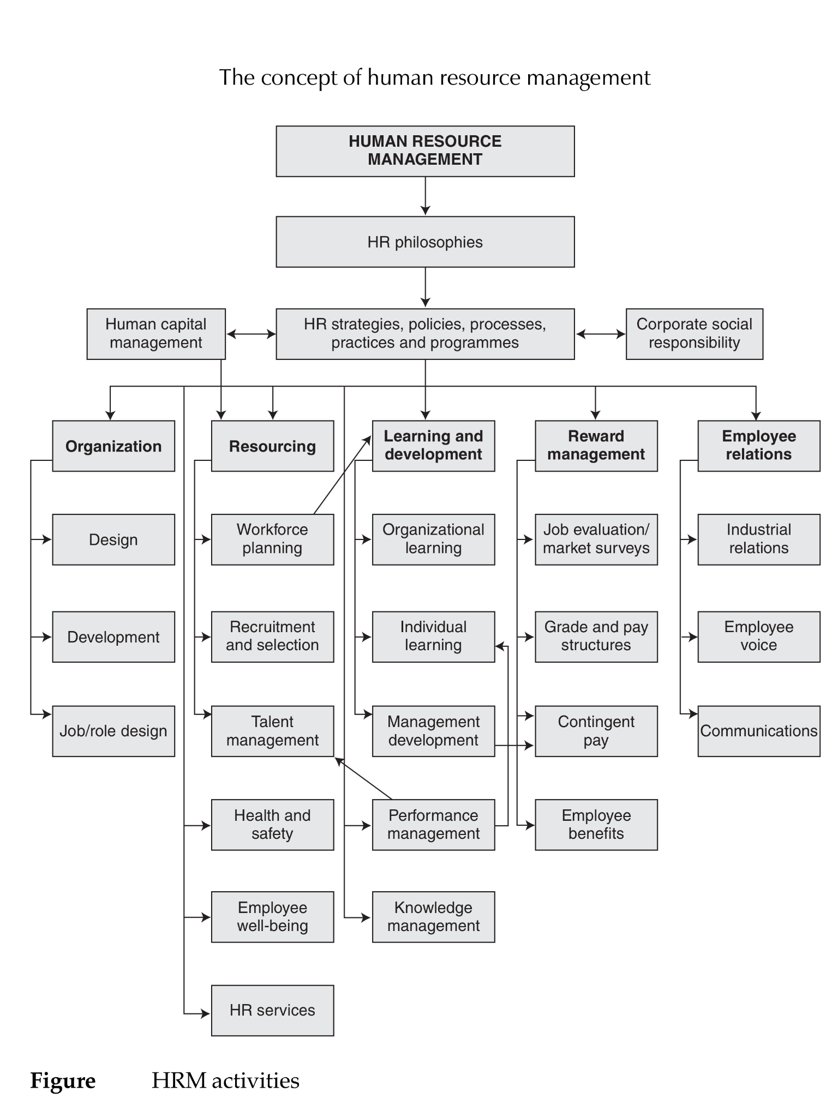

Slide 9
Corporate social responsibility strategy
Corporate social responsibility (CSR) is exercised by organizations when they conduct their business in an ethical way, taking account of the social, environmental and economic impact of how they operate.
‘continuing commitment by business to behave ethically and contribute to economic development while improving the quality of life of the workforce and their families as well as of the local community and society at large’.

Slide 10
STRATEGIC CSR DEFINED
Strategic CSR is about deciding initially whether or not the firm should be involved in social issues and then creating a corporate social agenda – deciding what social issues to focus on and to what extent.
It is believed that ‘It is through strategic CSR that the company will make the greatest social impact and reap the greatest business benefits.
CSR strategy needs to be integrated with the business strategy, but it is also closely associated with HR strategy. This is because it is concerned with ethical behaviour both outside and within the firm – with society generally and with the internal community.

Slide 11
CSR ACTIVITIES
CSR activities as listed by McWilliams et al (2006) include ;
  incorporating social characteristics or features into products and manufacturing processes, adopting progressive human resource management practices, achieving higher levels of environmental performance through recycling and pollution abatement and advancing the goals of community organizations

Slide 12
CSR ACTIVITIES
CSR activities summarized under four headings
1. Community. Skills and education, employability and social exclusion were frequently identified as key risks and opportunities. Other major activities were support for local community initiatives and being a responsible and safe neighbour.
2. Environment. Most companies reported climate change and resource use as key issues for their business, and 85 per cent of them managed their impacts through an environmental management system.

Slide 13
CSR ACTIVITIES
3. Marketplace. The issues most frequently mentioned by companies were research and development, procurement and supply chain, responsible selling, responsible marketing and product safety. There was a rising focus on fair treatment of customers, providing appropriate product information and labelling, and the impacts of products on customer health.

Slide 14
CSR ACTIVITIES
4. Workplace. This was the strongest management performing area, as most companies have established employment management frameworks that can cater for workplace issues as they emerge. Companies recognized the crucial role of employees to achieving responsible business practices. Increasing emphasis was placed on internal communications and training to raise awareness and understanding of why it is relevant to them and valuable for the business. More attention was being paid to health and well-being issues as well as the traditional safety agenda. More work was being done on diversity, both to ensure the business attracts a diverse workforce and to communicate the business care for diversity internally.

Slide 15
THE RATIONALE FOR CSR
The rationale for CSR as defined by Hillman and Keim (2001) is based on two propositions:
  first, there is a moral imperative for businesses to ‘do the right thing’ without regard to how such decisions affect firm performance (the social issues argument); and
  second, firms can achieve competitive advantage by tying CSR activities to primary stakeholders (the stakeholders argument).

Slide 16
DEVELOPING A CSR STRATEGY
The basis for developing a CSR strategy is provided by the Competency Framework of the CSR Academy (2006), which is made up of six characteristics:
1. Understanding society – understanding how business operates in the broader context and knowing the social and environmental impact that the business has on society.
2. Building capacity – building the capacity of others to help manage the business effectively. For example, suppliers understand the business’s approach to the environment and employees can apply social and environmental concerns in their day-to-day roles.

Slide 17
DEVELOPING A CSR STRATEGY
3. Questioning business-as-usual – individuals continually questioning the business in relation to a more sustainable future and being open to improving the quality of life and the environment.
4. Stakeholder relations – understanding who the key stakeholders are and the risks and opportunities they present; working with them through consultation and taking their views into account.
5. Strategic view – ensuring that social and environmental views are included in the business strategy, for example that they are integral to the way the business operates.
6. Harnessing diversity – respecting that people are different, which is reflected in fair and transparent business practices.

Slide 18
CSR Strategy
To develop and implement a CSR strategy based on these principles it is necessary to:
  understand the business and social environment in which the firm operates;
  understand the business and HR strategies and how the CSR strategy should be aligned to them;
  know who the stakeholders are (including top management) and find out their views and expectations on CSR;
  identify the areas in which CSR activities might take place by reference to their relevance in the business context of the organization and an evaluation of their significance to stakeholders;

Slide 19
CSR Strategy
  draw up the strategy and make the case for it to top management and the stakeholders;
  obtain approval for the CSR strategy from top management and key stakeholders
  communicate information on the whys and wherefores of the strategy comprehensively and regularly;
  provide training to employees on the skills they need to use in implementing the CSR strategy;
  measure and evaluate the effectiveness of CSR.

Slide 20
HR Strategies

Slide 21
HR Strategies
Human capital management strategy
High-performance strategy
Corporate social responsibility strategy
Organization development strategy
Employee engagement strategy
Knowledge management strategy
Employee resourcing strategy

Slide 22
HR Strategies
Talent management strategy
Learning and development strategy
Reward strategy
Employee relations strategy

Slide 23
Organization development strategy

Slide 25
ORGANIZATION DEVELOPMENT DEFINED
Organization development aims to help people work more effectively together, improve organizational processes such as the formulation and implementation of strategy and facilitate the transformation of the organization and the management of change.

Slide 26
ORGANIZATION DEVELOPMENT
A planned systematic process in which applied behavioural science principles and practices are introduced into an ongoing organization towards the goals of effecting organizational improvement, greater organizational competence, and greater organizational effectiveness. The focus is on organizations and their improvement or, to put it another way, total systems change. The orientation is on action – achieving desired results as a result of planned activities.
French and Bell (1990)

Slide 27
OD STRATEGIES
OD strategies concentrate on how things are done as well as what is done. They are concerned with system-wide change and are developed as programmes with the following features:
  1. They are managed, or at least strongly supported, from the top but may make use of third parties or ‘change agents’ to diagnose problems and to manage change by various kinds of planned activity or ‘intervention’.
  2. The plans for organization development are based upon systematic analysis and diagnosis of the strategies and circumstances of the organization and the changes and problems affecting it.

Slide 28
OD STRATEGIES
  3. They use behavioural science knowledge and aim to improve the way the organization copes in times of change through such processes as interaction, communications, participation, planning and conflict management.
  4. They focus on ways of ensuring that business and HR strategies are implemented and change is managed effectively.

Slide 29
Case study

Slide 30
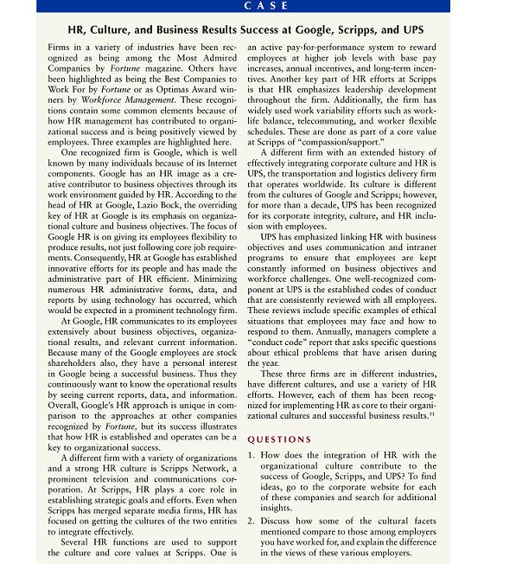

Slide 31
Thank you

