Slide 1
Strategic Human Resource Management
Imran Ghaznavi
Twitter: @ighaznavi
Course Code: MGT557
COMSATS

Slide 2
Lecture 27

Slide 3
Lecture outline
Overview of 26th Lecture
HR Strategies
Case study
HRM Skills

Slide 4
HR Strategies

Slide 5
HR Strategies
Human capital management strategy
High-performance strategy
Corporate social responsibility strategy
Organization development strategy
Employee engagement strategy
Knowledge management strategy
Employee resourcing strategy

Slide 6
HR Strategies
Talent management strategy
Learning and development strategy
Reward strategy
Employee relations strategy

Slide 7
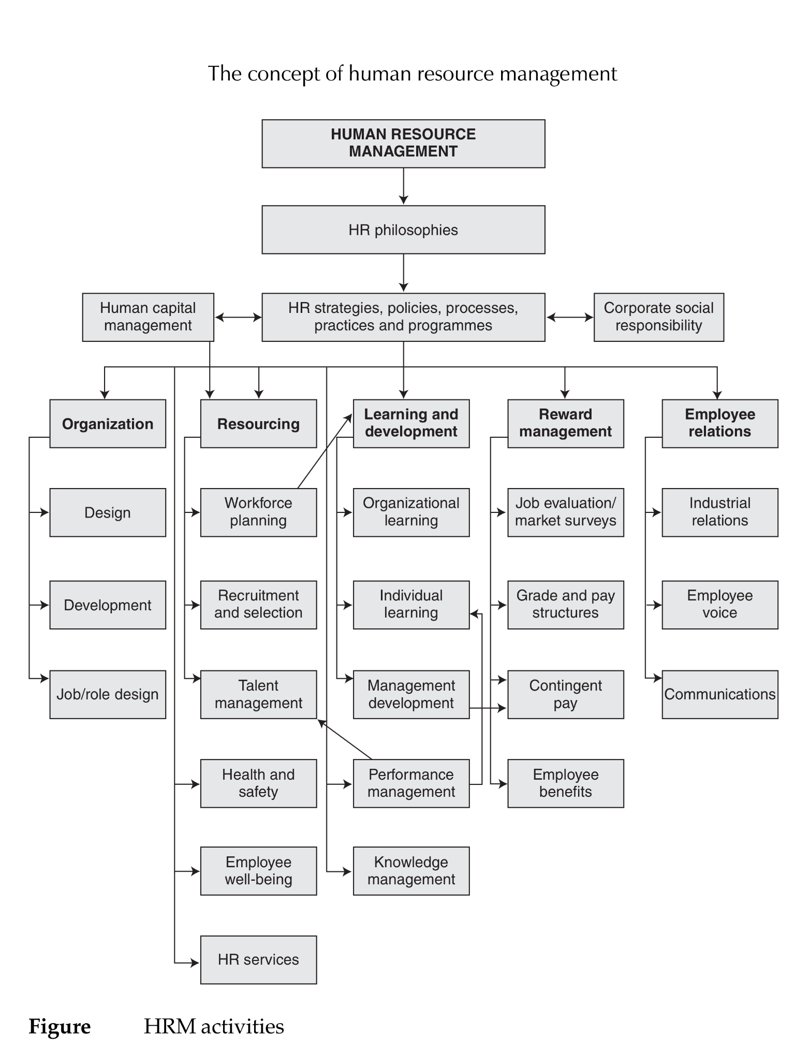

Slide 8
High-performance strategy

Slide 9
High-performance strategy
A high-performance strategy sets out the intentions of the organization on how it can achieve competitive advantage by improving performance through people.
The aim is to support the achievement of the organization’s strategic objectives.
This can be put into effect by means of high-performance work systems (HPWS)

Slide 10
High-performance work systems
High-performance work systems are also known as high-performance work practices
‘invest in the skills and abilities of employees, design work in ways that enable employee collaboration in problem-solving, and provide incentives to motivate workers to use their discretionary effort’.
Thompson and Heron (2005) describing high-performance work organizations

Slide 11
HIGH-PERFORMANCE WORK SYSTEM DEFINED
As defined by Appelbaum et al (2000), high-performance work systems are composed of practices that can facilitate employee involvement, skill enhancement and motivation.

Slide 12
HPWS concept
Armitage and Keeble- Allen (2007) identified three themes describing the HPWS concept:
  1. an open and creative culture that is people centered and inclusive, where decision taking is communicated and shared through the organization;
  2. investment in people through education and training, loyalty, inclusiveness and flexible working;
  3. measurable performance outcomes such as benchmarking and setting targets, as well as innovation through processes and best practice.

Slide 13
CHARACTERISTICS OF A HIGH-PERFORMANCE WORK SYSTEM
High-performance work system is described by Becker and Huselid (1998) as
  ‘internally consistent and coherent HRM system that is focused on solving operational problems and implementing the firm’s competitive strategy’.
Such a system is the key to the acquisition, motivation and development of the primary intellectual assets that can be a source of sustained competitive advantage because it;

Slide 14
CHARACTERISTICS OF A HIGH-PERFORMANCE WORK SYSTEM
  links the firm’s selection and promotion decisions to validated competency models;
  develops strategies that provide timely and effective support for the skills demanded by the firm’s strategy implementation;
  enacts compensation and performance management policies that attract, retain and motivate high-performance employees.

Slide 15
IMPACT OF HIGH-PERFORMANCE WORK SYSTEMS

Slide 16
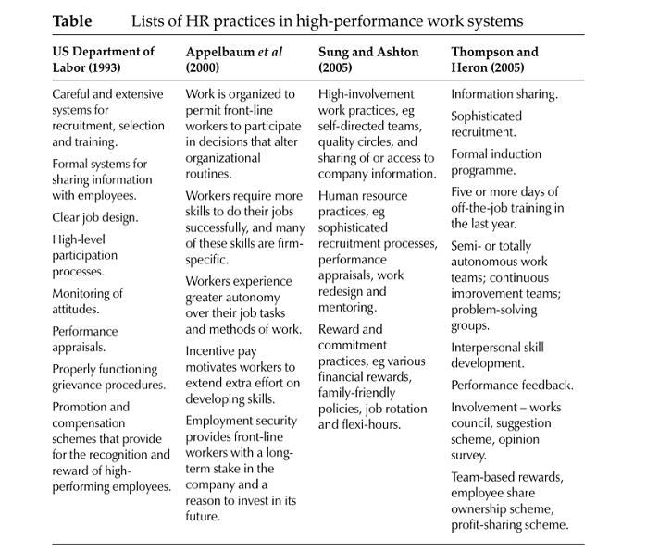
Table 9.1

Slide 17
DEVELOPING A HIGH-PERFORMANCE STRATEGY
A high-performance strategy has to be aligned to the context of the organization and to its business strategy.

Slide 18
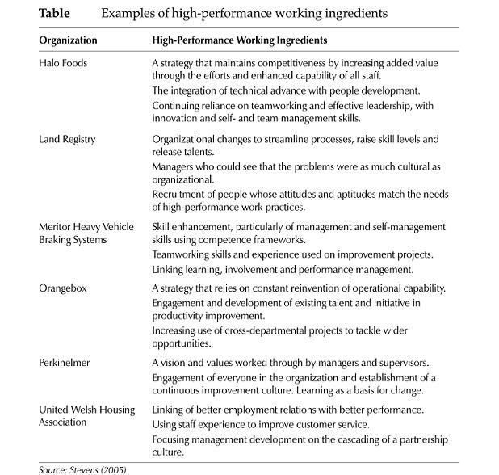
Table 9.2

Slide 19
High-performance culture
The characteristics of a high-performance culture are that:
  a clear line of sight exists between the strategic aims of the organization and those of its departments and its staff at all levels;
  people know what is expected of them – they understand their goals and accountabilities;
  people feel that their job is worth doing, and there is a strong fit between the job and their capabilities;
  people are empowered to maximize their contribution;
  management defines what it requires in the shape of performance improvements, sets goals for success and monitors performance to ensure that the goals are achieved;

Slide 20
High-performance culture
  there is strong leadership from the top, which engenders a shared belief in the importance of continuing improvement;
  there is a focus on promoting positive attitudes that result in an engaged, committed and motivated workforce;
  performance management processes are aligned to business goals to ensure that people are engaged in achieving agreed objectives and standards;
  capacities of people are developed through learning at all levels to support performance improvement and people are provided with opportunities to make full use of their skills and abilities;
  a pool of talent ensures a continuous supply of high performers in key roles;

Slide 21
High-performance culture
  people are valued and rewarded according to their contribution;
  people are involved in developing high-performance practices;
  there is a climate of trust and teamwork, aimed at delivering a distinctive service to the customer.

Slide 22
High-performance work systems
High-performance work systems provide the means for creating a performance culture.
They embody ways of thinking about performance in organizations and how it can be improved.
The development programme requires strong leadership from the top.
  Stakeholders – line managers, team leaders, employees and their representatives should be involved as much as possible through surveys, focus groups and workshops.

Slide 23
Case study

Slide 24
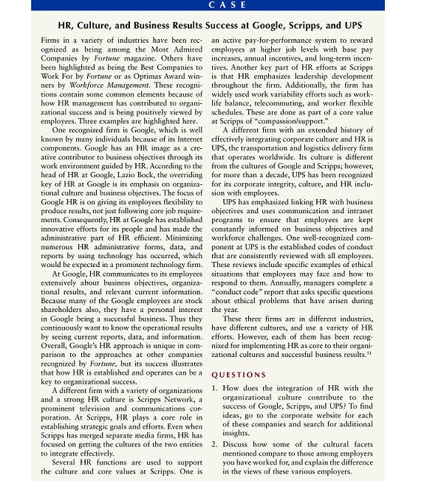

Slide 25
Thank you

