Slide 1
Strategic Human Resource Management
Imran Ghaznavi
Twitter: @ighaznavi
Course Code: MGT557
COMSATS

Slide 2
Lecture 26

Slide 3
Lecture outline
Overview of 25th Lecture
HR Strategies
Case study
HRM Skills

Slide 4
HR Strategies

Slide 5
HR Strategies
Human capital management strategy
High-performance strategy
Corporate social responsibility strategy
Organization development strategy
Employee engagement strategy
Knowledge management strategy
Employee resourcing strategy

Slide 6
HR Strategies
Talent management strategy
Learning and development strategy
Reward strategy
Employee relations strategy

Slide 7
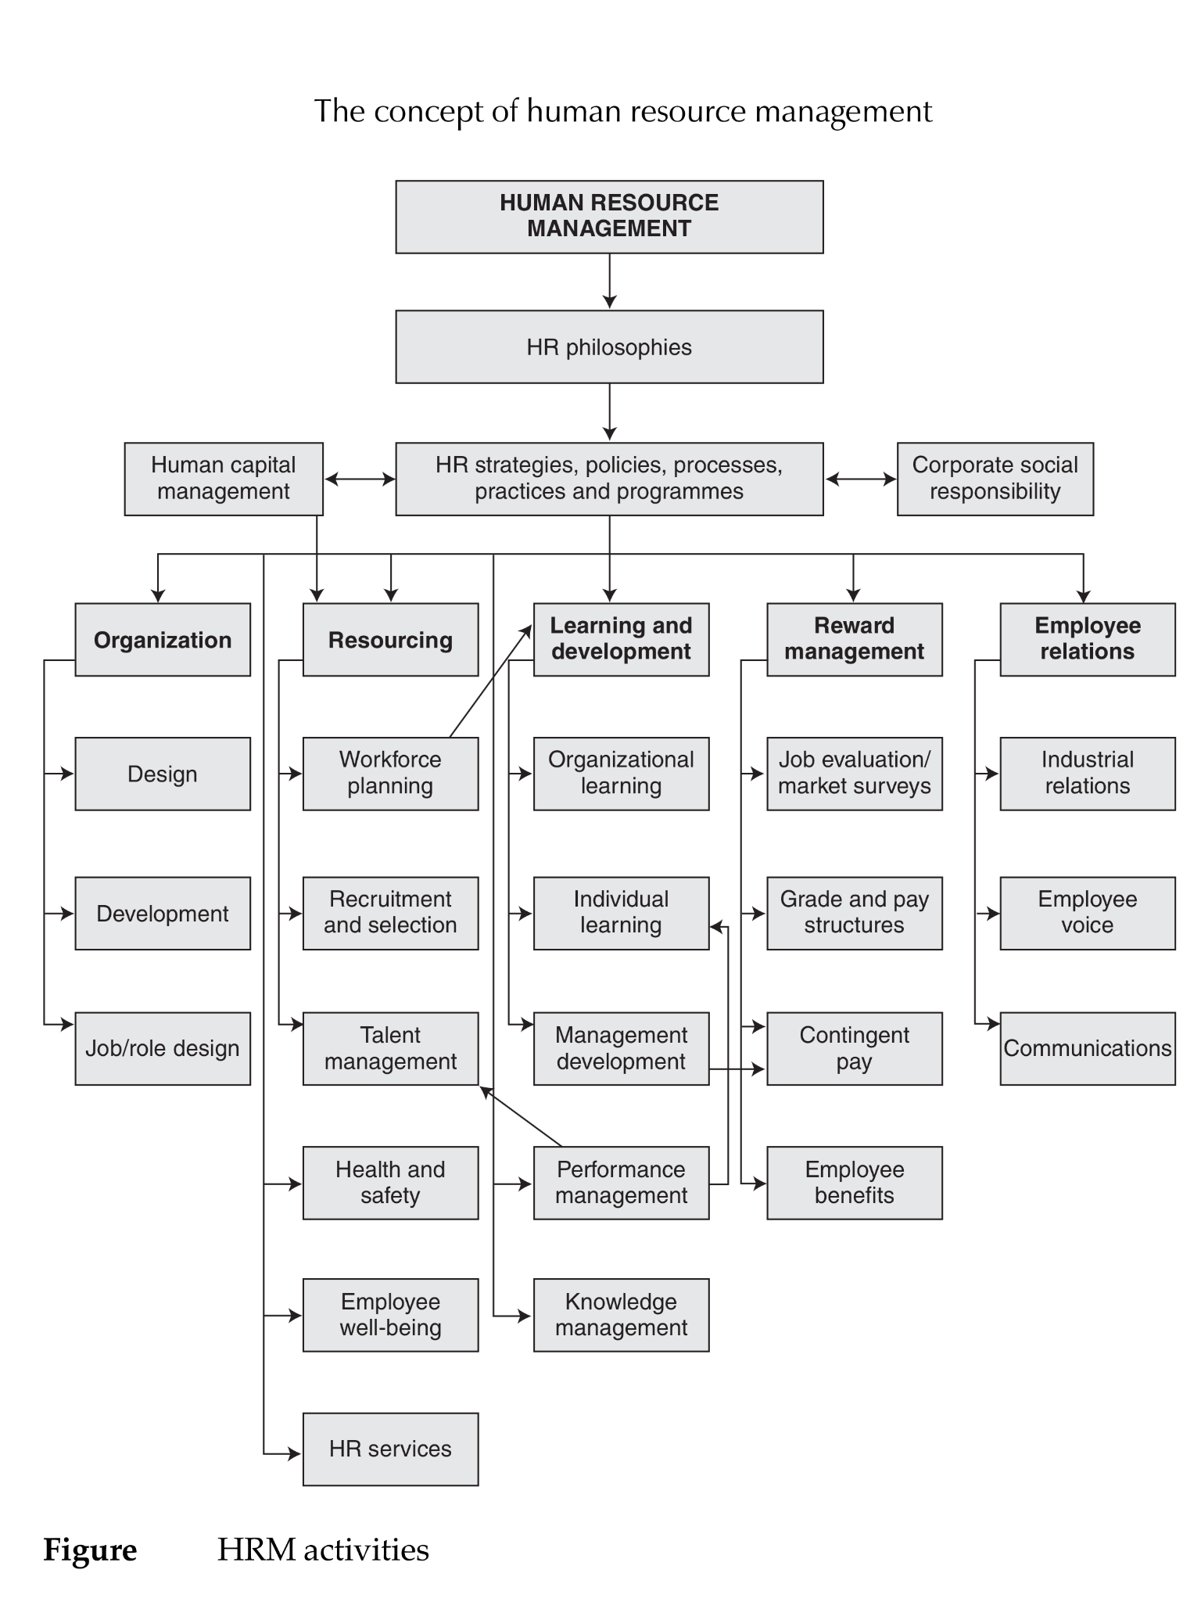

Slide 8
Human capital management strategy

Slide 9
Human capital management strategy
Human capital management (HCM) is concerned with obtaining, analysing and reporting on data that inform the direction of value-adding people management strategy.
HCM strategy is therefore closely associated with strategic HRM.
It emphasizes that competitive advantage is achieved by strategic investments in human assets through engagement, retention, talent management , learning and development programmes.
HCM provides a bridge between HR and business strategy.
It provides the basis for ‘evidence-based human resource management’.

Slide 10
Human capital management strategy
The Accounting for People Task Force report (2003) stated that HCM involves the systematic analysis, measurement and evaluation of how people policies and practices create value.
The report defined HCM as ‘an approach to people management that treats it as a high level strategic issue rather than an operational matter “to be left to the HR people”’.
‘HCM is about creating value through people’ and that it is ‘a people development philosophy,

Slide 11
AIMS of HCM
The four fundamental objectives of HCM are:
  1. to determine the impact of people on the business and their contribution to value;
  2. to demonstrate that HR practices produce value for money in terms, for example, of return on investment;
  3. to provide guidance on future HR and business strategies;
  4. to provide data that will inform strategies and practices designed to improve the effectiveness of people management in the organization.

Slide 12
THE LINK BETWEEN HCM AND BUSINESS STRATEGY
It is often asserted that HCM and business strategy are closely linked and that an HCM approach provides guidance on both HR and business strategy. For eg
  By linking good HR practice and strategic management to human capital measurement, firms are able to make a number of better-informed decisions that will help to ensure long-term business success
  The aim is to have a ‘robust people strategy mapped to the business strategy
  The prime purpose of human capital management is to establish ‘an employment proposition that links the work of employees to strategy and profits’
  the most productive way of linking HR and business strategy, is to relate business results to HR practices to determine how they can best contribute to improving performance.

Slide 13
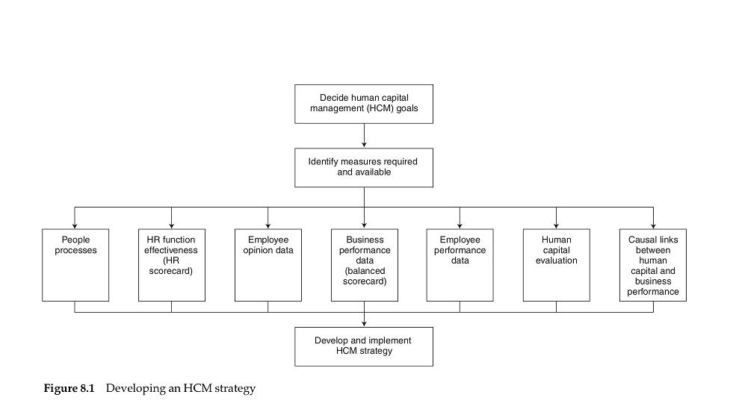
DEVELOPING A HUMAN CAPITAL MANAGEMENT STRATEGY

Slide 14
DEVELOPING A HUMAN CAPITAL MANAGEMENT STRATEGY
The development programme starts with a definition of the aims of the strategy, for example to:
  obtain, analyse and report on data that inform the direction of HR strategies and processes;
  inform the development of business strategy
  use measurements to prove that superior HRM strategies and processes deliver superior results;
  reinforce the belief that HRM strategies and processes create value through people;
  determine the impact of people on business results;
  assess the value of the organization’s human capital;
  improve the effectiveness of HR;
  provide data on the performance of the organization’s human capital for the operating and financial report;
  demonstrate that HR processes provide value for money.

Slide 15
CONCLUSIONS: THE ROLE OF HUMAN CAPITAL MANAGEMENT STRATEGY
The whole area of human capital management presents both an opportunity and a challenge:
  an opportunity to recognize people as an asset that contributes directly to organizational performance, and
  a challenge to develop the skills necessary to identify, analyse and communicate that contribution and ensure it is recognized in business decision making

Slide 16
CONCLUSIONS: THE ROLE OF HUMAN CAPITAL MANAGEMENT STRATEGY
By developing strategies to generate better and more accurate information on human capital and communicating this information both internally and externally,
organizations will not only improve their business decision making but also
enable stakeholders to make more accurate assessments about the long-term future performance of the organization

Slide 17
CONCLUSIONS: THE ROLE OF HUMAN CAPITAL MANAGEMENT STRATEGY
A human capital management strategy that includes the systematic collection and analysis of human capital data can help managers to begin to understand factors that will have a direct impact on the people they manage.
It can also help executives to understand and identify areas in which there are issues regarding the effective management of staff and to design management development programmes to address these.

Slide 18
Case study

Slide 19
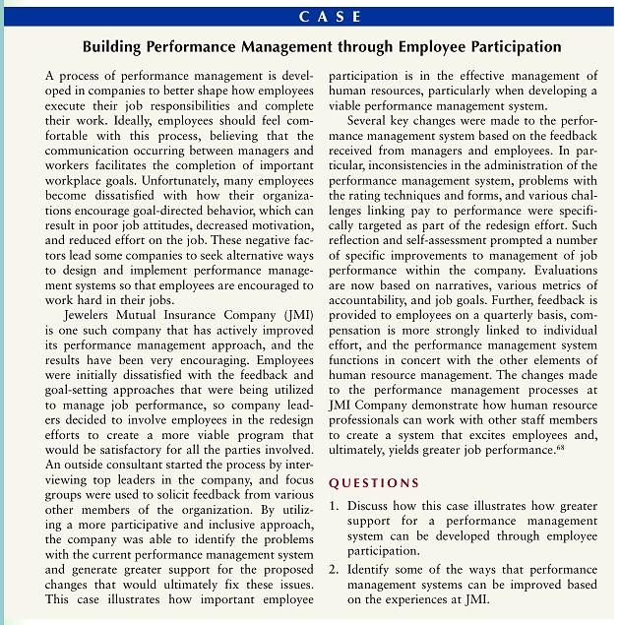

Slide 20
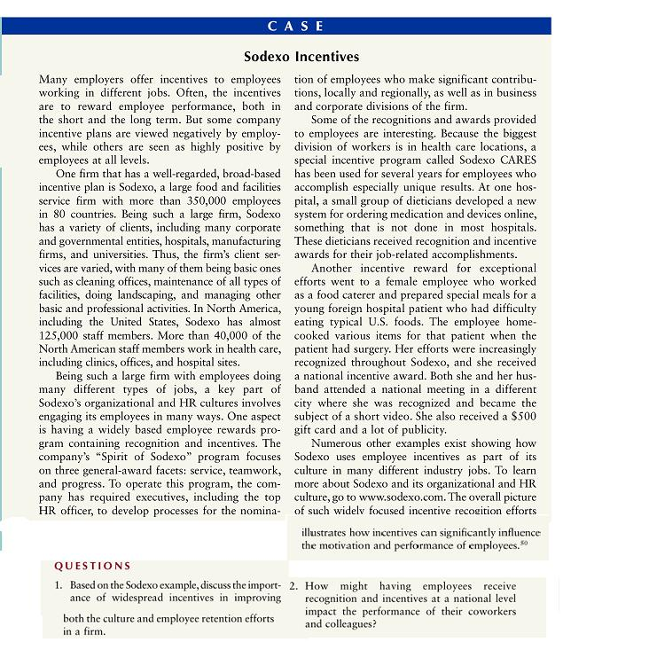

Slide 21
Thank you

