Slide 1
Strategic Human Resource Management
Imran Ghaznavi
Twitter: @ighaznavi
Course Code: MGT557
COMSATS

Slide 2
Lecture 25

Slide 3
Lecture outline
Overview of 24th Lecture
HR Strategies
Case study
HRM Skills

Slide 4
The impact of strategic HRM

Slide 5
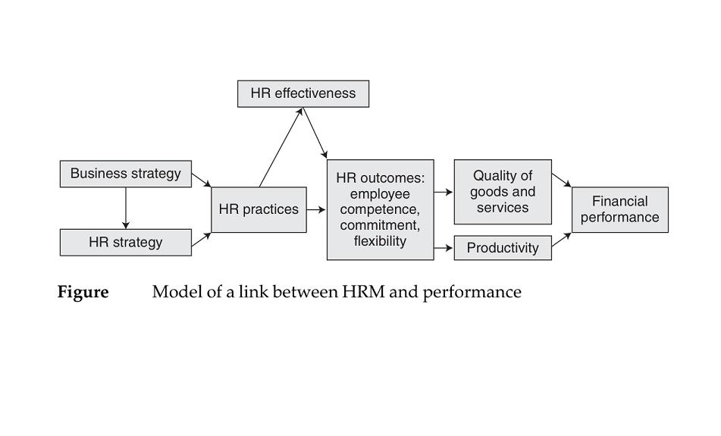
How HRM strategies make an impact

Slide 6
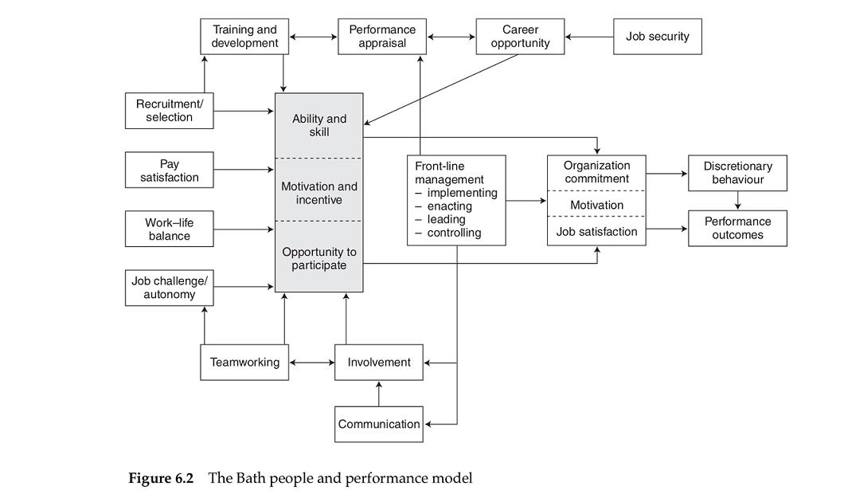

Slide 7
How HRM strategies make an impact
The Bath people and performance model developed by Purcell et al (2003) is shown in Figure 6.2.
  Central to this model is the concept that performance is a function of Ability + Motivation + Opportunity (AMO).
  On the outside ring 11 policy or practice areas are identified to feed into and give meaning to AMO
  The second crucial feature of the model is the central box – front-line management – which draws attention to the fact that nearly all HR policies are applied through and by line managers.

Slide 9
HR polices that impact on performance

Slide 10
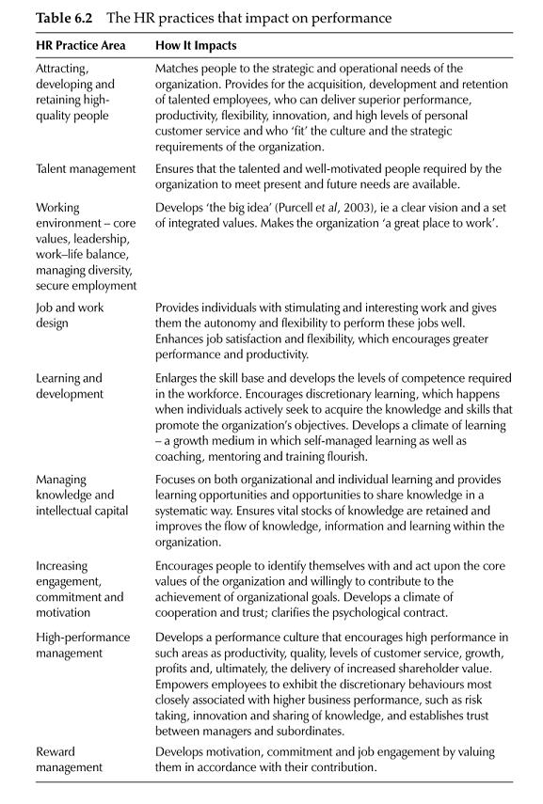

Slide 11
Case study/HRM Skills

Slide 12
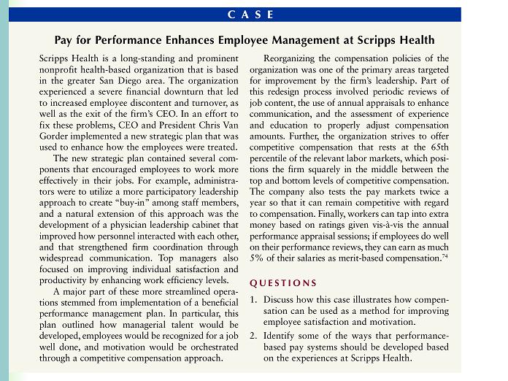

Slide 13
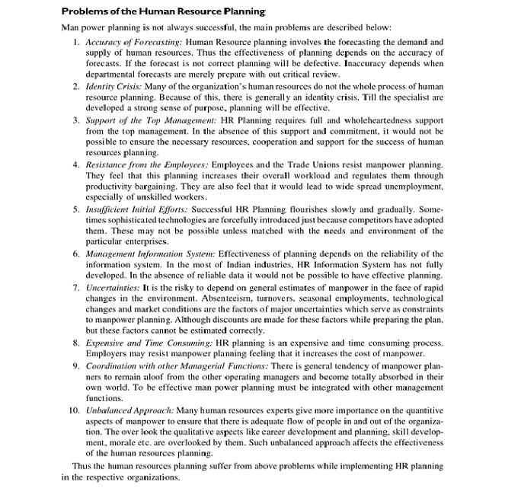

Slide 14
Thank you

