Slide 1
Strategic Human Resource Management
Imran Ghaznavi
Twitter: @ighaznavi
Course Code: MGT557
COMSATS

Slide 2
Lecture 24

Slide 3
Lecture outline
Overview of 23rd Lecture
The Impact of Strategic HRM
Case study
HRM Skills

Slide 4
The impact of strategic HRM

Slide 5
The impact of strategic HRM
Strategic HRM aims to improve business performance through people and to meet the needs of the organization’s employees - employee well being could be a major concern
However organizations in all sectors (private, public or voluntary) have to be businesslike in the sense that they are in the business of effectively and efficiently achieving their purpose, whether this is to make profits, deliver a public service or undertake charitable functions.

Slide 6
The impact of strategic HRM
The assumption underpinning the practice of HRM is that
  people are the organization’s key resource and organizational performance largely depends on them.
  If therefore an appropriate range of HR policies and processes is developed and implemented effectively, then HR will make a substantial impact on firm performance.

Slide 7
The impact of strategic HRM
There has been much research, as summarized in Table, that has attempted to answer two basic questions
  ‘Do HR practices make a positive impact on organizational performance?’;
  ‘If so, how is the impact achieved?’
Second question is the more important one.

Slide 8
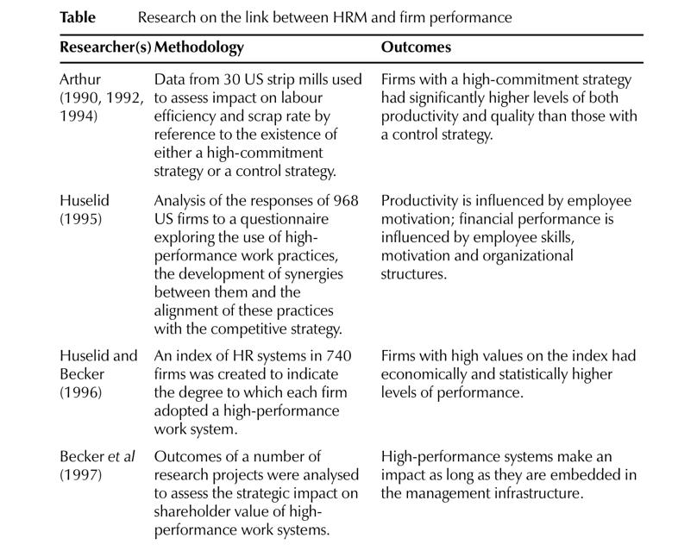

Slide 9
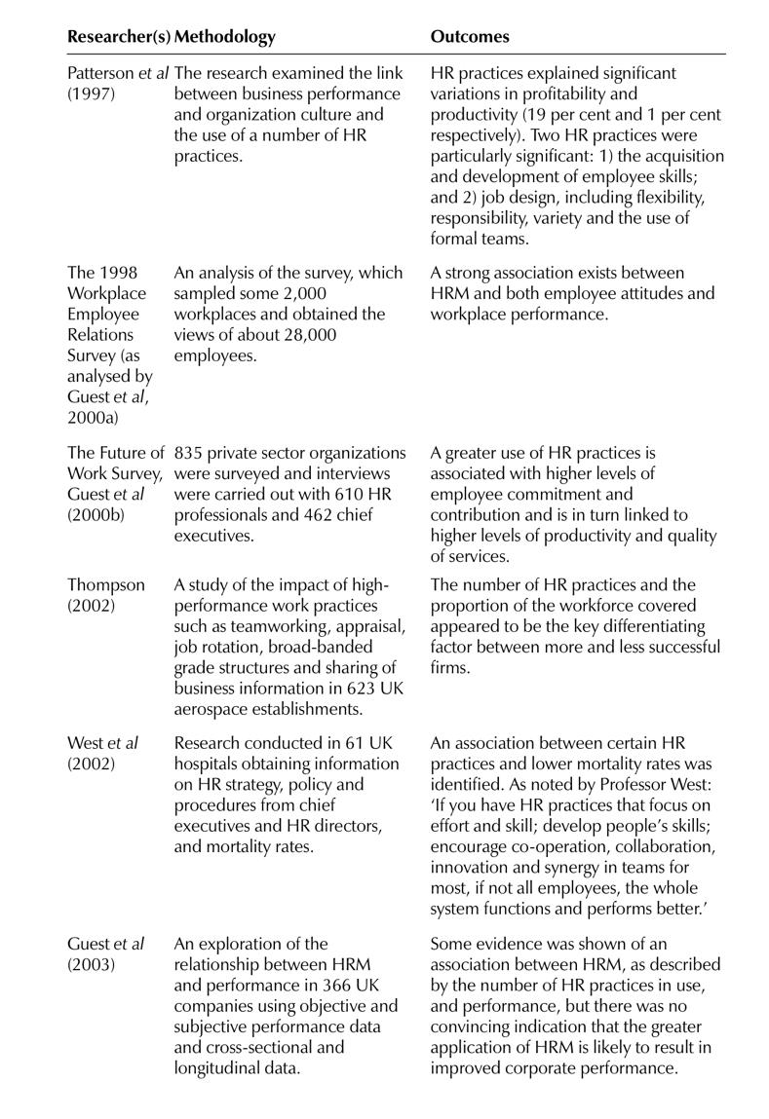

Slide 10
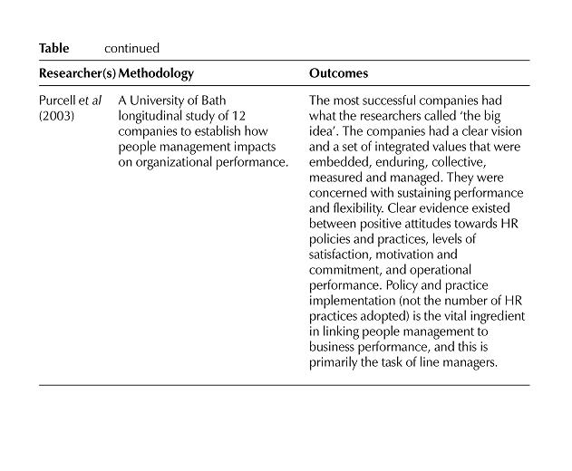

Slide 11
Thank you

