Slide 1
Strategic Human Resource Management
Imran Ghaznavi
Twitter: @ighaznavi
Course Code: MGT557
COMSATS

Slide 2
Lecture 23

Slide 3
Lecture outline
Overview of 22nd Lecture
Case Studies
HRM Skills

Slide 4
Case Study

Slide 5
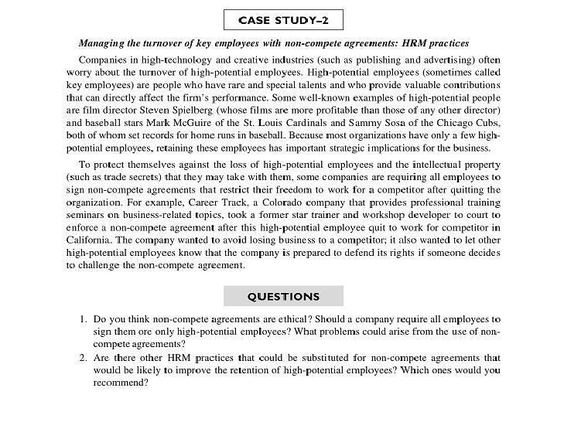

Slide 6
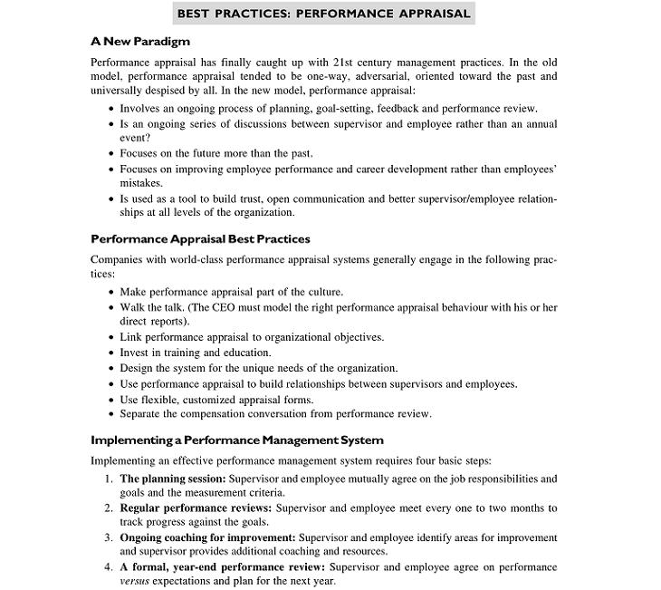

Slide 7
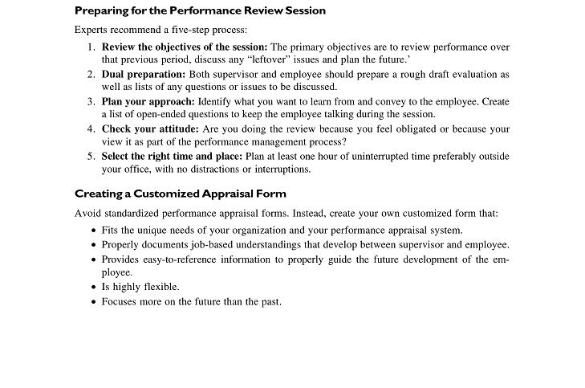

Slide 8
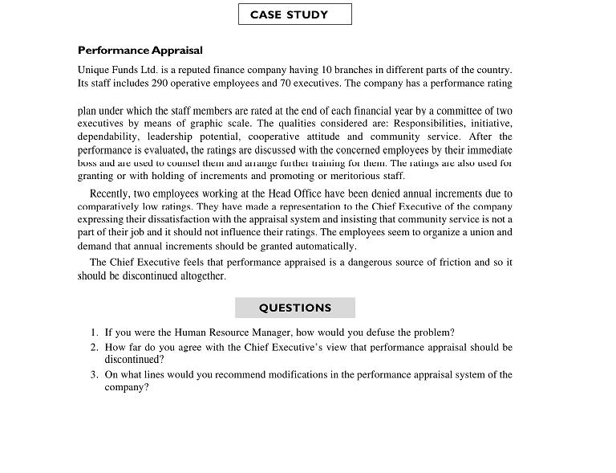

Slide 9
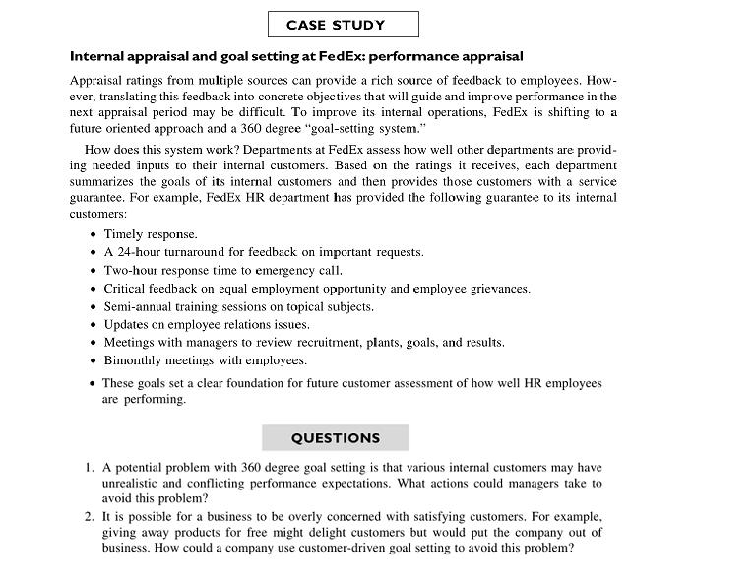

Slide 10
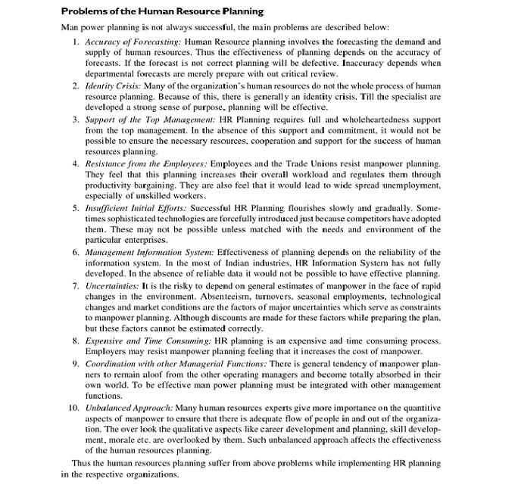

Slide 11
Thank you

