Slide 1
Strategic Human Resource Management
Imran Ghaznavi
Twitter: @ighaznavi
Course Code: MGT557
COMSATS

Slide 2
Lecture 22

Slide 3
Lecture outline
Overview of 21th Lecture
Strategic role of HR
Case Study

Slide 4
Case Study

Slide 5
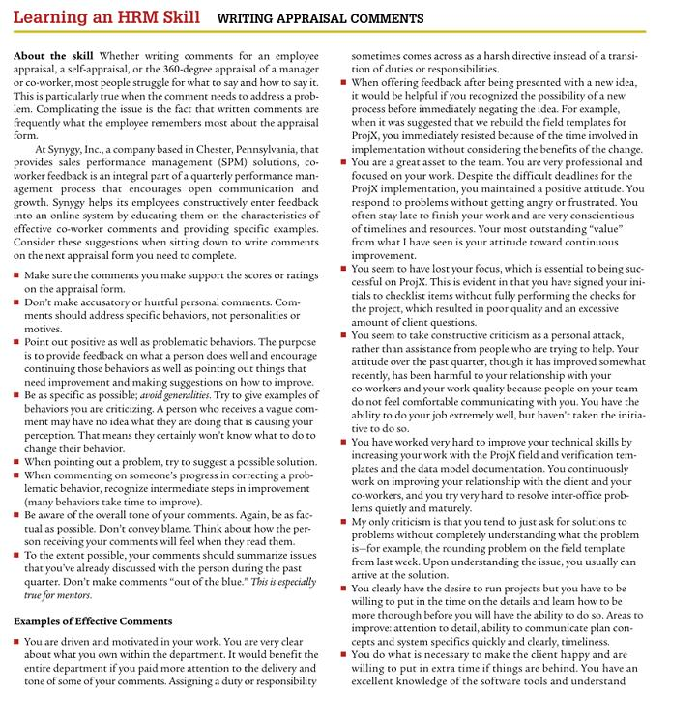

Slide 6
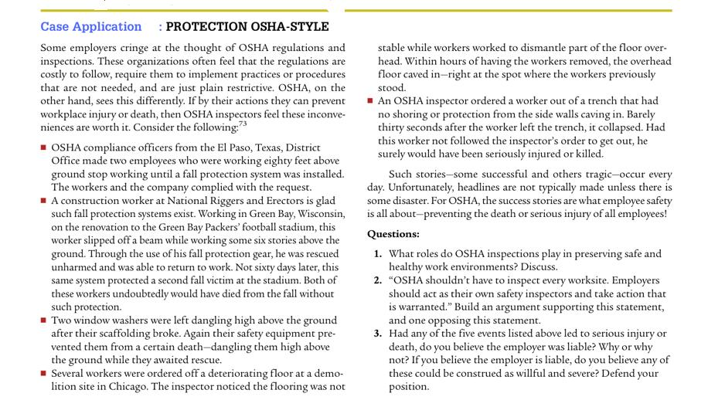

Slide 7
The strategic role of HR

Slide 8
The strategic role of HR
Strategic HRM is not just about strategic planning. It is equally, if not more, concerned with the implementation of strategy and the strategic behaviour of HR specialists working with their line management colleagues on an everyday basis to ensure that the business goals of the organization are achieved and its values are put into practice.

Slide 9
THE STRATEGIC NATURE OF HR
The work of HR practitioners can be divided into two main areas: transactional activities and strategic activities.
  Transactional activities consist of the service delivery aspects of HR – recruitment, training, dealing with people issues, legal compliance and employee services.
  HR strategic activities support the achievement of the organization’s goals and values and involve the development and implementation of forward-looking HR strategies that are integrated with one another and aligned to business objectives.

Slide 10
THE STRATEGIC NATURE OF HR
HR strategic activities also involve HR practitioners working with their line management colleagues in the continuous development and implementation of the business strategy
HR has to get its service delivery activities right – that’s what it’s there to do, day by day, and its reputation with line managers largely depends on this.
According to the resource-based view, the importance of human capital in achieving competitive advantage is necessary, therefore the credibility of HR depends on its ability to make a strategic contribution that ensures that the organization has the quality of skilled, motivated and engaged people.
The strategic nature of HR has been expressed in the strategic partner model

Slide 11
THE STRATEGIC PARTNER MODEL
HR practitioners share responsibility with their line management colleagues for the success of the enterprise.
  The are described as business managers who have the capacity to identify business opportunities,
  to see the broad picture and to understand how their role can help to achieve the company’s business objectives.
  They integrate their activities closely with top management and ensure that they serve a long-term strategic purpose.
  They anticipate needs, act flexibly and are proactive.

Slide 12
THE STRATEGIC PARTNER MODEL:
The David Ulrich approach
David Ulrich (1998) argued that HR professionals carry out the following proactive roles as champions of competitiveness in creating and delivering value:
  1. strategic partners helping the business to successfully implement strategy;
  2. administrative experts improving organizational efficiency by re-engineering the HR function and other work processes;
  3. employee champions maximizing employee commitment and competence and their overall responsiveness to change;
  4. change agents delivering organizational transformation and culture change.

Slide 13
The David Ulrich model: Reformulated
This model was reformulated by Ulrich and Brockbank in 2005 to list the following roles:
Strategic partner – consists of multiple dimensions: business expert, change agent, strategic HR planner, knowledge manager and consultant; combining them to align HR systems to help accomplish the organization’s vision and mission, helping managers to get things done, and disseminating learning across the organization
Employee advocate – focuses on the needs of today’s employees through listening, understanding and empathizing.
Human capital developer – in the role of managing and developing human capital (individuals and teams), focuses on preparing employees to be successful in the future.

Slide 14
The David Ulrich model: Reformulated
Functional expert – concerned with the HR practices that are central to HR value, acting with insight on the basis of the body of knowledge possessed. Some are delivered through administrative efficiency (such as technology or process design), and others through policies, menus and interventions.
Leader – leading the HR function, collaborating with other functions and providing leadership to them, setting and enhancing the standards for strategic thinking and ensuring corporate governance.

Slide 15
Business partnering
The concept of business partnering has been enthusiastically adopted by the Chartered Institute of Personnel and Development (2007a).
The term ‘business partner’ was defined loosely as covering ‘a diversity of jobs from strategic to administrative to consultancy’.
According to the CIPD, business partnering ‘makes HR accountable to the business, and expects HR to add real value’.

Slide 16
THE STRATEGIC ROLE OF HR DIRECTORS
The strategic role of HR directors is to promote the achievement of the organization’s business goals by
  1) developing and implementing HR strategies that are integrated with the business strategy and are coherent and mutually supportive and
  2) ensuring that a strategic approach is adopted by the HR function that supports the business and adds value

Slide 17
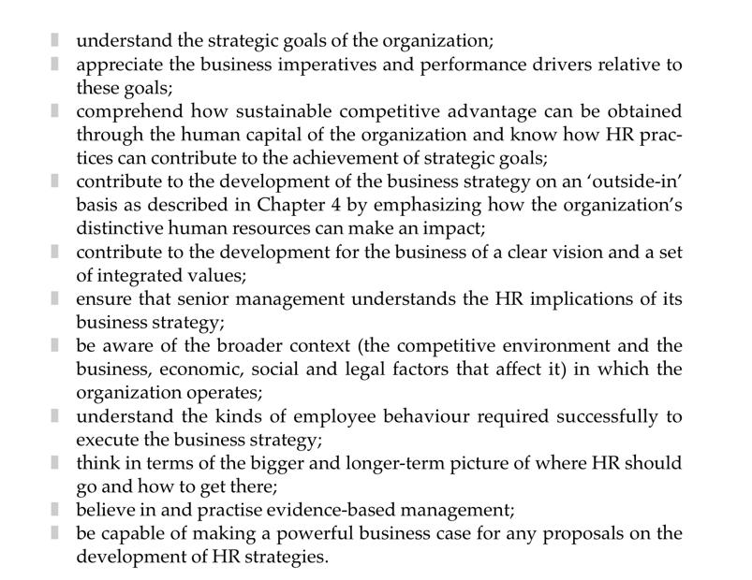
To carry out this role HR directors should

Slide 18
THE STRATEGIC ROLE OF HEADS OF HR FUNCTIONS
The strategic role of heads of HR functions is fundamentally the same for their function as that of HR directors for the whole organization.
They promote the achievement of the organization’s business goals by developing and implementing functional strategies that are aligned with the business strategy and integrated with the strategies for other HR functions and adopt a strategic approach in the sense of ensuring that HR activities support the business and add value.

Slide 19
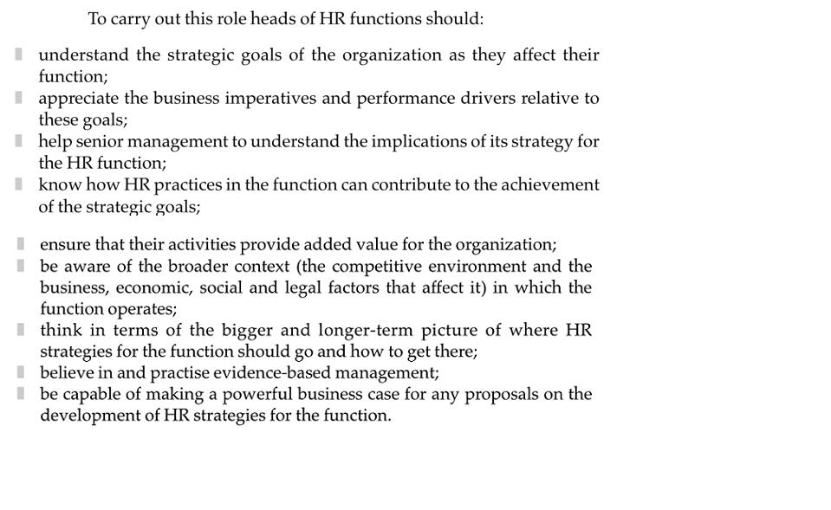
fig

Slide 20
THE STRATEGIC ROLE OF HR BUSINESS PARTNERS
The strategic role of HR business partners is to promote the achievement of the business goals of the organizational unit or function in which they operate

Slide 21
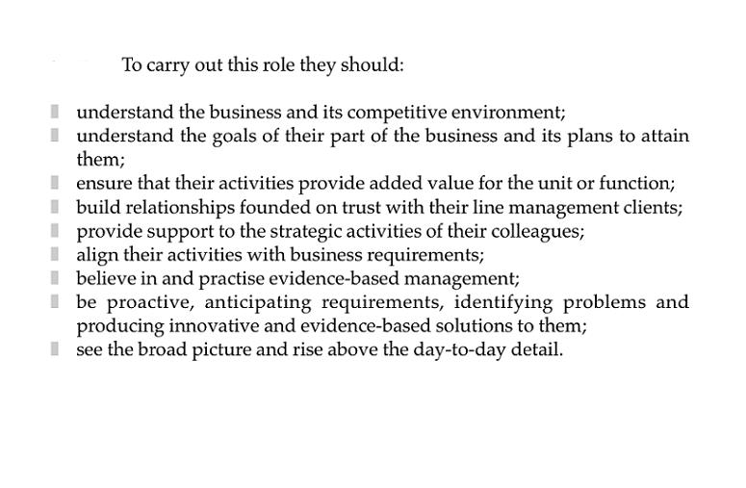

Slide 22
THE STRATEGIC CONTRIBUTION OF HR ADVISERSOR ASSISTANTS
The role of HR advisers or assistants is primarily that of delivering effective HR services within their function or as members of an HR service centre.
While they will not be responsible for the formulation of HR strategies they may contribute to them within their own specialty.
They will need to understand the business goals of the departments or managers for whom they provide services in order to ensure that these services support the achievement of those goals.

Slide 23
Case Study

Slide 24
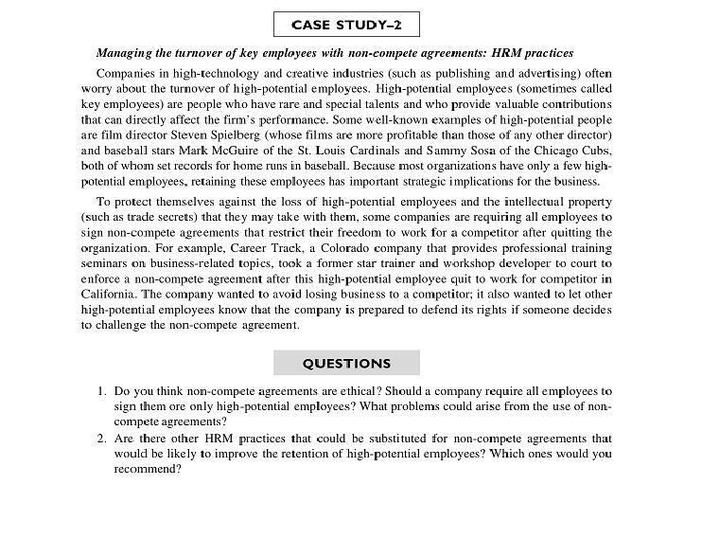

Slide 25
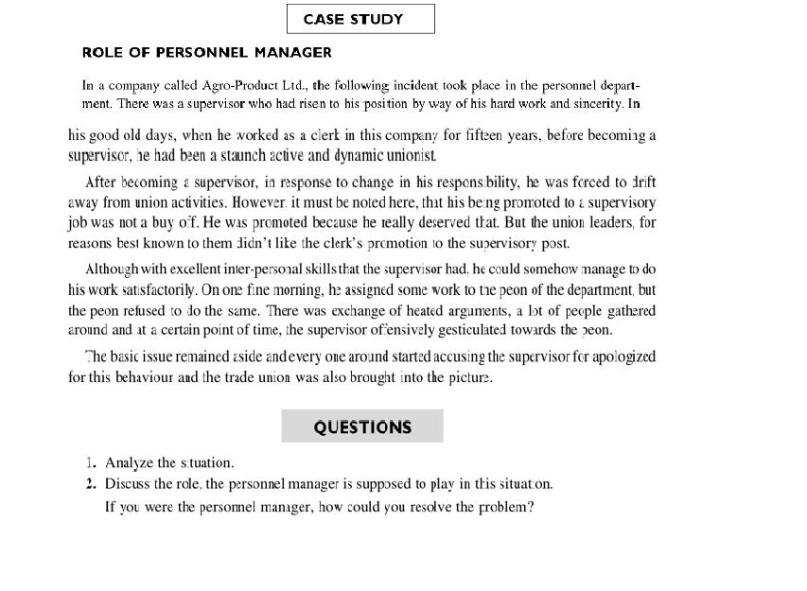

Slide 26
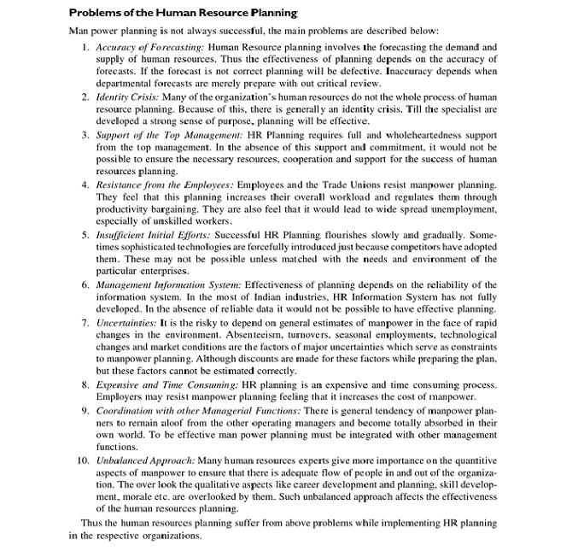

Slide 27
Thank you

