Slide 1
Strategic Human Resource Management
Imran Ghaznavi
Twitter: @ighaznavi
Course Code: MGT557
COMSATS

Slide 2
Lecture 20

Slide 3
Lecture outline
Overview of 19th Lecture
Case Study
Specific HR Strategies
Developing HR Strategies

Slide 4
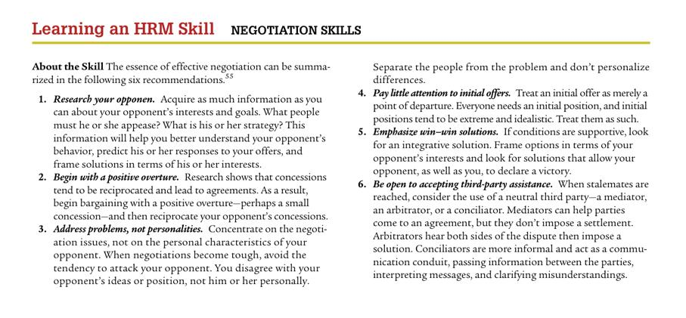

Slide 5
SPECIFIC HR STRATEGIES

Slide 6
SPECIFIC HR STRATEGIES
Specific HR strategies set out what the organization intends to do in areas such as:
human capital management – obtaining, analyzing and reporting on data, which inform the direction of value-adding people management, strategic, investment and operational decisions;
high-performance management – developing and implementing high-performance work systems;
corporate social responsibility – a commitment to managing the business ethically in order to make a positive impact on society and the environment;

Slide 7
SPECIFIC HR STRATEGIES
organization development – the planning and implementation of programs designed to enhance the effectiveness with which an organization functions and responds to change;
engagement – the development and implementation of policies designed to increase the level of employees’ engagement with their work and the organization;
knowledge management – creating, acquiring, capturing, sharing and using knowledge to enhance learning and performance;

Slide 8
SPECIFIC HR STRATEGIES
resourcing – attracting and retaining high-quality people;
talent management – how the organization ensures that it has the talented people it needs to achieve success;
learning and development – providing an environment in which employees are encouraged to learn and develop;
reward – defining what the organization wants to do in the longer term to develop and implement reward policies, practices and processes that will further the achievement of its business goals and meet the needs of its stakeholders;

Slide 9
SPECIFIC HR STRATEGIES
employee relations – defining the intentions of the organization about what needs to be done and what needs to be changed in the ways in which the organization manages its relationships with employees and their trade unions.

Slide 10
SPECIFIC HR STRATEGIES
Some examples of specific HR strategies:
The Children’s Society:
  Implement the rewards strategy of the Society to support the corporate plan and secure the recruitment, retention and motivation of staff to deliver its business objectives.
  Manage the development of the human resources information system to secure productivity improvements in administrative processes.
  Introduce improved performance management processes for managers and staff of the Society.
  Implement training and development which supports the business objectives of the Society and improves the quality of work with children and young people.

Slide 11
SPECIFIC HR STRATEGIES
A government agency:
The key components of the HR strategy are:
  Investing in people – improving the level of intellectual capital.
  Performance management – integrating the values contained in the HR strategy into performance management processes and ensuring that reviews concentrate on how well people are performing those values.
  Job design – a key component concerned with how jobs are designed and how they relate to the whole business.
  The reward system – in developing rewards strategies, taking into account that this is a very hard-driven business.

Slide 12
CRITERIA FOR AN EFFECTIVE HR STRATEGY
An effective HR strategy is one that works in the sense that it achieves what it sets out to achieve. In particular, it:
  will satisfy business needs;
  will be founded on detailed analysis and study, not just wishful thinking;
  can be turned into actionable programmes that anticipate implementation requirements and problems;

Slide 13
CRITERIA FOR AN EFFECTIVE HR STRATEGY
  is coherent and integrated, being composed of components that fit with and support each other;
  takes account of the needs of line managers and employees generally as well as those of the organization and its other stakeholders.
  As Boxall and Purcell (2003) emphasize, ‘HR planning should aim to meet the needs of the key stakeholder groups involved in people management in the firm.’

Slide 14
Case Study

Slide 15
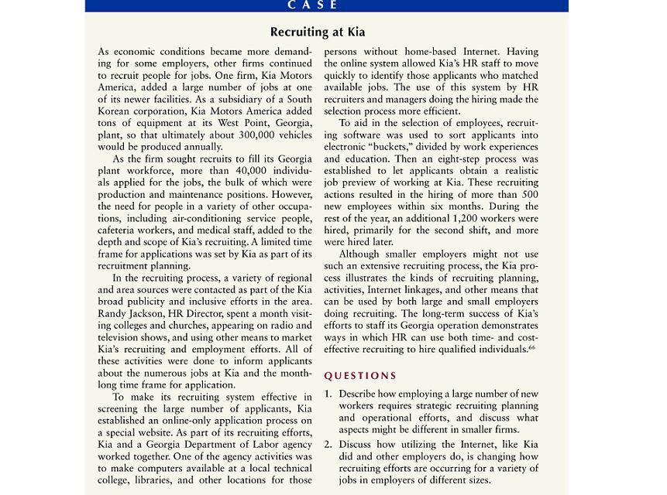

Slide 16
Thank you
For any question or query contact through
twitter: @ighaznavi

