Slide 1
Strategic Human Resource Management
Imran Ghaznavi
Twitter: @ighaznavi
Course Code: MGT557
COMSATS

Slide 2
Lecture Two

Slide 3
Lecture outline
Overview of 1st Lecture
HRM Process
Human Resource System
Aims of HRM
Characteristics of HRM

Slide 4
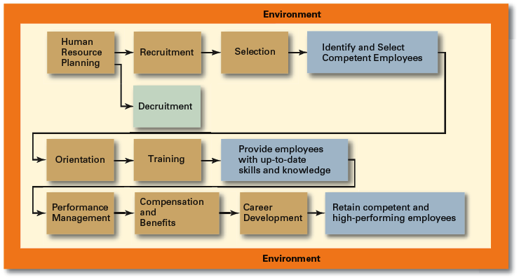
Human Resource Management Process

Slide 5
Orientation
Transitioning a new employee into the organization.
  Work-unit orientation
    Familiarizes new employee with work-unit goals
    Clarifies how his or her job contributes to unit goals
    Introduces he or she to his or her coworkers
  Organization orientation
    Informs new employee about the organization’s objectives, history, philosophy, procedures, and rules.
    Includes a tour of the entire facility

Slide 6
Types of Training
General
  Communication skills, computer systems application and programming, customer service, executive development, management skills and development, personal growth, sales, supervisory skills, and technological skills and knowledge
Specific
  Basic life/work skills, creativity, customer education, diversity/cultural awareness, remedial writing, managing change, leadership, product knowledge, public speaking/presentation skills, safety, ethics, sexual harassment, team building, wellness, and others

Slide 7
Employee Training Methods
Traditional
Training Methods
Technology-Based Training Methods
  On-the-job
  Job rotation
  Mentoring and coaching
  Experiential exercises
  Workbooks/manuals
  Classroom lectures
  CD-ROM/DVD/videotapes/ audiotapes
  Videoconferencing/ teleconferencing/
  satellite TV
  E-learning

Slide 8
Employee Performance Management
Performance Management System
  A process of establishing performance standards and appraising employee performance in order to arrive at objective HR decisions and to provide documentation in support of those decisions

Slide 9
Compensation and Benefits
Benefits of a Fair, Effective, and Appropriate Compensation System
  Helps attract and retain high-performance employees
  Impacts on the strategic performance of the firm
Types of Compensation
  Base wage or salary
  Wage and salary add-ons
  Incentive payments
  Skill-based pay
  Variable pay

Slide 10
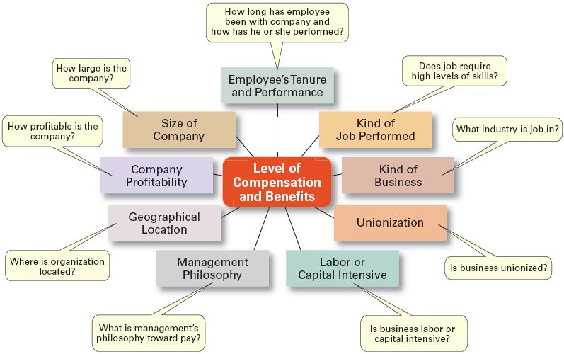
Factors That Influence Compensation and Benefits
Sources: Based on R.I. Henderson, Compensation Management, 6th ed. (Upper Saddle River, NJ: Prentice Hall, 1994), pp. 3–24; and A. Murray, “Mom, Apple Pie, and Small Business,” Wall Street Journal, August 15, 1994, p. A1

Slide 11
Material for next lecture
  Case Study
  HRM Skill
  Enhancing your communication skills

Slide 13
Case application
Questions:
1. What role, if any, does work/life balance play in the success of an organization? Explain.
2. How does diversity in an organization affect the organization’s work/life balance? What ethical considerations exist that may drive the organization to be more work/life balanced?
3. How can organizations develop a culture that supports work/ life balance?
4. What role does human resource play in making sure work/life practices are effective?
Reference Human Resource Management By David A. DeCenzo & Stephen P. Robbins 10th edition Page 25

Slide 14
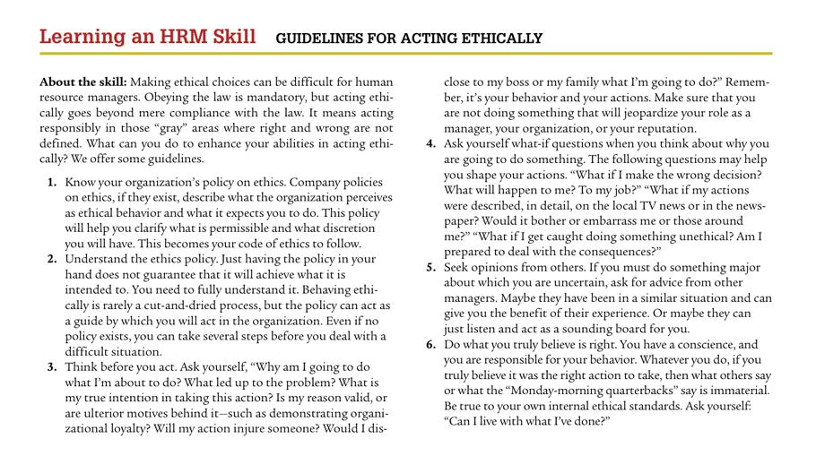

Slide 15
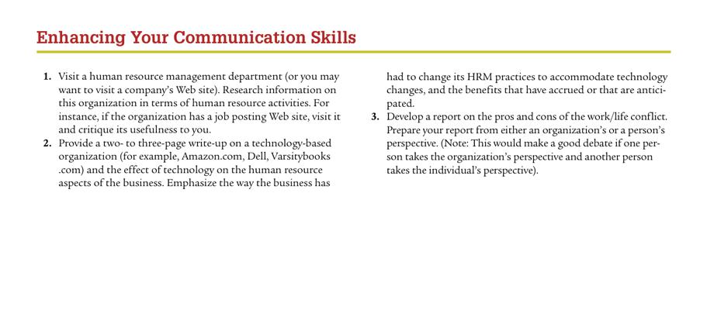

Slide 16
Thank you
For any question or query contact through
twitter: @ighaznavi

