Slide 1
Strategic Human Resource Management
Imran Ghaznavi
Twitter: @ighaznavi
Course Code: MGT557
COMSATS

Slide 2
Lecture 19

Slide 3
Lecture outline
Overview of 18th Lecture
Case Study/HRM Skills
Specific HR Strategies

Slide 4
HR strategies
As we have discussed that strategic HRM is a mindset, which leads to strategic actions and reactions, in the form of either overall or specific HR strategies or strategic behavior on the part of HR professionals

Slide 5
HR Strategies
Lets focuses on HR strategies under the following headings:
  What are HR strategies?
  What is the purpose of HR strategies?
  What are the main types of overall HR strategies?
  What are the main areas in which specific HR strategies are developed?
  What are the criteria for an effective HR strategy?
  How should HR strategies be developed?
  How should HR strategies be implemented?

Slide 6
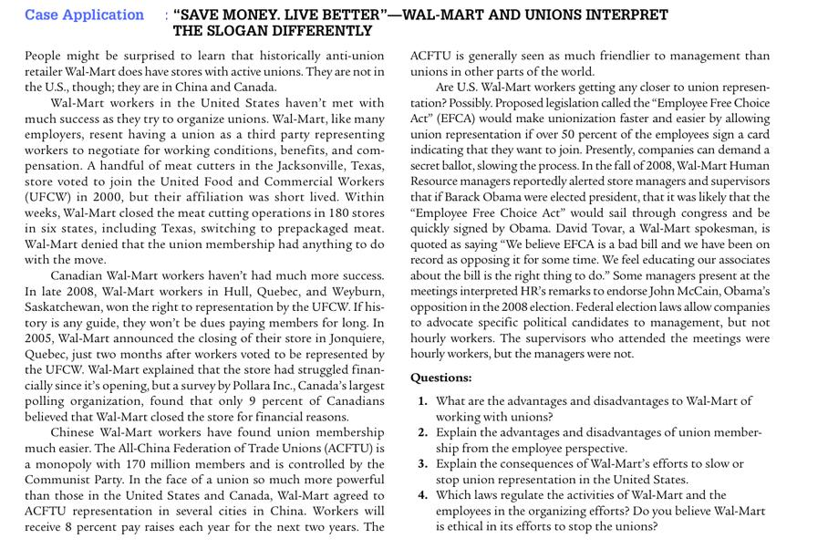

Slide 7
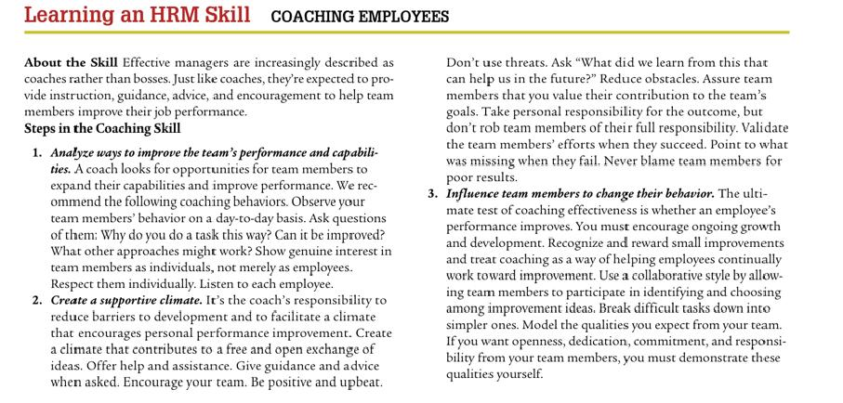

Slide 8
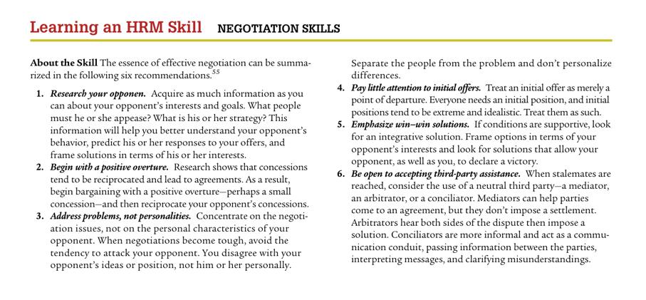

Slide 9
Case Study

Slide 10
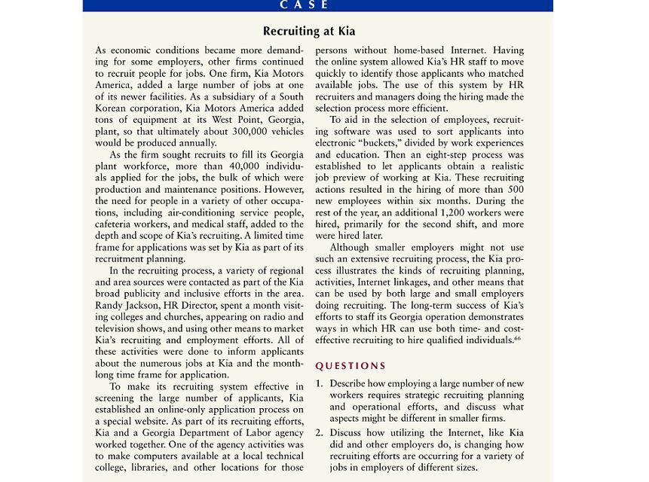

Slide 11
Thank you
For any question or query contact through
twitter: @ighaznavi

