Slide 1
Strategic Human Resource Management
Imran Ghaznavi
Twitter: @ighaznavi
Course Code: MGT557
COMSATS

Slide 2
Lecture 18

Slide 3
Lecture outline
Overview of 17th Lecture
HR Practices
Case Study

Slide 4
SHRM : The Best-Practice Approach
This approach is based on the assumption that there is a set of best HRM practices and that adopting them will inevitably lead to superior organizational performance.
They are universal in the sense that they are best in any situation.

Slide 5
The Best-Fit Approach
The best-fit approach emphasizes that HR strategies should be contingent on the context, circumstances of the organization and its type.
‘Best fit’ can be perceived in terms of vertical integration or alignment between the organization’s business and HR strategies.
There is a choice of models, namely life cycle, competitive strategy, and strategic configuration.
Notes:
Dependent

Slide 6
Bundling
‘A strategy’s success turns on combining “vertical” or external fit and “horizontal” or internal fit.’
  Richardson and Thompson (1999) conclude that a firm with bundles of associated HR practices should have a higher level of performance, providing it also achieves high levels of fit with its competitive strategy
‘Bundling’ is the development and implementation of several HR practices together so that they are interrelated and therefore complement and reinforce each other.

Slide 7
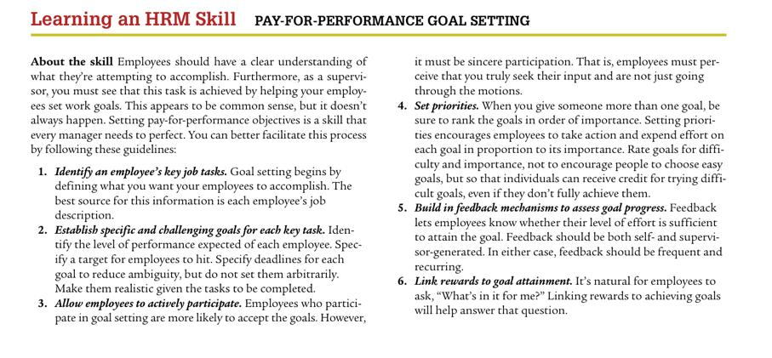

Slide 8
The practice of strategic HRM

Slide 9
HR strategies
As we have discussed that strategic HRM is a mindset, which leads to strategic actions and reactions, in the form of either overall or specific HR strategies or strategic behavior on the part of HR professionals

Slide 10
HR Strategies
Lets focuses on HR strategies under the following headings:
  What are HR strategies?
  What is the purpose of HR strategies?
  What are the main types of overall HR strategies?
  What are the main areas in which specific HR strategies are developed?
  What are the criteria for an effective HR strategy?
  How should HR strategies be developed?
  How should HR strategies be implemented?

Slide 11
WHAT ARE HR STRATEGIES?
HR strategies set out what the organization intends to do about its human resource management policies and practices and how they should be integrated with the business strategy and each other.
They are described by Dyer and Reeves (1995) as ‘internally consistent bundles of human resource practices’, and
In the words of Peter Boxall (1996) they provide ‘a framework of critical ends and means’

Slide 12
WHAT ARE HR STRATEGIES?
As we know all organizations are different, all HR strategies are different.
There is no such thing as a standard strategy, and research into HR strategy conducted by Armstrong and Long (1994) and Armstrong and Baron (2002) revealed many variations.
Some strategies are simply very general declarations of intent. Others go into much more detail.
But two basic types of HR strategies can be identified. These are: 1) overall strategies such as high performance working; and
2) specific strategies relating to the different aspects of human resource management such as learning and development and reward.

Slide 13
WHAT IS THE PURPOSE OF HR STRATEGIES?
The purpose of HR strategies is to articulate what an organization intends to do about its human resource management policies and practices now and in the longer term,
Bearing in mind the saying of Fombrun et al (1984) that business and managers should perform well in the present to succeed in the future.

Slide 14
WHAT IS THE PURPOSE OF HR STRATEGIES?
HR strategies may set out intentions and provide a sense of purpose and direction, but they are not just long-term plans.
As Lynda Gratton (2000) commented, ‘There is no great strategy, only great execution.’

Slide 15
OVERALL HR STRATEGIES
Overall strategies describe the general intentions of the organization about how people should be managed and developed and what steps should be taken to ensure that the organization can attract and retain the people it needs and ensure so far as possible that employees are committed, motivated and engaged.
There are four categories of overall strategy

Slide 16
OVERALL HR STRATEGIES
1. An emergent, evolutionary and possibly unarticulated understanding of the required approach to human resource management. This will be influenced by the business strategy as it develops, the position of the organization in its life cycle, and the organizational configuration (prospector, defender or analyser). It will also be affected by the views, experience and management style of the chief executive, senior managers and the head of HR, whose influence will depend on position and credibility.

Slide 17
OVERALL HR STRATEGIES
2. Broad-brush statements of aims and purpose that set the scene for more specific strategies. They will be concerned with overall organizational effectiveness – achieving human resource advantage by employing ‘better people in organizations with better process’ and generally creating ‘a great place to work’.
3. Specific and articulated plans to create ‘bundles’ of HR practices and develop a coherent HR system.

Slide 18
OVERALL HR STRATEGIES
4. The conscious introduction of overall approaches to human resource management such as high-performance management, high-involvement management and high-commitment management

Slide 19
High-performance management
High-performance management aims to make an impact on the performance of the organization through its people in such areas as productivity, quality, levels of customer service, growth, profits and, ultimately, the delivery of increased shareholder value.
As a bundle, these practices are often called high-performance work systems (HPWS)
Notes:
High-performance management practices include rigorous recruitment and selection procedures, extensive and relevant training and management development activities, incentive pay systems and performance management processes

Slide 20
High-involvement management
The term ‘high involvement’ was used by Lawler (1986) to describe management systems based on commitment and involvement, as opposed to the old bureaucratic model based on control.
Employees will increase their involvement with the company if they are given the opportunity to control and understand their work
This approach involves treating employees as partners in the enterprise whose interests are respected and who have a voice on matters that concern them.

Slide 21
High-commitment management
One of the defining characteristics of HRM is its emphasis on the importance of enhancing mutual commitment.
‘A form of management which is aimed at eliciting a commitment so that behaviour is primarily self regulated rather than controlled by sanctions and pressures external to the individual, and relations within the organization are based on high levels of trust.’
High-commitment management has been described by Wood (1996)

Slide 22
High-commitment management
The approaches to achieving high commitment as described by Beer et al (1984) and Walton (1985) are:
the development of career ladders and emphasis on trainability and commitment as highly valued characteristics of employees at all levels in the organization;
a high level of functional flexibility, with the abandonment of potentially rigid job descriptions;
the reduction of hierarchies and the ending of status differentials;
a heavy reliance on team structure for disseminating information (team briefing), structuring work (team working) and problem solving (quality circles).

Slide 23
Case Study : HRM Skills

Slide 24
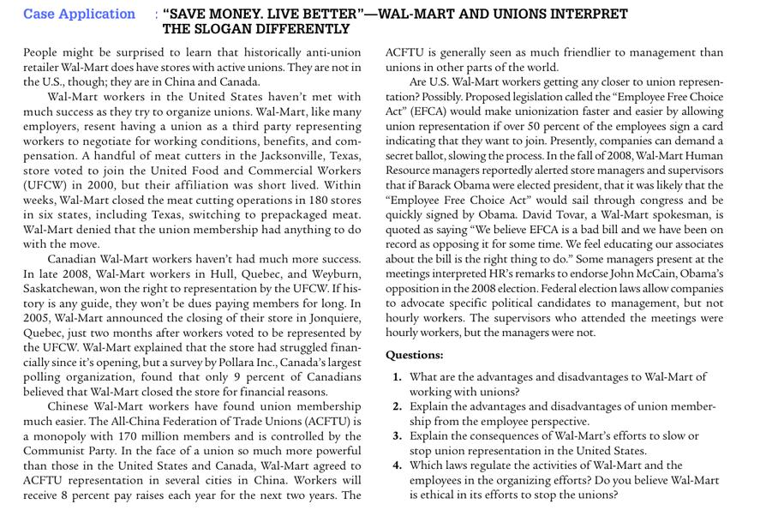

Slide 25
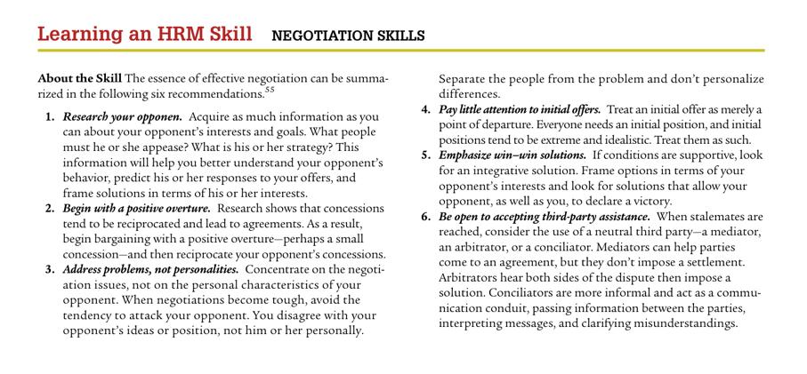

Slide 26
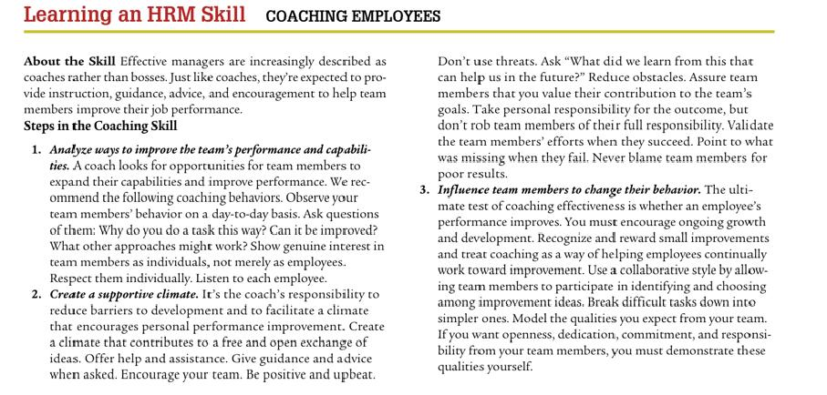

Slide 27
Thank you
For any question or query contact through
twitter: @ighaznavi

