Slide 1
Strategic Human Resource Management
Imran Ghaznavi
Twitter: @ighaznavi
Course Code: MGT557
COMSATS

Slide 2
Lecture 17

Slide 3
Lecture outline
Overview of 16th Lecture
Case Study
HR Practices

Slide 4
Case Study: HRM skills

Slide 5
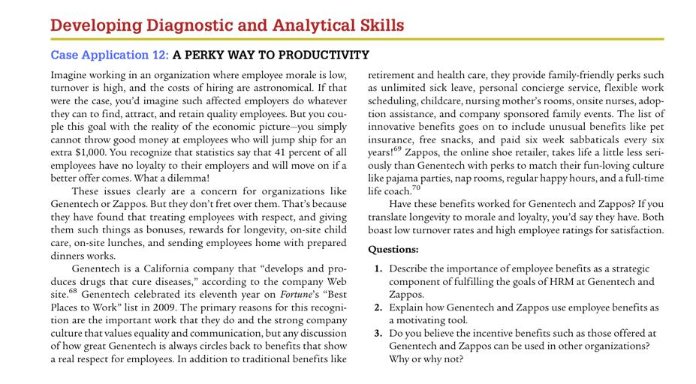

Slide 6
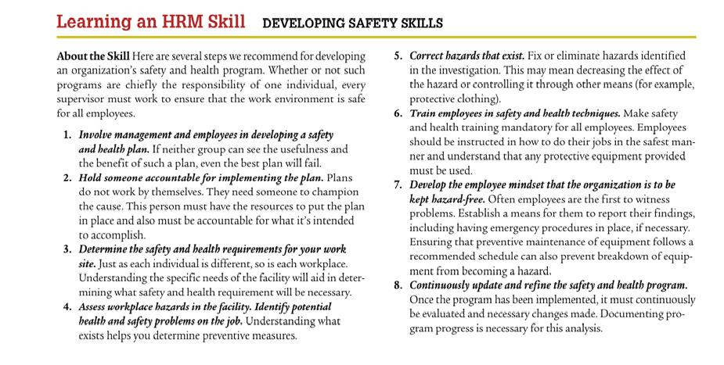

Slide 7
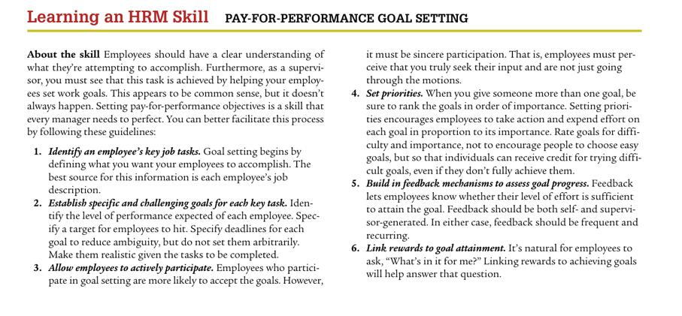

Slide 8
Strategic Human Resource Management

Slide 9
Best Practice Approach
A number of lists of ‘best practices’ have been produced, the best known of which was produced by Pfeffer (1994), namely
  1. employment security;
  2. selective hiring;
  3. self-managed teams;
  4. high compensation contingent on performance;
  5. training to provide a skilled and motivated workforce;
  6. reduction of status differentials;
  7. sharing information.

Slide 10
Best Practice Approach
List drawn up by Guest (1999):
1. selection and the careful use of selection tests to identify those with potential to make a contribution;
2. training, and in particular a recognition that training is an ongoing activity;
3. job design to ensure flexibility, commitment and motivation, including steps to ensure that employees have the responsibility and autonomy fully to use their knowledge and skills;
4. communication to ensure that a two-way process keeps everyone fully informed;
5. employee share ownership programms to increase employees’ awareness of the implications of their actions on the financial performance of the firm.

Slide 11
The Best-Fit Approach
The best-fit approach emphasizes that HR strategies should be contingent on the context, circumstances of the organization and its type.
‘Best fit’ can be perceived in terms of vertical integration or alignment between the organization’s business and HR strategies.
There is a choice of models, namely life cycle, competitive strategy, and strategic configuration.
Notes:
Dependent

Slide 12
The Best-Fit Approach
The life cycle model
  The life cycle model is based on the theory that the development of a firm takes place in four stages: start-up, growth, maturity and decline. This is in line with product life cycle theory.

Slide 13
Best fit approach : Life cycle model
Human resource management’s effectiveness depends on its fit with the organization’s stage of development.
As the organization grows and develops, human resource management programs, practices and procedures must change to meet its needs.
Consistent with growth and development models it can be suggested that human resource management develops through a series of stages as the organization becomes more complex.
Baird and Meshoulam (1988)

Slide 14
Best fit :Competitive strategies
Three strategies aimed at achieving competitive advantage have been identified by Porter (1985):
  1. innovation – being the unique producer;
  2. quality – delivering high-quality goods and services to customers;
  3. cost leadership – the planned result of policies aimed at ‘managing away’ expense.
‘Effectiveness can be increased by systematically melding human resource practices with the selected competitive strategy’.
Schuler and Jackson (1987)
They described the HR characteristics of firms pursuing one or other of the three strategies (Table ).

Slide 15
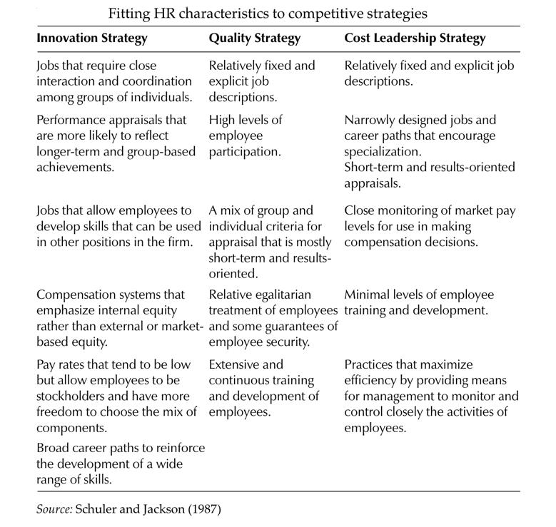

Slide 16
Strategic Configuration
Another approach to best fit is the proposition that organizations will be more effective if they adopt a policy of strategic configuration by matching their strategy to one of the ideal types defined by theories such as those produced by Mintzberg (1979) and Miles and Snow (1978).

Slide 17
Strategic configuration
Mintzberg (1979) classified them into five ideal types: simple structure, machine bureaucracy, professional bureaucracy, divisionalized form and adhocracy.
Miles and Snow (1978) identified four types of organizations, classifying the first three types as ‘ideal’ organizations:

Slide 18
Strategic Configuration
1. Prospectors, which operate in an environment characterized by rapid and unpredictable changes. They react to this environment by focusing on the development of new products, markets and technologies.
  Prospectors have low levels of formalization and specialization and high levels of decentralization. They have relatively few hierarchical levels

Slide 19
Strategic Configuration
2. Defenders, which operate in a more stable and predictable environment than prospectors and engage in more long-term planning.
  They have more mechanistic or bureaucratic structures than prospectors and obtain coordination through formalization, centralization, specialization and vertical differentiation

Slide 20
Strategic Configuration
3. Analyzers, which are a combination of the prospector and defender types. They operate in stable environments like defenders and also in markets where new products are constantly required like prospectors.
They are usually not the initiators of change like prospectors but they follow the changes more rapidly than defenders.
Analyzers seek effectiveness through both efficiency and new products or markets.
They may also exhibit higher levels of interdependence than either prospectors or defenders.

Slide 21
Strategic Configuration
4. Reactors, which are unstable organizations existing in what they believe to be an unpredictable environment. They lack consistent, well-articulated strategies and do not undertake long-range planning.

Slide 22
Strategic Configuration
Delery and Doty (1996) suggest that organizations should align their HR systems with the strategy linked to their configuration and identified two systems :
market-type system where hiring is mainly from outside the organization, little use is made of internal career ladders, there is no formal training, performance appraisal is results-orientated, there is not much security, and jobs are not clearly defined.
internal system where hiring is mainly from within the organization, extensive use is made of career ladders, a lot of formal training is provided, performance is appraised by behavior orientated measures, there is considerable security, and jobs are tightly defined

Slide 23
Strategic Configuration
The prospector strategy requires a market system, while the internal system is appropriate for the defender strategy
The best-fit model seems to be more realistic than the best-practice model
Notes:
As Dyer and Holder (1988) point out, ‘The inescapable conclusion is that what is best depends.’ It can therefore be claimed that best fit is more important than best practice.

Slide 24
Bundling
‘A strategy’s success turns on combining “vertical” or external fit and “horizontal” or internal fit.’
  Richardson and Thompson (1999) conclude that a firm with bundles of associated HR practices should have a higher level of performance, providing it also achieves high levels of fit with its competitive strategy
‘Bundling’ is the development and implementation of several HR practices together so that they are interrelated and therefore complement and reinforce each other.

Slide 25
Thank you
For any question or query contact through
twitter: @ighaznavi

