Slide 1
Strategic Human Resource Management
Imran Ghaznavi
Twitter: @ighaznavi
Course Code: MGT557
COMSATS

Slide 2
Lecture 16

Slide 3
Lecture outline
Overview of 15th Lecture
Case Studies
SHRM: Best Practice Approach
SHRM : Best Fit approach
Case Study

Slide 4
Concepts of Strategic HRM
Strategic HRM is underpinned by three concepts, namely
  resource-based view,
  strategic fit and
  strategic flexibility.

Slide 5
Case Study

Slide 6
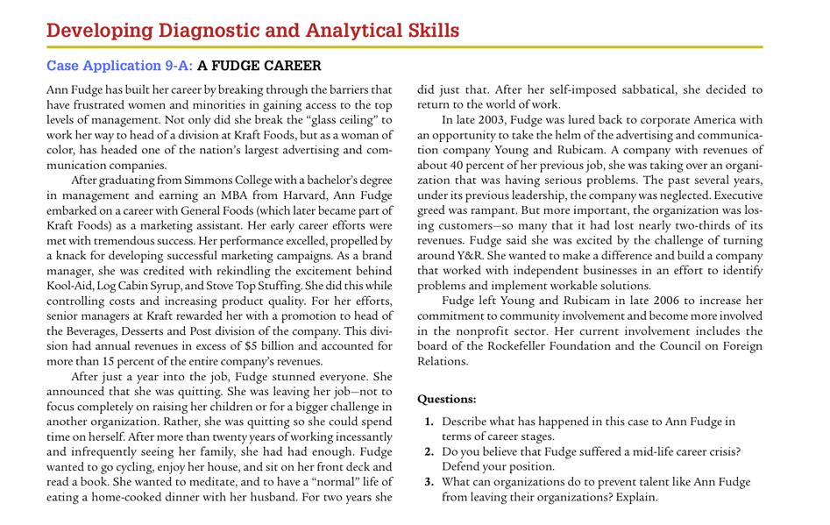

Slide 7
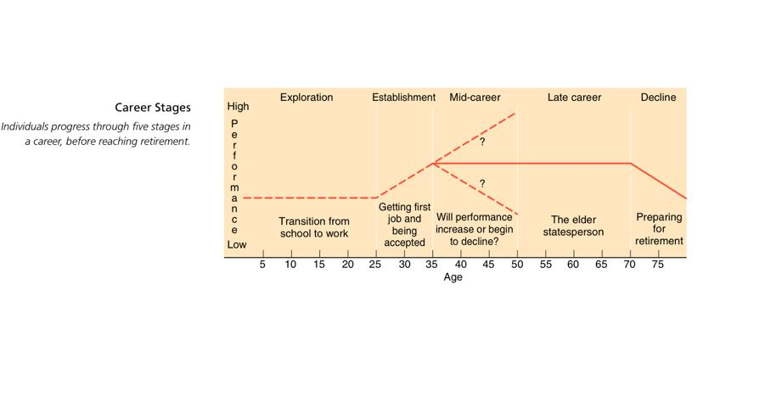

Slide 8
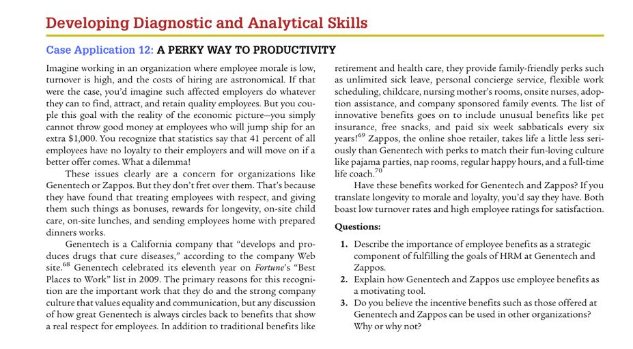

Slide 9


Slide 10
Case Study – HRM Skills

Slide 11
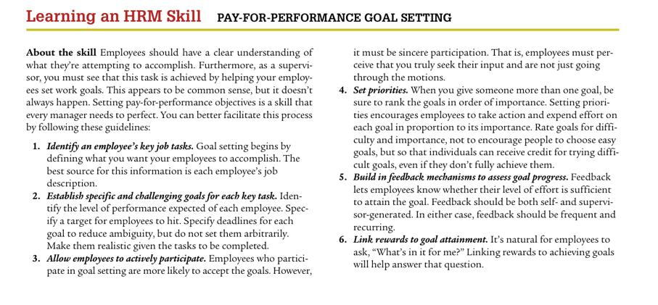

Slide 12
Thank you
For any question or query contact through
twitter: @ighaznavi

