Slide 1
Strategic Human Resource Management
Imran Ghaznavi
Twitter: @ighaznavi
Course Code: MGT557
COMSATS

Slide 2
Lecture 15

Slide 3
Lecture outline
Overview of 14th Lecture
SHRM defined, Principles of SHRM, Aims of SHRM
The Concept of SHRM
Case Study

Slide 4
Concepts of Strategic HRM
Strategic HRM is underpinned by three concepts, namely
  resource-based view,
  strategic fit and
  strategic flexibility.

Slide 5
Concepts of Strategic HRM
The resource-based view
  To a large extent, the philosophy of strategic HRM is based on the resource based view.
  This states that it is the range of resources in an organization, including its human resources, that produces its unique character and creates competitive advantage
(Hamel and Prahalad, 1989).

Slide 6
The resource-based view
For a firm resource to have the potential for creating sustained competitive advantage it should have four attributes:
  it must be 1) valuable, 2) rare, 3) imperfectly imitable and 4) non-substitutable.
  To discover these resources and capabilities, managers must look inside their firm for valuable, rare and costly-to imitate resources, and then exploit these resources through their organization.

Slide 7
The resource-based view
Resource-based strategic HRM can produce what Boxall and Purcell (2003) refer to as human resource advantage.
The aim is to develop strategic capability.

Slide 8
The resource-based view
The strategic fit between resources and opportunities, obtaining added value from the effective deployment of resources, and developing people who can think and plan strategically in the sense that they understand the key strategic issues and ensure that what they do support the achievement of the business’s strategic goals.

Slide 9
Concepts of Strategic HRM
Strategic fit
  As explained by Wright and McMahan (1992) strategic fit refers to the two dimensions that distinguish strategic HRM:
  ‘First, vertically, it entails the linking of human resource management practices with the strategic management processes of the organization.
  Second, horizontally, it emphasizes the coordination or congruence among the various human resource management practices.’

Slide 10
Concepts of Strategic HRM
Strategic flexibility
Strategic flexibility is defined as the ability of the firm to respond and adapt to changes in its competitive environment.

Slide 11
Strategic flexibility
Environmental differences will affect a flexibility strategy.
Wright and Snell (1998) indicated that ,
  In a stable, predictable environment the strategy could be to develop people with a narrow range of skills (or not to develop multi-skilled people) and to elicit a narrow range of behavior (eg tight job descriptions).
  In a dynamic, unpredictable environment, however, organizations might develop organic HR systems that produce a human capital pool with people possessing a wide range of skills who can engage in a wide variety of behaviors.
The need is to achieve resource flexibility by developing a variety of ‘behavioral scripts’ and encourage employees to apply them in different situations.

Slide 12
Perspectives on SHRM
Taking into account the concepts of the resource-based view and strategic fit, Delery and Doty (1996) identified three HRM perspectives:
The universalistic perspective
The contingency perspective
The configurational perspective

Slide 13
Perspectives on SHRM
The universalistic perspective – some HR practices are better than others and all organizations should adopt these best practices. There is a universal relationship between individual ‘best’ practices and firm performance.

Slide 14
Perspectives on SHRM
The contingency perspective – in order to be effective, an organization’s HR policies must be consistent with other aspects of the organization. The primary contingency factor is the organization’s strategy. This can be described as ‘vertical fit’.

Slide 15
Perspectives on SHRM
The configurational perspective – this is a holistic approach that emphasizes the importance of the pattern of HR practices and is concerned with how this pattern of independent variables is related to the dependent variable of organizational performance

Slide 16
Case Study

Slide 17
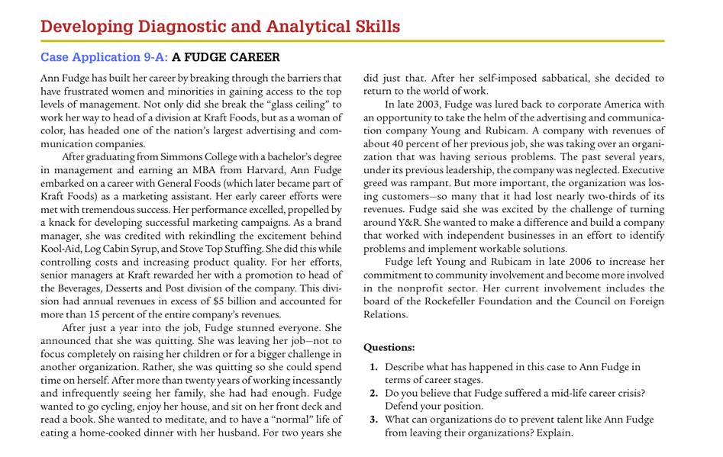

Slide 18
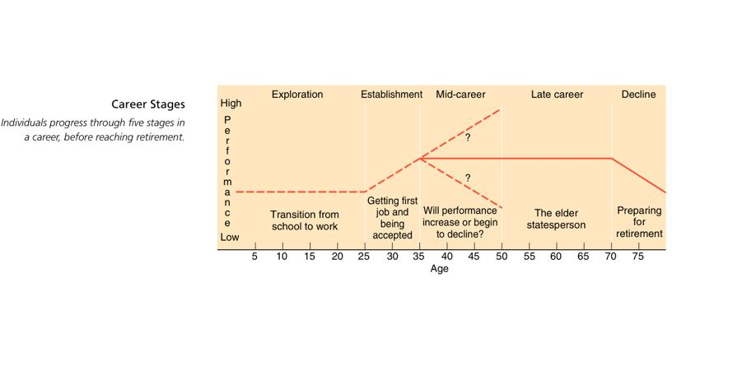

Slide 19
Case Study

Slide 20
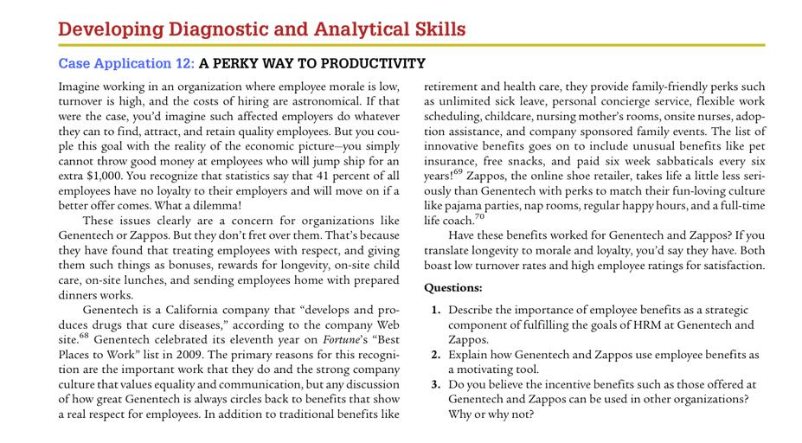

Slide 21
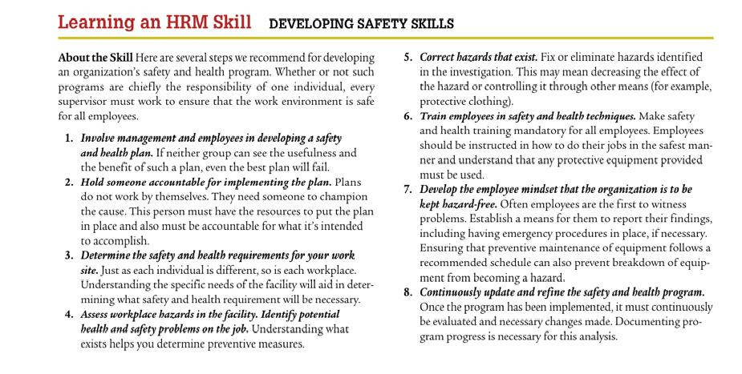

Slide 22
Thank you
For any question or query contact through
twitter: @ighaznavi

