Slide 1
Strategic Human Resource Management
Imran Ghaznavi
Twitter: @ighaznavi
Course Code: MGT557
COMSATS

Slide 2
Lecture 14

Slide 3
Lecture outline
Overview of 13th Lecture
SHRM Defined
Principles of SHRM
Aims of SHRM
The Concept of SHRM
Case Study

Slide 4
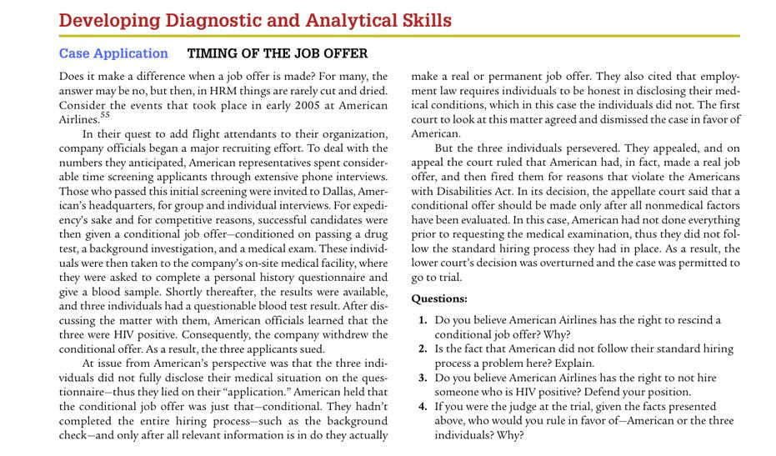
The concept of strategic human resource management

Slide 5
The concept of SHRM
‘Business objectives are accomplished when human resource practices, procedures and systems are developed and implemented based on organizational needs, that is, when a strategic perspective to human resource management is adopted.’
Baird and Meshoulam (1988)

Slide 6
SHRM Defined
Strategic HRM is an approach that defines how the organization’s goals will be achieved through people by means of HR strategies and integrated HR policies and practices.
Strategic HRM is concerned with ‘seeing the people of the organization as a strategic resource for the achievement of competitive advantage’
(Hendry and Pettigrew, 1986)

Slide 7
SHRM Defined
‘The pattern of planned human resource deployments and activities intended to enable an organization to achieve its goals’
(Wright and McMahan, 1992).
‘The central premise of strategic human resource management theory is that successful organizational performance depends on a close fit or alignment between business and human resource strategy’
(Batt, 2007).

Slide 8
Basis of SHRM
Strategic HRM is based on three propositions:
  1. The human resources or human capital of an organization play a strategic role in its success and are a major source of competitive advantage.
  2. HR strategies should be integrated with business plans (vertical integration). . The major focus of strategic HRM should be aligning HR with firm strategies.
  3. Individual HR strategies should cohere by being linked to each other to provide mutual support (horizontal integration).

Slide 9
Principles of SHRM
Strategic HRM supplies a perspective on the way in which critical issues or success factors related to people can be addressed, and strategic decisions are made that have a major and long-term impact on the behavior and success of the organization.

Slide 10
Principles of SHRM
As a means of developing integrated HR strategies, strategic HRM is facilitated to the extent to which the following seven principles set out by Ondrack and Nininger (1984) are followed:
  1. There is an overall purpose and the human resource dimensions of that purpose are evident.
  2. A process of developing strategy within the organization exists and is understood, and there is explicit consideration of human resource dimensions.
  3. Effective linkages exist on a continuing basis to ensure the integration of human resource considerations with the organizational decision-making process.

Slide 11
Principles of SHRM
  4.The office of the chief executive provides the challenge for integrating human resource considerations to meet the needs of the business.
  5. The organization of all levels establishes responsibility and accountability for human resource management.

Slide 12
Principles of SHRM
  6.Initiatives in the management of human resources are relevant to the needs of the business.
  7. It includes the responsibility to identify and interact in the social, political, technological and economic environments in which the organization is and will be doing business.

Slide 13
AIM of SHRM
The fundamental aim of strategic HRM is to generate strategic capability by ensuring that the organization has the skilled, engaged and well-motivated employees it needs to achieve sustained competitive advantage.

Slide 14
AIM of SHRM
Strategic human resource management is largely about integration and adaptation.
Its concern is to ensure that:
(1) human resources (HR) management is fully integrated with the strategy and strategic needs of the firm;
(2) HR policies cohere both across policy areas and across hierarchies; and
(3) HR practices are adjusted, accepted and used by line and employees as part of their every day work.

Slide 15
Thank you
For any question or query contact through
twitter: @ighaznavi

