Slide 1
Strategic Human Resource Management
Imran Ghaznavi
Twitter: @ighaznavi
Course Code: MGT557
COMSATS

Slide 2
Lecture 13

Slide 3
Lecture outline
Overview of 12th Lecture
Case Studies

Slide 4
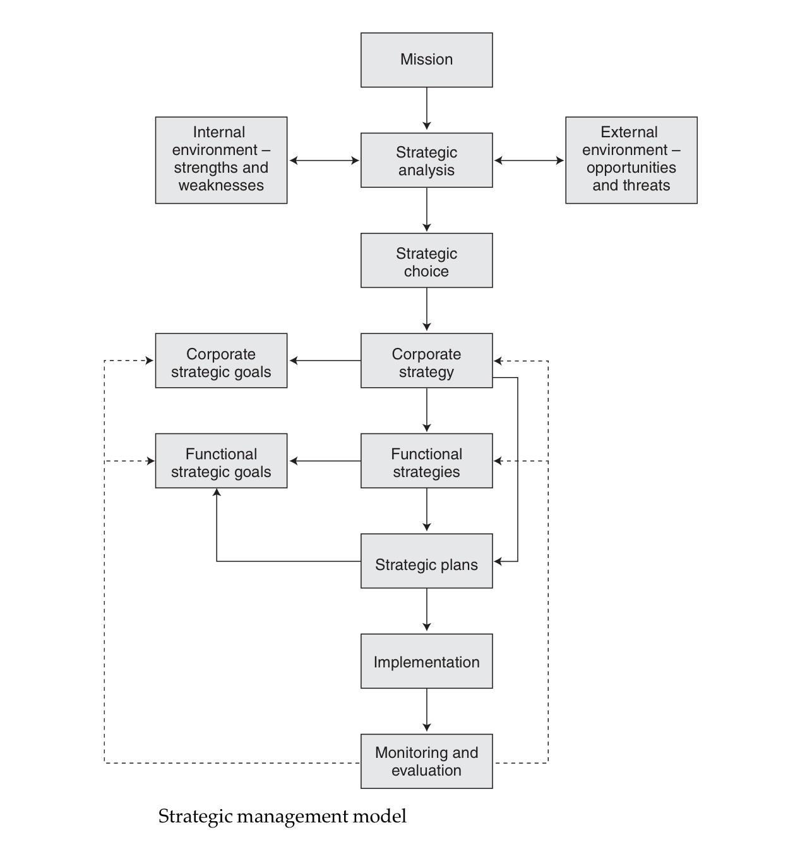
The process of strategic management

Slide 5
Case Studies

Slide 6
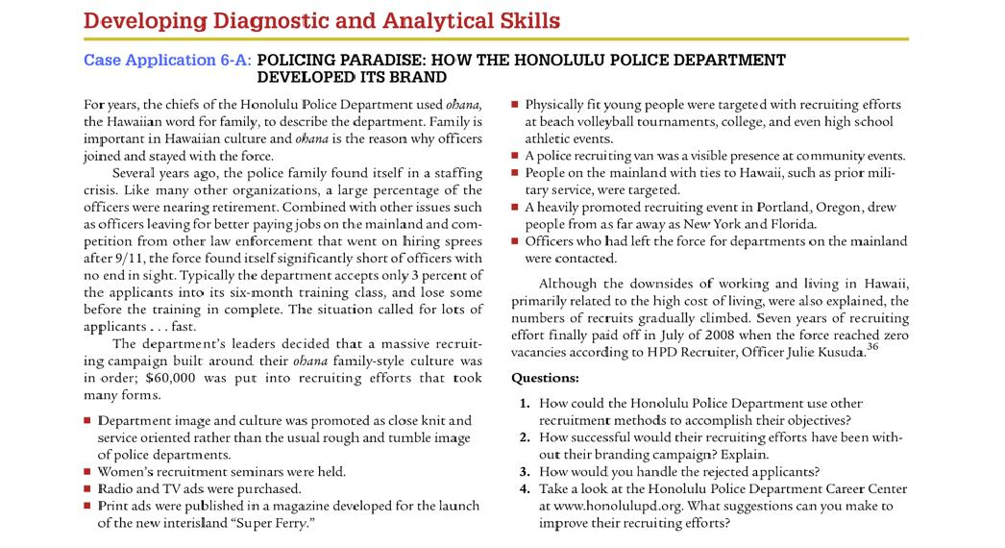

Slide 7
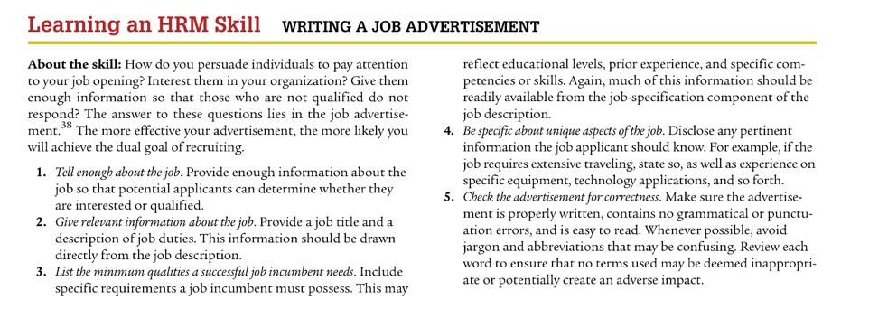

Slide 8
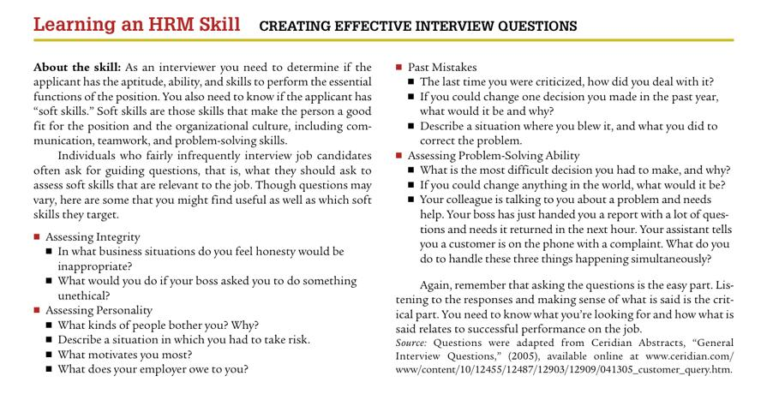

Slide 9
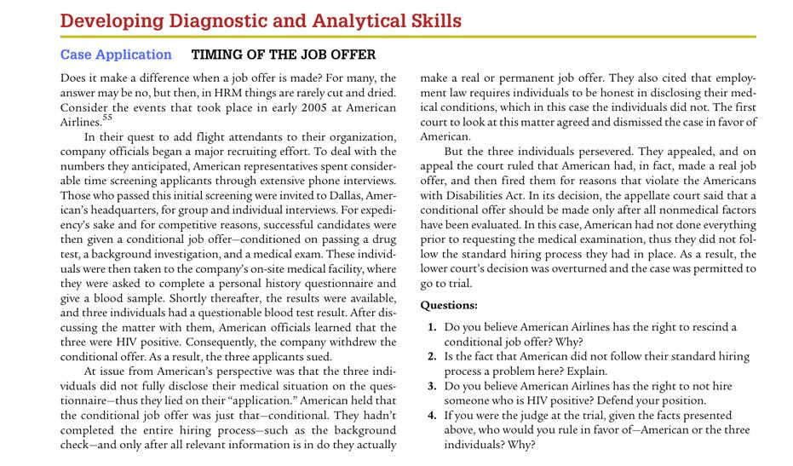

Slide 10
Thank you
For any question or query contact through
twitter: @ighaznavi

