Slide 1
Strategic Human Resource Management
Imran Ghaznavi
Twitter: @ighaznavi
Course Code: MGT557
COMSATS

Slide 2
Lecture 12

Slide 3
Lecture outline
Overview of 11th Lecture
The Formulation of Strategy
Case Studies

Slide 4
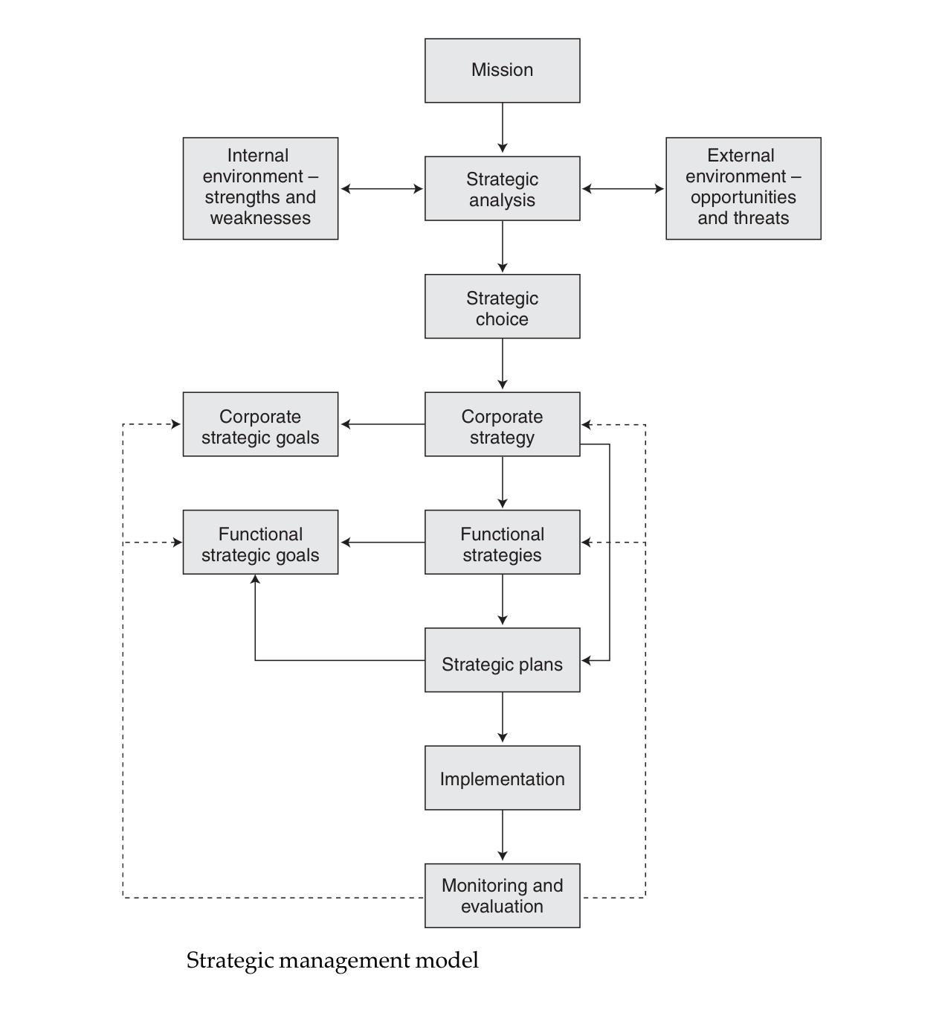
The process of strategic management

Slide 5
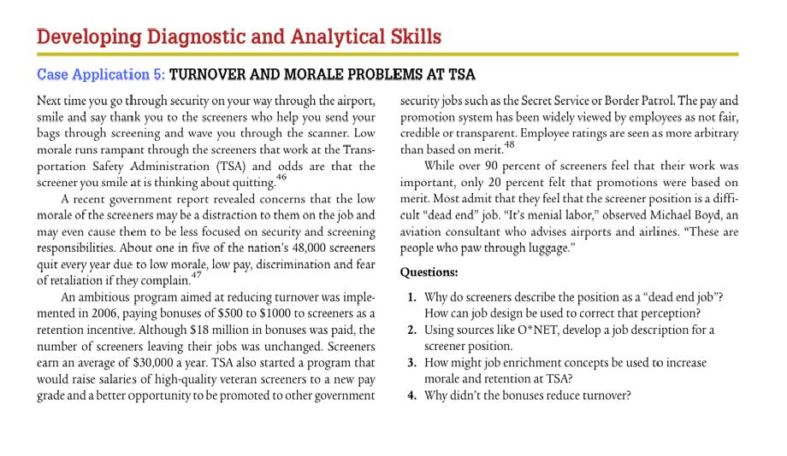
Case study

Slide 6
The Formulation of Strategy
It is best described as a process for developing a sense of direction and ensuring strategic fit.
It has often been described as a logical, step-by-step affair, the outcome of which is a formal written statement that provides a definitive guide to the organization’s intentions.

Slide 7
Approaches to strategy formulation
Whittington (1993) has identified four approaches to the formulation of strategy:
Classical
Evolutionary
Processual
Systemic

Slide 8
Approaches to strategy formulation:
Classical
Classical – strategy formulation as a rational process of deliberate calculation. The process of strategy formulation is seen as being separate from the process of implementation

Slide 9
Approaches to strategy formulation:
Evolutionary
Evolutionary – strategy formulation as an evolutionary process that is a product of market forces in which the most efficient and productive organizations win through

Slide 10
Approaches to strategy formulation:
Processual
Processual – strategy formulation as an incremental process that evolves through discussion and disagreement. It may be impossible to specify what the strategy is until after the event.

Slide 11
Approaches to strategy formulation:
Systemic
Systemic – strategy is shaped by the social system in which it is embedded. Choices are constrained by the cultural and institutional interests of a broader society rather than the limitations of those attempting to formulate corporate strategy.

Slide 12
The classical approach to formulating strategy
Conceptually, the classical approach as described by Whittington involves the following steps (implementation and monitoring steps have been added to the Whittington model):
1. Define the mission.
2. Set objectives.
3. Conduct internal and external environmental scans to assess internal strengths and weaknesses and external opportunities and threats (a SWOT analysis).

Slide 13
The classical approach to formulating strategy
Analyze existing strategies to determine their relevance in the light of the internal and external appraisal. This may include gap analysis, which will establish the extent to which environmental factors might lead to gaps between what could be achieved if no changes were made and what needs to be achieved
Define in the light of this analysis the distinctive capabilities of the organization
Define the key strategic issues emerging from the previous analysis. These will be concerned with such matters as product-market scope, enhancing shareholder value and resource capability.

Slide 14
The classical approach to formulating strategy
Determine corporate and functional strategies for achieving goals and competitive advantage, taking into account the key strategic issues.
  These may include business strategies for growth or diversification, or broad generic strategies for innovation, quality or cost leadership; or they could take the form of specific corporate/functional strategies concerned with product-market scope, technological development or human resource development.

Slide 15
The classical approach to formulating strategy
Prepare integrated strategic plans for implementing strategies
Implement the strategies.
Monitor implementation and revise existing strategies or develop new strategies as necessary.

Slide 16
Case Study

Slide 17
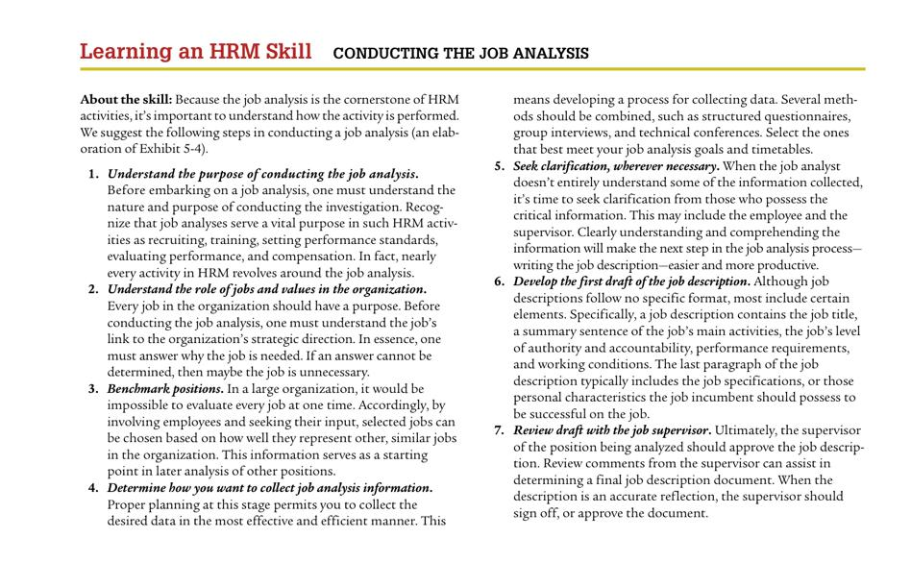

Slide 18
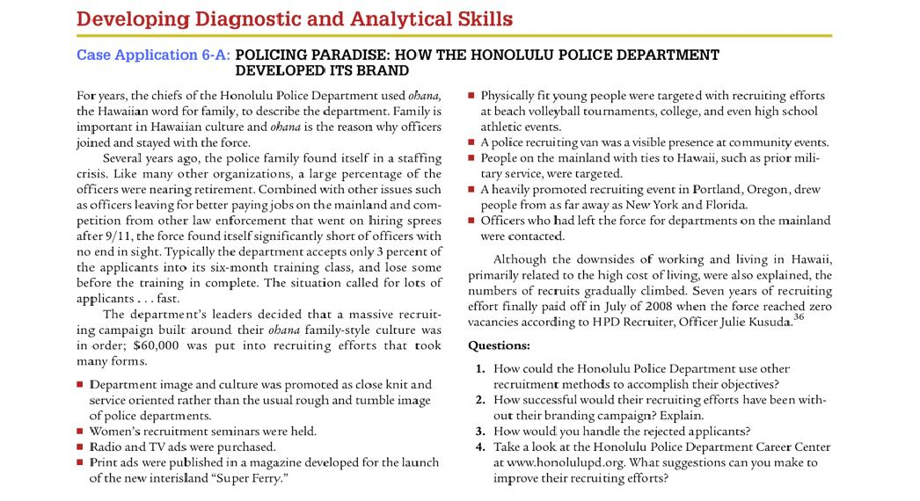

Slide 19
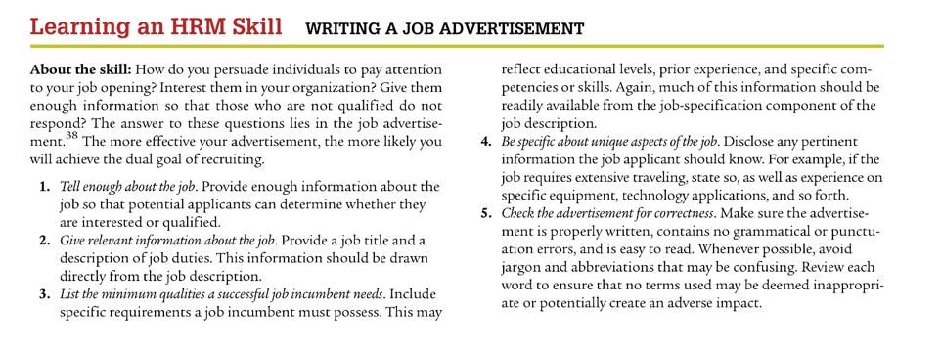

Slide 20
Case Studies

Slide 24
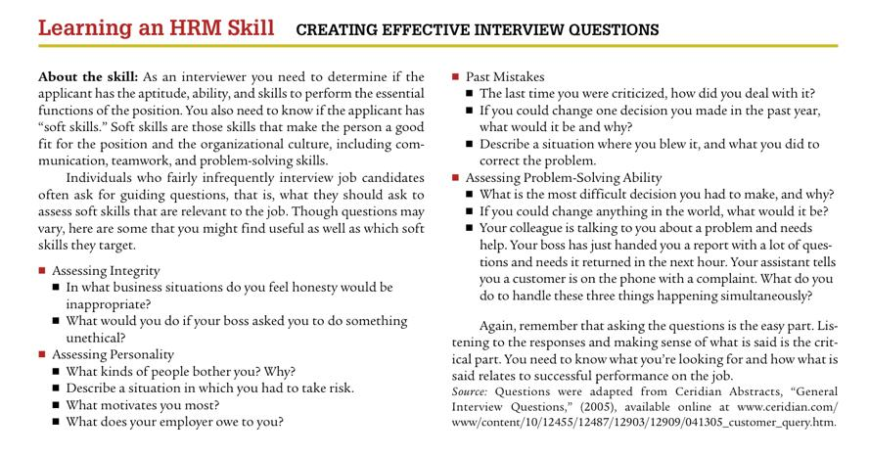

Slide 25
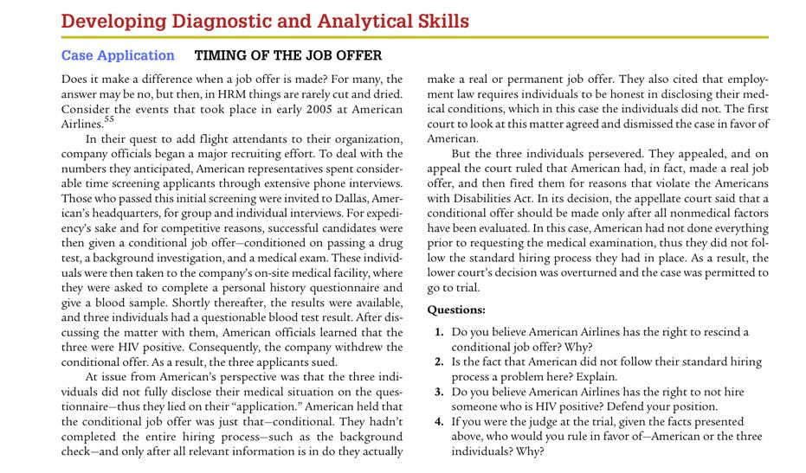

Slide 26
Thank you
For any question or query contact through
twitter: @ighaznavi

