Slide 1
Strategic Human Resource Management
Imran Ghaznavi
Twitter: @ighaznavi
Course Code: MGT557
COMSATS

Slide 2
Lecture 11

Slide 3
Lecture outline
Overview of 10th Lecture
The concept of strategy
The formulation of Strategy
Case Study

Slide 4
The Concept of Strategy
It is based on a number of associated concepts:
competitive advantage, resource-based strategy, distinctive capabilities, strategic intent, strategic capability, strategic management, strategic goals and strategic plans.
Notes:
Porter emphasized the importance of differentiation, which consists of offering a product or service ‘that is perceived industry-wise as being
unique’,

Slide 5
Concept of Strategy
Competitive advantage
The concept of competitive advantage was formulated by Michael Porter (1985).
“Competitive advantage, arises out of a firm creating value for its customers. To achieve it, firms select markets in which they can excel and present a moving target to their competitors by continually improving their position.

Slide 6
Distinctive capabilities
‘The opportunity for companies to sustain competitive advantage is determined by their capabilities.’
Kay (1999)
Distinctive capabilities are those characteristics that cannot be replicated by competitors or can only be imitated with great difficulty.
Distinctive capabilities or core competences describe what the organization is specially or uniquely capable of doing

Slide 7
Strategic intent
In its simplest form, strategy could be described as an expression of the intentions of the organization
– what it means to do and how,
Wickens (1987) suggests that the business means to ‘get from here to there’.

Slide 8
Strategic intent
The strategic intent sequence has been defined by Miller and Dess (1996) as:
1. a broad vision of what the organization should be;
2. the organization’s mission;
3. specific goals, which are operationalized as:
4. strategic objectives.

Slide 9
Strategic capability
Strategic capability is a concept that refers to the ability of an organization to develop and implement strategies that will achieve sustained competitive advantage
It is therefore about the capacity to select the most appropriate vision, to define realistic intentions, to match resources to opportunities and to prepare and implement strategic plans.
Notes:
The strategic capability of an organization depends on the strategic capabilities of its managers. People who display high levels of strategic capability know where they are going and know how they are going to get there. They recognize that, although they must be successful now to succeed in the future, it is always necessary to create and sustain a sense of purpose and direction.

Slide 10
The resource-based view
The resource-based view of strategy is that the strategic capability of a firm depends on its resource capability
As Boxall (1996)belives, ‘Competitive success does not come simply from making choices in the present; it stems from building up distinctive capabilities over significant periods of time.’

Slide 11
Strategic management
‘Strategic management is the set of decisions and actions resulting in the formulation and implementation of strategies designed to achieve the objectives of an organization.’
Pearce and Robinson (1988)

Slide 12
Strategic Management
Strategic management has been described by Burns (1992) as being primarily concerned with:
  the full scope of an organization’s activities, including corporate objectives and organizational boundaries;
  matching the activities of an organization to the environment in which it operates;
  ensuring that the internal structures, practices and procedures enable the organization to achieve its objectives;

Slide 13
Strategic Management
matching the activities of an organization to its resource capability, assessing the extent to which sufficient resources can be provided to take advantage of opportunities or to avoid threats in the organization’s environment;
acquiring, divesting and reallocating resources;
translating the complex and dynamic set of external and internal variables that an organization faces into a structured set of clear future objectives that can then be implemented on a day-to-day basis.
Notes:
The focus is on identifying the organization’s mission and strategies, but attention is also given to the resource base required to make it succeed.
Managers who think strategically will have a broad and long-term view of where they are going

Slide 14
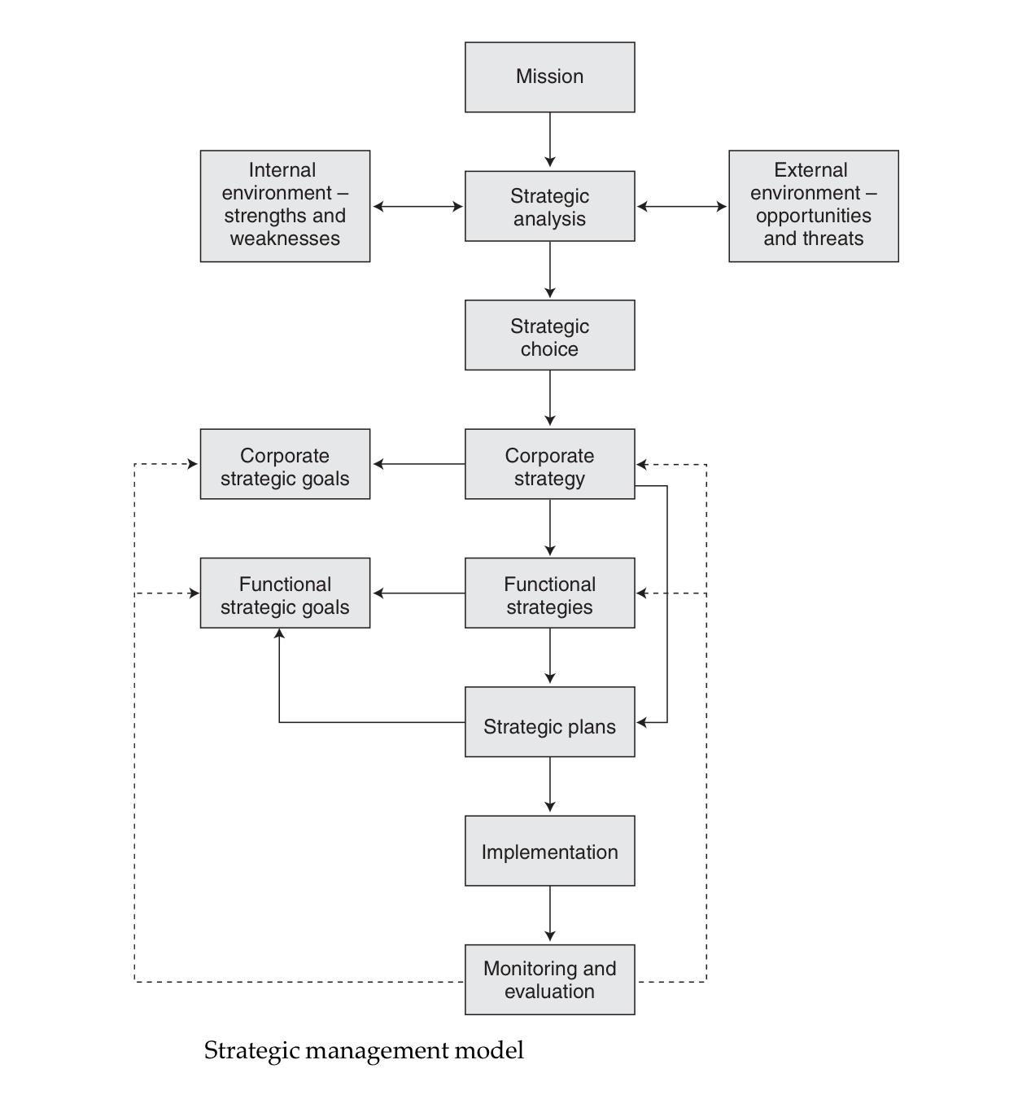
The process of strategic management

Slide 15
The process of strategic management
It involves defining the organization’s mission, analyzing the internal and external environment, exercising strategic choice (there is always choice), formulating corporate and functional strategies and goals, implementing strategies and monitoring and evaluating progress in achieving goals.

Slide 16
Strategic goals
Strategic goals define where the organization wants to be. They may be specified in terms of actions, quantified in terms of growth, or expressed in general terms as aspirations rather than specifics.

Slide 17
Strategic plans
Strategic plans are formal expressions of how an organization intends to attain its strategic goals.

Slide 18
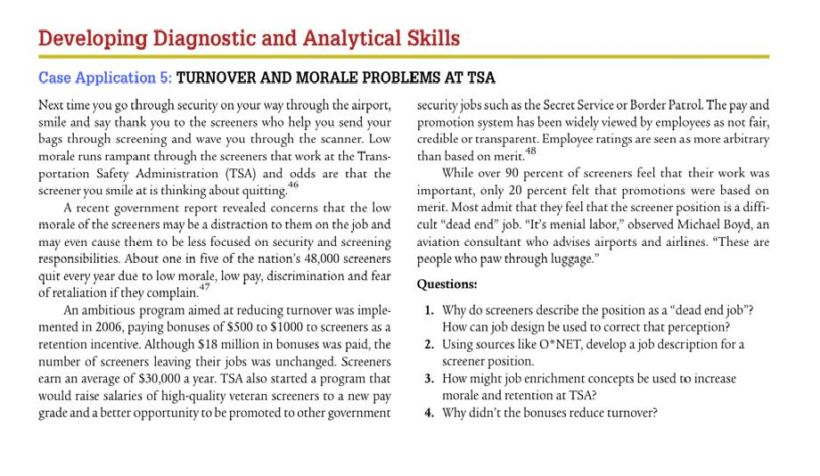
Case study

Slide 19
Thank you
For any question or query contact through
twitter: @ighaznavi

