Slide 1
Strategic Human Resource Management
Imran Ghaznavi
Twitter: @ighaznavi
Course Code: MGT557
COMSATS

Slide 2
Course outline
Introduction of HRM
The Process
Strategic Management
The concept of strategic human resource management
The practice of Strategic HRM
HR Strategies

Slide 3
Reference books:
Strategic Human Resource Management
By Michael Armstrong
Human Resource Management
By David A. DeCenzo & Stephen P. Robbins
Strategic Human Resource Management
By Alan Nankervis, Robert Compton & Marian Baird

Slide 4
Lecture One

Slide 5
Strategic Human Resource Management
SHRM is an approach to the development and implementation of HR strategies that are integrated with business strategies and enable the organization to achieve its goals
Conceptually SHRM is to achieve “fit between HR and business strategies”

Slide 6
To understand Strategic Human Resource Management, it is very important to appreciate the concepts of Human Resource Management and Strategy

Slide 7
Introduction : Human Resource Management
Human Resource Management
  It is defined as a strategic and coherent approach to the management of an organization’s most valued assets – the people working there, who individually and collectively contribute to the achievement of its objectives.

Slide 8
Introduction : Human Resource Management
Boxall et al (2007) describe HRM as
‘ the management of work and people towards desired ends’
John Storey (1989) believes that HRM can be regarded as
‘Set of interrelated policies with an ideological and philosophical underpinning’
Notes:
Foundation, support, reinforcement

Slide 9
Human Resource Management
John Storey suggests four aspects that constitute the meaningful version of HRM:
  1) a particular constellation of beliefs and assumptions;
  2) a strategic thrust informing decisions about people management;
  3) the central involvement of line managers; and
  4) reliance upon a set of ‘levers’ to shape the employment relationship.
Notes:
Constellation : collection

Slide 10
Human Resource Management
HRM is further defined by the two models developed by what might be described as its founding fathers
The matching model of HRM
The Harvard framework

Slide 11
Human Resource Management
  The matching model of HRM
    One of the first explicit statements of the HRM concept was made by the Michigan School (Fombrun, Tichy and Devanna, 1984). They held that HR systems and the organization structure should be managed in a way that is congruent with organizational strategy (hence the name ‘matching model’)
Notes:
Congruent : matching

Slide 12
  The matching model of HRM
    The model further explained that there is a human resource cycle (an adaptation of which is illustrated in Figure 1.1), which consists of four generic processes or functions that are performed in all organizations. These are:
  Selection – matching available human resources to jobs;
  Appraisal – performance management;
  Rewards – ‘ the reward system is one of the most under-utilized and mishandled managerial tools for driving organizational performance’; it must reward short- as well as long-term achievements, bearing in mind that ‘business must perform in the present to succeed in the future’;
  Development – developing high-quality employees.

Slide 13
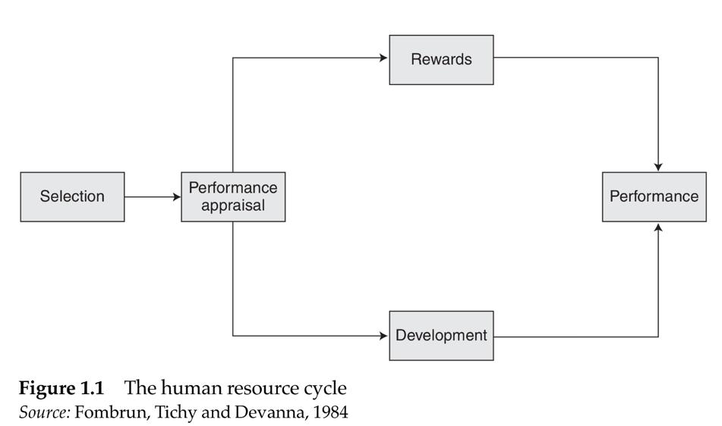
The matching model of HRM

Slide 14
Human Resource Management
The Harvard framework
  The other pioneers of HRM were the Harvard School of Beer et al (1984), who developed ‘Harvard framework’.
  ‘Human resource management involves all management decisions and action that affect the nature of the relationship between the organization and its employees – its human resources.

Slide 15
The Harvard framework
The Harvard school suggested that HRM had two characteristic:
  1) line managers accept more responsibility for ensuring the alignment of competitive strategy and personnel policies;
  2) personnel has the mission of setting policies that govern how personnel activities are developed and implemented in ways that make them more mutually reinforcing.

Slide 16
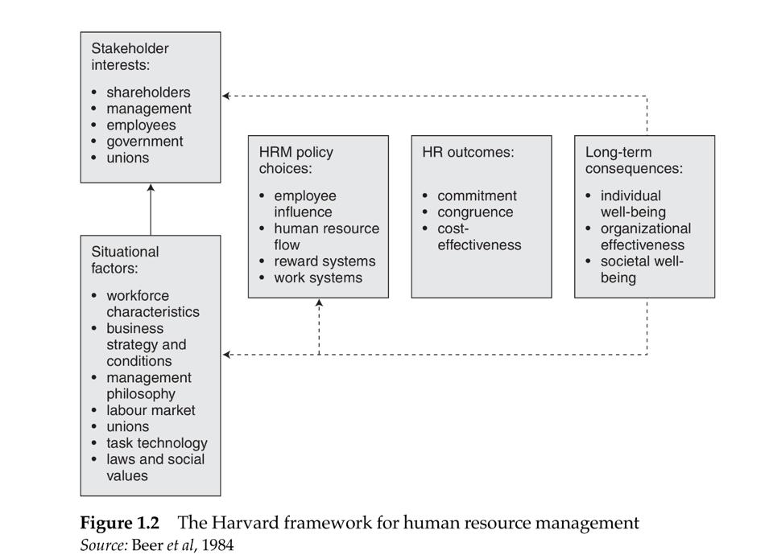
The Harvard framework

Slide 17
The Harvard framework
According to Boxall (1992) the advantages of this model are:
  It incorporates recognition of a range of stakeholder interests;
  It recognizes the importance of ‘trade-offs’, either explicitly or implicitly, between the interests of owners and those of employees as well as between various interest groups;
  It widens the context of HRM to include ‘employee influence’, the organization of work and the associated question of supervisory style;
  It acknowledges a broad range of contextual influences on management’s choice of strategy
  It emphasizes strategic choice – it is not driven by situational or environmental determinism.

Slide 18
Human Resource Process

Slide 19
The Importance of Human Resource Management (HRM)
As a necessary part of the organizing function of management
  Selecting, training, and evaluating the work force
As an important strategic tool
  HRM helps establish an organization’s sustainable competitive advantage.
Adds value to the firm
  High performance work practices lead to both high individual and high organizational performance.

Slide 20
Examples of High-Performance Work Practices
Self-managed teams
Decentralized decision making
Training programs to develop knowledge, skills, and abilities
Flexible job assignments
Open communication
Performance-based compensation
Staffing based on person–job and person–organization fit
        Source: Based on W. R. Evans and W. D. Davis, “High-Performance Work Systems and Organizational Performance: The Mediating Role of Internal Social Structure,” Journal of Management, October 2005, p. 760.

Slide 21
The HRM Process
Functions of the HRM Process
  Ensuring that competent employees are identified and selected.
  Providing employees with up-to-date knowledge and skills to do their jobs.
  Ensuring that the organization retains competent and high-performing employees who are capable of high performance.

Slide 22
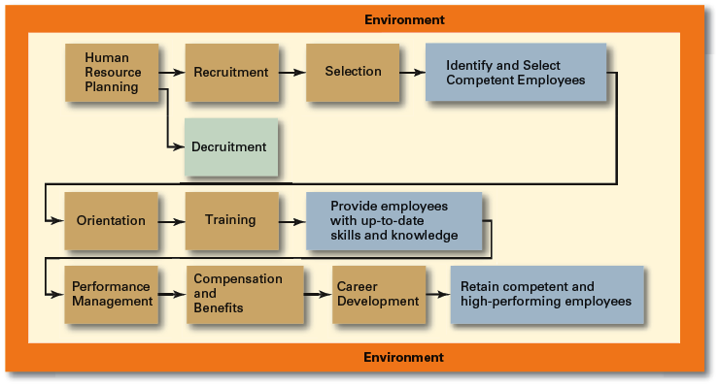
Human Resource Management Process

Slide 23
Environmental Factors Affecting HRM
Employee Labor Unions
  Organizations that represent workers and seek to protect their interests through collective bargaining.
    Collective bargaining agreement
      A contractual agreement between a firm and a union elected to represent a bargaining unit of employees of the firm in bargaining for wage, hours, and working conditions.
Governmental Laws and Regulations
  Limit managerial discretion in hiring, promoting, and discharging employees.
    Affirmative Action: the requirement that organizations take proactive steps to ensure the full participation of protected groups in its workforce.

Slide 24
Managing Human Resources
Human Resource (HR) Planning
  The process by which managers ensure that they have the right number and kinds of people in the right places, and at the right times, who are capable of effectively and efficiently performing their tasks.
  Helps avoid sudden talent shortages and surpluses.
  Steps in HR planning:
    Assessing current human resources
    Assessing future needs for human resources
    Developing a program to meet those future needs

Slide 25
Current Assessment
Human Resource Inventory
  A review of the current make-up of the organization’s current resource status
  Job Analysis
    An assessment that defines a job and the behaviors necessary to perform the job
      Knowledge, skills, and abilities (KSAs)
    Requires conducting interviews, engaging in direct observation, and collecting the self-reports of employees and their managers.

Slide 26
Current Assessment (cont’d)
Job Description
  A written statement of what the job holder does, how it is done, and why it is done.
Job Specification
  A written statement of the minimum qualifications that a person must possess to perform a given job successfully.

Slide 27
Meeting Future Human Resource Needs
Supply of Employees
Demand for Employees
Factors Affecting Staffing
Strategic Goals
Forecast demand for products and services
Availability of knowledge, skills, and abilities

Slide 28
Recruitment and Decruitment
Recruitment
  The process of locating, identifying, and attracting capable applicants to an organization
Decruitment
  The process of reducing a surplus of employees in the workforce of an organization
E-recruiting
  Recruitment of employees through the Internet
    Organizational web sites
    Online recruiters

Slide 29
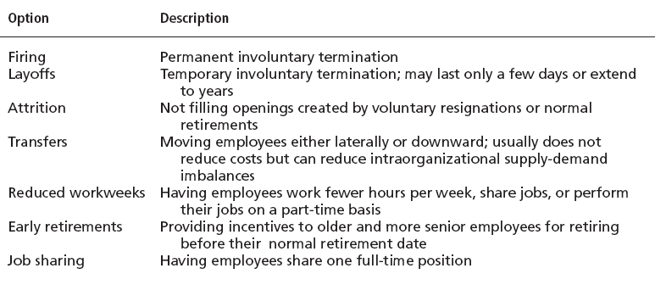
Decruitment Options

Slide 30
Selection
Selection Process
  The process of screening job applicants to ensure that the most appropriate candidates are hired
What is Selection?
  An exercise in predicting which applicants, if hired, will be (or will not be) successful in performing well on the criteria the organization uses to evaluate performance.
  Selection errors:
    Reject errors for potentially successful applicants
    Accept errors for ultimately poor performers

Slide 31
Selection Tools
Application Forms
Written Tests
Performance Simulations
Interviews
Background Investigations
Physical examinations

Slide 32
Written Tests
Types of Tests
  Intelligence: how smart are you?
  Aptitude: can you learn to do it?
  Attitude: how do you feel about it?
  Ability: can you do it now?
  Interest: do you want to do it?
Legal Challenges to Tests
  Lack of job-relatedness of test items or interview questions to job requirements
  Discrimination in equal employment opportunity against members of protected classes

Slide 33
Performance Simulation Tests
Testing an applicant’s ability to perform actual job behaviors, use required skills, and demonstrate specific knowledge of the job.
  Work sampling
    Requiring applicants to actually perform a task or set of tasks that are central to successful job performance.
  Assessment centers
    Dedicated facilities in which job candidates undergo a series of performance simulation tests to evaluate their managerial potential.

Slide 34
Other Selection Approaches
Interviews
  Although used almost universally, managers need to approach interviews carefully.
Background Investigations
  Verification of application data
  Reference checks:
    Lack validity because self-selection of references ensures only positive outcomes.
Physical Examinations
  Useful for physical requirements and for insurance purposes related to pre-existing conditions.

Slide 35
Other Selection Approaches (cont’d)
Realistic Job Preview (RJP)
  The process of relating to an applicant both the positive and the negative aspects of the job.
    Encourages mismatched applicants to withdraw.
    Aligns successful applicants’ expectations with actual job conditions; reducing turnover.

Slide 36
Summery of the lecture
Human Resource Management
HRM Models
HRM Process

Slide 37
Thank you
For any question or query contact through
twitter: @ighaznavi

