Slide 1
MGT-555
PERFORMANCE AND CAREER
MANAGEMENT
LECTURE NO - 7

Slide 2
RECAP
Course Objective
Key Learning Outcomes
Contents of the Course Structure
We have discussed HRM and Strategic HRM(SHRM) in previous lectures, which included following points;
1. Definitions
2. Functions of HRM and SHRM
3. Types of assistance provided by HRD.
4. Challenges faced by Human resource managers.
5. Relationship between Human resource department and other departments.

Slide 3
RECAP
6. Role of Human resource managers in future.
7. Effect of HRM on organizational performance.
8. Role of HRM in training and development of employees.
9. Role of HRM in Performance and career management.
10. Role of HRM in maintaining competitive pay practices.

Slide 4
RECAP
Understanding Performance management
Definitions
Case study - PM Systems
Case Study - Morgan Stanley
Contribution / Advantages of PM System
Performance Management Process

Slide 5
RECAP
Performance management Process
  Components of PMP
    Performance Execution
    Performance Assessment
    Performance review
    Performance renewal and Re-contracting

Slide 6
Agenda of Today’s Lecture
Performance Management Role in Strategic planning
Purpose of strategic planning
Why strategic planning- need
Process of linking performance management to the strategic planning
Successful strategic plans
Environmental Analysis
External factors – Environmental Analysis

Slide 7
Performance Management role in Strategic Planning
“Strategic management involves the formulation and implementation of the major goals and initiatives taken by a company's top management on behalf of owners, based on consideration of resources and an assessment of the internal and external environments in which the organization competes”

Slide 8
Definition and purpose of strategic planning
Strategic planning is an organization’s process of defining its strategy, or direction, and making decisions on allocating its resources to pursue its strategy. It may also extend to control mechanisms for guiding the implementation of the strategy.
Strategic planning is an organizational management activity that is used to set priorities, focus energy and resources, strengthen operations, ensure that employees and other stakeholders are working toward common goals, establish agreement around intended outcomes/results, and assess and adjust the organization's direction in response to a changing environment.

Slide 9
Definition and purpose of strategic planning
Strategic planning is a process that involves describing the organizations destination, assessing barriers that stand in the way of that destination, and selecting approaches for moving forward.

Slide 10
Strategic Planning (Contd.)
It is a disciplined effort that produces fundamental decisions and actions that shape and guide what an organization is, who it serves, what it does, and why it does it, with a focus on the future. Effective strategic planning articulates not only where an organization is going and the actions needed to make progress, but also how it will know if it is successful.

Slide 11
Strategic Planning (Contd.)
The main goal of strategic planning is to allocate resources in a way that provide organizations with a competitive advantage.
Overall, a strategic plan serves as a blueprint that defines how the organization will allocate its resources in pursuit of its goals.

Slide 12
Strategic Planning (Contd.)
Strategic planning serves the following purpose
First and foremost strategic planning allows organizations to define their Mission and Objectives. In other words, it provides organizations with a clearer scene of who they are and what their purpose is.

Slide 13
Strategic Planning (Contd.)
The Mission and Objectives statement describes the company’s business vision, including the unchanging values and purpose of the firm and forward looking visionary goals that guide the pursuit of future oppurtunities.

Slide 14
Strategic Planning (Contd.)
Second, strategic planning helps organizations prepare for the future because it clarifies the desired destination.
Knowing where the organization wants to go is a key first step in planning how to get there.

Slide 15
Strategic Planning (Contd.)
Third, strategic planning allows organizations to analyze their environment, and doing so enhance their ability to adapt to environmental changes and even anticipate future changes.

Slide 16
Strategic Planning (Contd.)
The environmental scan includes the following components:
Internal analysis of the firm
Analysis of the firm's industry (task environment)
External macro environment (PEST analysis)
The internal analysis can identify the firm's strengths and weaknesses and the external analysis reveals opportunities and threats. A profile of the strengths, weaknesses, opportunities, and threats is generated by means of a SWOT analysis
An industry analysis can be performed using a framework developed by Michael Porter known as Porter's five forces. This framework evaluates entry barriers, suppliers, customers, substitute products, and industry rivalry.

Slide 17
Strategic Planning (Contd.)
Fourth, strategic planning provides organization with focus and allows them to allocate resources to what matters the most.
In turn the improved allocation of resources is likely to stimulate growth and improve profitability.

Slide 18
Strategic Planning (Contd.)
Fifth, strategic planning can produce a culture of cooperation within the organization given that a common set of goals is created.
Such a culture of cooperation can gain organization a key competitive advantage.

Slide 19
Strategic Planning (Contd.)
Sixth, strategic planning can be a good corporate eye-opener because it generates new options and opportunities to be considered.
New opportunities to be considered may include expanding to new markets or offering new products.

Slide 20
Strategic Planning (Contd.)
Finally, strategic planning can be a powerful tool to guide employee’s daily activities because it identifies the behaviors and results that really matter.
A strategic plan provides critical information to be used in the performance management system.

Slide 21
Strategic Planning (Contd.)
Helps define the organization’s identity.
Helps organizations prepare for the future.
Enhances ability to adapt to environmental changes.
Provides focus and allows for better allocation of resources.
Produces an organizational culture of cooperation
Allows for the consideration of new options and opportunities.
Provides employees with information to direct daily activities.

Slide 22
Process of linking performance management to the strategic planning
There is indeed a very important relationship between strategic planning and performance management. Performance management is really about setting and achieving goals at the employee level, and identifying and fixing barriers related to achieving those goals. But where do the goals come from?

Slide 23
Process of linking performance management to the strategic planning
That's where strategic planning comes in. Strategic planning (and also tactical planning), are methods a company, and its individual work-units define their goals and objectives. In turn, those goals and objectives are used to determine and analyze the goals and objectives of each employee in a work unit. This is called cascading of goals.

Slide 24
Process of linking performance management to the strategic planning
When done properly, setting employee goals should rely on the goals of the particular work-unit, which gets its goals from the planning done by the next bigger work unit, and so on.
That's why the setting of individual goals and objectives should be done once the goals and objectives of the work-unit are established.

Slide 25
Process of linking performance management to the strategic planning
The mere presence of strategic plan does not guarantee that this information will be used effectively as part of performance management system.
In fact, countless organizations spend thousand of hours creating strategic plans that lead to no tangible actions.

Slide 26
Process of linking performance management to the strategic planning
The mere presence of strategic plan does not guarantee that this information will be used effectively as part of performance management system.
In fact, countless organizations spend thousand of hours creating strategic plans that lead to no tangible actions.

Slide 27
Process of linking performance management to the strategic planning (Contd.)
Many organization spend to much time and effort crafting their mission and vision statements without undertaking any concrete follow-up actions.
The process then holds up a huge waste of time and a source of frustration and long-lasting cynicism (general distrust).

Slide 28
Process of linking performance management to the strategic planning (Contd.)
Thus, to ensure that strategic plan cascades down the organization and leads to concrete actions, a conscious effort must be made to link the strategic plans with individual performance.

Slide 29
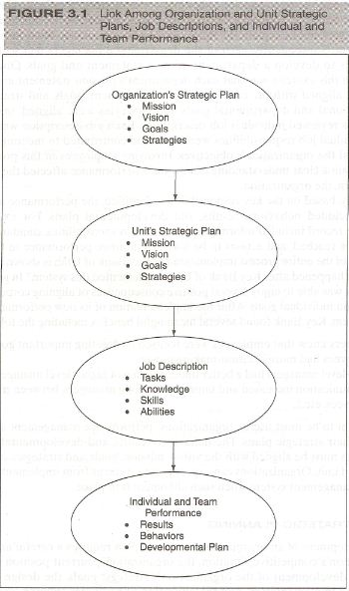

Slide 30
Case Study
As a concrete example, consider the case of Key Bank, USA, a financial company with assets of $92 billion which provides investment management, retail commercial banking, consumer finance, and investment banking products and services. Key Bank successfully developed a performance management system that is aligned with the strategic plan of the organization.

Slide 31
Case Study
To do this, the bank first involved managers at all hierarchical levels to develop an organization mission statement. Next, they developed goals and strategies that would help achieve Key Bank's mission. The mission statement, goals, and strategies at the organizational level served as the foundation for developing the strategies for individual departments and units.

Slide 32
Case Study
To develop these, senior managers met with each department manager to discuss the organization's goals and strategies and to explain the importance of having similar items in place in each department. Subsequently, each of the departmental managers met with his or her employees to develop a department mission statement and goals.

Slide 33
Case Study
One important premise in this exercise was that each department's mission statement and objectives had to be aligned with the corporate mission statement, goals, and strategies. After organizational and departmental goals and strategies were aligned, managers and employees reviewed individual job descriptions.

Slide 34
Case Study
Each job description was tailored so that individual job responsibilities were clear and contributed to meeting the department's and the organization's objectives. Involving employees in this process helped them to gain a clear understanding of how their performance affected the department and, in turn, the organization. Finally, based on the key responsibilities identified, the performance management system included behaviors, results, and developmental plans.

Slide 35
Case Study
For example, each employee record included information on various responsibilities, standards expected, goals to be reached, and actions to be taken to improve performance in the future. A summary of the entire process implemented at Key Bank is shown in Figure 3.2. What happened after Key Bank implemented this system? In general terms, Key Bank was able to enjoy several positive consequences of aligning corporate, departmental, and individual goals. After the implementation of its new performance management system.

Slide 36
Case Study
Key Bank found several meaningful benefits, including the following:
• Managers knew that employees were focused on meeting important goals.
• Employees had more decision-making power.
• Lower-level managers had a better understanding of higher-level managers' decisions
• Communication increased and improved (among managers, between managers and employees, etc.).

Slide 37
Case Study
In sum to be most useful, organizations' performance management systems must rely on their strategic plans. The behaviors, results, and developmental plans of all employees must be aligned with the vision, mission, goals, and strategies of the organization and unit. Organizations can expect greater returns from implementing a performance management system when such alignment is in place.

Slide 38
Strategic planning
The development of an organizations strategic plan requires a careful analysis of the organizations competitive situation, the organizations current position and destination, the development of the organizations strategic goals, the design of a plan of action and implementation, and the allocation of resources that will increase the likely hood of achieving the stated goals.

Slide 39
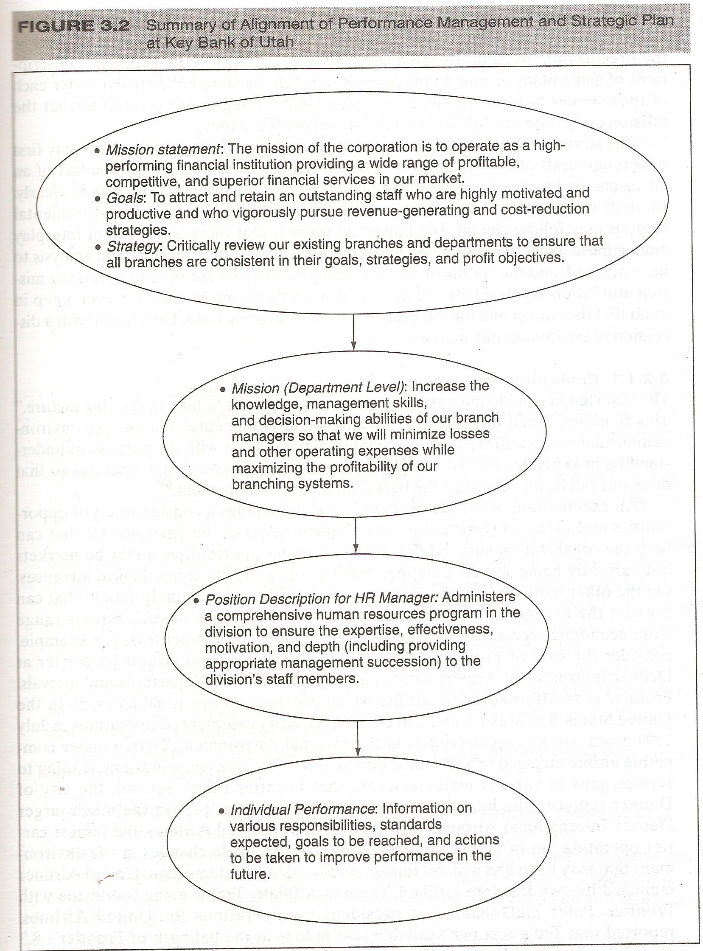

Slide 40
Thanks

