Slide 1
MGT-555
PERFORMANCE AND CAREER MANAGEMENT
LECTURE NO - 6

Slide 2
RECAP
Course Objective
Key Learning Outcomes
Contents of the Course Structure
We have discussed HRM and Strategic HRM(SHRM) in previous lectures, which included following points;
1. Definitions
2. Functions of HRM and SHRM
3. Types of assistance provided by HRD.
4. Challenges faced by Human resource managers.
5. Relationship between Human resource department and other departments.

Slide 3
RECAP
6. Role of Human resource managers in future.
7. Effect of HRM on organizational performance.
8. Role of HRM in training and development of employees.
9. Role of HRM in Performance and career management.
10. Role of HRM in maintaining competitive pay practices.

Slide 4
RECAP
Understanding Performance management
Definitions
Case study - PM Systems
Case Study - Morgan Stanley
Contribution / Advantages of PM System
Performance Management Process

Slide 5
Agenda of Today’s Lecture
Developmental Plan in Performance Planning
Disadvantages / Dangers of poorly implemented PM systems
Case study
Reward Systems
Types of Return
Aims and Role of PM system
Characteristics of Ideal PM system
Case Study- PM system

Slide 6
Performance Management Process
Components of PMP
1. Prerequisites
  Knowledge of Organization.
  Knowledge of job.
2. Performance Planning;
  Results.
  Behaviors.
  Development Plan.

Slide 7
Development plan
An important step before the review cycle begins is for the supervisor and employee to agree on a development plan.
At a minimum, this plan should include identifying areas that need improvement and setting goals to be achieved in each area.
Development plan usually include both results and behaviors.

Slide 8
Development plan (Contd.)
Performance plan includes the consideration of results and behaviors and the developmental plan.
A discussion of results need to include;
  key accountabilities ,(i.e broad area for which an employee is responsible)
  specific objectives for each key accountability,(i.e goals to be reached)
  and performance standards.(i.e what constitutes acceptable and unacceptable levels of performance)

Slide 9
Development plan (Contd.)
A discussion of behaviors needs to include competencies.(i.e clusters of Knowledge Skills Abilities)
Finally the developmental plan includes a description of areas that need improving and goals to be achieved in each area.

Slide 10
RECAP of PMP
Now we will have a briefly revise what we have discussed in PMP;
PMP includes following stages;
1. Prerequisites
2. Performance Planning
3. Performance Execution
4.Performance Assessment
5. Performance Review
6. Performance Renewal and Recontracting

Slide 11
Disadvantages/ Dangers of Poorly Implemented PM System
Increase turnover:
  If the process is not seen as fair, employees may become upset and leave the organization.
Use of misleading information:
  If a standard system is not in place, there are multiple opportunities for fabricating information about an employees performance

Slide 12
Disadvantages/ Dangers of Poorly Implemented PM System (Contd.)
Lowered self esteem:
  Self esteem may be lowered if feedback is provided in an in-appropriate and in-accurate way.
Wasted time and money :
  Performance management system costs money and quite a bit of time.
Damaged relationships:
  As a consequence of a deficient system, the relationships among the individuals involved may be damaged, often permanently.

Slide 13
Disadvantages/ Dangers of Poorly Implemented PM System (Contd.)
Decreased motivation to perform:
  Motivations can be lowered for many reasons, including the feeling that superior performance is not translated into meaningful tangible or intangible rewards.
Employee burnout and job dissatisfaction:
  When the performance assessment system is not seen as a valid and the system is not perceived as fair, employees are likely to feel increased levels of job burnout and job dissatisfaction.

Slide 14
Disadvantages/ Dangers of Poorly Implemented PM System (Contd.)
Increased risk of litigations:
  Expensive law suits may be filled by individuals who feel that they have been appraised unfairly.
Unjustified demands on managers and employees resources:
  Poorly implemented system do not provide the benefits provided by well implemented systems, yet they still take up managers and employees time.

Slide 15
Disadvantages/ Dangers of Poorly Implemented PM System (Contd.)
Varying and unfair standards ratings:
  Both standards and individual ratings may vary across and within units and also be unfair.
Emerging biases:
  Personal values, biases, and relationships are likely to replace organizational standards.
Unclear rating system:
  Because of poor communication, employees may not know how their ratings are generated and how the ratings are translated into rewards.

Slide 16
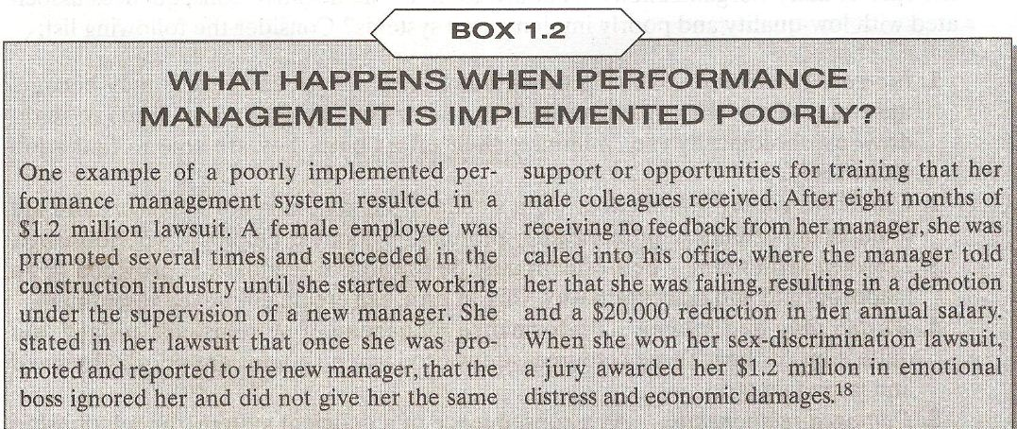
Disadvantages/ Dangers of Poorly Implemented PM System- Case Study

Slide 17
Reward System
An employee’s compensation, usually referred to as tangible returns, includes;
  Cash compensation
    Basic Pay
    Cost of Living
    Merit Pay
    Short Term incentives
    Long Term incentives

Slide 18
Reward System (Contd.)
  And Benefits;
    Income protection
    Work / life focus
    Tuition reimbursement
    And allowances
However, employees also receive intangible returns, also referred to as relational returns.

Slide 19
Reward System (Contd.)
They include;
  Recognition
  Status
  Employment security
  Challenging work
  And learning opportunities.

Slide 20
Reward System (Contd.)
Definition;
  A reward system is the set of mechanisms for distributing both tangible and intangible returns as part of an employment relationship”.

Slide 21
Reward System (Contd.)
It should be noted that not all types of returns are directly related to performance management systems.
This is the case because not all types of returns are allocated based on performance.
For example:
  Some allocations are based on seniority as opposed to performance.

Slide 22
Types of Returns
Base Pay;
  Base pay is given to employees in exchange for work performed.
  The base pay which usually includes a range of values, focuses on the position and duties performed rather than an individual’s contribution.

Slide 23
Types of Returns (Contd.)
Cost of Living Adjustments and Contingent Pay:
  Cost of Living Adjustments (COLA) imply the same percentage increase for all employees regardless of their individual performance.
  COLA is given to combat the effects of inflation in an attempt to preserve the employee’s buying power.

Slide 24
Types of Returns (Contd.)
  Contingent pay sometimes referred to as Merit pay is given as an addition to the base pay based on past performance.
  Contingent pay means that the amount of additional compensation given according to employee’s level of past performance.

Slide 25
Types of Returns (Contd.)
Short Term Incentives:
  Similar to contingent pay, short term incentives are allocated based on past performance.
  They are one time payments and they are known in advance.

Slide 26
Types of Returns (Contd.)
Long Term Incentives:
  Long term incentives attempt to influence future performance over a longer period of time.
  Typically they involve stock ownership or options to buy stock at a pre-established and profitable rate.
  This way employees will be personally investing in the organizational success and this investment is expected to translate into a sustained high level of performance.

Slide 27
Types of Returns (Contd.)
Income Protection:
  Income protection programs serve as a backup to employee’s salaries in the event that an employee is sick, disabled, or no longer able to work.
  Other type of benefits which come under income protection are ;
    Medical insurance
    Pension plan
    Savings plan

Slide 28
Types of Returns (Contd.)
Work Life Focus:
  Benefits related to work life focus include programs that help employees achieve a better balance between work and non work activities.
  They include;
    Vacation
    Counselling
    Financial Planning
    On site fitness programs
    Flexible work schedules

Slide 29
Types of Returns (Contd.)
Allowances:
  Benefits include allowances covering housing and transportation.
  Example
    Employer provides a house or reimburses the rent.
    Employer provides a car for private and business use or allowance is paid for the transportation.

Slide 30
Types of Returns (Contd.)
Relational Returns:
  Relational returns are intangible in nature.
  They include;
    Recognition and status
    Employment Security
    Challenging work
    Opportunities to learn
    Opportunities to form personal relationships at work
  Example: SunU

Slide 31
Aims and Role of Performance Management Systems
Performance management systems can serve the following six main purposes;
  Strategic
  Administrative
  Informational
  Developmental
  Organizational maintenance
  Documentational Purpose.

Slide 32
Strategic Purpose of PMS
Performance management systems help top management achieve strategic business objectives.
By linking organization’s goal with individual goals, the PM system reinforces behaviors consistent with the attainment of organizational goals.

Slide 33
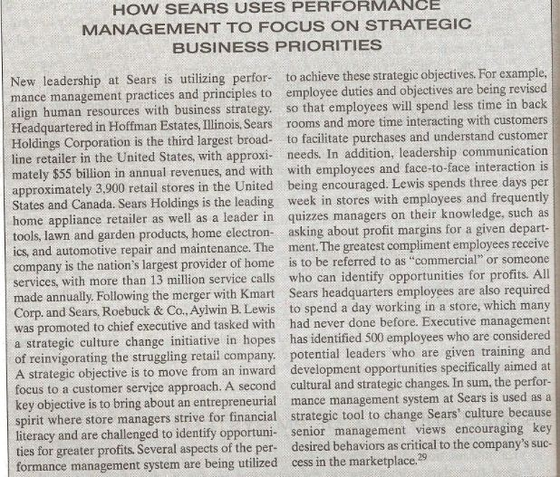

Slide 34
Administrative Purpose of PMS
PM system also functions to furnish valid and useful information for making administrative decisions about employees.
Such decisions include:
  Salary Adjustments
  Promotions
  Employee retention or termination
  Recognition of performance
  Identification of poor performers.

Slide 35
Informational Purpose of PMS
PM system serve as an important communication device.
First information is relayed to employee about their performance and the specific area which they need to improve.
Second information is provided about the organization and supervisor’s expectation and what aspects of work are of most importance.

Slide 36
Developmental Purpose of PMS
Managers coach employees on the basis of feedback to improve their performance.
The feedback also allows for the identification of strengths and weakness and causes of performance deficiencies.

Slide 37
Organizational Maintenance Purpose of PMS
PM system also serves the purpose of work force planning.
Workforce planning comprises a set of system that allows organizations to anticipate and respond to needs emerging within and outside the organization, to determine priorities and to allocate human resources where they can do the most good.

Slide 38
Documentational Purpose of PMS
Performance management systems allow organizations to collect, useful information that can be used for several documentation and administrative decision purposes.
This information can also be useful in case of litigation.

Slide 39
Characteristics of an Ideal Performance Management System
Following are the main characteristics of an Ideal PMS;
  Strategic Congruence
  Thoroughness
  Practicality
  Meaningfulness
  Specificity
  Identification of effective and ineffective performance
  Reliability

Slide 40
Characteristics of an Ideal Performance Management System (Contd.)
Validity
Acceptability
Fairness
Inclusiveness
Openness
Correctability
Standardization
Ethnicality

Slide 41
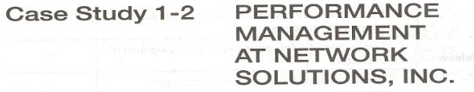

Slide 42
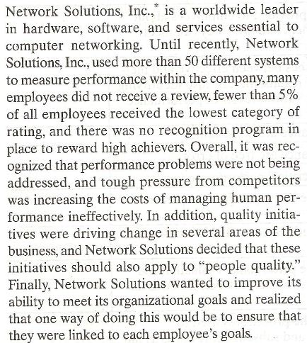

Slide 43
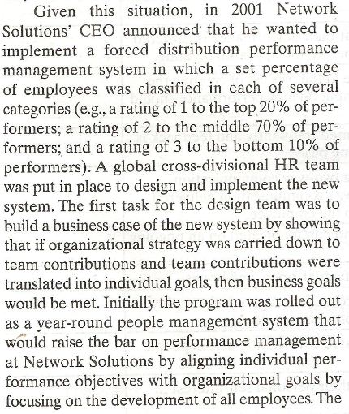

Slide 44
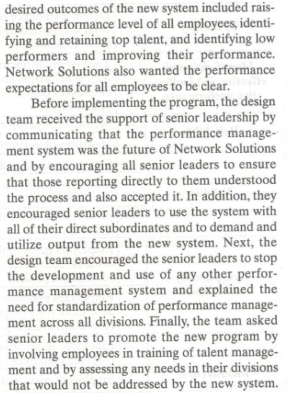

Slide 45
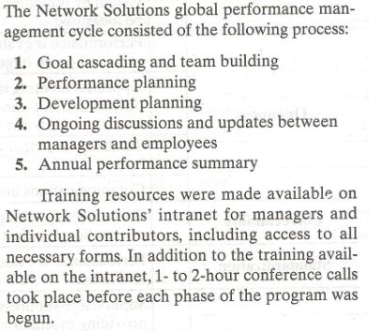

Slide 46
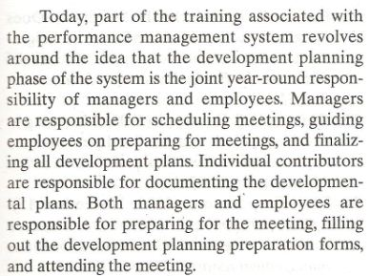

Slide 47
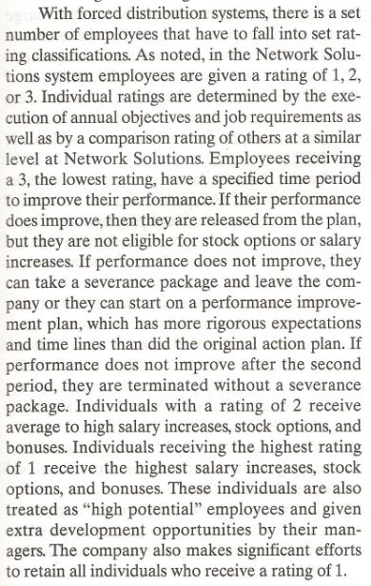

Slide 48
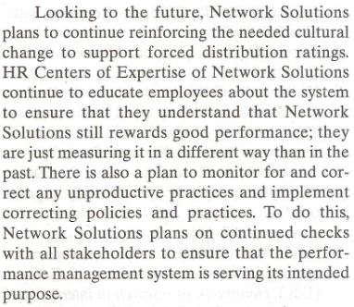

Slide 49
Summary of Today’s Lecture
Disadvantages / Dangers of poorly implemented PM systems
Case study
Reward Systems
Types of Return
Aims and Role of PM system
Characteristics of Ideal PM system
Case Study- PM system

Slide 50
Thanks

