Slide 1
MGT-555
PERFORMANCE AND CAREER MANAGEMENT
LECTURE NO - 5

Slide 2
RECAP
Course Objective
Key Learning Outcomes
Contents of the Course Structure
We have discussed HRM and Strategic HRM(SHRM) in previous lectures, which included following points;
1. Definitions
2. Functions of HRM and SHRM
3. Types of assistance provided by HRD.
4. Challenges faced by Human resource managers.
5. Relationship between Human resource department and other departments.

Slide 3
RECAP
6. Role of Human resource managers in future.
7. Effect of HRM on organizational performance.
8. Role of HRM in training and development of employees.
9. Role of HRM in Performance and career management.
10. Role of HRM in maintaining competitive pay practices.

Slide 4
RECAP
Understanding Performance management
Definitions
Case study - PM Systems
Case Study - Morgan Stanley
Contribution / Advantages of PM System

Slide 5
RECAP
Performance management Process
  Components of PMP
    Performance Execution
    Performance Assessment
    Performance review
    Performance renewal and Re-contracting
Case study

Slide 6
Agenda of Today’s Lecture
Performance management Process
  Components of Performance Management process
    Pre-requisites
    Performance Planning
  Implementation of Performance Management process

Slide 7
Performance management process
“In theory, the Performance Review process can be thought of a positive interaction between a coach and an employee, working together to achieve maximum performance . In reality, its more like finding a dead squirrel in your backyard and realizing the best solution is to fling it into your neighbors roof”.
  --SCOTT ADAMS

Slide 8
Performance management process (Contd.)
Performance management is an ongoing process.
PM does not take place just once a year, it is a continuous process including several components.
These components are closely related to each other, and poor implementation of any of the component has a negative impact on the performance management system as a whole.

Slide 9
Prerequisites
There are two main prerequisites that are required before a performance management system is implemented
Knowledge of organizations mission and strategic goals and
Knowledge of job in question

Slide 10
Prerequisites (Contd.)
PRE-REQUISITE 1
  Knowledge of organizations mission and strategic goals is a result of strategic planning
  Strategic planning allows an organization to clearly define it purpose or reason for existing, where it wants to be in future, the goals it wants to achieve and the strategies it will use to attain these goals.

Slide 11
Prerequisites (Contd.)
  Once the goals for the entire organization has been established, similar goals cascade downward, with departments setting objectives to support the organizations overall mission and objectives.
  The cascading continues downward until each employee has a set of goals compatible with those of the organization.

Slide 12
Prerequisites (Contd.)
PRE-REQUISITE 2
  The second important pre-requisite before a performance management system is implemented is to understand the job in question.
  This is done through job analysis.
  Job analysis is a process of determining the key components of a particular job, including activities, tasks, products, services and processes.

Slide 13
Prerequisites (Contd.)
  A job analysis is a fundamental pre-requisite of any performance management system.
  Without a job analysis, it is difficult to understand what constitutes the required duties for a particular job.
  If we don’t know what an employee is supposed to do on the job, we won’t know what needs to be evaluated and how to do so.
  As a result of the job analysis, we obtain information regarding the tasks carried out and the knowledge, skills and abilities (KSAs) required of a particular job.

Slide 14
Prerequisites (Contd.)
KSA refers to;
K- (knowledge)
  Information needed to perform the work
S- (skills)
  Required attributes that are usually acquired by having done the work in the past
A- (ability)
  The physical, emotional, intellectual and psychological aptitude to perform work.

Slide 15
Prerequisites (Contd.)
The tasks and KSAs needed for the various jobs are typically presented in the form of job description, which summarizes the job duties, needed KSAs and working conditions for a particular job.
CASE- Example– Trailer Truck Driver Job Description.

Slide 16
Prerequisites (Case Study)
JOB DESCRIPTION FOR TRAILER TRUCK DRIVER: CIVILIAN PERSONNEL MANAGEMENT SERVICE
Operates gasoline or diesel powered truck or truck tractor equipped with two or more driving wheels and with four or more forward speed transmissions, which may include two or more gear ranges. These vehicles are coupled to a trailer or semitrailer by use of a turntable (fifth wheel) or pintle (pivot) hook. Drives over public roads to transport materials, merchandise or equipment. Performs difficult driving tasks such as backing truck to loading platform, turning narrow corners, negotiating narrow passageways, and keeping truck and trailer under control, particularly on wet or icy highways. May assist in loading and unloading truck. May also handle manifest, bills of lading, expense accounts, and other papers pertinent to the shipment.

Slide 17
Prerequisites (Contd.)
This job description includes information about;
  What tasks are to be performed (e.g operation of a specific type of truck)
  Information about the needed
    knowledge (e.g manifests, bill of lading)
    Skills (e.g keeping truck and trailer under control, particularly in difficult whether conditions)
    Abilities (e.g physical and spatial abilities needed to turn narrow corners)

Slide 18
Prerequisites (Contd.)
Job Analysis:
  Job analysis can be conducted using observation, off-the-shelf questionnaires or interviews.
  Alternatively if the job is yet to be created, data can be gathered from individuals responsible for creating the job or those who will supervise the individuals in the new position.

Slide 19
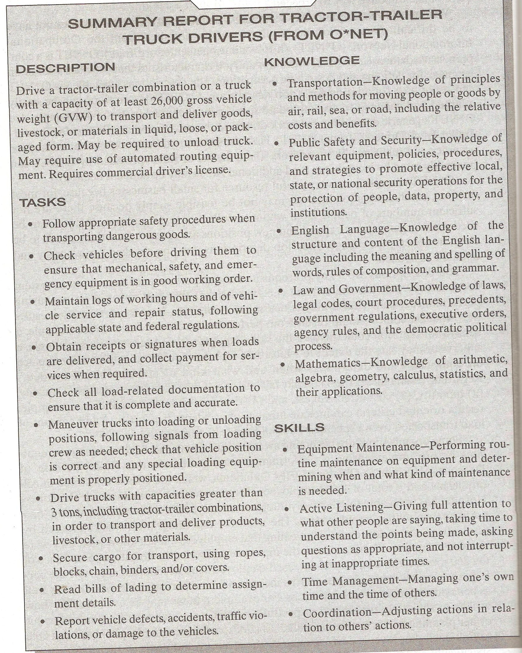

Slide 20
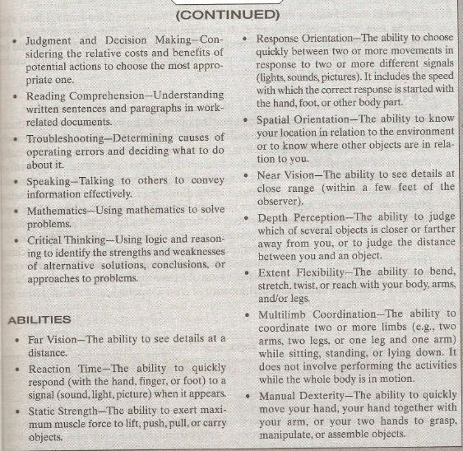

Slide 21
Performance planning
Employees should have thorough knowledge of the performance management system. In fact, at beginning of each performance cycle the supervisor and the employee meet to discuss, and agree upon, what needs to be done and how it should be done.

Slide 22
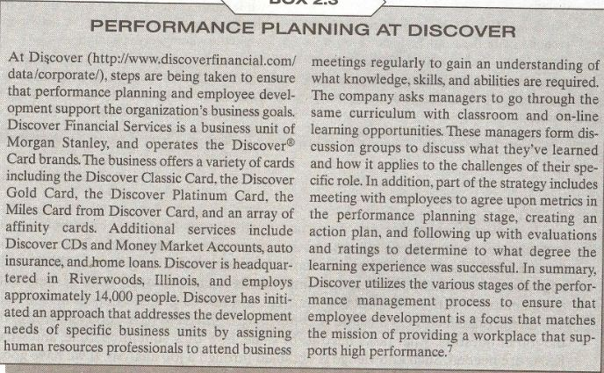

Slide 23
Performance planning (Contd.)
The performance planning includes;
  a consideration of both results
  and behaviors,
  as well as a developmental plan.

Slide 24
Results
Results refer to what need to be done or the outcomes an employee must produce.
A consideration of results needs to include the key accountabilities, or broad areas of a job for which the employee is responsible for producing results.

Slide 25
Results (Contd.)
This information is typically obtained from the job discussion.
A discussion of results also includes specific objectives that the employee will achieve as a part of each accountability.
Objectives are statements of important and measurable outcomes.

Slide 26
Results (Contd.)
Finally, discussing results also means discussing performance standards.
A performance standard is a yardstick used to evaluate how well employees have achieved each objective.
Performance standards provide information about acceptable and unacceptable performance.

Slide 27
Results (Contd.)
Example:-
  Consider the job of a university professors.
  Two key accountabilities are;
    Teaching
    Research
  An objective for teaching could be “to obtain a student evaluation of teaching performance on a point scale.

Slide 28
Results (Contd.)
  An objective for research could be ‘to publish two articles in scholarly referred journals per year”.
  Performance standard could be “to obtain a student evaluation of teaching performance of at-least 2 on a 4 point scale”
  And to publish at least one article in scholarly referred journals per year.
Thus objective is desired level of performance, where as the standard is usually a minimum acceptable level of performance.

Slide 29
Behaviors
Its is important to measure results, an exclusive emphasis on results can give a skewed or incomplete picture of employees performance.
Results from a survey indicated that, in addition to sales figure, salespeople would like to be appraised on such behavioral criteria as communications skills and product knowledge.

Slide 30
Behaviors (Contd.)
A consideration of behavior includes discussing competencies, which are measurable clusters of KSAs that are critical in determining how results will be achieved.
Examples of competencies are custom service, written or oral communication, creative thinking, and dependability.

Slide 31
Behaviors (Contd.)
Example:-
  Returning to the same example of professor, assume that teaching is done online and numerous technology related problems exist, so that the resulting teaching evaluations are deficient.
  This is an example of situation in which behaviors should be given more importance than results.
  In this situation the evaluation could include competencies such as online communication skills (e,g in the chat room).

Slide 32
Thanks

