Slide 1
MGT-555
PERFORMANCE AND CAREER MANAGEMENT
LECTURE NO - 31

Slide 2
RECAP
  ENHANCING PERFORMANCE MANAGEMENT SKILLS
Performance management Skills
Coaching
Guiding Principles for Successful Coaching
Functions of Coaching
Coach Engagement
Good Coach
Coaching Styles

Slide 3
Agenda of Today’s Lecture
AGENDA FOR TODAYS LECTURE IS “REVISION” ONLY.
Chapters 1 - 15

Slide 4
Human Resource Management
Human resource management (HRM, or simply HR) is a function in organizations designed to maximize employee performance in service of their employer’s strategic objectives.

Slide 5
Human Resource Management Process
Human Resource Planning
Recruitment
Selection
Orientation
Training & Development
Performance management
Compensation & Benefits
Career Development

Slide 6
The Human Resource Department
Primary function – Provide support to operating managers on all human resource matters
Fulfills a traditional staff role and acts in an advisory capacity
Depending upon the organization, functions may be split between operating managers and human resource department

Slide 7
The Human Resource Department
Other functions:
Customarily organizes and coordinates hiring and training
Maintains personnel records
Acts as a liaison between management, labor, and government
Coordinates safety programs

Slide 8
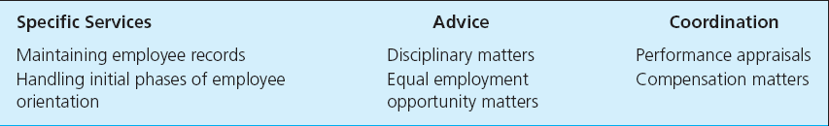
Examples of Types of Assistance Provided by Human Resource Departments

Slide 9
Impact of the HR Manager on Organizational Performance
Reducing unnecessary overtime expenses by increasing productivity during a normal day
Staying on top of absenteeism and instituting programs designed to reduce money spent for time not worked
Eliminating wasted time by employees with sound job design

Slide 10
Impact of the HR Manager on Organizational Performance
Minimizing employee turnover and unemployment benefit costs by practicing sound human relations and creating a work atmosphere that promotes job satisfaction
Installing and monitoring effective safety and health programs to reduce lost-time accidents and keep medical and workers’ compensation costs low

Slide 11
Impact of the HR Manager on Organizational Performance
Properly training and developing all employees to improve their value to company and do a better job producing and selling high-quality products and services at lowest possible cost
Decreasing costly material waste by eliminating bad work habits, attitudes and poor working conditions that lead to carelessness and mistakes
Hiring the best people available at every level and avoiding overstaffing

Slide 12
Impact of the HR Manager on Organizational Performance
Maintaining competitive pay practices and benefit programs to foster a motivational climate for employees
Encouraging employees to submit ideas for increasing productivity and reducing costs
Installing human resource information systems to streamline and automate many human resource functions

Slide 13
Strategic Human Resource Management
Involves the development of a consistent, aligned collection of practices, programs, and policies to facilitate the achievement of the organization’s strategic objectives.

Slide 14
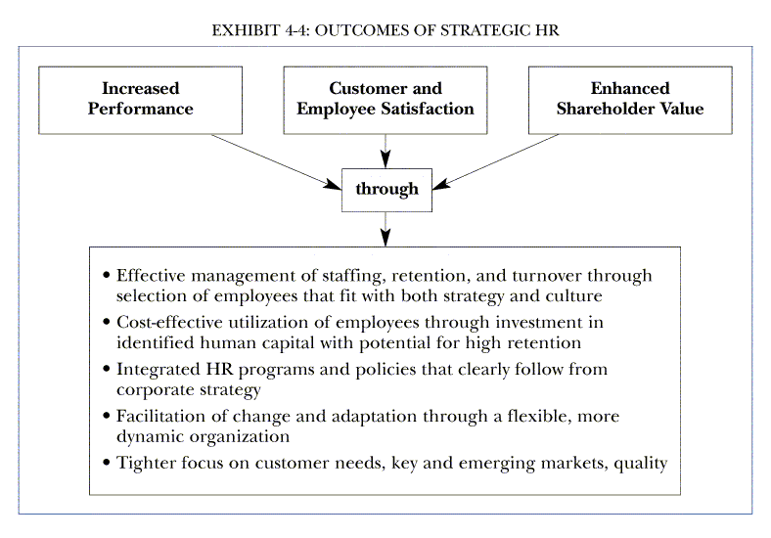

Slide 15
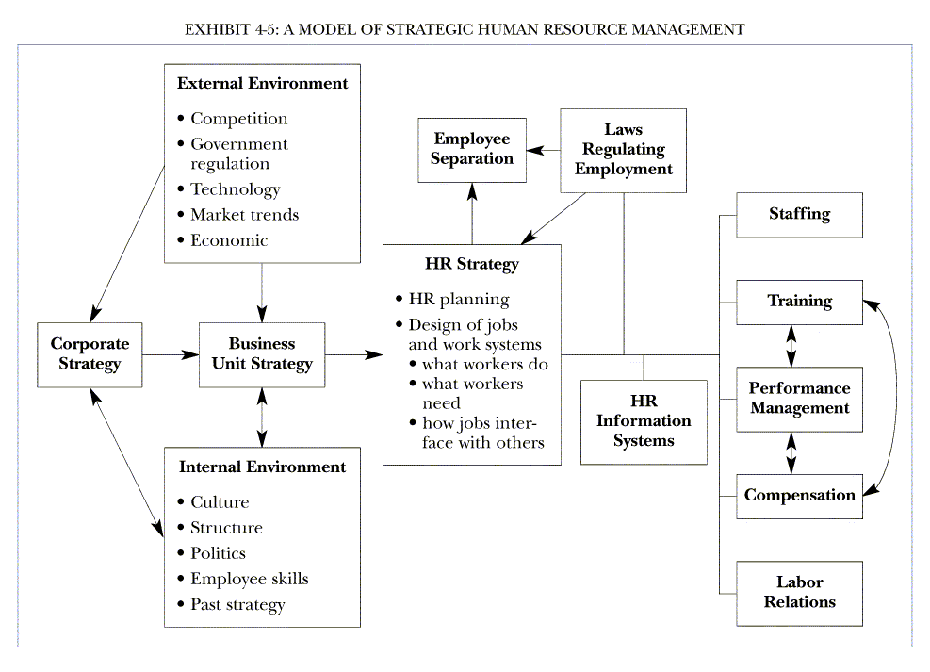

Slide 16
Performance Management
  “Performance management is a continuous process of identifying, measuring, and developing the performance of individuals and teams and aligning performance with the strategic goals of the organization”.

Slide 17
Performance Management
  lets consider each of the definition’s two main components.
    Continuous process:
      Performance management is ongoing. It involves a never ending process of setting goals and objectives, observing performance ,and giving and receiving ongoing coaching and feedback.

Slide 18
Performance Management
  Alignment with strategic goals:
    Performance management requires that managers ensure that employee’s activities and output are congruent with the organization’s goals
    and consequently, help the organization gain a competitive advantage.

Slide 19
The Performance Management Contribution/ Advantages
There are many advantage associated with the implementation of a performance management system.
A performance management system can make the following important contributions

Slide 20
The Performance Management Contribution/ Advantages (Contd.)
Motivation to perform is increased:
  Receiving feedback about ones performance increases the motivation for future performance.
  Knowledge about how one is doing and recognition about ones past success provide the fuel for future accomplishments.

Slide 21
The Performance Management Contribution/ Advantages (Contd.)
Self-esteem is increased:
  Receiving feedback about ones performance fulfills a basic human need to be recognized and valued at work.
  This, in turn, is likely to increase employee’s self-esteem.

Slide 22
The Performance Management Contribution/ Advantages (Contd.)
Managers gains insight about subordinates:
  Direct supervisors and other managers in charge of appraisal gain new insights into the person being appraised.

Slide 23
The Performance Management Contribution/ Advantages (Contd.)
The definition of job and criteria are clarified:
  The job of person being appraised may be clarified and defined more clearly.
  In other words, employee’s gain a better understanding of the behaviors and results required of their specific position.

Slide 24
The Performance Management Contribution/ Advantages (Contd.)
Self insight and development are enhanced:
  The participants in this system are likely to develop a better understanding of themselves and of the kind of development activities that are of value to them as they progress through the organization.
  Participants in this system also gain a better understanding of their particular strengths and weaknesses that can help them better define future career paths.

Slide 25
The Performance Management Contribution/ Advantages (Contd.)
Administrative actions are more fair and appropriate :
  Performance management system provides valid information about performance that can be used for administrative actions such as merit increases, promotions, and transfers, as well as terminations.
  In general, a performance management system helps ensure that rewards are distributed on fair and credible basis.
  In turn, such decision based on sound performance management system lead to improved interpersonal relationship and enhanced supervisor-subordinate trust.

Slide 26
The Performance Management Contribution/ Advantages (Contd.)
Organizational goals are made clear:
  The goal of unit and organization are made clear, and the employee understands the link between what she does and organization success.
  This is the contribution to the communication of what the unit and organization are all about and how organization goals cascade down to the unit and the individual employee.

Slide 27
The Performance Management Contribution/ Advantages (Contd.)
Employee becomes more competent:
  An obvious contribution is that employee performance is improved.
  In addition, there is a solid foundation for helping employees become more successful by establishing developmental plans.

Slide 28
The Performance Management Contribution/ Advantages (Contd.)
There is a better protection from lawsuits:
  Data collected through performance management system can help document compliance with regulations(e.g., equal treatment of all employees regardless of sex or ethnic back ground).

Slide 29
The Performance Management Contribution/ Advantages (Contd.)
Supervisors view of performance are communicated more clearly:
  Performance management system allows managers to communicate to their subordinates their judgment regarding performance.

Slide 30
The Performance Management Contribution/ Advantages (Contd.)
Organization change is facilitated:
  Performance management system can be a useful tool to drive organizational change.
  For example, assume an organization decides to change its culture to give top priority to product quality to produce quality and consumer service.
  Once this new organization direction is established, performance management is used to align the organizational culture with the goals and objectives of the organization to make possible changes.

Slide 31
The Performance Management Contribution/ Advantages (Contd.)
Motivation, commitment , and intentions to stay in the organization are enhanced:
  When employees are satisfied with their organizations performance management system, they are more likely to be motivated to perform well, to be committed to their organization, and not try to leave the organization.

Slide 32
Performance management process
Performance management is an ongoing process.
PM does not take place just once a year, it is a continuous process including several components.
These components are closely related to each other, and poor implementation of any of the component has a negative impact on the performance management system as a whole.

Slide 33
Performance management process(contd.)
PMP includes following stages;
1. Prerequisites
2. Performance Planning
3. Performance Execution
4.Performance Assessment
5. Performance Review
6. Performance Renewal and Recontracting

Slide 34
Disadvantages/ Dangers of Poorly Implemented PM System
Increase turnover
Use of misleading information
Lowered self esteem
Wasted time and money
Damaged relationships
Decreased motivation to perform
Employee burnout and job dissatisfaction

Slide 35
Disadvantages/ Dangers of Poorly Implemented PM System (Contd.)
Increased risk of litigations
Unjustified demands on managers and employees resources
Varying and unfair standards ratings
Emerging biases
Unclear rating system

Slide 36
Process of linking performance management to the strategic planning
There is a very important relationship between strategic planning and performance management. Performance management is really about setting and achieving goals at the employee level, and identifying and fixing barriers related to achieving those goals. But where do the goals come from?

Slide 37
Process of linking performance management to the strategic planning
That's where strategic planning comes in. Strategic planning (and also tactical planning), are methods a company, and its individual work-units define their goals and objectives. In turn, those goals and objectives are used to determine and analyze the goals and objectives of each employee in a work unit. This is called cascading of goals.

Slide 38
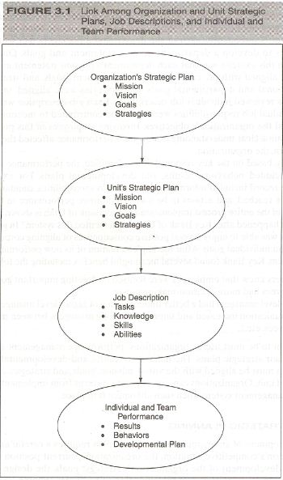

Slide 39
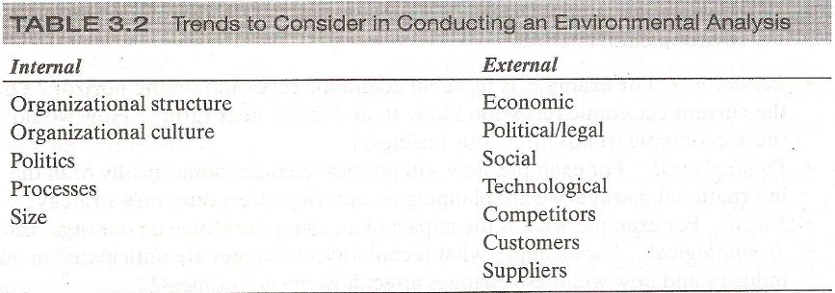
Questions to consider:
Where does your organization stand in regard to each of these important internal and external issues?
Regarding the external issues, what are some of the opportunities and threats?
Regarding the internal issues, what are some of the strengths and weaknesses?

Slide 40
Gap Analysis
After external and internal issues have been considered, information is collected regarding opportunities, threats, strengths and weaknesses.
This information is used to conduct gap analysis, which analyzes the external environment in relation to the internal environment.

Slide 41
Mission
After the environmental analysis has been completed and the gap analysis reveals an organizations leverage, constraints, vulnerabilities, and problems, the members of organization must determine who they are and what they do.

Slide 42
Vision
An organizations vision is a statement of future aspiration. In other words, the vision statement includes a description of what the organization would like to become in the future(about 10 years in the future).

Slide 43
Goals
After an organization has analyzed its external opportunities and threats as well as internal strengths and weaknesses and has defined its mission and vision, it can realistically establish goals that will further its mission.

Slide 44
Strategies
At this point, we know that organization is all about mission, what it needs to be in future(vision), and some intermediate steps to follow to get there(goals).
What remains is a discussion of how to fulfill the mission and vision and how to achieve the stated goals.

Slide 45
Strategies (Contd.)
This is achieved by creating strategies, which are description of game plans, or how to proceed to reach the stated objectives.
The strategies could address issues of growth, survival, turn around, stability, innovation and leadership, among others.

Slide 46
Strategies- HR Function
Human resources function play a critical role in creating and implementing the strategies that will allow the organization to realize its mission and vision.

Slide 47
Strategies- HR Function (Contd.)
HR function can make the following contributions:
Communicate knowledge of strategic plans
Outline knowledge, skills, and abilities needed for strategic implementation
Propose reward system

Slide 48
Developing strategic plans at unit level
The organization’s strategic plan has a direct impact on the unit’s strategic plan.
This illustrates that a mission statement is aligned with the overall organization’s mission statement.

Slide 49
Developing strategic plans at unit level (Contd.)
Similarly, the vision statement, goals and strategies of various units need to be congruent with the overall organizational vision, goals, and strategies.

Slide 50
Job descriptions
Job description also need to be congruent with the organization and unit mission, vision and goals and strategies.
The job analysis process leads to the creation of job description.

Slide 51
Job descriptions (Contd.)
After the strategic plan is completed, some rewriting of the existing job descriptions may be required.

Slide 52
Job descriptions (Contd.)
Job description provide information about the various tasks performed together with a description of some of KSAs required for the position.

Slide 53
Job descriptions (Contd.)
But what is the link with the organization and unit strategic plans?
How do the specific tasks make a contribution to the strategic priorities of the transportation division and the organization as a whole?

Slide 54
Individual and team performance
The performance management system needs to display the behavior and produce the results required to support the organizations and the units mission, vision, and goals.
Developmental plans need to be aligned with unit and organizational priorities as well.

Slide 55
Individual and team performance (Contd.)
Well designed management system defines a clear path from organizational mission, vision, and goals to individual and team performance.
This is critical because organizational success is a direct function of the alignment between collectives and individual objectives.

Slide 56
Defining performance
Performance management system usually includes measure of both behavior (what an employee does) and results (the outcomes of an employee’s behavior).
The definition of performance does not include the results of an employees behavior but only the behavior themselves.

Slide 57
Defining performance (Contd.)
Performance is about behavior or what the employee do, not about what employee produce or the outcomes of their work.

Slide 58
Determinants of performance
A combination of three factors allow some people to perform at higher levels than others.
Declarative knowledge
Procedural knowledge
Motivation

Slide 59
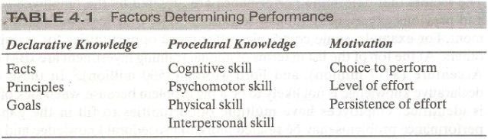

Slide 60
Factors influencing determinants of performance
The factors that determine performance are affected by
The employee
Human resource(HR) practices
And the work environment.

Slide 61
Performance Dimensions
Performance is multidimensional, meaning that we need to consider many different type of behaviors to understand performance.
Although we can identify many specific behaviors, two types of behaviors or performance facets stand out:
  task performance and
  contextual performance.

Slide 62
Performance Dimensions (Contd.)
Contextual and task performance must be considered separately because they do not necessarily occur in tandem.

Slide 63
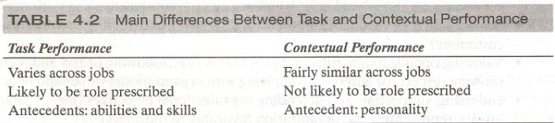

Slide 64
Approaches to measure performance
The employees work in organization by interacting with each other and engaging in certain behaviors that produce certain results.
The same employee may behave differently if placed in a different situation.

Slide 65
Approaches to measure performance (Contd.)
Trait Approach
  Emphasizes individual traits of employees
Behavior Approach
  Emphasizes how employees do the job
Results Approach
  Emphasizes what employees produce

Slide 66
Job Performance in Context
That produce various results
A performer
(individual or team)
Engages in certain behaviors
In a given situation
TRAIT
BEHAVIOR
RESULTS

Slide 67
Measuring Results
Performance measurement is a fundamental building block of an organization. Historically, organizations have always measured performance in some way through the ﬁnancial performance, be this success by proﬁt or failure through liquidation. But now different approaches have been emerged for measuring results.

Slide 68
Measuring Results (Contd.)
BOTH the results and the underlying employee behaviors need to be measured and evaluated if a performance management system is to drive both short and long-term business success. If results approach is adopted, the following key question should be:
What are the different focus areas for the individual (key accountability)?
Within each area, what are the expected objectives?
How do we know how well the results have been achieved(performance standards)?

Slide 69
Measuring Results (Contd.)
The key accountability are broad areas of job for which the employee is responsible for producing results.
A discussion of results also include specific objectives that the employee will achieve as a part of each accountability.

Slide 70
Measuring Results (Contd.)
Objectives are statements of important and measurable outcomes.
Discussing results also means discussing performance standards.

Slide 71
Measuring Results (Contd.)
A performance standard is the yardstick used to evaluate how all employees have achieved each objective.
Performance standard provide information on acceptable and unacceptable performance in relation to quality, quantity, cost and time.

Slide 72
Measuring Results (Contd.)
Organizations that implement management by objective (MBO) philosophy are likely to implement performance management systems, including objectives and standards.

Slide 73
Determining Accountabilities
The first step in determining accountability is to collect information about the job.
The primary source is of course the job description that has resulted from the job analysis and a consideration of unit and organization level strategic priorities.
The job description provides information on the tasks performed.

Slide 74
Determining Accountabilities (Contd.)
Tasks included in the job description can be grouped into clusters of tasks based on their degree of relatedness.
Each of these clusters or accountabilities is a broad area of the job for which the employee is responsible for producing results.

Slide 75
Determining Objectives
After the accountability have been identified, the next step in measuring results is to determine specific objectives.

Slide 76
Determining Objectives (Contd.)
Objectives are statement of an important and measurable outcomes that, when accomplished, will help ensure success for the accountability.
Objectives are clearly important because they help employees guide their efforts.

Slide 77
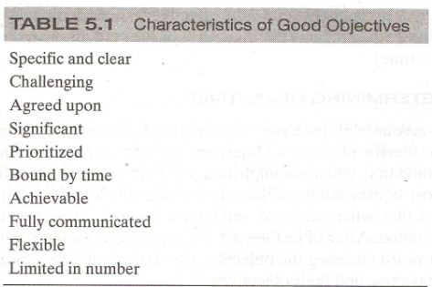

Slide 78
Determining Performance Standards
After accountability and objectives have been determined, the next step is to define performance standards. These are yard sticks designed to help people understand to what extent the objectives have been achieved. The standards provide raters with information about what to look for to determine the level of performance that has been achieved.

Slide 79
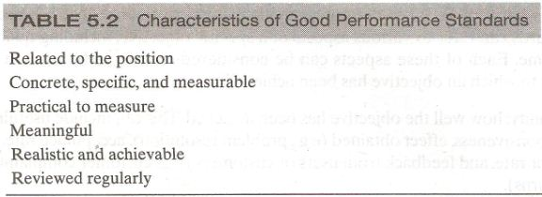

Slide 80
Measuring behaviors
Results measure past performance. Behavior points to future performance. Clearly, measuring both employee and organizational behavior is of strategic importance.
A behavior approach to measuring performance includes the assessment of competencies.
Competencies are measureable clusters of knowledge, skills and abilities that are critical in determining how results will be achieved.
Example of competencies are customer services, written or oral communication, creative thinking, and dependability.

Slide 81
Measuring behaviors (Contd.)
We can consider two types of competencies:
Differentiating competencies:
  which are those that allow us to distinguish between average and superior performers.
Threshold competencies:
  which are those that everyone needs to display to the job to a minimally adequate standard.

Slide 82
Indicator
To understand the extent to which an employee possess a competency, we measure indicators.
An indicator is a behavior that if displayed suggests that the competency is present.

Slide 83
Indicator (Contd.)
Five indicators whose presence would indicate the existence of competency, are the following;
  Support subordinates project
  Ask about the well being of employees lives outside of work
  Encourage subordinates to reach their established goals
  Get to know employees personally
  Show respect for employees work and home lives.

Slide 84
Comparative system
Comparative system of measuring behavior imply that employees are compared to one another. For example simple rank order system, alternation rank order system etc.

Slide 85
Absolute system
In absolute system, the supervisor provide evaluation of an employees performance without making direct reference to others employees.
In the simplest absolute system, supervisors write an essay describing each employees strengths and weaknesses and make suggestions for improvement.

Slide 86
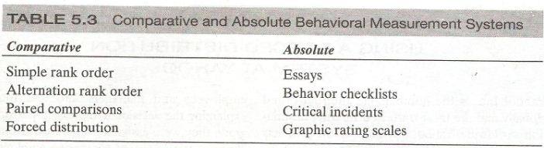

Slide 87
Summary of Today’s Lecture
We revised from Chapters 1 – 15.

Slide 88
Thank You

