Slide 1
MGT-555
PERFORMANCE AND CAREER MANAGEMENT
LECTURE NO - 30

Slide 2
RECAP
EMPLOYEE DEVELOPMENT - PERFORMANCE AND CAREER
  Personal Developmental Plan
  Objectives of Developmental Plan
  Content of Developmental Plan
  Development Activities

Slide 3
RECAP
Direct Supervisors Role
360 Degree Feedback System
Advantages of 360 degree feedback system
Risks of implementing 360 degree feedback system
Characteristic of a Good System

Slide 4
Agenda for Today’s Lecture
Advantages of 360 degree feedback system
Risks of implementing 360 degree feedback system
Characteristic of a Good System
ENHANCING PERFORMANCE MANAGEMENT SKILLS
Performance management Skills
Coaching
Guiding Principles for Successful Coaching
Functions of Coaching
Coach Engagement
Good Coach
Coaching Styles

Slide 5
Advantages of 360 degree feedback system
Organizations and individual can gain several advantages as a consequence of implementing a 360 degree feedback system. These include the following
Decreased possibility of biases:
  Because these systems include information from more than one sources, there is decreased possibility of biases in the identification of employees weaknesses.

Slide 6
Advantages of 360 degree feedback system (Contd.)
Increased awareness of expectations:
  Employees become very aware of others expectations about their performance.
  This include not only the supervisors expectations but also the expectations of other managers, coworkers, subordinates and customers.

Slide 7
Advantages of 360 degree feedback system (Contd.)
Increased commitment to improve:
  Employees become aware of what others expectations about their performance.
  This includes not only the supervisors expectations but also the expectations of other managers, coworkers, subordinates and customers.

Slide 8
Advantages of 360 degree feedback system (Contd.)
Improve self-perceptions of performance:
  Employees distorted views of their own performance are likely to change as a result of the feedback received from other sources.

Slide 9
Advantages of 360 degree feedback system (Contd.)
Improved performance:
  Although receiving information about ones performance is not sufficient to improve, it is certainly a very important step.

Slide 10
Advantages of 360 degree feedback system (Contd.)
Deduce discussable:
  360 degree feedback systems provide an excellent opportunities to coworkers, supervisors, and subordinates to give information about performance in an anonymous and nonthreatening way.

Slide 11
Advantages of 360 degree feedback system (Contd.)
Employees enable to take control of their careers:
  By receiving detailed and constructive feedback on weakness and strengths in various areas, employees can gain a realistic assessment of where they should go with their careers.

Slide 12
Risks for implementing 360 degree feedback system
The risk for implementing 360 degree feedback system is as
Negative feedback can hurt an employees feelings, particularly if those giving the feedback do not offer their comments in a constructive way.

Slide 13
Risks for implementing 360 degree feedback system (Contd.)
The system is likely to lead to positive results only if individuals feel comfortable with the system and believe they will be rated honestly and treated fairly.

Slide 14
Risks for implementing 360 degree feedback system (Contd.)
When very raters are providing the information, say, two or three, it may be easy for the employee being rated to identify who the rater are.
Raters may become overloaded with forms to fill out because they need to provide information on so many individuals.

Slide 15
Risks for implementing 360 degree feedback system (Contd.)
Implementing a 360 degree feedback system should not be a one time only event. The system should be in place and data collected over time on an ongoing basis.

Slide 16
Characteristic of a Good System
When the system have the following characteristics, they are most likely to be successful:
Anonymity:
  In good systems, feedback is anonymous and confident.

Slide 17
Characteristic of a Good System (Contd.)
Observation of employee performance:
  Only those with good knowledge and first hand experience with the person being rated should participate in the process.
Feedback interpretation:
  Good systems allow the person being rated to discuss the feedback received with a person interested in the employees development.

Slide 18
Characteristic of a Good System (Contd.)
Follow up:
  The information gathered has little value if there is no follow up action. Once feedback is received, it is essential that a developmental plan is created right away.
Used for developmental purposes only:
  When 360 degree feedback systems are used for administrative purposes such as promotions and compensation, raters are likely to distort the information provided.

Slide 19
Characteristic of a Good System (Contd.)
Avoidance of survey fatigue:
  Survey fatigue can be avoided if individuals are not asked to rate too many employees at the same time.

Slide 20
Characteristic of a Good System (Contd.)
Emphasis on behaviors:
  Although systems can include feedback on both behavior and results, it is better to emphasize behaviors.
Raters go beyond ratings:
  In addition to providing scores on various dimensions, raters should provide written descriptive feedback that gives detailed and constructive comments on how to improve performance.

Slide 21
ENHANCING PERFORMANCE MANAGEMENT SKILLS

Slide 22
Performance management skills
Performance management systems are NOT likely to help employees develop and improve their performance if managers do not have the necessary skills to help employees accomplish their goals.

Slide 23
Performance management skills (Contd.)
Such skills include;
  being able to serve as coaches,
  to observe, and
  document performance accurately,
  To give both positive and negative feedback,
  And to conduct useful and constructive performance review discussions.

Slide 24
Coaching
Coaching is a collaborative, ongoing process in which the manger interacts with his or her employees and takes an active role and interest in their performance.
In general, coaching involves directing, motivating, and rewarding employee behavior.

Slide 25
Coaching (Contd.)
Coaching is a day to day function that involves observing performance, complimenting good work, and helping to correct and improve any performance that does not meet expectations and standards.

Slide 26
Coaching (Contd.)
Coaching is also concerned with long term performance and involves ensuring that the developmental plan is being achieved.
Being a coach thus is similar to serving as a consultant and for coaching to be successful, a coach must establish a helping relationship.

Slide 27
Guiding Principles for Successful Coaching
Although many theories on coaching exist, there are four guiding principles that provide a good framework for understanding successful coaching.
A good coaching relationship is essential:
  For coaching to work, it is imperative that the relationship between the coach and the employee be trusting and collaborative.
  The coach needs to try to walk in employees shoes and view the job and organization from his or her perspective.

Slide 28
Guiding Principles for Successful Coaching (Contd.)
  The coach also need to search for positive aspects of the employee because this is likely to lead to a better understanding and acceptance of the employee.
  The coach needs to understand that coaching is not something done to the employees but done with the employees.

Slide 29
Guiding Principles for Successful Coaching (Contd.)
The employee is the source and director of change:
  The coach must understand that the employee is the source of change and self growth.
  After all, the purpose of coaching is to change employee behavior and set a direction for what the employee will do differently in the future.

Slide 30
Guiding Principles for Successful Coaching (Contd.)
  This change will not happen if the employee is not in the driving seat.
  Accordingly the coach needs to facilitate the employee’s setting the agenda, goals and direction.

Slide 31
Guiding Principles for Successful Coaching (Contd.)
Each employee is unique:
  The coach must understand that each employee is a unique individual with several job related and job unrelated identities and a unique personal history. (e.g computer network specialist, father, skier)
  The coach must try to create a whole, complete and rich picture of the employee.

Slide 32
Guiding Principles for Successful Coaching (Contd.)
  It will be beneficial if the coach has knowledge of and can help the employee connect his life and work experiences in meaningful way.

Slide 33
Guiding Principles for Successful Coaching (Contd.)
The coach is the facilitator of the employees growth:
  The coach main role is one of facilitation.
  A coach must direct the process and help with the content (e.g of a developmental plan) but not take control of these issues.

Slide 34
Guiding Principles for Successful Coaching (Contd.)
  The coach needs to maintain an attitude of exploration, help expand the employee’s awareness of strengths, resources and challenges and facilitate goal setting.

Slide 35
Functions of Coaching
In more specific terms, coaching involves the following functions:
Giving advice to help employee improve their performance.
Providing employees with guidance so that employees can develop their skills and knowledge appropriately.
Providing employees support and being there only when the manager is needed.

Slide 36
Functions of Coaching (Contd.)
Giving employees confidence that will enable them to enhance their performance continuously and to increase their sense of responsibility for managing their own performance.

Slide 37
Functions of Coaching (Contd.)
Helping employees gain greater competence by guiding them towards acquiring more knowledge and sharpening the skills that can prepare them for more complex tasks and higher level positions.
Coaching involves a consideration of both short term and long term objectives, including how the employee can benefit from acquiring new skills and knowledge that could be useful in future positions and in novel tasks.

Slide 38
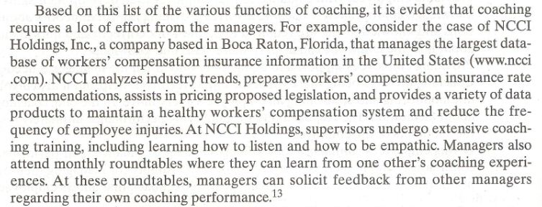

Slide 39
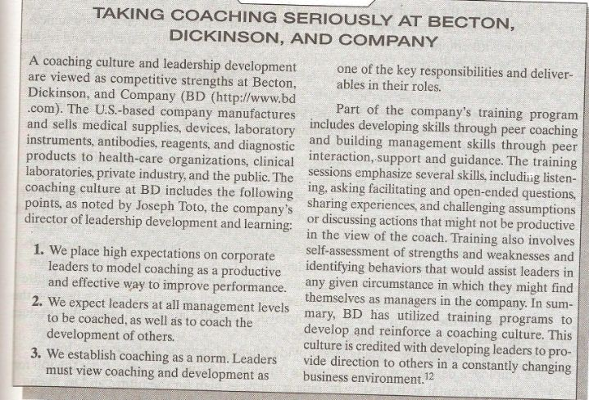

Slide 40
Coach Engagement
Coaching help turns feedback into results. For this to happen, coaches need to engage in the following:
Establish development objectives:
  The manger works jointly with the employees in creating the developmental plan and its objectives.

Slide 41
Coach Engagement (Contd.)
Communicate effectively:
  The manager maintains regular and clear communication with employees about their performance, including both behaviors and results.

Slide 42
Coach Engagement (Contd.)
Motivate employees:
  Managers must reward positive performance.
  When positive performance is rewarded, employees are motivated to repeat the same level of positive performance in the future.

Slide 43
Coach Engagement (Contd.)
Document performance:
  Managers observe employee behavior and results. Evidence must be gathered regarding instance of good and poor performance.

Slide 44
Coach Engagement (Contd.)
Give feedback:
  Managers measure employee performance and progress towards goal. They praise good performance and point out instance of substandard performance.

Slide 45
Coach Engagement (Contd.)
Diagnose performance problems:
  Managers must listen to employees and gather information to determine whether performance deficiencies are the result of a lack of knowledge and skills, abilities or motivation or whether they stem from situational factors beyond the control of the employee.

Slide 46
Coach Engagement (Contd.)
Develop employees:
  Managers provide support and resources for employee development by helping employees plan for future and by giving challenging assignments that force employees to learn new things.

Slide 47
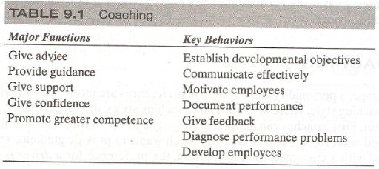


Slide 48
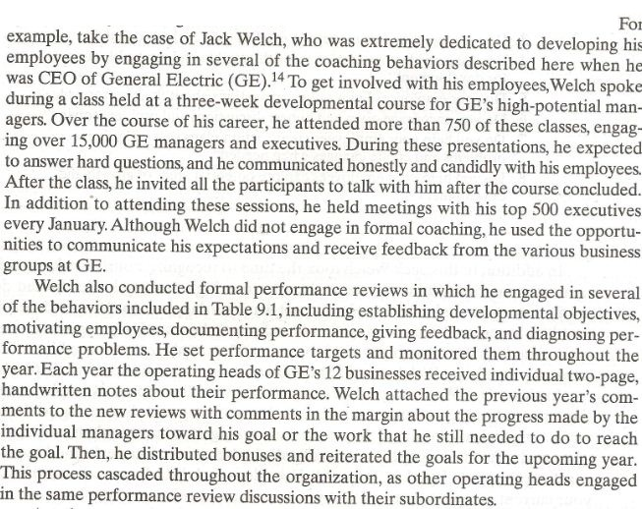

Slide 49
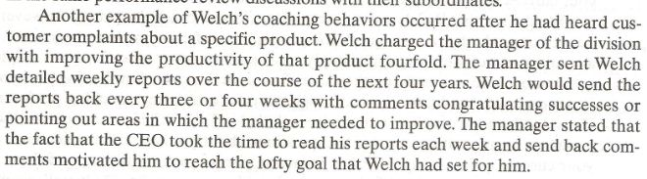

Slide 50
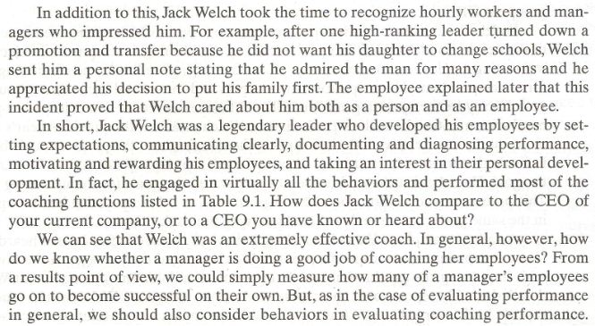

Slide 51
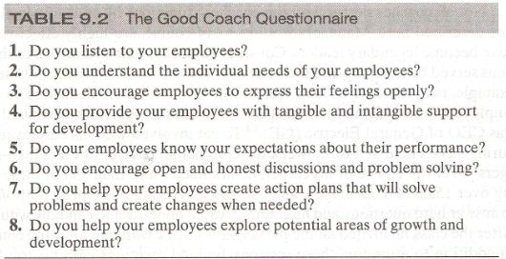
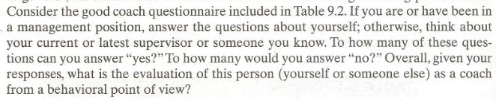

Slide 52
Coaching styles
A manager personality and behavioral preference are more likely to influence his or her coaching styles.
There are four main coaching styles:
  Driver
  Persuader
  Amiable
  Analyzer

Slide 53
Coaching styles (Contd.)
First, coaches can adopt a driving style in which they tell the employee being coached what to do.
Assume that the coach wants to provide guidance regarding how to deal with a customer.
In this situation, the preference for a driver is to say to the employee “you must talk to customer in this way”.

Slide 54
Coaching styles (Contd.)
Such coaches are assertive, speak quickly and often firmly, usually talk about facts and tasks, are not very expressive and expose a narrow range of personal feelings to others.

Slide 55
Coaching styles (Contd.)
Second, coaches can use a persuading style in which they try to sell what they want the employee to do.
Someone who is a persuader would try to explain to the employee why it is beneficial for the organization, as well as for the employee himself, to talk to a customer in a specific way.

Slide 56
Coaching styles (Contd.)
Third, other coaches may adopt an amiable style and want every one to be happy.
Such coaches are likely to be more subjective than objective and direct employees to talk to customers in a certain way because it feels like the right thing to do or because the employee feels it is a right way to do it.

Slide 57
Coaching styles (Contd.)
Finally, coaches may have a preference for analyzing performance in a logical and systemic way and then follow rules and procedures when providing a recommendation.
To use the same example, such analyzer coaches may tell employees to talk to a customer in a specific way “because this is what the manual says.”

Slide 58
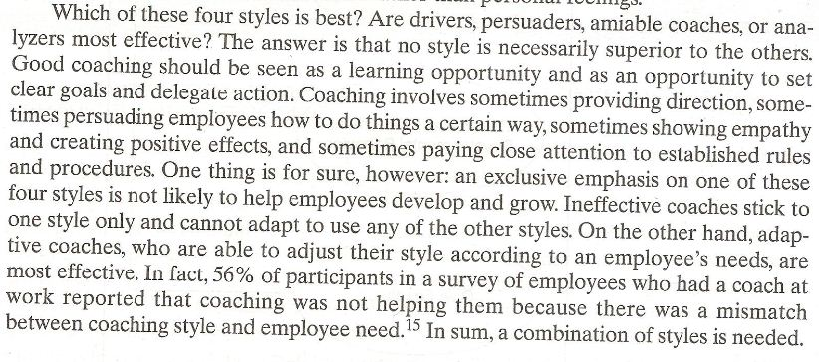

Slide 59
Summary of Today’s Lecture
Advantages of 360 degree feedback system
Risks of implementing 360 degree feedback system
Characteristic of a Good System
ENHANCING PERFORMANCE MANAGEMENT SKILLS
Performance management Skills
Coaching
Guiding Principles for Successful Coaching
Functions of Coaching
Coach Engagement
Good Coach
Coaching Styles

Slide 60
Thank You

