Slide 1
MGT-555
PERFORMANCE AND CAREER MANAGEMENT
LECTURE NO - 29

Slide 2
RECAP
Career Development
Career Stages
Career Choices and Preferences.

Slide 3
Agenda for Today’s Lecture
EMPLOYEE DEVELOPMENT - PERFORMANCE AND CAREER
  Personal Developmental Plan
  Objectives of Developmental Plan
  Content of Developmental Plan
  Development Activities

Slide 4
Agenda for Today’s Lecture
Direct Supervisors Role
360 Degree Feedback System
Advantages of 360 degree feedback system
Risks of implementing 360 degree feedback system
Characteristic of a Good System

Slide 5
EMPLOYEE DEVELOPMENT - PERFORMANCE AND CAREER
“One of the test of Leadership is the ability to recognize a problem before it becomes an emergency”– ARNOLD H. GLASOW

Slide 6
Personal Developmental Plan
Personal developmental plan specifies courses of action to be taken to improve performance. Achieving the goals stated in the developmental plan allows employees to keep abreast of changes in their field or profession.

Slide 7
Personal Developmental Plan (Contd.)
Such plans highlight an employees strengths and areas in need of development, and they provide an action plan to improve in areas of weakness and further develop areas of strength.

Slide 8
Personal Developmental Plan (Contd.)
The personal developmental plan allow employees to answer the following questions:
  How can I continually learn and grow in the next year?
  How can I do better in the future?
  How can I avoid performance problems faced in the past?

Slide 9
Personal Developmental Plan (Contd.)
Developmental plans can be created for every job, ranging from entry level to the executive suite.
No matter how high up the position within the organization and how simple or complex the nature of job in question, there is always room for improvement.

Slide 10
Personal Developmental Plan (Contd.)
Information to be used in developmental plans comes from the appraisal form.
Specifically, a developmental plan can be designed based on each of the performance dimensions evaluated.

Slide 11
Developmental Plan Objectives
The overall objective of developmental plan is to encourage continuous learning performance improvement, and personal growth.

Slide 12
Developmental Plan Objectives (Contd.)
In addition developmental plans have other, more specific objectives:
  Improve performance in current job:
    A good developmental plan helps employees meet performance standards.
    Thus, a developmental plan includes suggested courses of action to address each of performance dimensions that are deficient.

Slide 13
Developmental Plan Objectives (Contd.)
  Sustain performance in current job:
    A good developmental plan provides tool so that employees can continue to meet and exceed expectations regarding the current job.

Slide 14
Developmental Plan Objectives (Contd.)
  Prepare employees for advancement:
    A good developmental plan includes advice and courses of action that should be taken so that employees will be able to take advantage of future opportunities and career advancement.

Slide 15
Developmental Plan Objectives (Contd.)
  Enrich the employees work experience:
    Even if career opportunities within the organization are not readily available, a good plan provides employees with growth opportunities and opportunities to learn new skills.

Slide 16
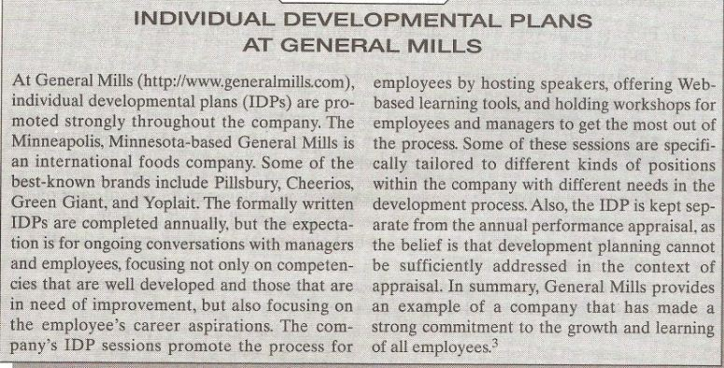

Slide 17
Developmental Plan Objectives (Contd.)
Consider the employee developmental plan used by Texas A and M university in college station, Texas.
Since the developmental plan is a formal component of the university’s performance management system, the developmental plan is included within the appraisal form.

Slide 18
Developmental Plan Objectives (Contd.)
The appraisal form used by Texas A and M first lists the six objectives of the performance management system:
  Provide employees with feedback to improve or maintain job performance.
  Outline areas for employee development.

Slide 19
Developmental Plan Objectives (Contd.)
  Set standards for the next review period.
  Recognize job related accomplishments.

Slide 20
Developmental Plan Objectives (Contd.)
  Enhance communication and working relationships.
  Identify job performance deficiencies and report to the next level of supervisory responsibility.

Slide 21
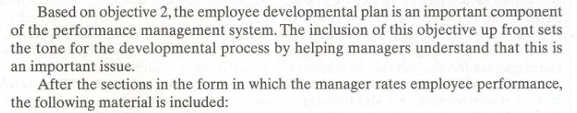

Slide 22
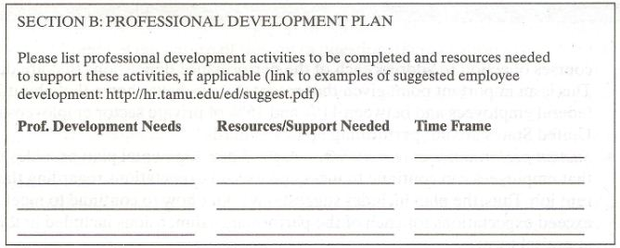

Slide 23
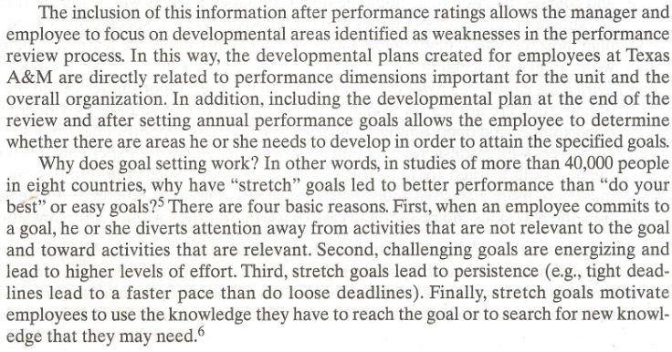

Slide 24
Content of Developmental Plan
What does a developmental plan looks like?
Plans should include a description of specific steps to be taken and specific objectives to reach.

Slide 25
Content of Developmental Plan (Contd.)
In other words, what is the new skill or knowledge that will be acquired and how will this occur?
This include information on the resources and strategies that will be used to achieve the objectives.
Example will the employee learn from a coworker through on the job training? Or will the company reimburse the employee if he takes on line course for building that skill?

Slide 26
Content of Developmental Plan (Contd.)
The plans objectives should include not only the end product, such as new skill to be learned, but also the completion date and how the supervisor will know whether the new skill has indeed been acquired.

Slide 27
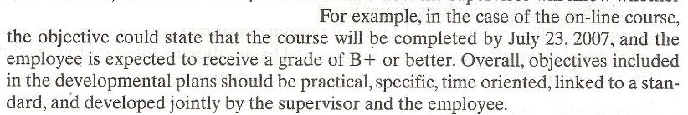

Slide 28
Content of Developmental Plan (Contd.)
An additional important feature of development plan is that they should keep the needs of both the organization and the employee in mind.
The choice of what specific skills or performance areas will be improved is dictated by the needs of the organization, especially when the organization is investing in the plan.

Slide 29
Content of Developmental Plan (Contd.)
In addition the plan created is dictated by the needs of the individual.
The supervisor and the employee need to agree on what development or new skills will help enrich the employees work experience, as well as help accomplish organizational goals now or in the near future.

Slide 30
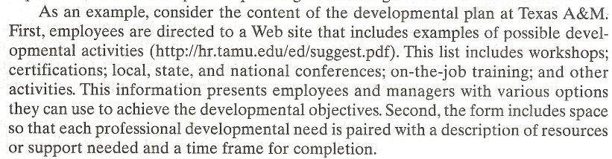

Slide 31
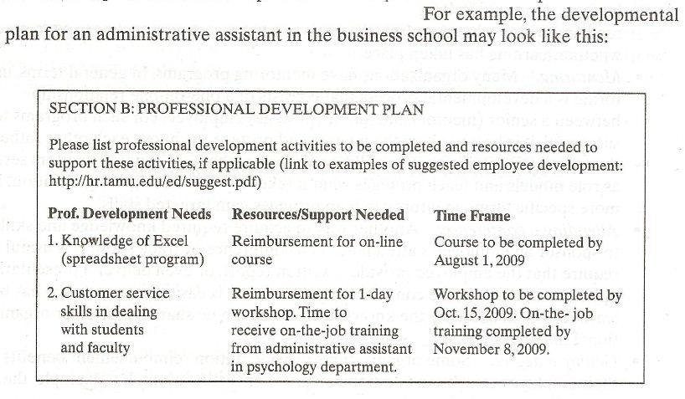

Slide 32
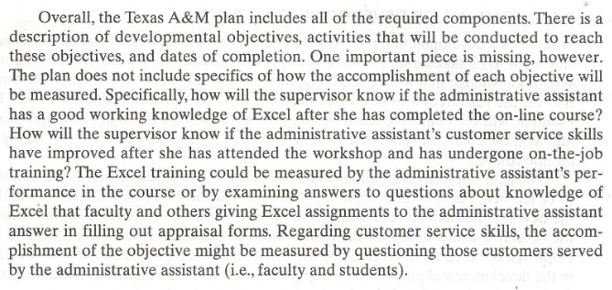

Slide 33
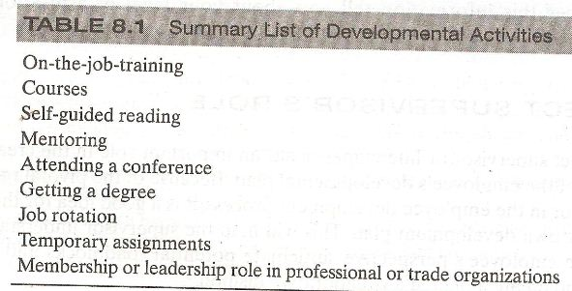
DEVELOPMENTAL ACTIVITIES

Slide 34
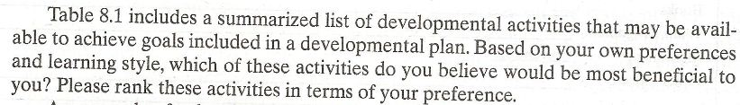

Slide 35
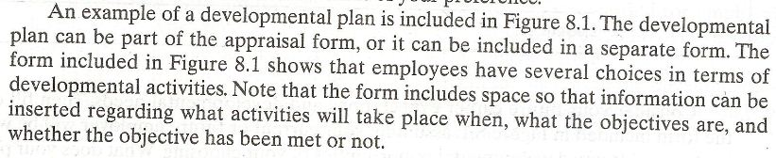

Slide 36
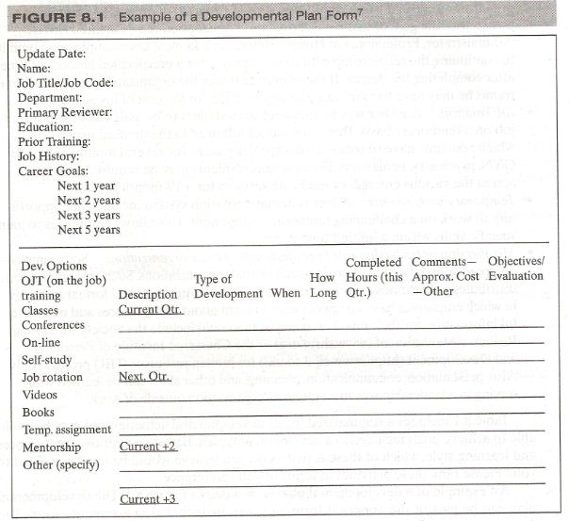

Slide 37
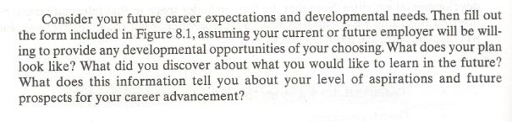

Slide 38
Developmental Activities
There are several ways through which employees can reach the objectives stated in their developmental plans. Including:
On the job training:
  Employees are paired with a coworker or supervisor who designs a formal on the job training course.
  The design of these mini training programs includes how many hours a day or week training will take place and specific learning objectives.

Slide 39
Developmental Activities (Contd.)
Courses:
  Some large organizations such as McDonalds, Motorola, Capgemini, Ernst and young, and others, offer in house courses given at their own corporate universities.
  Other organizations may provide tuition reimbursements.
  Given the proliferation of online courses, employees have a wide variety of options from which to choose.

Slide 40
Developmental Activities (Contd.)
Self guided reading:
  An employee can read books and study other resources on her own.
  Once again it is important that an objective be set regarding what will be read and within what time frame, as well as what measures will be used to assess whether learning has taken place.

Slide 41
Developmental Activities (Contd.)
Mentoring:
  Many organizations have mentoring programs.
  In general terms, mentoring is a developmental process that consist of a one on one relationship between a senior (mentor) and junior (mentee) employee.
  For such programs to be successful, it is best to allow the mentor and mentee to choose each other rather than arbitrarily assigning who will be mentoring whom.

Slide 42
Developmental Activities (Contd.)
  In general mentors serve as role models and teach mentee what it takes to succeed in the organization.
  In more specific terms, mentors can help mentee gain targeted skills.

Slide 43
Developmental Activities (Contd.)
Attending a conference:
  Another way to acquire required knowledge and skill is to sponsor an employees attendance at a conference or trade show.
  It is useful to require that the employee provide a written report, or even deliver a presentation, upon returning from the conference.
  In this way it is easier to assess what has been learned and in addition, the knowledge gained can be shared with other organizational members.

Slide 44
Developmental Activities (Contd.)
Getting a degree:
  Some organizations provide tuition reimbursement benefits for their employee to obtain additional degrees or certifications.
  For Example; the organization can sponsor an employee’s MBA program or an employee’s taking a course with the goal of earning a certification designation (e.g Certified Novell Administrator, Professional in Human Resources)

Slide 45
Developmental Activities (Contd.)
  In most cases, employees commit to continuing the relationship with their employer for a pre-specified amount of time after completing the degree.
  If the employee leaves the organization before this time frame, he may have to reimburse the organization for the cost of his education.

Slide 46
Developmental Activities (Contd.)
Job rotation:
  Another way to gain necessary skills is to be assigned to different job on a temporary basis.
  This is the model followed in medical profession in which residents have to rotate across specialty areas for several months.
  For example; residents may be required to rotate across the various emergency medicine services for a x number of months period.

Slide 47
Developmental Activities (Contd.)
Temporary assignments:
  A less systematic rotation system includes the opportunity to work on challenging temporary assignment.
  This allows employees to gain specific skills within a limited time frame.

Slide 48
Developmental Activities (Contd.)
Membership or leadership role in profession or trade organization:
  Some employer sponsor membership in professional or trade organizations,
  Such an organization distributes publications to its members and also holds informal and formal meetings in which employee have an opportunity to learn about best practices and other useful information for their jobs.

Slide 49
Developmental Activities (Contd.)
  For example; this could include The Society for Human Resource Management or The Chartered Institute of Personnel and Development for Human Resources Professionals.
  Also, presentation, communication, planning and other skills can be learned while serving in a leadership role in a volunteer organization outside of work.

Slide 50
Direct Supervisors Role
The direct supervisor or the line manager has an important role in the creation and completion of the employees developmental plan.
Because of a pivotal role of the direct supervisor in the employee developmental process, it is a good idea for the supervisor to have her own developmental plan.

Slide 51
Direct Supervisors Role (Contd.)
This will help the supervisor understand the process from the employees prospective, anticipate potential roadblocks and defensive attitudes, and create a plan in a collaborative fashion.

Slide 52
Direct Supervisors Role (Contd.)
First, the supervisor needs to explain what would be required for the employee to achieve the desired performance.
This information needs to be provided together with information on the probability of success if the employee completes the suggested steps.

Slide 53
Direct Supervisors Role (Contd.)
Second, the supervisor has a primary role in referring the employee to appropriate developmental activities that can assist the employee in achieving the goals.
This include helping the employee select a mentor, appropriate reading resources, courses, and so forth.

Slide 54
Direct Supervisors Role (Contd.)
Third, the supervisor reviews and make suggestions about the developmental objectives.
Specifically, the supervisor helps assure the goals are achievable, specific and doable.

Slide 55
Direct Supervisors Role (Contd.)
Fourth, the supervisor has primary responsibility for checking in the employees progress towards achieving the developmental goals.
For example;
  The supervisor can remind the employee of due dates and revise goals if needed.

Slide 56
Direct Supervisors Role (Contd.)
Finally, the supervisor needs to provide reinforcements so that employee will be motivated to achieve the developmental goals.
Reinforcements can be extrinsic and include rewards such as bonuses and additional benefits, but reinforcements can also include the assignment of more challenging and interesting work that takes advantage of the new skills learned.

Slide 57
Direct Supervisors Role (Contd.)
Supervisors themselves need to be motivated to perform functions that will support the employees completion of their developmental objectives.
For this to happen, supervisors must be rewarded for doing a good job in helping their employees develop.

Slide 58
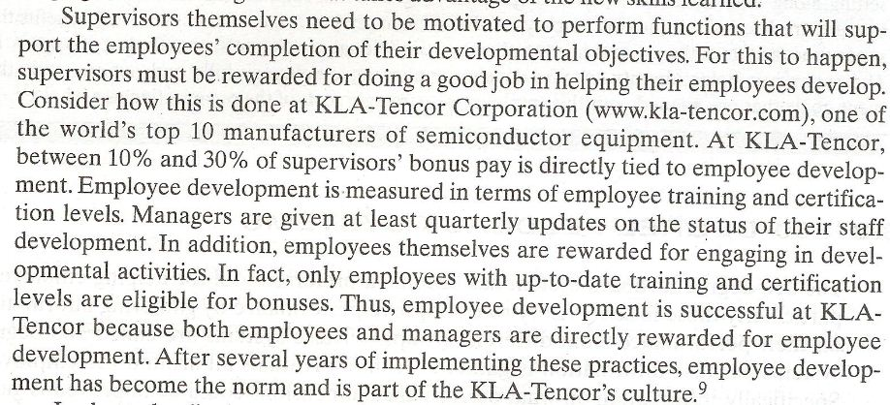

Slide 59
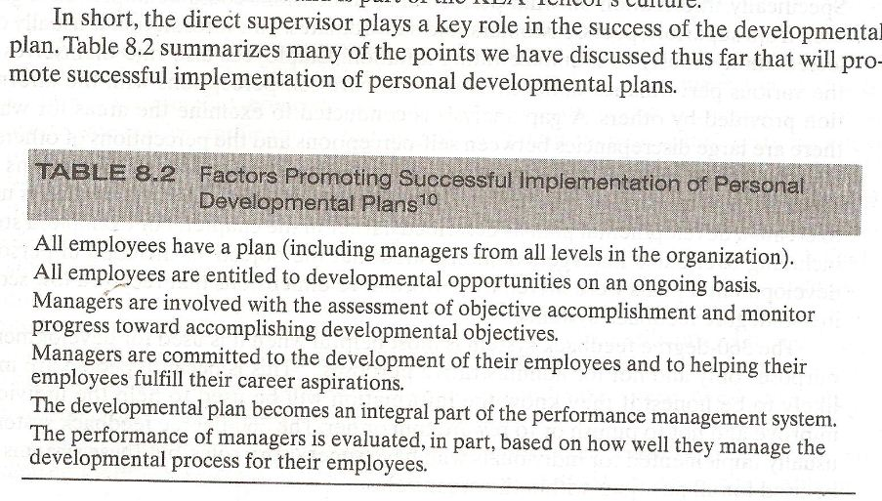

Slide 60
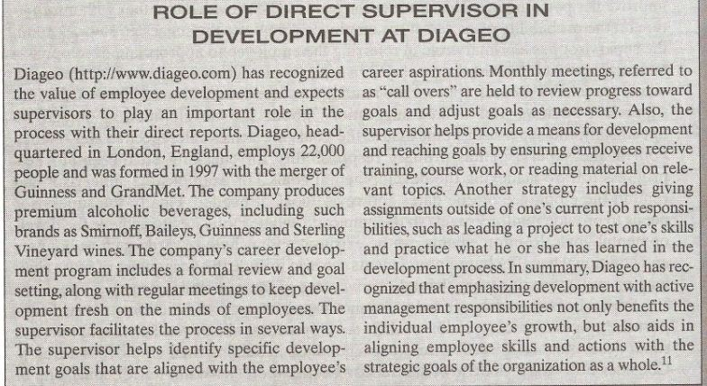

Slide 61
360 Degree Feedback System
The 360 degree feedback system has become a preferred tool for helping employees, particularly those in supervisory roles, improve performance by gathering information on their performance from different groups.
These systems are called 360 degree systems because information is gathered from individuals all around the employee.

Slide 62
360 Degree Feedback System (Contd.)
Specifically, information on what performance dimensions could be improved is gathered from supervisors, peers, customers, and subordinates.
This information is usually collected anonymously to minimize rating inflation.

Slide 63
360 Degree Feedback System (Contd.)
Employees also rate themselves on the various performance dimensions and compare self perceptions with the information provided by others.
A gap analysis is conducted to examine the areas for which there are large discrepancies between self perception and the perception of others.

Slide 64
360 Degree Feedback System (Contd.)
A 360 degree feedback system reports usually includes information on dimensions for which there is agreement that further development is needed.
This information is used to create a developmental plan as described earlier.

Slide 65
360 Degree Feedback System (Contd.)
The 360 degree feedback system is most helpful when it is used for developmental purposes only and not for administrative purposes.
This is because people are more likely to be honest if they know the information will be used to help the individual improve and not to punish or to reward him or her.

Slide 66
360 Degree Feedback System (Contd.)
The 360 degree feedback system is usually implemented for individuals who have supervisory roles, but these systems can be used for all positions within the organization.

Slide 67
360 Degree Feedback System (Contd.)
Many organizations take advantage of technology to minimize the amount of paperwork and time involved in collecting such data.
The internet is becoming a pervasive medium by which to administer 360 degree feedback systems.

Slide 68
360 Degree Feedback System (Contd.)
The service provider , usually an outside consulting firm, sends an email message with instructions and time frames for assessment to each employee to be rated.

Slide 69
360 Degree Feedback System (Contd.)
Then employees can assess a secure website and after entering their personal IDs and password, create individual lists of raters who will be asked to provide feedback about their performance.

Slide 70
360 Degree Feedback System (Contd.)
To make things easier, the employee can even select names from a drop-down menu that includes company managers and employees.
Allowing employees to select the raters who will provide information on their performance and is likely to increase acceptance of the results.

Slide 71
360 Degree Feedback System (Contd.)
The raters selected are asked to visit the web site and to provide performance feedback within a certain time period.
After the data have been collected electronically, it is fairly easy to compile the results and e-mail a report to the employee who has been evaluated.

Slide 72
360 Degree Feedback System (Contd.)
Some internet based systems also provide on line training for raters on how to complete the feedback forms in helpful and constructive ways.
Some systems even include features that allow for the detection of rating errors.

Slide 73
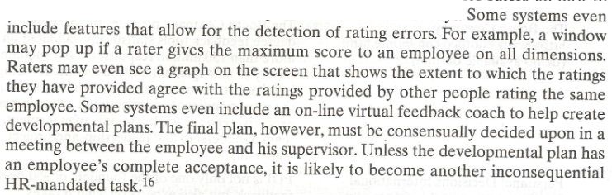

Slide 74
360 Degree Feedback System (Contd.)
Feedback Reports can include graphs showing the areas in which employee’s perception differs the most from the perceptions of other raters.
They can also show average scores, across sources of information, so that the areas that need improvement are readily identified.

Slide 75
360 Degree Feedback System (Contd.)
The resulting report can be e-mailed automatically to the employee and his supervisor so that both have an opportunity to review the results before meeting to create a development plan.

Slide 76
Internet- based 360-degree systems
A trend adopted by software companies that offer Internet- based 360-degree systems is to offer a bundle of systems including 360-degree feedback together with;
  learning management,
  Compensation
  And even recruiting
  And succession planning.

Slide 77
Internet- based 360-degree systems (Contd.)
These integrative applications, usually called “talent management” systems, allow organizations to manage data about employees in a systematic and coordinated way.

Slide 78
Internet- based 360-degree systems (Contd.)
Such integrative software applications allow organizations to create an inventory of their human capital and better understand their strengths and weaknesses at the organizational level.

Slide 79
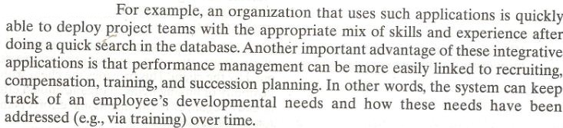

Slide 80
Internet- based 360-degree systems (Contd.)
The following cases provides informations on organizations which offer Internet- based 360-degree feedback systems and a brief description of their products.
It also includes information on whether a demonstration of it is available on-line.

Slide 81
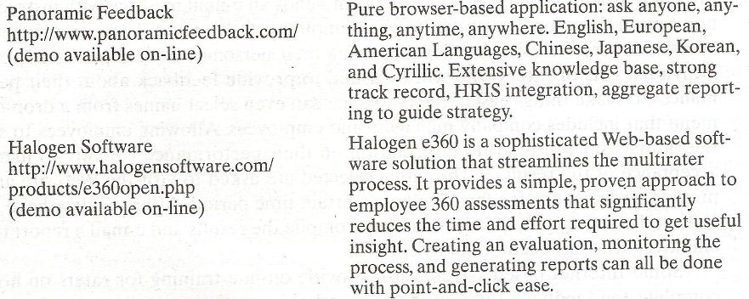

Slide 82
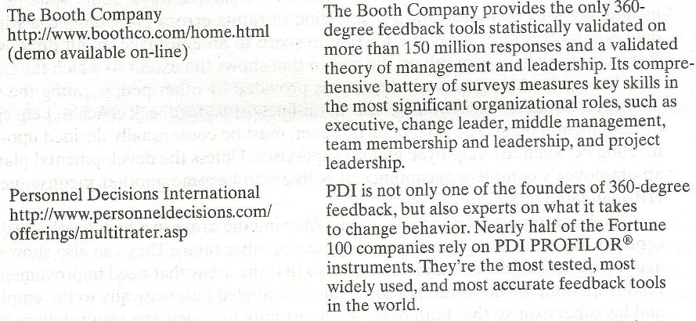

Slide 83
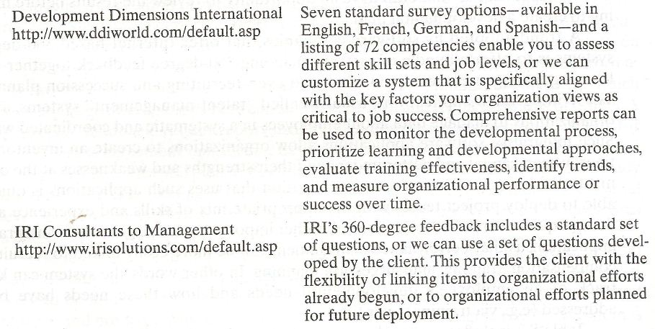

Slide 84
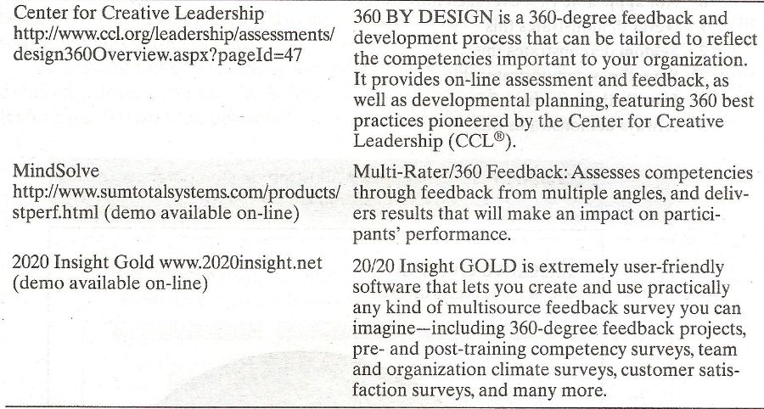

Slide 85
360-degree System Beneficial or NOT Beneficial?
The following questions give good insight as to whether implementing a 360-degree system would be beneficial in a specific organization.
Are decisions that are made about rewards and promotions fairly free of favoritism?

Slide 86
360-degree System Beneficial or NOT Beneficial? (Contd.)
Are decisions made that take into account the input of people affected by such decisions?
Do people from across departments usually cooperate with each other and help each other?

Slide 87
360-degree System Beneficial or NOT Beneficial? (Contd.)
Is there little or no fear of speaking up?
Do people believe that their peers and subordinates can provide valuable information about their performance?
Are employees trusted to get the job done?

Slide 88
360-degree System Beneficial or NOT Beneficial? (Contd.)
Do people want to improve their performance?

Slide 89
360-degree System Beneficial or NOT Beneficial? (Contd.)
In sum, the successful implementation of a 360-degree feedback system is heavily dependent on the culture of the organization and the work context.
If the answer to most of these questions is ‘yes’, the implementation of a 360-degree feedback system is likely to be successful and leads to performance implementation.

Slide 90
Characteristic of a Good System (Contd.)
Raters are trained:
  As in the case of providing evaluations for administrative purposes, raters should be trained. Mainly, this includes skills to discriminate good from poor performance and how to provide feedback in a constructive manner.

Slide 91
Summary of Today’s Lecture
EMPLOYEE DEVELOPMENT - PERFORMANCE AND CAREER
  Personal Developmental Plan
  Objectives of Developmental Plan
  Content of Developmental Plan
  Development Activities

Slide 92
Summary of Today’s Lecture
Direct Supervisors Role
360 Degree Feedback System
Advantages of 360 degree feedback system
Risks of implementing 360 degree feedback system
Characteristic of a Good System

Slide 93
Thank You

