Slide 1
MGT-555
PERFORMANCE AND CAREER MANAGEMENT
LECTURE NO - 27

Slide 2
CAREER MANAGEMENT

Slide 3
RECAP
Compensation - Reward Systems
Legal Issues
Managing Performance

Slide 4
Agenda for Today’s Lecture
Career and its basics
Traditional and protean careers
Career Management and its Process
Career Planning
Organizational Career Planning

Slide 5
How important is your career?

Slide 6

What is Career
A career
  is a pattern of work-related
  experiences that span the
  course of a person’s life
  reflects any work, paid or unpaid
  is a broad definition helpful in
  today’s work environment where employees and organizations have diverse needs

Slide 7

Career
According to Hall’s, a career refers to the individual sequence of attitudes and behavior associated with work related experiences and activities over the span of the person’s life.

Slide 8
Career
Employees values needs & feelings
Depending on: -Stage of career development
WORK EXPERIENCE
Employees position
CAREER
tasks A series of work related experiences
-biological changes
Job experiences

Slide 9
Four different meanings can be accepted to the concept of career
• As Advancement- sequence of promotion or upward moves in a company during the person’s work life
• As Profession- certain occupations which have a clear pattern of advancement.
• A lifelong sequence of job
• A lifelong sequence of role related experience

Slide 10

Why Understand Careers
If we know what to look forward to, we can be proactive in planning our Future
As managers, we need to understand the experiences of our employees and colleagues in order to understand and plan for future KSA requirements.

Slide 11

The Basics of Career Management
Career
  The occupational positions a person has had over many years.
Career management
  The process for enabling employees to better understand and develop their career skills and interests, and to use these skills and interests more effectively.
Career planning
  The deliberate process through which someone becomes aware of personal skills, interests, knowledge, motivations, and other characteristics; and establishes action plans to attain specific goals.
Career Development
  The lifelong series of activities that contribute to a person’s career exploration, establishment, success, and fulfillment.

Slide 12
Career: Paradigm Shift
New Career Paradigm
Old Career Paradigm
Discrete Exchange
Mutual Loyalty Contract
Occupational Excellence
One-Employer Focus
Organizational Empowerment
Top-Down Firm
Project Allegiance
Corporate Allegiance

Slide 13
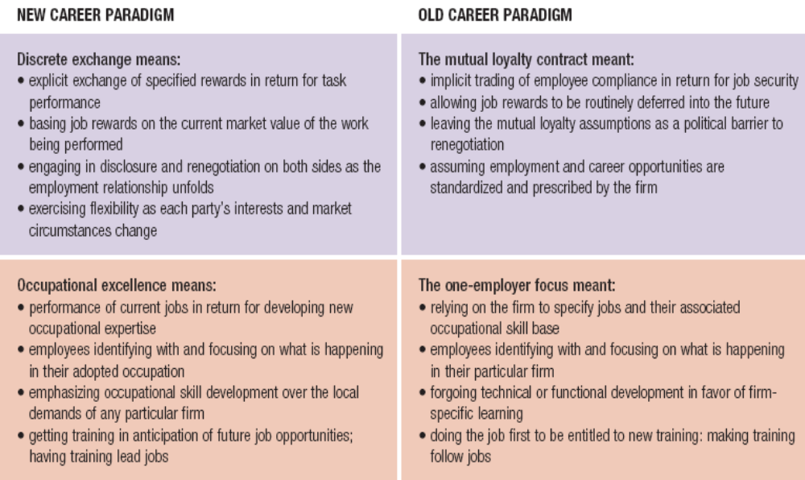
Career: Paradigm Shift

Slide 14
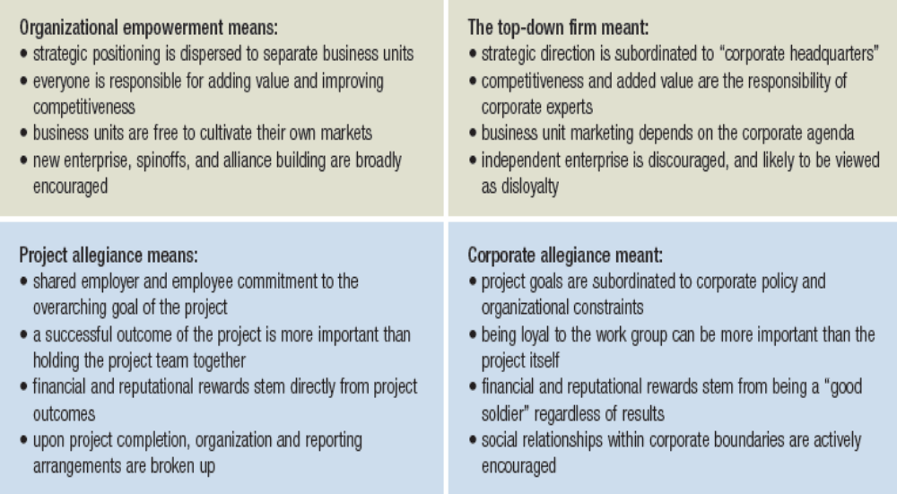
Career: Paradigm Shift

Slide 15
Traditional Career & Protean Career
Traditional Career
  -Sequence of positions held within an occupation
  -Context of mobility is within an organization
  -Characteristic of the employee
Protean Career
-Frequently changing based on
changes in the person and changes in
the work environment
- Employees take major responsibility for managing their careers ,Based on self-direction with the goal of psychological success in one’s work

Slide 16
Comparison of Traditional & Protean(fluctuating)Careers
Dimension
Goals
Psychological contract
Traditional Career
Promotions
Salary increase
Security for commitment
Protean Career
Psychological success
Employability for flexibility
Mobility
Vertical
Lateral
Responsibility for Management
Company
Employee
Expertise
Know how
Learn how
Development
Heavy reliance on formal training
Greater reliance on relationships and job experiences

Slide 17
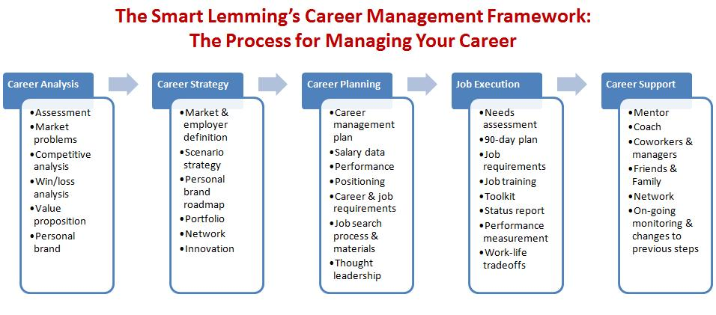
Career Management Framework

Slide 18
Career Management
Career management is the process through which employees:
Become aware of their own interests, values, strengths, and weaknesses.
Obtain information about job opportunities within the company.
Identify career goals.
Establish action plans to achieve career goals.

Slide 19
Career Management Systems
A career management system helps in identify career development needs.
• Effective career management systems develop employees who are more committed to the company and also have a positive influence on employee’s job performance.

Slide 20
Why Is Career Management Important?
From the company’s perspective
The failure to motivate employees to plan their careers can result in:
-a shortage of employees to fill open positions
-lower employee commitment
-inappropriate use of funds allocated for training and development programs

Slide 21
Why Is Career Management Important?
From the employees’ perspective
lack of career management can result in:
frustration
feelings of not being valued by the company
being unable to find suitable employment should a job change be necessary due to mergers, acquisitions, restructuring, or downsizing

Slide 22
Design factors of Effective Career Management Systems
  System is positioned as a response to a business need.
  Employees and managers participate in development of the system.
  Employees are encouraged to take an active role in career management.
  Evaluation is ongoing and used to improve the system.

Slide 23
Design factors of Effective Career Management Systems: (continued)
  Business units can customize the system for their own purposes.
  Employees need access to career information sources.
  Senior management supports the career system.
  Career management is linked to other human resource practices such as training, recruiting systems, and performance management.

Slide 24
Career Management Process
Self-assessment
Reality check
Goal Setting
Action Planning

Slide 25
Self Assessment
Refers to use of information by the employees to determine their career interests, values aptitudes and behavioral tendencies.
Involves tests such as , Strong –Campbell Interest Inventory Self Directed Search

Slide 26
Reality Check
Refers to information employees receive about how the company evaluate their skills and knowledge and where they fit into company’s plans.eg-potential promotion opportunities
This information is provided by the employee’s manager as a part of performance appraisal.

Slide 27
Goal Setting
In goal setting the employees develop short and long term career objectives.
These goals usually relate to desired positions, level of skill application, work setting or skill application.
The goals are discussed and written into a development plan which includes description of strengths and weaknesses, goals and development activities to reach the goal.

Slide 28
Action Planning
Employees determine how to achieve their long and short term career goals.
It involve enrolling in training courses and seminars, conducting informational interviews or applying for job openings within the company.

Slide 29
Career Management and Career Motivation:
Career motivation refers to:
Employees’ energy to invest in their careers Their awareness of the direction they want their careers to take The ability to maintain energy and direction despite barriers they may encounter
Career motivation has three aspects:
  Career resilience
  Career insight
  Career identity

Slide 30
Career Motivation
Career Resilience
Career Insight
Career Identity

Slide 31
Career Management and Career Motivation:
Career resilience
– the extent to which employees are able to cope with problems that affect their work

Slide 32
Career Insight
Involves: how much employees know about their interests, skill strengths, and weaknesses the awareness of how these perceptions relate to their career goals

Slide 33
Career Identity
the degree to which employees define their personal values according to their work

Slide 34
The Value of Career Motivation:
Company Value
Components of Career Motivation
Career Resilience
Career Insight
Career Identity
• Innovation
• Employees adapting to unexpected changes
• Commitment to Company
• Pride in Work
Employee Value
• Be aware of skill strengths and weaknesses
• Participate in learning activities
• Cope with less than ideal working conditions
• Avoid skill obsolescence

Slide 35
The Goal: Matching Individual and Organizational Needs
The Employee’s Role
The Organization’s Role
Career Management
Individual and Organizational Goals

Slide 36
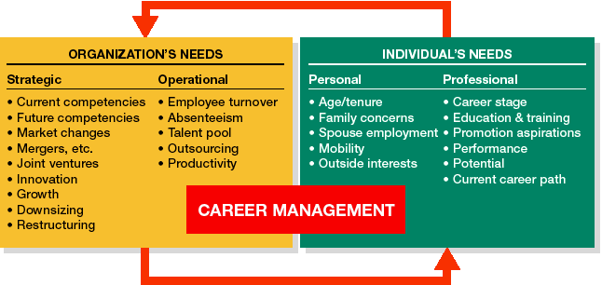
Balancing Individual and Organizational Needs

Slide 37
Employees’ Role in Career Management
Take the initiative to ask for feedback from managers and peers regarding their skill strengths and weaknesses
Identify their stage of career development and development needs
Seek challenges by gaining exposure to a range of learning opportunities
Interact with employees from different work groups inside and outside the company
Create visibility through good performance

Slide 38
Managers’ Role in Career Management
Roles
Responsibilities
Coach
Appraiser
Advisor
Referral agent
Probe problems, interests, values, needs Listen Clarify concerns Define concerns
Give feedback Clarify company standards Clarify job responsibilities Clarify company needs
Generate options, experiences, and relationships Assist in goal setting Provide recommendations
Link to career management resources Follow up on career management plan

Slide 39
Company’s Role in Career Management:
Companies are responsible for providing employees with the resources needed to be successful in career planning:
  Career workshops
  Information on career and job opportunities
  Career planning workbooks
  Career counseling
  Career paths

Slide 40





The Employer’s Role in
Career Development
Realistic Job Previews
Networking and Interactions
Challenging First Jobs
Employer’s Role
Mentoring
Career-Oriented Appraisals
Job
Rotation

Slide 41
Evaluating Career Management Systems
Career management systems need to be evaluated to ensure that they are meeting the needs of employees and the business.
Two types of outcomes can be used to evaluate:
  Reactions of the customers (employees and managers) who use the career management system
  Results of the career management system
Evaluation of a career management system should be based on its objectives.

Slide 42

Career Planning

Slide 43
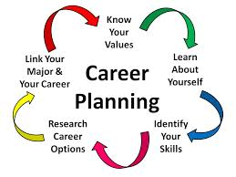
CAREER PLANNING
A systematic process by which one decides his/her career goals and the path to reach these goals.
Organization point of view
A technique for mapping out the entire career of employees from employment stage to retirement stage.
It involves discovery, development, planned employment and reemployment.

Slide 44
Career Planning
Career planning is a subset of career management. Career planning applies the concepts of Strategic planning and Marketing to taking charge of one's professional future.
Career is an ongoing process and so it needs to be assessed on continuous basis. This process of re-assessing individual learning and development over a period of time is called Career Planning.

Slide 45
Career Choices
Interest
Goals
Salary
Education
Preparation
Skills
Planning

Slide 46
Planning
Steps:
  What are your interest?
  What do you want to be?
  What are your skills?
  What types of careers fit your skills and interest?
  How do you prepare for the career?

Slide 47
Career planning: understand who I am
Understanding who you are - identifying your strengths, motivations, values, weaknesses and skills - is a key part of the career planning process.
Ask yourself these questions:
What are my skills/strengths?
What are my interests?
How do I like to work?
What’s important to me?

Slide 48
Your skills, interests & strengths
Think about everything you have done in your time at university – voluntary work, part-time jobs, vacation jobs, student societies, even things during your course – where you have developed skills. Make a list.

Slide 49
Your skills and values
Thinking about your values is just as important as reflecting on your skills as values are what give purpose to a job in the eyes of the individual who does it. Values include ethical working, work/life balance, respect, material rewards, stability etc.

Slide 50
Career Goal
What is your Career Goal?
  A career goal helps you focus on what you want to do for a living. A career goal can be a specific job you want to do
  such as doctor or teacher
  or a career goal can be a particular field you want to work in, such as medicine or education.
  Rather than limiting your future, a career goal may help you discover career possibilities that you wouldn't have thought of otherwise.

Slide 51
Career Goal
  A career goal will also guide you into doing what you want with your life -- rather than just drifting into a job.
  Generally, a career goal is based on your skills and interests, career possibilities, and job trends.
  Once you have chosen a career, think strategically about the steps to accomplish your goal. Understanding and accomplishing your career goal will be a lot easier if you create a career plan.
  A career plan determines your skills and interests, what career best suits your talents, and what skills and training you need for your chosen career.

Slide 52
Skills
What are your skills?
  Evaluate school, volunteer, work, or leisure experiences.
  Make a list of your school activities (clubs, organizations to which you belonged). Make a list of any volunteer work you have done (either through social, civic or religious organizations).
  After you have assessed your interests and skills, determine the relationship between skills and interests and possible careers. You may need to research types of careers.

Slide 53
Career + Skills
What types of careers fit your skills and interest?
  Use the Occupational Handbook to locate a career.

Slide 54
Preparation
How do you prepare for the career?
  Selecting A School
  The courses you take in high school, the grades you make, your class rank, the results of your standardized tests, and the life experiences you have all play a part in determining whether or not a college will admit you.
How do you prepare for the career?
  Familiarize yourself with the different types of schools.

Slide 55
Education & Salary
What education is required for your chosen career?
Explore the salary about the job.

Slide 56
Explore
Ask from people questions about their jobs. They'll be happy you asked.
Have them tell you what they enjoy most about their jobs…and what they enjoy least! Ask them what skills someone must possess to be successful in that occupation.

Slide 57
Explore
Find out what high school and/or college classes are important to their field. Ask how much education is required for their career.

Slide 58
Jobs People Do
Explore the Jobs People Do.
Learn about what people do at work and how they make our world a better place.
See what people "on the job" say about your dream career!

Slide 59
Lifestyle
In thinking about your future, you must consider what's important to you in your daily life.
What would you think about a career that required a great deal of travel?
Is the amount of money you make important to you?

Slide 60
Lifestyle
How would you feel about a job that required you to move on a regular basis?
What hours of the day—or night—will you be working?
Choose three or four aspects of your future lifestyle that are most important.

Slide 61
Read
Ask your school librarian to help you find books on careers that might match your interests and abilities. Many publications can provide you with information about careers that you may never have considered.

Slide 62
Talk
Visit with your counselor about your interests and abilities. Find out if your school offers tests or interest inventories that can assess your skills and interests. Some schools also have computer software programs that assist with career exploration.

Slide 63
Try the following exercises to help you understand what you want from your career.
Skills analysis - Take a look at each skill and its description and rate each one according to how important it is to you to be able to use that skill in your future role. Then rank them into a top ten.
Values analysis – Think about what will motivate you in any career. Again rate each value’s importance to you and rank them into a top ten.

Slide 64
Importance of Career Planning
It is important to come up with your career planning as it gives you the much needed direction and makes it clear , where you want to see yourself in future.
It makes you aware of your strength and weaknesses and the skills and knowledge that are required to achieve your goals in future.

Slide 65
Importance of Career Planning
A large proportion of our life is spent in achieving our career goals, thus it is very important to make sure that right steps were taken and correct planning was done in the early years of your life.
There are very few lucky ones who are born with a clear mind and who knows what they want to do and where they see themselves in life ahead. But majority of us are not sure what we want from life and so it is very important to plan out things.
Thus career planning is what gives your career and in some way your life, true meaning and purpose.

Slide 66
Need for Career Planning
To attract competent persons and to retain them
To reduce dissatisfaction and turnover
To provide suitable promotional opportunities
To improve and employee motivation and morale in the organization

Slide 67
Organizational Career planning

Slide 68
Organizational Career Planning Process
Direction
Career Time
Transitions
Career planning options
Projected Outcome

Slide 69
Organizational Career Planning Process
1. Direction
Assessing employee wants and organizational needs
common goal setting
2. Career time
Relates to distance & speed of an employee
How far & how fast can employee move on career path??
3. Transition
Relates to changes expected to a career goal
Analyzing transition factors
Setting goals and a timetable

Slide 70
Organizational Career Planning Process
4. Career planning options
Advancement.
Lateral
Change to Lower Grade
Mobility.
Job Enrichment
Exploratory Research
5. Projected Outcome
Calculate the risks attached
How well will it pay off?

Slide 71
Enhancing Your Career
You are ultimate responsible for your own career.
manage your
reputation
know yourself
network contacts
Successful
Career
Tips
build and maintain
keep current
balance your
specialist & generalist
competencies
keep your
options open
document your
achievements

Slide 72
Seven Habits to Successfully Manage Your Career
Plan your career
Build your network of contacts
Prepare yourself before the start of your career
Gather all information
Pay attention to details
Practice your interview skills
Attitude: be positive and enthusiastic all the time

Slide 73
Summary of Today’s Lecture
Career and its basics
Traditional and protean careers
Career Management and its Process
Career Planning
Organizational Career Planning

Slide 74
THANKS

