Slide 1
MGT-555
PERFORMANCE AND CAREER MANAGEMENT
LECTURE NO - 22

Slide 2
RECAP
Communication Plan
Good Communication Plan
Communication Bias
Types of Bias
  Selective Exposure
  Selective Perception
  Selective Retention
Ways to minimize negative impact of Biases
Appeals Process

Slide 3
Agenda of Today’s Lecture
Appeals Process
Types of Issues
  Judgmental
  Administrative
Training programs for the acquisition of required skills
Content Areas for rater training program
Rater Error Training (RET)

Slide 4
Appeals Process
In addition to implementing a communication process, support for the performance management system can be gained by implementing an appeals process.

Slide 5
Appeals process (Contd.)
The inclusion of appeal process is important in gaining employee acceptance for the performance management system because it allows employees to understand that, if there is a disagreement regarding performance ratings or any resulting decisions, then such disagreement can be resolved in an amicable and non retaliatory way.

Slide 6
Appeals process (Contd.)
The inclusion of an appeals process increases perception of the system as fair.

Slide 7
Appeals process (Contd.)
When the appeal process is in place, employees have the ability to question two types of issues:
  Judgmental and
  Administrative.

Slide 8
Judgmental issues
Judgmental issues:
  These issues center on the validity of the performance evaluation.
  For example, an employee may believe that a managers performance rating for that employee do not reflect his actual performance.

Slide 9
Administrative Issues
Administrative issues:
  These issues involve where the polices and procedures were followed.
  For example, an employee may argue that her supervisor did not meet with her as frequently as he had with her coworkers and that the feedback she is receiving about her performance is not as thorough as that received by her coworkers.

Slide 10
Appeals process (Contd.)
Typically when the appeal is first filled, the HR department serves as a mediator between the employee and the supervisor.
An appeal sent to HR department is usually called a level 1 or level A appeal.

Slide 11
Appeals process (Contd.)
The HR department is in a good position to judge whether the polices and procedures have been implemented correctly and also has good information about various jobs, level of performance expected, and level of performance of other employee within the unit and the organization.

Slide 12
Appeals process (Contd.)
The HR department gathers the necessary facts and brings them to the attention of either the rater to encourage reconsideration of the decision that caused the appeal or to complainant to explain that there have been no biases or violations.

Slide 13
Appeals process (Contd.)
In other words, the HR department either suggests corrective actions to the supervisor or informs the employee that the decisions or the procedures were correct.

Slide 14
Appeals process (Contd.)
If the supervisor does not believe corrective action should be taken or if the employee does not accept the HR decision, and the appeal continues, then an outside and unbiased arbitrator makes a final and binding resolution.

Slide 15
Appeals process (Contd.)
This is usually called a Level 2 or Level B appeal.
This arbitrator can consists of a panel of peers and managers.
The panel reviews the case, asks questions, interviews witnesses, researches precedents, and reviews policy.

Slide 16
Appeals process (Contd.)
Then they simply take a vote to make the decision.
In some cases, the vote manager (vice president or higher level) who takes the panel’s vote into consideration in making the final decision.

Slide 17
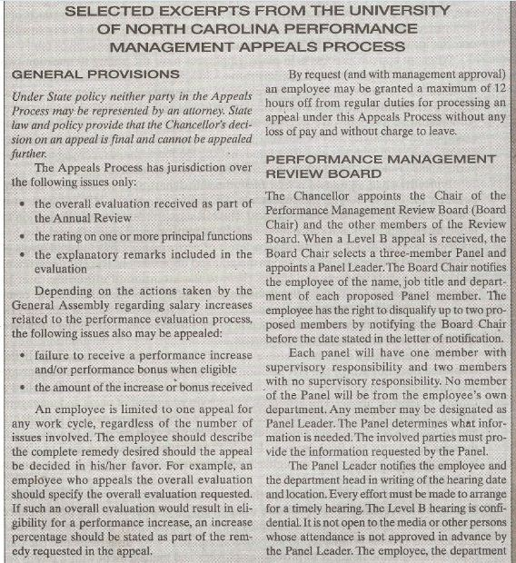

Slide 18
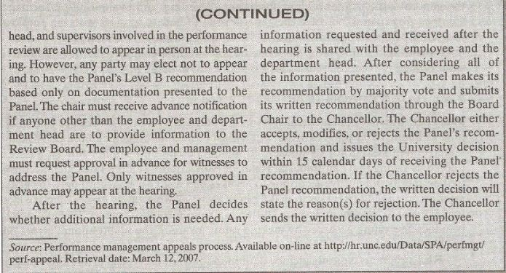

Slide 19
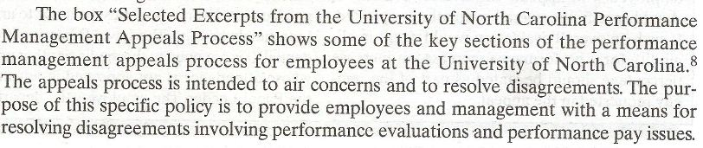

Slide 20
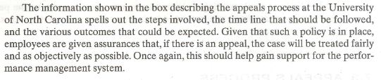

Slide 21
Training programs for the acquisition of required skills
Training the raters is another step necessary in preparing for the launching of the performance management system.

Slide 22
Training programs for the acquisition of required skills (Contd.)
Training not only provides participation in the performance management system with needed skills and tools to do a good job by implementing it but also helps increase satisfaction with the system.

Slide 23
Content Areas
Content areas that can be included in rater training programs
  Reasons for implementing the performance management system
  Information on appraisal form and system mechanics
  How to identify and rank job activities
  How to observe, record, and measure performance
  How to minimize rating errors
  How to conduct an appraisal interview
  How to train, counsel, and coach

Slide 24
Content Areas (Contd.)
In-fact the above are common components of the communication plan in which all organizational members participate not just the raters.

Slide 25
Content Areas (Contd.)
Content area 3-5;
  How to identify and rank job activities
  How to observe, record, and measure performance
  How to minimize rating errors
  Involve the general issue of
    identifying,
    observing,
    recording and
    evaluating performance.

Slide 26
Content Areas (Contd.)
Content area 6, 7;
  How to conduct an appraisal interview
  How to train, counsel, and coach
  Involve the general issue of how to interact with the employees receiving performance information.

Slide 27
Rater error training
Many performance management system are plagued with rater errors.
The goal of rater error training is to make raters aware of what rating errors they are likely to make and help them develop strategies to minimize those errors.

Slide 28
Rater error training (Contd.)
The goal of RET is to increase rating accuracy by making raters aware of unintentional errors they are likely to make.

Slide 29
Rater error training (Contd.)
RET typically includes definition of the most typical errors and a description of possible causes for those errors.
Such programs also allow trainees to view examples of common errors and to review suggestions on how to avoid making errors.

Slide 30
Rater error training (Contd.)
This can be done by showing videotaped vignettes designed to elicit rating error and asking trainees to fill out appraisal forms regarding the situations that they observed on the videotapes.

Slide 31
Rater error training (Contd.)
Finally, a comparison is made between the ratings provided by the trainees and the correct ratings.
The trainer then explain why the error took place, which specific errors were made, and ways to overcome the errors in the future.

Slide 32
Rater error training (Contd.)
RET does not guarantee increased accuracy.
Raters do become aware of the possible errors they can make but, because many of the errors are unintentional, simple awareness of the errors does not mean that errors will not be made.

Slide 33
Rater error training (Contd.)
Nevertheless, It may be useful to expose raters to the range of possible errors.

Slide 34
Summary of Today’s Lecture
Appeals Process
Types of Issues
  Judgmental
  Administrative
Training programs for the acquisition of required skills
Content Areas for rater training program
Rater Error Training (RET)

Slide 35
Thank You

