Slide 1
MGT-555
PERFORMANCE AND CAREER
MANAGEMENT
LECTURE NO - 21

Slide 2
RECAP
Training Programs Coverage
Case study
IMPLEMENTING A PERFORMANCE MANAGEMENT SYSTEM
Preparation process for Implementation
Communication Plan
Good Communication Plan

Slide 3
Agenda of Today’s Lecture
Communication Plan
Good Communication Plan
Communication Bias
Types of Bias
  Selective Exposure
  Selective Perception
  Selective Retention
Ways to minimize negative impact of Biases
Appeals Process

Slide 4
Communication plan
Having more and better knowledge of performance management system leads to greater employee acceptance and satisfaction.
Organizations often design a communication plan to ensure that information regarding the performance management system is widely disseminated in the organization.

Slide 5
Good Communication Plan
A good communication plan answers the following questions:
What is performance management?
  Answering this question involves providing general information about performance management, how performance management systems are implemented in other organizations, and the general goal of performance management systems.

Slide 6
Good Communication Plan (Contd.)
How does performance management fit into our strategy?
  To answer this question, we should provide information on the relationship between performance management and strategic planning. Information is provided on how the performance management system will help accomplish strategic goals.

Slide 7
Good Communication Plan (Contd.)
What’s in it for me?
  A good communication plan describes the benefit of implementing performance management for all those involved.

Slide 8
Good Communication Plan (Contd.)
How does it work?
  Answering this question entails giving a detailed description of performance management process and time line: for example, when meetings will take place, what the purpose of each meeting are, and when decisions about rewards will be made
.

Slide 9
Good Communication Plan (Contd.)
What are my responsibilities?
  The communication plan should include information on the role and responsibilities of each person involved at each stage of process.
  For example, it includes a description of the employees and supervisors main responsibilities in the performance management process.

Slide 10
Good Communication Plan (Contd.)
How is performance management related to other initiatives?
  The communication plan should provide information on the relationship between performance management and other systems, such as training, promotion, and succession planning.

Slide 11
Case Study
Consider the performance management system for the position of Senior Executive-Service (SES) in the United States Department of Justice. SES members serve in key leadership positions directly below the top presidential appointees. SES members link the appointees to the rest of the federal government, and they are charged with overseeing various governmental activities in 75 federal agencies. The communication plan states that the Department of Justice implemented a performance management system which is described in a document divided into three chapters:
Chapter 1, "General Information,"
Chapter 2, "Performance Appraisal for the Senior Executive Service," and
Chapter 3, "Actions Based on Less Than Fully Successful Performance."

Slide 12
Case Study (contd.)
This is how their plan answered each of the questions, discussed before:
• What is performance management? Chapter 1 states the reasons for the department's implementing a performance management system and discuses what it is expected to accomplish. For example, the chapter notes that performance management aims at promoting efficient and effective attainment of the department's mission, program objectives, and strategic planning initiatives, and it also aims at motivating high levels of achievement and accountability. This chapter also includes definitions of several key terms, including performance management system, performance, progress review, rating levels, and annual summary rating.

Slide 13
Case Study (contd.)
• How does performance management fit into our strategy? Chapter 2 begins with a list of principles that guide the system, including, "The Department of Justice federal leaders and managers create a climate for excellence by communicating their vision, values and expectations clearly." It goes on to detail all of the ways in which leaders in the agency do this. In addition, in a memorandum that was sent with the chapters, the director of the Office of Personnel Management (OPM) included this quote from President George W. Bush: "We are not here to mark time, but to make progress, to achieve results, and to leave a record of excellence." The director then describes how the system would be used to implement the key principles of the president's administration.

Slide 14
Case Study (contd.)
• What's in it for me? Throughout the memo, there is clear information on how the performance management system will help the SES members be more effective leaders so that the president's mission can be achieved.
•' How does it work? Chapter 2 outlines the steps in a performance management process, detailing the managers' responsibilities at each step. For example, it out-lines the performance dimensions, the rating categories, and how to assign an over-all rating.

Slide 15
Case Study (contd.)
• • What are my responsibilities? The communication plan outlines the responsibilities of the SES members as well as their rating official, the person in charge of rating their performance. The plan emphasizes that leaders must create a culture performing at a high level by continually communicating expectations and rewarding high achieving performers.
• How is performance management related to other initiatives? The communication plan touches briefly on the importance of linking system outcomes to performance based pay. The importance of training to maximize performance is also considered.

Slide 16
Good Communication Plan (Contd.)
In summary the communication plan implemented by the Department of Justice is extremely detailed and provides answers to most , if not all of the key questions that should be addressed by a good communication plan.

Slide 17
Communication Bias
However, even if a communication plan answers all or most of the important questions, the fact that the information has been made available does not necessarily mean the communication plan will be successful in gaining acceptance.

Slide 18
Communication Bias (Contd.)
This is because people have cognitive biases that affect what information is taken in and how it is processed.

Slide 19
Communication Bias (Contd.)
Specifically there are three types of biases that affect the effectiveness of a communication plan, regardless of how well it has been implemented.
These are;
  Selective Exposure
  Selective Perception
  Selective Retention

Slide 20
Selective Exposure
It is a tendency to expose our minds only to ideas with which we already agree.
Those employees who already agree that performance management is a good idea may become involved in the communication plan activities including reading about the system and attending meetings describing how the system works.

Slide 21
Selective Exposure (Contd.)
On the other hand, those who do not see much value in performance management may choose not to read information about it and do not attend meetings related to performance management.

Slide 22
Selective Perception
Second, selective perception is a tendency to perceive a piece of information as meaning what we would like it to mean even though the information as intended by the communicator, may mean the exact opposite.

Slide 23
Selective Perception (Contd.)
Someone who believes performance management is about only rewards and punishment may incorrectly interpret that receiving a pay increase or bonus.

Slide 24
Selective Retention
Third selective retention is a tendency to remember only those pieces of information with which we already agree.
If an employee perceives his employer as vindictive, that employee is not likely to remember information about how the appeals process works or about other fair and equitable aspects of the system.

Slide 25
Selective Retention (Contd.)
Selective Exposure, Selective Perception, Selective Retention biases are pervasive and could easily render the communication plan ineffective.

Slide 26
Ways to minimize negative impact of Biases
There are several ways to minimize the negative impact of these biases and therefore, help gain support for the system.
Involve employees:
  Involve employee in the design of the system. People support what they create.
  The higher the level of participation is in designing the system, the greater the support for the system will be.

Slide 27
Ways to minimize negative impact of Biases (Contd.)
Understand employee needs:
  Understand the needs of employees and identify ways in which these needs can be met through performance management.

Slide 28
Ways to minimize negative impact of Biases (Contd.)
Strike first:
  Create a positive attitude toward the new performance system, before any negative attitude and rumors are created.
  Make communication realistic and do not set up expectation you cannot deliver.

Slide 29
Ways to minimize negative impact of Biases (Contd.)
Provide facts and consequences:
  Because of employees biases, facts do not necessarily speak for themselves.
  Clearly explain facts about the system and also explain what they mean or what the consequences are.

Slide 30
Ways to minimize negative impact of Biases (Contd.)
Put it in writing:
  Written communication are usually more powerful and credible than spoken communication because they can be carefully examined and challenged for accuracy.

Slide 31
Ways to minimize negative impact of Biases (Contd.)
Use multiple channels of communication:
  Use multiple methods of communication, including meetings, e-mails, and paper communication.

Slide 32
Ways to minimize negative impact of Biases (Contd.)
Use credible communications:
  Use credible source to communicate the performance management system.
  In companies where HR department members are perceived as “HR cops” because they continually emphasize what cannot be done as opposed to how ones job can be done better, it may be better to use a different department or group.

Slide 33
Ways to minimize negative impact of Biases (Contd.)
  In such situations, communication should be delivered by people who are trusted and admired within the organization.

Slide 34
Ways to minimize negative impact of Biases (Contd.)
Say it, and then say it again:
  Repeat the information frequently. Since people can absorb only a small amount of information at a time, the information should be repeated frequently.

Slide 35
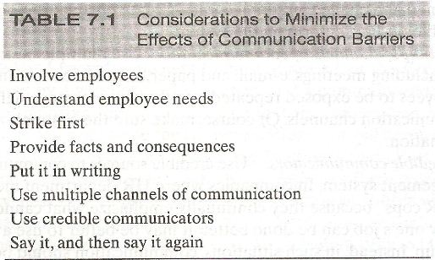

Slide 36
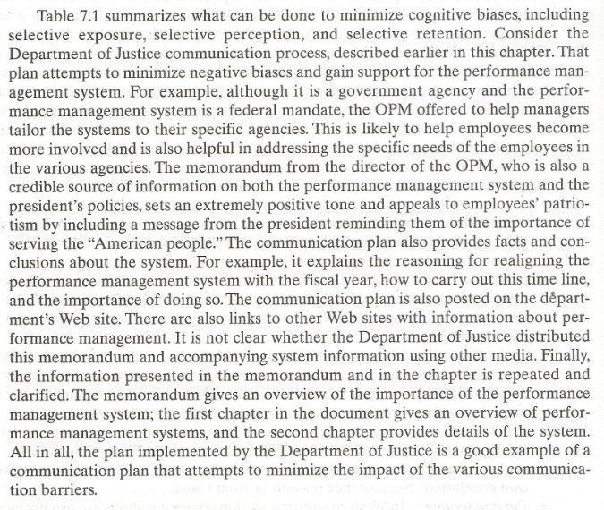

Slide 37
Appeals Process
In addition to implementing a communication process, support for the performance management system can be gained by implementing an appeals process.

Slide 38
Summary of Today’s Lecture
Communication Plan
Good Communication Plan
Communication Bias
Types of Bias
  Selective Exposure
  Selective Perception
  Selective Retention
Ways to minimize negative impact of Biases
Appeals Process

Slide 39
Thank You

