Slide 1
MGT-555
PERFORMANCE AND CAREER MANAGEMENT
LECTURE 02

Slide 2
RECAP
Defined human resource management.
Studied the functions of human resource management.
Summarized the types of assistance the human resource department provides.
Explained the desired relationship between human resource managers and operating managers.

Slide 3
RECAP
Identified several challenges today’s human resource managers currently face.
Outlined several potential challenges and contributions that an increasingly diverse workforce presents.
Discussed the role of human resource managers in the future.
Explained how human resource managers can affect organizational performance.
Summarized several guidelines to follow when communicating human resource programs.

Slide 4
Impact of the HR Manager on Organizational Performance
Properly training and developing all employees to improve their value to company and do a better job producing and selling high-quality products and services at lowest possible cost
Decreasing costly material waste by eliminating bad work habits, attitudes and poor working conditions that lead to carelessness and mistakes
Hiring the best people available at every level and avoiding overstaffing

Slide 5
Impact of the HR Manager on Organizational Performance
Maintaining competitive pay practices and benefit programs to foster a motivational climate for employees
Encouraging employees to submit ideas for increasing productivity and reducing costs
Installing human resource information systems to streamline and automate many human resource functions

Slide 6
Metrics and the HR Scorecard
Metrics
  Any set of quantitative measures used to assess workforce performance
Analysis of cost per hire
Average length of time to fill a position
Training cost per employee
Turnover cost per employee
New-hire performance by recruiting strategy

Slide 7
Metrics and the HR Scorecard
HR Scorecard
  Measurement and control system using a mix of quantitative and qualitative measures to evaluate performance
  Modified form of the balanced scorecard system

Slide 8
Communicating Human Resource Programs
Communication
  The transfer of information that is meaningful to those involved
Human resource managers must develop an appreciation for the importance of communication

Slide 9
Guidelines for Communicating Human Resource Programs
Avoid communicating in peer group or “privileged-class” language by focusing on the audience
Don’t ignore cultural and global aspects of communication
Back up communications with management action
Periodically reinforce employee communications

Slide 10
Guidelines for Communicating Human Resource Programs (cont.)
Data
  Raw material from which information is developed
  composed of facts that describe places, people, things, or events and that have not been interpreted
Information
  Data that have been interpreted
  meet a need of one or more managers

Slide 11
Strategic Human Resource Management

Slide 12
Strategic Human Resource Management
Involves the development of a consistent, aligned collection of practices, programs, and policies to facilitate the achievement of the organization’s strategic objectives.
Requires abandoning the mindset and practices of “personnel management” and focusing on strategic issues than operational issues.
Integration of all HR programs within a larger framework, facilitating the organization’s mission and its objectives.

Slide 13
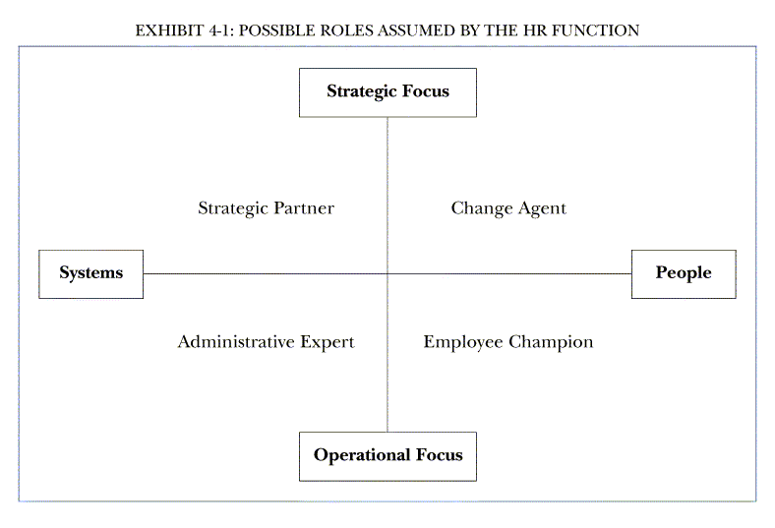

Slide 14
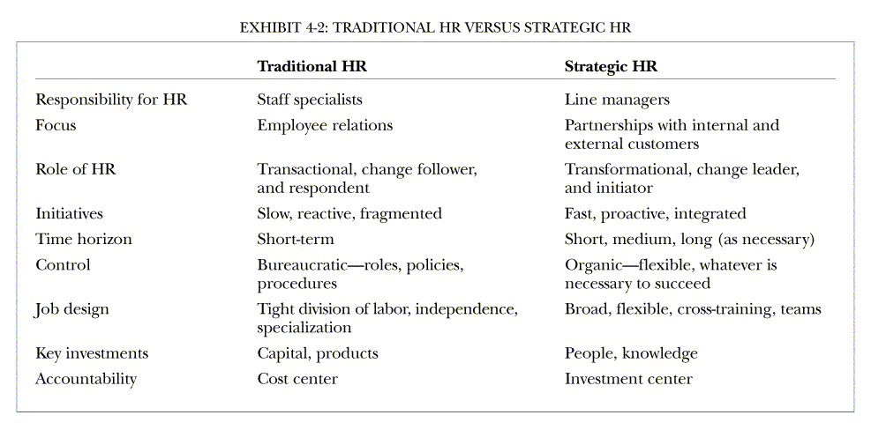
Traditional HR versus Strategic HR

Slide 15
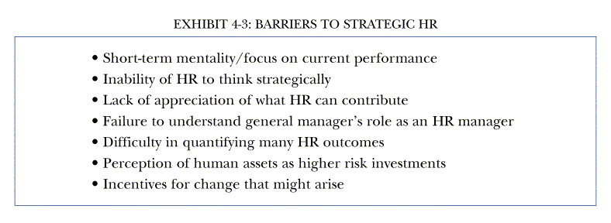
Barriers to Strategic HR

Slide 16
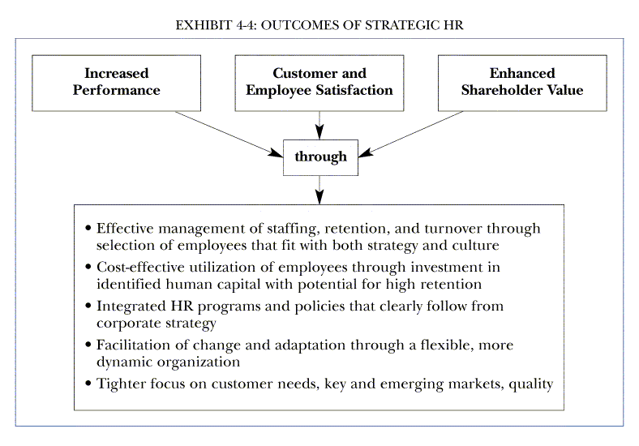

Slide 17
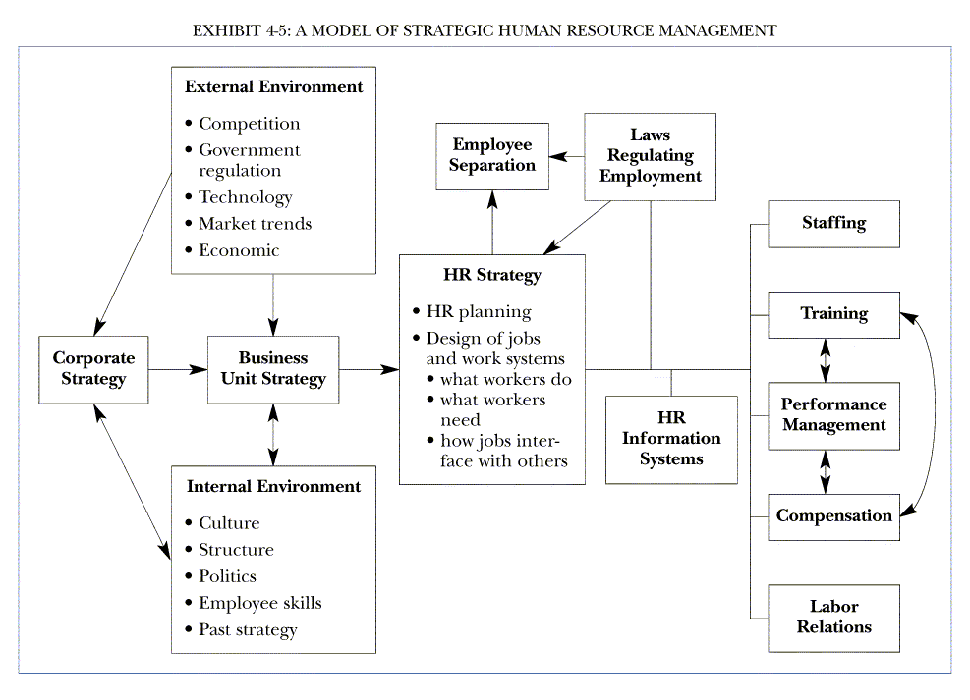

Slide 18
HR and Organizational Excellence
HR can help deliver organizational excellence by:
  Becoming a partner with senior and line managers in strategy execution.
  Becoming expert in the way work is organized, delivering administrative efficiency to ensure that costs are reduced while quality is maintained.
  Becoming a champion for employees, representing their concerns to senior management and working to increase employee contributions.
  Becoming an agent of continuous transformation by shaping processes and organizational culture.

Slide 19
Five Critical Business Challenges
Globalization
Profitability through Growth
Technology
Intellectual Capital
Change, Change, and More Change

Slide 20
HR as Strategy Execution Partner
HR is responsible for defining an organizational structure as the model for the company’s way of doing business.
HR must be accountable for conducting an organizational audit.
HR is to identify methods to renovate part of the organizational architecture.
HR must take stock of its own work and set clear priorities.

Slide 21
HR and Organizational Culture
HR can help bring about a cultural change by:
  Defining and clarifying the concept of cultural change.
  Articulating why cultural change is central to business success.
  Defining a process for assessing the current culture and the desired new culture, as well as measuring the gap between the two.
  Identifying alternative approaches to creating culture change.

Slide 22
Four Changes for the Line
How senior operating management can create an environment in which HR becomes focused on outcomes instead of activities:
  Communicate to the organization that the “soft stuff” matters.
  Explicitly define the deliverables from HR, and hold HR accountable for results.
  Invest in innovative HR practices.
  Upgrade HR professionals.

Slide 23
Human Capital Management
To become effective human capital managers, HR mangers must develop competencies in:
  Knowledge of the business.
  Human resource functional expertise.
  The management of change.

Slide 24
New Functional Role for HR
HR must focus on business level outcomes rather than HR level inputs.
HR must become a strategic core competency rather than a market follower.
Strategic competencies are more important than functional competencies.
The most important missing element in the HR function expertise is a systems perspective.

Slide 25
Organization Culture Questionnaire
Topics to be included in the questionnaire:
  How is performance defined, measured and rewarded in the organization?
  How are information and resources allocated and managed in the organization?
  What is the operational philosophy of the organization with regard to risk-taking, leadership, and concern for overall results?
  Does the organization regard its human resources as costs or assets?

Slide 26
Analyzing Dysfunctional Cultures
Which components of the culture are misaligned?
What priorities should be assigned each of the gaps between what the culture is and what people feel that it should be?
What resources are needed and how should they be used to change the culture?
How should the change effort be managed and who does what?
What role should HR strategy play in signaling, making and reinforcing the necessary changes?

Slide 27
Thanks

