Slide 1
MGT-555
PERFORMANCE AND CAREER MANAGEMENT
LECTURE NO - 18

Slide 2
RECAP
Determining overall rating
  Judgmental Procedure
  Mechanical Procedure
CASE Example: PA Form
Appraisal period and number of meeting
Possibilities of Appraisal Meetings

Slide 3
RECAP(Contd.)
Formal Meetings
  System inauguration
  Self appraisal
  Classical performance review
  Merit/salary review
  Developmental plans
  Objectives setting

Slide 4
Agenda of Today’s Lecture
Who should provide performance information?
  Supervisors
  Peers
  Subordinates
  Self
  Customers
Disagreement across sources: is this a problem?

Slide 5
Who should provide performance information?
So far we have assumed that the supervisor is the primary source for performance information.
This is the case in most organizations because the supervisor observes employees directly and has good knowledge about performance standards.

Slide 6
Who should provide performance information?
However, there are also alternative sources of performance information.

Slide 7
Who should provide performance information?
Performance infomation can be provided by
Supervisors
Peers
Subordinates
Self
Customers

Slide 8
Supervisors
Advantage of using supervisors as a source of performance information is that they are usually in best position to evaluate performance in relation to strategic organizational goals.
Supervisors are often those making those decisions about reward associated with performance evaluation.

Slide 9
Supervisors (Contd.)
In addition supervisors are able to differentiate among various performance dimension (e.g adaptability, coaching and development) regardless of the level of experience of the employee being rated.

Slide 10
Supervisors (Contd.)
In short supervisors are often the most important source of performance information because they are knowledgeable about strategic issues, understand performance and are usually in charge of managing employee performance.

Slide 11
Supervisors (Contd.)
Although supervisors are usually the most important, and sometimes only, source of performance information, other sources should be considered as well.

Slide 12
Supervisors (Contd.)
For Example:
  We have already seen that self-appraisals are an important component in the performance review process.
  In addition to self-appraisals and supervisor appraisals, performance information can be collected from peers, customers and subordinates.

Slide 13
Supervisors (Contd.)
Alternate sources are usually considered because for some jobs such as teaching law enforcement or sales the supervisor may not observe her subordinates performance on regular basis.

Slide 14
Supervisors (Contd.)
Also performance evaluations given by the supervisor may be biased because the supervisor may evaluate performance based on whether the ratee is contributing to goals valued by the supervisors as opposed to goals valued by the organization as a whole.

Slide 15
Supervisors (Contd.)
For Example:
  A supervisor may provide high performance ratings to employees who help the supervisor advance his career aspirations within the company, as opposed to those who engage in behaviors conducive to helping achieve organizational strategic goals.

Slide 16
Peers
Many organizations use performance evaluation provided by peers.
Peer evaluation suffer from three problems:
Such evaluation may not be readily accepted when employees believe there is a friendship or bias at work.

Slide 17
Peers (Contd.)
A second problem with peer evaluation is that peers are less discriminating among performance dimensions then are supervisors.
Finally peer evaluation is likely to be affected by what is called context effects.

Slide 18
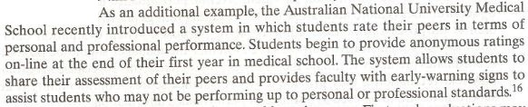
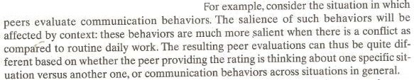

Slide 19
Subordinates
Subordinates are a good source of information regarding the performance of their managers.
Subordinates are in good position to evaluate leadership competencies, including delegation, organization, and communication.

Slide 20
Subordinates (Contd.)
Subordinates may be asked to rate their managers ability to remove barriers that employee face, shield employee from politics, and raise employees competencies.

Slide 21
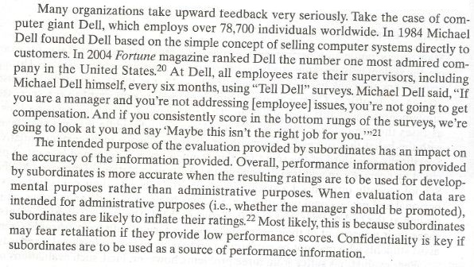

Slide 22
Self
Self appraisals are an important component of any performance management system.
When employees are given the opportunity to participate in the performance management process, their acceptance of the resulting decision is likely to increase and their defensiveness during the appraisal interview is likely to decrease.

Slide 23
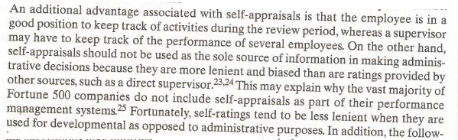

Slide 24
Self (Contd.)
Following suggestions may improve the quality of self-appraisal.
Use comparative as opposed to absolute measurement systems
  For Example: Instead of asking individuals to rate themselves using ranging from poor to excellent provide scale that allows them to compare their performance with that of others.

Slide 25
Self (Contd.)
Allow employee to practice their self rating skills
  For Example: Provide multiple opportunities for self appraisal because the skill of self evaluation may well be one that improves with practice.

Slide 26
Self (Contd.)
Assure confidentiality
  For Example: Provide reassurance that performance information collected from oneself will not be disseminated and shared with any one other than the direct supervisor and other relevant parties (e.g members of the same group)

Slide 27
Self (Contd.)
Emphasize the future
  The developmental plan section of the form should receive substantial attention.
  The employee should indicate his plan for future development and accomplishments.

Slide 28
Customers
Customers and other key stakeholders in general, provide yet another source of performance information.
Collecting information from customers can be a costly and time consuming process, however performance information provided by customers is particularly useful for jobs that require a high degree of interaction with the public or particular job related individuals.(e.g purchasing manager, suppliers, sales reps)

Slide 29
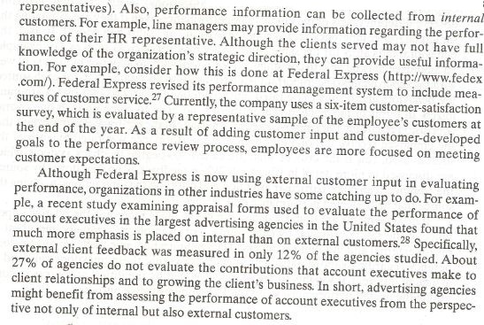

Slide 30
Disagreement across sources: is this a problem?
If performance information is collected from more than one source, it is likely that there will be some overlap in the dimensions measured.

Slide 31
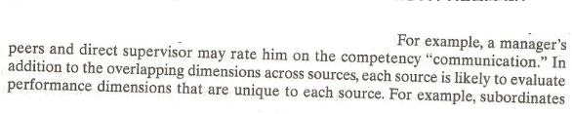
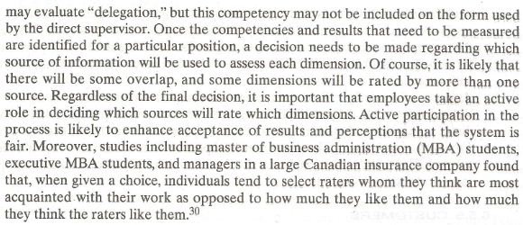

Slide 32
Disagreement across sources: is this a problem? (Contd.)
When the same dimension is evaluated across sources, we should not necessarily expect ratings to be similar.

Slide 33
Disagreement across sources: is this a problem? (Contd.)
Different sources disagreeing about an employees performance is not necessarily a problem.

Slide 34
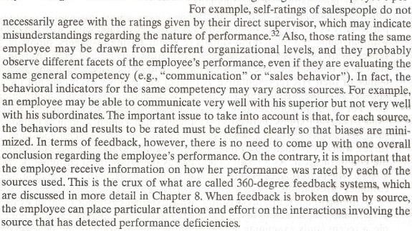

Slide 35
Disagreement across sources: is this a problem? (Contd.)
If disagreements are found, a decision must be made regarding the relatively importance of the rating provided by each source.

Slide 36
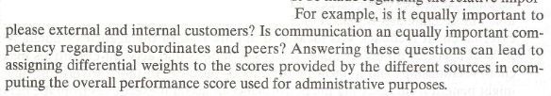

Slide 37
Summary of Today’s Lecture
Who should provide performance information?
  Supervisors
  Peers
  Subordinates
  Self
  Customers
Disagreement across sources: is this a problem?

Slide 38
Thank You

