Slide 1
MGT-555
PERFORMANCE AND CAREER MANAGEMENT
LECTURE NO - 13

Slide 2
RECAP
Determinants of Performance
Implications for addressing performance problems
Factors influencing determinants of performance
Performance Dimensions
Reasons for inclusion of Task and Contextual Performance in PMS

Slide 3
Agenda of Today’s Lecture
Approaches to measure performance
  Trait approach
  Behavior approach
  Result approach
End of Chapter CASE EXAMPLE

Slide 4
Approaches to measure performance
The employees work in organization by interacting with each other and engaging in certain behaviors that produce certain results.
The same employee may behave differently if placed in a different situation.

Slide 5
Approaches to measure performance (Contd.)
The common approaches that are used to measure performance are:
  Trait approach
  Behavior approach
  Result approach

Slide 6
Approaches to measure performance (Contd.)
Trait Approach
  Emphasizes individual traits of employees
Behavior Approach
  Emphasizes how employees do the job
Results Approach
  Emphasizes what employees produce

Slide 7
Job Performance in Context
That produce various results
A performer
(individual or team)
Engages in certain behaviors
In a given situation
TRAIT
BEHAVIOR
RESULTS

Slide 8
Trait Approach
Emphasis on individual
  Evaluate stable traits
    Cognitive abilities
    Personality
  Based on relationship between traits & performance

Slide 9
Trait approach (Contd.)
Trait approach emphasizes the individual performer and ignores the specific situation, behavior, and results.
If one adopts the trait approach, raters evaluate relatively stable traits.
These can include abilities such as cognitive abilities or personality.

Slide 10
Trait approach (Contd.)
These can include abilities;
  such as cognitive abilities (which are not easily trainable) or
  personality (which is not likely to change over time).

Slide 11
Trait approach (Contd.)
Appropriate if
  Structural changes planned for organization
Disadvantages
  Improvement not under individual’s control
  Trait may not lead to
    Desired behaviors or
    Desired results

Slide 12
Trait approach (Contd.)
Performance measurement may consist of assessing an employee's intelligence and conscientiousness at the end of each review period. This approach is justified based on the positive relationship found between abilities (such as intelligence) and personality traits (such as conscientiousness) and desirable work-related behaviors. Several vendors provide tools to assess relatively stable traits, sometimes with the capability of administering them on-line. Vendors who describe their products on-line include ddi.com,ww.appliedpsych.com,www.previsor.com,www.kenexa.com,www. personneldecisions.com and www.vangent-hcm.com.

Slide 13
Trait approach (Contd.)
What are some of the challenges of implementing a system that emphasizes the measurement of traits only? First, traits are not under the control of individuals. In most cases, they are fairly stable over one's life span. They are not likely to change even if an individual is willing to exert substantial effort to do so. Consequently, employees may feel that a system based on traits is not fair because the development of these traits is usually beyond their control.

Slide 14
Trait approach (Contd.)
Second, the fact that an individual possesses a certain trait (e.g., intelligence) does not mean that this trait will necessarily lead to desired results and behaviors. Individuals are embedded in specific situations. If the equipment is faulty and coworkers are uncooperative, even a very intelligent and conscientious employee is not likely to engage in behaviors conducive to supporting the organization's goals.

Slide 15
Trait approach (Contd.)
In spite of these challenges, there are situations in which a trait oriented approach can be fruitful. For example, as part of its business strategy, an organization may anticipate drastic structural changes that will result in the reorganization of most functions and the resulting reallocation of employees.

Slide 16
Trait approach (Contd.)
In such a circumstance, it may be useful to assess the traits possessed by the various individuals so that fair and appropriate decisions are made regarding the allocation of HR resources across the newly created organizational units. This is, of course, a fairly unique circumstance. In most organizations, performance is not measured using the trait approach. Two more popular approaches to measuring performance are based on behaviors and results, discussed next.

Slide 17
Behavior approach
The behavior approach emphasizes;
  what employees do on the job and does not consider employees traits or the outcomes resulting from their behaviors.
  This is basically a process oriented approach that emphasizes how an employee does the job.

Slide 18
Behavior approach (Contd.)
  Behavior approach is most appropriate under the following circumstance:
  The link between behaviors and results is not obvious:
    sometimes the relationship between behaviors and the desired outcomes is not clear.
    In some cases the desired results are not achieved in spite of fact that the right behaviors are in place.

Slide 19
Behavior approach (Contd.)
Appropriate if
  Employees take a long time to achieve desired outcomes
  Link between behaviors and results is not obvious
  Outcomes occur in the distant future
  Poor results are due to causes beyond the performer’s control
Not appropriate if
above conditions are not present

Slide 20
Behavior approach (Contd.)
For example, a salesperson may not be able to close a deal because of a downturn in the economy. In other cases, results may be achieved in spite of the absence of the correct behaviors. For example, a pilot may not check all the items in the preflight checklist but the flight may nevertheless be successful (i.e., take off and land safely and on time). When the link between behaviors and results is not always obvious, it is beneficial to focus on behaviors as opposed to outcomes.

Slide 21
Behavior approach (Contd.)
  Outcomes occur in distant future:
    when the desired results will not be seen for months, or even years, the measurement of behavior is beneficial.

Slide 22
Behavior approach (Contd.)
  Take the case of NASA's Mars Exploration Rover Mission program. NASA launched the exploration rover Spirit on June 10, 2003, which landed on Mars on January 3, 2004, after traveling 487 million kilometers (302.6 million miles). Its twin, the exploration rover Opportunity, was launched on July 7, 2003, and landed on the opposite side of Mars on January 24, 2004.

Slide 23
Behavior approach (Contd.)
  From launching to landing, this mission took about six months to complete. In this circumstance, it is certainly appropriate to assess the performance of the engineers involved in the mission by measuring their behaviors in short intervals during this six-month period rather than waiting until the final result (i.e., successful or unsuccessful landing ) is observed.

Slide 24
Behavior approach (Contd.)
  Poor results are due to causes beyond the performers control:
    when the results of an employees performance are beyond the employees control ,then it makes sense to emphasize the measurement of behaviors.

Slide 25
Behavior approach (Contd.)
For example, consider a situation involving two assembly-line workers, one of them working the day shift and the other the night shift. When the assembly line gets stuck because of technical problems, the employee working during the day receives immediate technical assistance, so the assembly line is back in motion in less than five minutes. In contrast, the employee working the night shift has very little technical support and, there-fore, when the assembly line breaks down, it takes about 45 minutes for it to be up and running again.

Slide 26
Behavior approach (Contd.)
If we measured results, we would conclude that the performance of the day-shift employee is far superior to that of the night-shift employee, but this would be an incorrect conclusion. Both employees may be equally competent and do the job equally well. The results produced by these employees are uneven because they depend on the amount and quality of technical assistance they receive when the assembly line is stuck.

Slide 27
Results approach
The result approach emphasizes the outcomes and results produced by the employees.
It does not consider the traits that employees may possess or how employees do the job.
This is basically a bottom line approach that is not concerned about the employees behaviors and processes but instead focuses on what is produced.

Slide 28
Results Approach (contd.)
Most appropriate when:
  Workers skilled in necessary behaviors
  Behaviors and results obviously related
  Consistent improvement in results over time
  Many ways to do the job right

Slide 29
Results Approach (contd.)
Advantages:
  Less time
  Lower cost
  Data appear objective

Slide 30
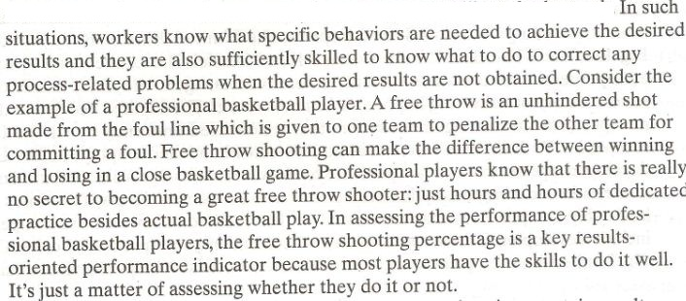

Slide 31
Results approach (Contd.)
Behavior and results are obviously related :
  in some situations, certain results can be obtained only if a worker engages in certain specific behaviors. This is a case of jobs involving repetitive tasks such as assembly line work or newspaper delivery

Slide 32
Results approach (Contd.)
This is the case of jobs involving repetitive tasks such as assembly-line work or newspaper delivery. Take the case of a person delivering newspapers. Performance can be measured adopting a results approach: whether the newspaper is delivered to every customer within a particular time frame. For the employee to obtain this result, she needs to pick up the papers at a specific time and use the most effective delivery route. If these behaviors are not present, the paper will not be delivered on time.

Slide 33
Results approach (Contd.)
Results show consistent improvement over time:
  when the results improve consistently over time, it is an indication that workers are aware of behaviors needed to complete the job successfully.
  In these situations, it is appropriate to adopt a results approach to assessing performance.

Slide 34
Results approach (Contd.)
There are many ways to do the job right :
  when there are different ways in which one can do the tasks required for a job, a result approach is appropriate.
  An emphasis on result can be beneficial because it could encourage employees to achieve the desired outcomes in creative and innovative ways.

Slide 35
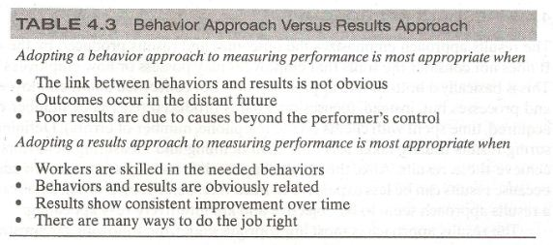

Slide 36
Results approach (Contd.)
Measuring both behavior and results is the approach adopted by many organizations. Consider the case of The Limited, Inc., a retailer headquartered in Columbus, Ohio. The Limited, Inc., now operates 3,500 retail stores and seven retail brands, including Victoria's Secret, Express, The Limited, Bath & Body Works, C 0. Bigelow. The White Barn Candle Co., and Henri Bendel. The Limited aims to foster an entrepreneurial culture for its managers therefore, managers who thrive in the company have a history of delivering impressive business results.

Slide 37
Results approach (Contd.)
The Limited decided to design a new performance management system that is now used uniformly by all The Limited companies. With the involvement of outside consultants and employees, The Limited developed a performance management system wherein managers are measured on business results including total sales, market share, and expense/sale growth ratio, as well as leadership competencies that are tailored to The Limited. A few of these competencies include developing fashion sense, financial acumen, and entrepreneurial drive.

Slide 38
Results approach (Contd.)
Overall, The limited has been pleased with the new system because it helps align individual goals with business strategy and results. Raters like the new system because behavioral anchors help define the competencies, which make ratings more straightforward. Finally, employees comment that they appreciate the new focus on how results are achieved, as opposed to focusing only on what is achieved (i.e., sales).

Slide 39
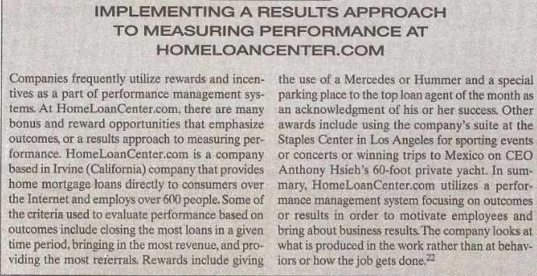

Slide 40
Summary of Today’s Lecture
Approaches to measure performance
  Trait approach
  Behavior approach
  Result approach
End of Chapter CASE EXAMPLE

Slide 41
Thank You

