Slide 1
MGT-755
PERFORMANCE AND CAREER MANAGEMENT
LECTURE NO - 12

Slide 2
RECAP
Individuals and Team performance
Choices in Performance management system design
Building Support
DEFINING PERFORMANCE AND CHOOSING A MEASUREMENT APPROACH
Defining Performance
Determinants of Performance
Steps in Deliberate Practice

Slide 3
Agenda of Today’s Lecture
Determinants of Performance
Implications for addressing performance problems
Factors influencing determinants of performance
Performance Dimensions
Reasons for inclusion of Task and Contextual Performance in PMS

Slide 4
Determinants of performance
A combination of three factors allow some people to perform at higher levels than others.
Declarative knowledge
Procedural knowledge
Motivation

Slide 5
Declarative knowledge
Declarative knowledge is information about facts and things, including information regarding a given tasks requirement, labels, principles, and goals.

Slide 6
Procedural knowledge
Procedural knowledge is a combination of knowing what to do and how to do it and includes cognitive, physical, perceptual, motor, and interpersonal skills.

Slide 7
Motivation
Motivation involves three type of choice behaviors.
  Choice to expand effort (e.g I will go to work today)
  Choice of level of effort (e.g I will put in my best at work versus I will not try very hard)
  Choice to persist in the expenditure of that level of effort (e.g I will give up after a little while versus I will persist no matter what)

Slide 8
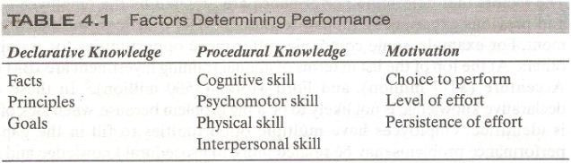

Slide 9
Determinants of performance (Contd.)
The three determinants have a multiplicative relationship, such that
  Performance = Declarative Knowledge x Procedural Knowledge x Motivation
If any of the determinants has a value of 0, then performance also has a value of zero.

Slide 10
Implications for addressing performance problems
The fact that performance is affected by combined effect of three different factors has implications for addressing performance problems.

Slide 11
Implications for addressing performance problems (Contd.)
In order to address performance problems properly, manager must find information that will allow them to understand whether the source of problem is declarative knowledge, procedural knowledge, motivation or some combination of these three factors.

Slide 12
Factors influencing determinants of performance
The factors that determine performance are affected by
The employee
Human resource(HR) practices
And the work environment.

Slide 13
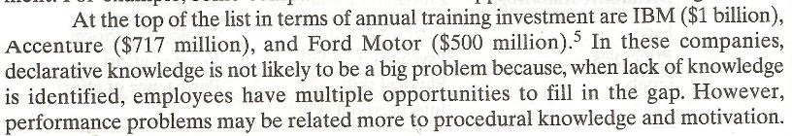
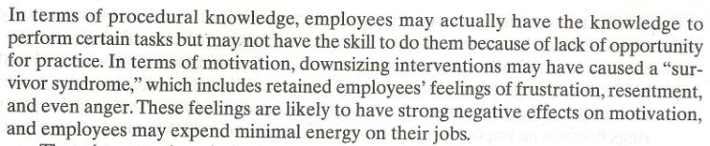

Slide 14
Determinants of performance (Contd.)
There are three individual characteristics that determine performance:
Procedural knowledge
Declarative knowledge
Motivation

Slide 15
Determinants of performance (Contd.)
In addition HR practices and work environment can affect performance.
When addressing performance problems, manager first need to identify which of these factors is hampering performance and then helps the employee improve his or her performance.

Slide 16
Performance Dimensions
Performance is multidimensional, meaning that we need to consider many different type of behaviors to understand performance.
Although we can identify many specific behaviors, two types of behaviors or performance facets stand out:
  task performance and
  contextual performance.

Slide 17
Performance Dimensions (Contd.)
Contextual and task performance must be considered separately because they do not necessarily occur in tandem.

Slide 18
Task Performance
Task performance is defined as
Activities that transform raw materials into the goods and services that are produced by the organization.

Slide 19
Task Performance
Activities that help with the transformation process by replenishing the supply of raw materials, distributing its finished products, or providing important planning, coordination, supervising or staff functions that enable the organization to function effectively and efficiently

Slide 20
Contextual Performance
Many authors use the labels pro-social behaviors and organizational citizenship behaviors in referring to contextual performance.
Contextual performance is defined as those behaviors that contribute to the organization’s effectiveness by providing a good environment in which task performance can occur.

Slide 21
Contextual Performance (Contd.)
Contextual performance includes behaviors such as the following
Persisting with enthusiasm and exerting extra effort as necessary to complete ones own task activities successfully (e.g being punctual and rarely absent, expending extra effort on the job)

Slide 22
Contextual Performance (Contd.)
Volunteering to carry out task activities that that are not formally part of the job (e.g suggesting organizational improvements, making constructive suggestions)
Helping and cooperation with others (e.g assisting and helping co workers and customers)

Slide 23
Contextual Performance (Contd.)
Following organizational rules and procedures (e.g following orders and regulations, showing respect for authority, complying with organizational value and policies)
Endorsing, supporting, and defending organizational objectives (e.g organizational loyalty, representing the organization favorably to outsiders)

Slide 24
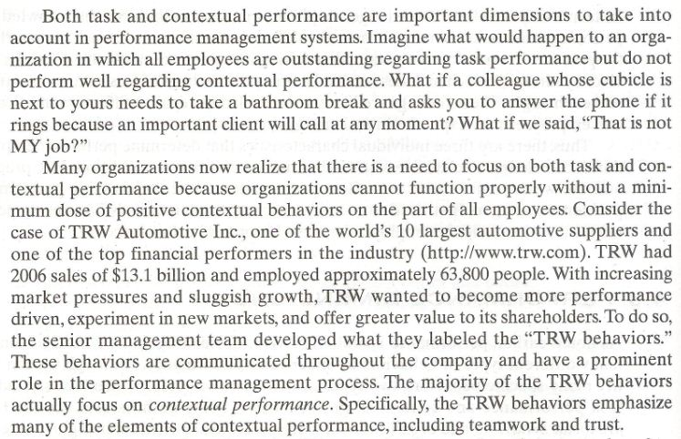

Slide 25
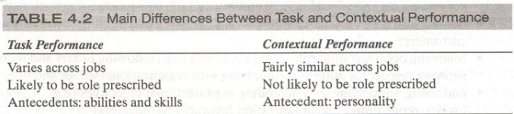

Slide 26
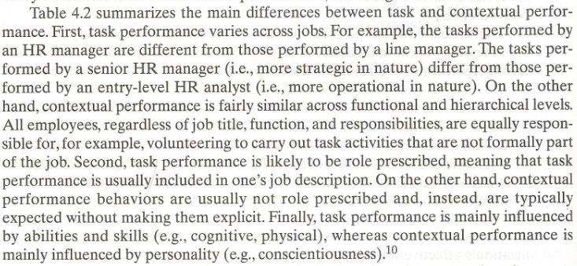

Slide 27
Reasons for inclusion of Task and Contextual Performance in PMS
There are numerous pressing reasons why both task and contextual performance dimensions should be included in a performance management system.
First, global competition is raising the levels of effort required of employees.

Slide 28
Reasons for inclusion of Task and Contextual Performance in PMS (Contd.)
Second related to the issue of global competition is the need to offer outstanding customer service.
  Contextual performance behavior can make a profound impact on customer satisfaction.

Slide 29
Reasons for inclusion of Task and Contextual Performance in PMS (Contd.)
Third, many organizations are forming employees into teams.
  Although some teams my not be permanent because they are created to complete a short term task.
  The reality of today’s world of work is that teams are here to stay.
  Interpersonal cooperation is a key determinant of team effectiveness.

Slide 30
Reasons for inclusion of Task and Contextual Performance in PMS (Contd.)
Fourth, including both task and contextual performance in the performance management system provides an additional benefit;
  Employee being rated are more satisfied with the system and also believe the system is more fair if contextual performance is measured in addition to task performance.

Slide 31
Reasons for inclusion of Task and Contextual Performance in PMS (Contd.)
It seems that employees are aware that contextual performance is important in affecting organizational effectiveness and therefore;
  Believe that these types of behavior should be included in a performance management system in addition to more traditional task performance.

Slide 32
Reasons for inclusion of Task and Contextual Performance in PMS (Contd.)
Finally when supervisors evaluate performance it is difficult for them to ignore the contextual performance dimension, even though the evaluation form that they are using may not include any specific questions about contextual performance.

Slide 33
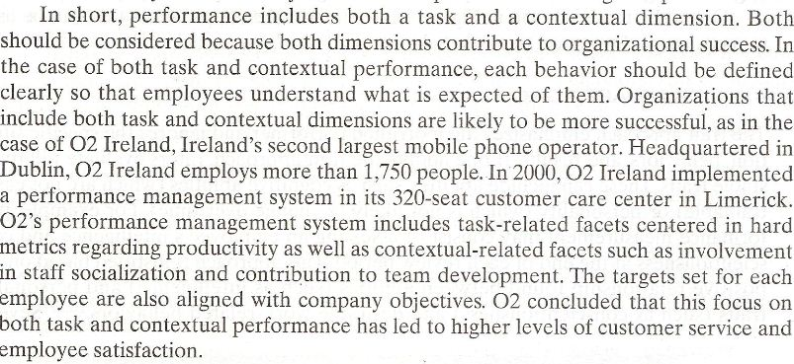

Slide 34
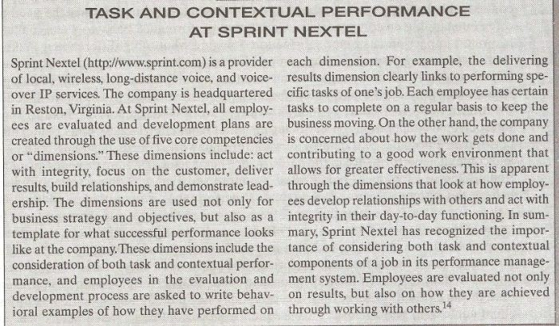

Slide 35
Summary of Today’s Lecture
Determinants of Performance
Implications for addressing performance problems
Factors influencing determinants of performance
Performance Dimensions
Reasons for inclusion of Task and Contextual Performance in PMS

Slide 36
Thank You

