Slide 1
MGT-555
PERFORMANCE AND CAREER MANAGEMENT
LECTURE NO - 11

Slide 2
RECAP
Characteristics of Good Vision statements
Goals
Strategies
Strategies – HR Function
Developing strategic plans at unit level
Job descriptions

Slide 3
Agenda of Today’s Lecture
Individuals and Team performance
Choices in Performance management system design
Building Support
DEFINING PERFORMANCE AND CHOOSING A MEASUREMENT APPROACH
Defining Performance
Determinants of Performance
Steps in Deliberate Practice

Slide 4
Individual and team performance
The performance management system needs to display the behavior and produce the results required to support the organizations and the units mission, vision, and goals.
Developmental plans need to be aligned with unit and organizational priorities as well.

Slide 5
Individual and team performance (Contd.)
Well designed management system defines a clear path from organizational mission, vision, and goals to individual and team performance.
This is critical because organizational success is a direct function of the alignment between collectives and individual objectives.

Slide 6


Slide 7
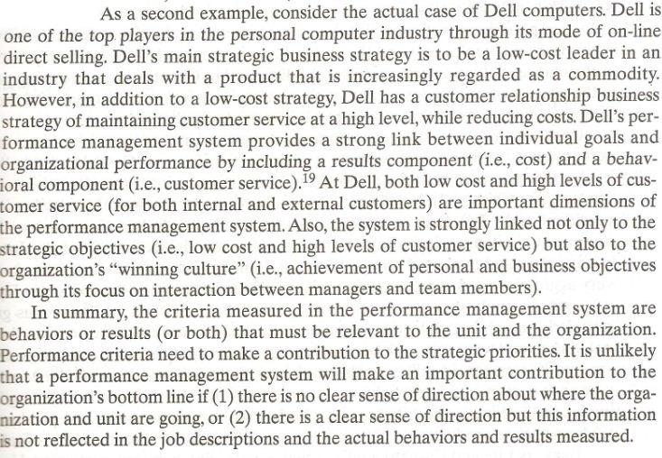

Slide 8
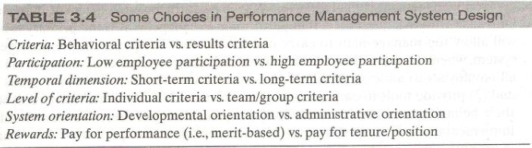

Slide 9
Building support
Given the many competitive projects and usual scarcity of resources, some organizations may be reluctant to implement a performance management system.

Slide 10
Building support (Contd.)
Primarily, the reason is a lack of any perceived value added to a system that requires many resources and that seems to produce little tangible payoffs.

Slide 11
Building support (Contd.)
The need to align organization and unit priorities with the performance management system is one of the key factors contributing to obtain much needed top management support for the system.

Slide 12
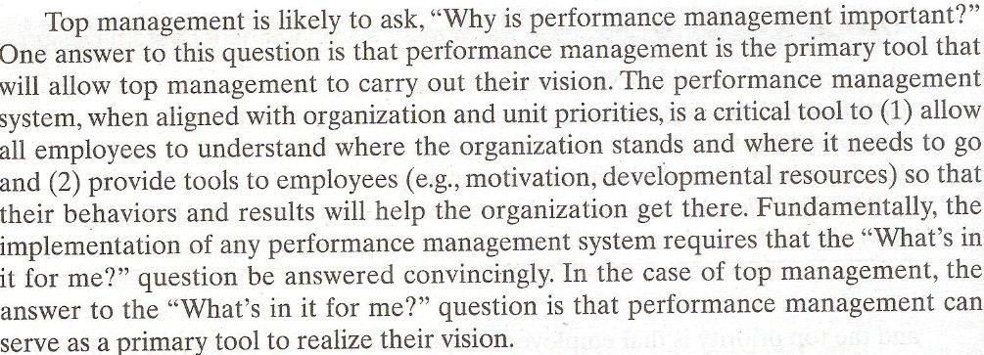

Slide 13
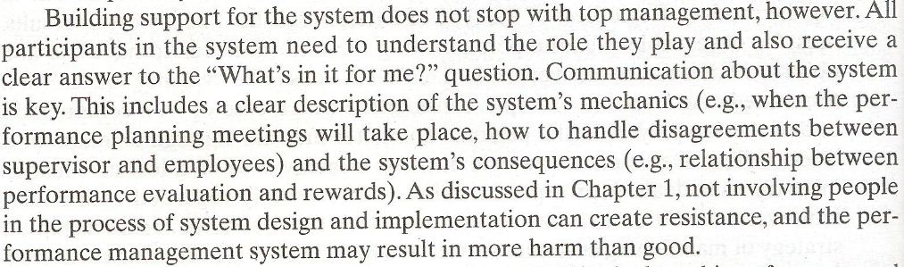

Slide 14
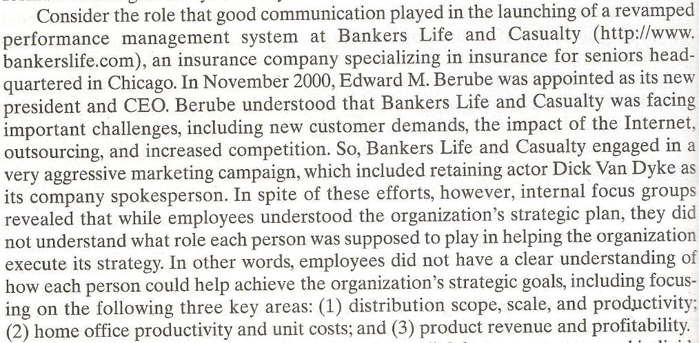

Slide 15
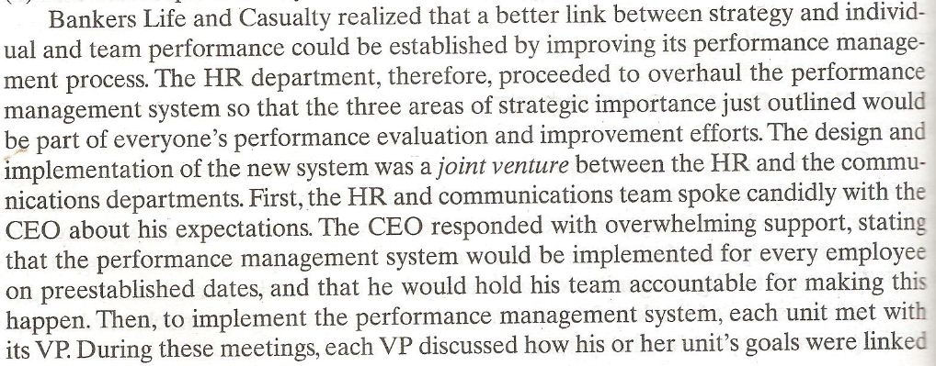

Slide 16
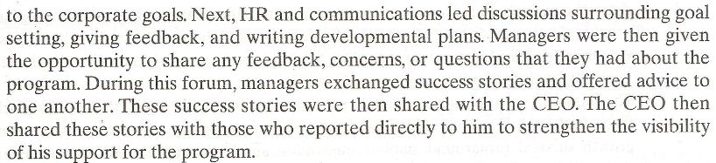

Slide 17
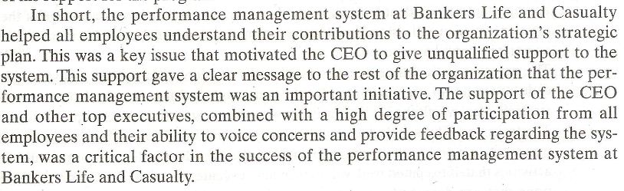

Slide 18
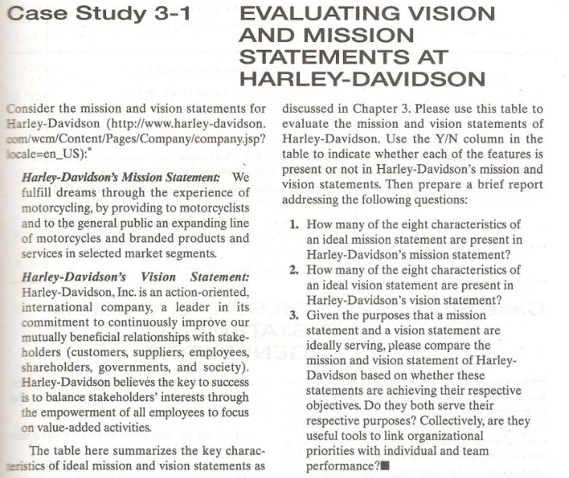

Slide 19
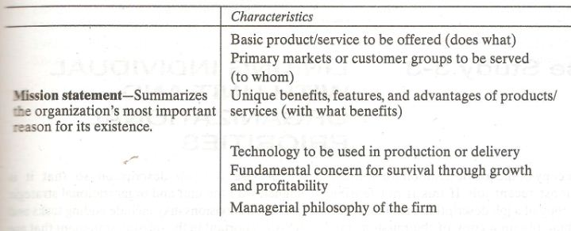

Slide 20
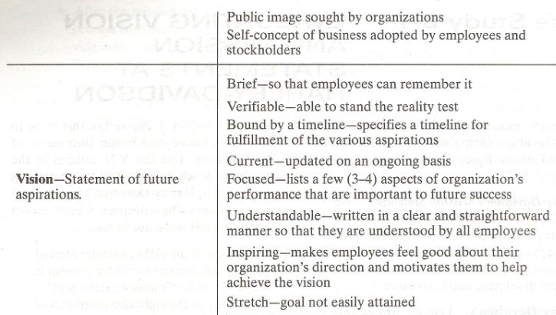

Slide 21
DEFINING PERFORMANCE AND CHOOSING A MEASUREMENT APPROACH

Slide 22
Defining performance
Performance management system usually includes measure of both behavior (what an employee does) and results (the outcomes of an employee’s behavior).
The definition of performance does not include the results of an employees behavior but only the behavior themselves.

Slide 23
Defining performance (Contd.)
Performance is about behavior or what the employee do, not about what employee produce or the outcomes of their work.

Slide 24
Defining performance (Contd.)
There are two additional characteristics of behaviors that label performance.
First they are evaluative.
  This means that such behavior can be judged as negative, neutral, or positive for individual and organizational effectiveness.
  In other words the value of these behaviors can vary, based on whether , they make a contribution towards the achievement of individual, unit or organizational goals

Slide 25
Defining performance (Contd.)
Second performance is multidimensional.
  This means that there are many different kind of behaviors that have the capacity to advance organizational goals.

Slide 26
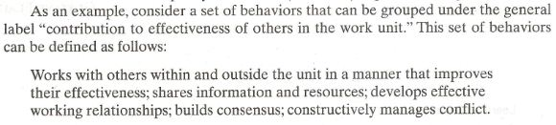

Slide 27
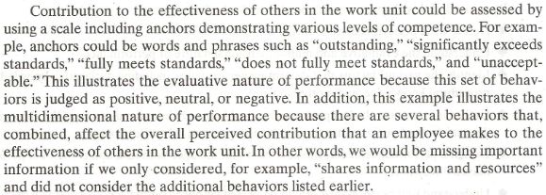

Slide 28
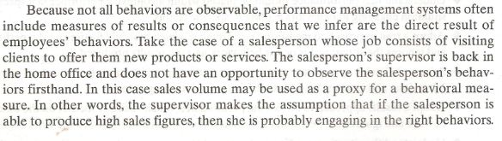

Slide 29
Determinants of performance
A combination of three factors allow some people to perform at higher levels than others.
Declarative knowledge
Procedural knowledge
Motivation

Slide 30
Declarative knowledge
Declarative knowledge is information about facts and things, including information regarding a given tasks requirement, labels, principles, and goals.

Slide 31
Procedural knowledge
Procedural knowledge is a combination of knowing what to do and how to do it and includes cognitive, physical, perceptual, motor, and interpersonal skills.

Slide 32
Motivation
Motivation involves three type of choice behaviors.
  Choice to expand effort (e.g I will go to work today)
  Choice of level of effort (e.g I will put in my best at work versus I will not try very hard)
  Choice to persist in the expenditure of that level of effort (e.g I will give up after a little while versus I will persist no matter what)

Slide 33
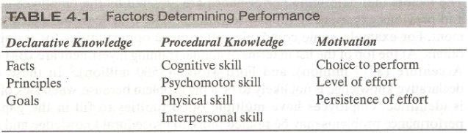

Slide 34
Determinants of performance (Contd.)
The three determinants have a multiplicative relationship, such that
  Performance = Declarative Knowledge x Procedural Knowledge x Motivation
If any of the determinants has a value of 0, then performance also has a value of zero.

Slide 35
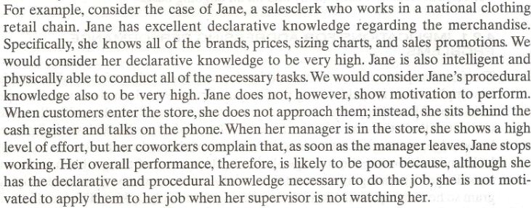

Slide 36
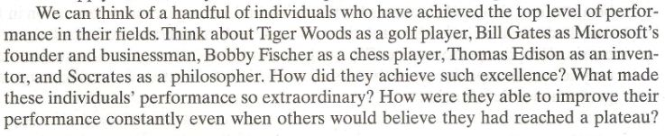
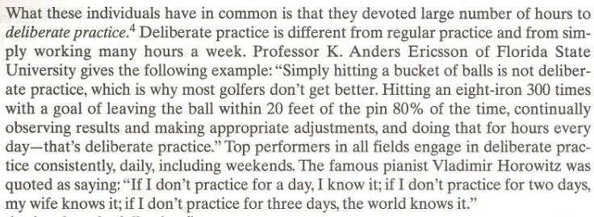

Slide 37
Steps in Deliberate Practice
Deliberate practice involves the following five steps;
  Approach performance with the goal of getting better and better.
  As you are performing, focus on what is happening and why you are doing things the way you do.

Slide 38
Steps in Deliberate Practice (Contd.)
  Once your task is finished, seek performance feedback from expert sources and the more sources the better.
  Build mental models of your job, your situation, and your organization.
  Repeat steps 1-4 continually and on a ongoing basis.

Slide 39
Summary of Today’s Lecture
Individuals and Team performance
Choices in Performance management system design
Building Support
DEFINING PERFORMANCE AND CHOOSING A MEASUREMENT APPROACH
Defining Performance
Determinants of Performance
Steps in Deliberate Practice

Slide 40
Thank You

